Slide 1
COLLAGEN

Slide 2
Collagen
Major component of most connective tissue
~25% of the protein of mammals
In humans
28 Distinct types of collagen
Made up of
30 Distinct types of Polypeptide chains
Each encoded by separate gene

Slide 3
Types of collagen
Type | Location | Type | Location
I | Skin, Bone, Tendon(non cartilage) | XV | Associated with collagen to basement membrane
II | Cartilage, Vitreous humor | XVI | Many Tissues
III | Extensible conn. Tissue(skin, lung, vascular system | XVII | Epithelia, Skin hemidesmosomes
IV | Basement Membrane | XVIII | Close structural homologue of XV
V | Along with Type -I | XIX | Rare, Rhabdomyosarcoma
VI | Muscle | XX | Corneal epithelium
VII | Dermal epidermal junction | XXI | Many Tissues
VIII | Endothelium | XXII | Tissue Junctions
IX | Along with type -II | XXIII | Limited in tissues transmembrane and shed forms
X | Hypertrophic cartilage | XXIV | Developing Cornea, Bone
XI | Along with type-II | XXV | Brain
XII | Along with type-I | XXVI | Testis, Ovary
XIII | NM Junction and Skin | XXVII | Embryonic Cartilage
XIV | Along with type-I | XXVIII | BM Around Schwann cells

Slide 4
Mature Collagen ( Type-1)
The entire molecule is triple helical
~1000 AA
Each polypeptide subunit (α chain not α helix) is twisted into left handed polyproline helix and 3 residues per turn
3 of these α chains are then wound into a parallel right handed superhelix, forming a rod like molecule (1.4×300nm)

Slide 5
The repeating structure, represented as (Gly-X-Y) is an absolute requirement for the formation of triple helix
X = mostly proline
Y = mostly hydroxyl proline / sometimes hydroxy-lysine
Hydroxyl derivatives on Y positions because of specificity of prolyl/lysyl hydroxylase
- Gly – X – Y – Gly – X – Y – Gly – X – Y - Amino Acid sequence

Slide 6
What is glycine residue at every 3rd position?
Glycine is the only AA small enough to be accomodated in the limited space available in contral core of triple helix

Slide 7
X & Y Positions
Proline / hydroxyproline confer regidity on collagen molecules
Hydroxyproline & Hydroxylysine are result of post translational modification
Can be further modified by addition of
Glactose
Galactosyl-glucose
Through O-Glycosidic limkage
(unique glycosylation site of collagen)

Slide 8
Staggering of α- chains:
3 polypeptide chains are staggered so that Gly-X-Y
Resides from the three polypeptide chains occures at similar level
And so –NH of ‘Gly’ makes strong H-bond with –CO of an ‘X(pro)’ of neighbour chain

Slide 10
Quarter Staggered alignment
Collagen types (only rod like fibers) are assembled by lateral association of these triple helical units into fibrils (10-300 nm diameter) in a ‘Quarter staggered’ alignment
Means, each triple helix is displaced longitudinally from its neighboure by slightly less than 1/4th of its length

Slide 11
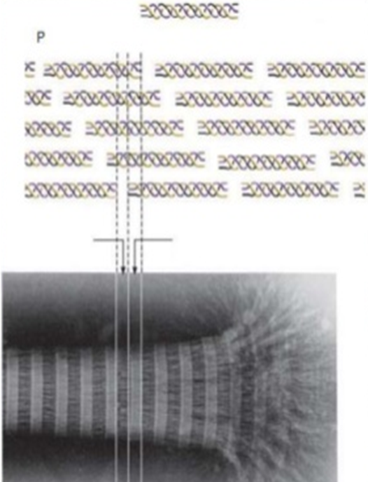
Fibril –
many fibrils associate into thicker FIBER (1-20μm diameter)
In some tissues (like tendons) fibers associates into even larger bundles, with diameter of 500μm

Slide 12
Covalent links provide extra stabilization (Lehninger)
The increasingly rigid and brittle character of aging connective tissue results from accumulative covalent cross links in collagen fibrils

Slide 13
Strength – Triple helix provides tensile strength
Scaffold – provides organization and structure for the ECM ,
without it what would happen?
Loss of cell-cell communication
Cell migration
Loss of cell shape

Slide 14
Collagen – According to macro-structure
Collagen:
Fibril forming (1,2,3,5,11,24,27)
Network like (4,8,10)
Anchoring fibrils(7)
Multiplexins (15,18) Multiple triple helix domains with innterruptions
Beaded filaments (6,26,28)
Transmembrane (13,17,23,25) have short intracellular N-terminal domians
FACITs (9,12,14,16,19,20,21,22) Fibril associated collagens with interrupted Triple helix

Slide 15
Some collagen types do not form fibrils:
They are characterized by interruptions of triple helix with stretches of protein lacking (Gly-X-Y) repeat sequence
It repeats in areas of globular structure interspersed in triple helical structure

Slide 16
Collagen Biosynthesis

Slide 17
Genetics of Collagen
> 30 genes encode the collagens
Heterotrimeric:
(pro α-chains different)
e.g Type-I Collagen 2Pro α1 (I) + 1 Pro α2 (I)
Homotrimeric;
( 3 identical Pro α chains)
e.g Collagen Type-II
Gene Nomenclature
COL1A2
Gene prefix
Type of chain
Type of collagen

Slide 18
Uses
Collagen has a wide variety of applications, from food to medical.
It is used in cosmetic surgery and burn surgery.
It is widely used in the form of collagen casings for sausages,
Also used in the manufacture of musical strings.

Slide 19
Uses
Formation of gelatin- when collagen is subjected to Denaturation
Gelatin used in many foods, including flavored gelatin desserts.
Besides food, gelatin has been used in pharmaceutical, cosmetic, and photography industries.
It is also used as a dietary supplement.

Slide 20
Uses
Collagen adhesive was used by Egyptians about 4,000 years ago, and Native Americans used it in bows about 1,500 years ago.
It is used as a protective lining on rope baskets and embroidered fabrics, and to hold utensils together;
Crisscross decorations on human skulls

Slide 21
Animal glues are thermoplastic
Softening again upon reheating, so they are still used in making musical instruments such as
fine violins and
Guitars
Also used to repair experimental incisions in rabbit lungs.

Slide 22
Diseases
Osteogenesis imperfecta
Caused by a mutation in type 1 collagen, dominant autosomal disorder, results in weak bones and irregular connective tissue
Some cases can be mild while others can be lethal. Mild cases have lowered levels of collagen type 1 while severe cases have structural defects in collagen.

Slide 23
Brittle bone disease

Slide 24
Chondrodysplasias
Skeletal disorder believed to be caused by a mutation in type 2 collagen
Osteochondrodysplasias can result in marked functional limitation and even mortality.

Slide 25
Chondrodysplasia

Slide 26
Ehlers-Danlos syndrome
Thirteen different types of this disorder
Deformities in connective tissue, are known.
Some of the rarer types can be lethal, leading to the rupture of arteries.
Each syndrome is caused by a different mutation. For example, the vascular type (vEDS) of this disorder is caused by a mutation in collagen type 3

Slide 27
Ehlers-Danlos syndrome

Slide 28
Alport syndrome
It can be passed on genetically, usually as X-linked dominant, but also as both an autosomal dominant and autosomal recessive disorder
Sufferers have problems with their kidneys and eyes, loss of hearing can also develop during the childhood or adolescent years.

Slide 29
Alport syndrome

Slide 30
Knobloch syndrome
Caused by a mutation in the COL18A1 gene that codes for the production of collagen XVIII.
Patients present with protrusion of the brain tissue and degeneration of the retina; an individual who has family members suffering from the disorder is at an increased risk of developing it themselves since there is a hereditary link.

Slide 31
Knobloch syndrome

