Slide 1
Trace elements in agriculture (V)

Slide 2
Outline of presentation
Introduction of trace elements
Number of trace elements
Introduction of vanadium
Details about vanadium
Importance of vanadium regarding living identities
Effects of vanadium
Vanadium commercially availability
Question session

Slide 3
What do you mean by trace element?
Elements which are detective in small amount in living body term as trace elements.
Determine by
Spectrophotometry

Slide 4
Important Trace elements and its typical range
Elements | Range
Vanadium | <1%
Chlorine | 18-806
Cobalt | 0.3-200
Chromium | 0.9-1500
Copper | 2.5-60
Iodine | 0.09-80
Zinc | 1.5-2000

Slide 5
Vanadium as a trace element
Name | Vanadium
Symbol | V
Atomic number | 23
Atomic weight | 50.942
Structure | Crystal
Physical state | 20°C
Properties | Acid-base of higher valence oxides

Slide 6
Who found vanadium and when?
Vanadium was discovered by Andres Manuel del Rio a Spanish- Mexican mineralogist, in 1801. Del Rio extracted element from a sample of Mexican “brown lead” ore. Later named vanadinite.

Slide 7
Characteristic
* Vanadium is a bright white, soft, ductile metal with good structural strength.
* Vanadium is resistant to attack by alkalis, hydrochloric acid, sulfuric acid, and salt water.

Slide 8
Harmful effects
* Although vanadium is an essential trace element for some creatures a number of its compounds are toxic.
* Generally, the higher the oxidation state of vanadium, the, more toxic the compound.

Slide 9
Role in plant
* Vanadium stimulates in plants growth and flowering, increases concentrations of amino acids, sugars and chlorophylls, and modifies nutrient concentrations
* Vanadium was found to retard the growth of Chinese green mustard and tomato plant, especially for nutrient solutions containing more than 40 mg/l NH4VO3. It as also found that V accumulated at higher levels in root compare to stem and leaf in Chinese green mustard samples.

Slide 10
Role in humans health
Vanadium as a supplement
As a medicine
Treating diabetes
Low blood pressure
High cholesterol
Heart disease
Syphilis

Slide 11
Industrial use of V
Vanadium steel alloys are used in gears and axels.
Titanium-Al-vanadium alloy used in jet engines and high speed aircraft
Vanadium-gallium tape is used in superconducting magnets.
Vanadium pentoxide used in ceramics.
Used in production of sulfuric acid as catalyst.

Slide 12
Vanadium deficiency symptoms in human
* There are no known specific symptoms of vanadium deficiency in humans, but bone deformities, growth retardation, infertility and increased infant mortality have resulted from vanadium deficiency in animals.

Slide 13
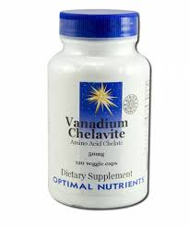
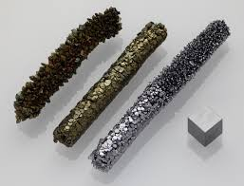
Commercially available
* Ductile vanadium is commercially available,. Commercially vanadium metal, of about 95% purity, cost $20. vanadium 99.9% purity , cost $100.

