Slide 1
NEUROMUSCULAR JUNCTIONS
Dr. MADIHA NAZIR

Slide 2
Neuromuscular junction in skeletal muscles
Neuromuscular junctions in smooth muscles
Neuromuscular junctions in cardiac muscles

Slide 3
Neuromuscular junctions in skeletal muscles physiological anatomy

Slide 4
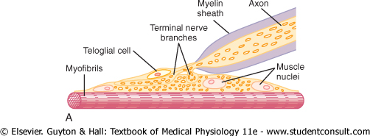

Slide 5
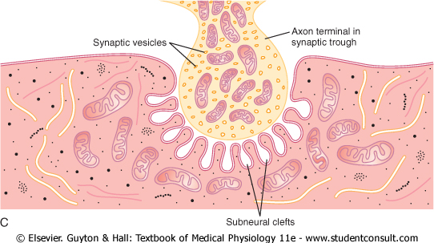

Slide 6
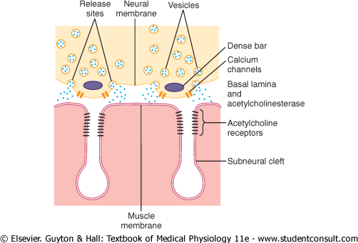

Slide 7
Axon terminal
mitochondria
cytoplasm
synaptic vesicles
dense bars – active zones
voltage gated calcium channels

Slide 8
Synaptic gutter or synaptic trough
Synaptic cleft
→ basal laminae – spongy reticular fibers
→ acetylcholine esterase

Slide 9
Junctional folds or sub neural clefts
Acetylcholine receptors
Motor endplate

Slide 10
Acetylcholine receptors(ion-channel linked receptors)
Location
Structure
Stimulus
Functions
→far more sodium ions flow through the acetylcholine channels
→end plate potential

Slide 11
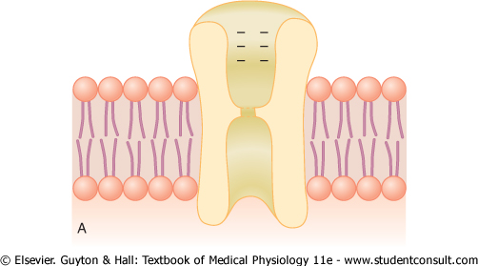

Slide 12
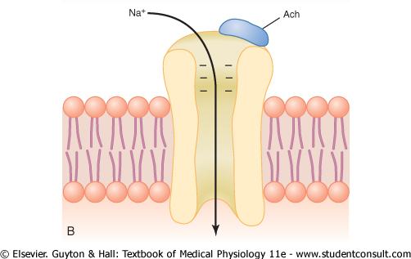

Slide 13
Location
almost entirely near the mouth of subneural clefts lying immediately below the dens bar areas

Slide 14
Structure
protein complex - composed of five sub units – two alpha , one beta,delta and gamma
Stimulation
binding of two acetylcholine molecules to two alpha subunits bring conformational change in the channel

Slide 15
Function
Diameter of acetylcholine channel is about 0 .65 nm
Allows far more sodium ions to pass through it

Slide 16
Neuromuscular transmission
Motor neurons in anterior horn of spinal cord → neuromuscular junctions → secretion of acetylcholine by nerve terminal →end plate potential→ activation of voltage gated sodium channels →action potential in muscle fiber →excitation of skeletal muscle fiber

Slide 17
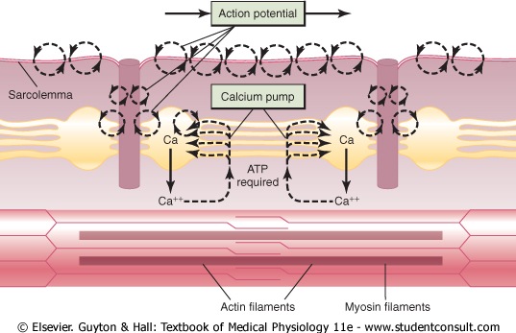

Slide 18
Synthesis of acetylcholine and it’s release
Acetylcholine vesicles are formed by the Golgi apparatus in the cell body of motor neuron in spinal cord
Acetylcholine is synthesized in the cytosol of the nerve fiber terminal but is immediately transported through the membrane of the vesicles to their interior
When an action potential arrives at the nerve terminal it opens many calcium channels in nerve fiber membrane. It causes exocytosis of acetylcholine in to the synaptic space

Slide 19
Fatigue of neuromuscular junction
High safety factor
Role of clathrine in reforming the vesicles

Slide 20
High safety factor
each impulse that arrives at neuromuscular junction causes about three times as much end plate potential as that required to stimulate the muscle fiber

Slide 21
Fate of acetylcholine
→most of acetylcholine is destroyed by enzyme acetylcholinesterase
→A small amount of acetylcholine diffuses out of the synaptic space

Slide 22
Miniature end plate potential
It is the activity recorded from skeletal muscle fiber in the absence of nerve impulses in its motor fibers
The amplitude is about 0.5 mv
It is due to leakage of transmitter substance from pre-synaptic terminals

Slide 23
Miniature end plate potential and end plate potential differ from one another. The MEPP is small and occurs in a random fashion without the need of nerve activity,
otherwise they have same electrical properties

Slide 24
 | END PLATE POTENTIAL | ACTION POTENTIAL
1 | Local potential recorded only at end plate region | Self propagated
2 | EPP is decremental | It is all or none in character
3 | Is proportionate to the amount of neurotransmitter released | Requires only threshold stimulus
4 | Can show summation | Does not show any type of summation

Slide 25
Substances which block neuromuscular transmission
The sites at which neuromuscular transmission is blocked
synthesis and storage
release of acetylcholine
acetylcholine receptors

Slide 26
Substance which block synthesis of acetylcholine
HEMICHOLINIUM
It competes for active sites on choline -acetyl transferase

Slide 27
Substances which block release of acetylcholine
Botulinum toxins
Black spider venom

Slide 28
Botulinum toxins
Micro-organism clostridium botulinum →grow in improperly canned foods→produce a toxin botulin → prevents release of acetylcholine by interfering with the mobilization of transmitter by calcium ions

Slide 29
Black spider venom
The venom first increase and then eliminate acetylcholine release at neuromuscular junction
The venom , a protein molecule , is attached with the presynaptic membrane→ form pores →both sodium and calcium enters the terminal

Slide 30
Electron microscopic examination
swollen axon terminals
synaptic vesicles are missing

Slide 31
Substances which block acetylcholine receptors
Cobra toxins
Curariform drugs

Slide 32
Drugs which enhance neuromuscular transmission
Anti acetylcholine esterase
- organo phosphates(diisopropyl fluorophosphate)
-eserine
-neostigmine
Drugs that stimulate the muscle fibers by acetylcholine like action

Slide 33
Drugs that stimulate the muscle fiber by acetylcholine like action
Para sympathomimetics
-methacholine
-carbachol
-nicotine

Slide 34
Tetanus
Etiology
clostridium tetani – enter the body through unclean skin wounds , animal bites , injuries caused by road side accidents

Slide 35
Site of action
tetanospasmin → blocks presynaptic transmitter release in the CNS , so block inhibitory neurons causing spastic paralysis

Slide 36
Clinical features
Excitation is increased and muscles go into violent contractions with a small stimulus such as light and noise
Spasm of masseter muscles causing lock –jaw
Respiratory arrest
Occurs predominantly in neonates

Slide 37
Treatment
Anti tetanus serum at the time of road side accidents
For long term immunity injection of tetanus toxoid

Slide 38
Tetany
State of neuromuscular hyperexcitability
on account of hypocalcemia
→ Involuntary tetanic contractions of skeletal muscles – carpo-pedal spasm

Slide 39
Hypocalcemia causes
1-increase permeability of neurons to sodium causes increase stimulation of muscles
2-decrease calcium level , decreases the threshold potential
3-low level of partial pressure of carbon dioxide causes tetany by altering the albumin binding of calcium and ionized calcium is reduced – in hyperventilation

Slide 40
Myasthenia gravis
An autoimmune disease which may arise as follows
1-auto antibodies – Ig G against acetylcholine receptors
2-there may be an autoimmune thymitis associated with the release of hormone thymopoietin
3-neonatal myasthenia gravis

Slide 41
Clinical features
→ skeletal muscle weakness
→rapid onset of fatigue
→first and most affected muscles are those supplied by cranial nerves
→paralysis of respiratory muscles

Slide 42
Treatment
- administration of cortisol
- neostigmine – provide symptomatic improvement(anti choline esterase)
- thymectomy

