Slide 1
Introduction To Demography ^{BS Sociology} Semester: 5th ^{Lecture No. 05, 6 and 7} ^{Instructor: Mumtaz Hussain} University of Sargodha Sb Campus ^{Bhakkar}

Slide 2
Demography and other social science

Slide 3
Continue..

Slide 5
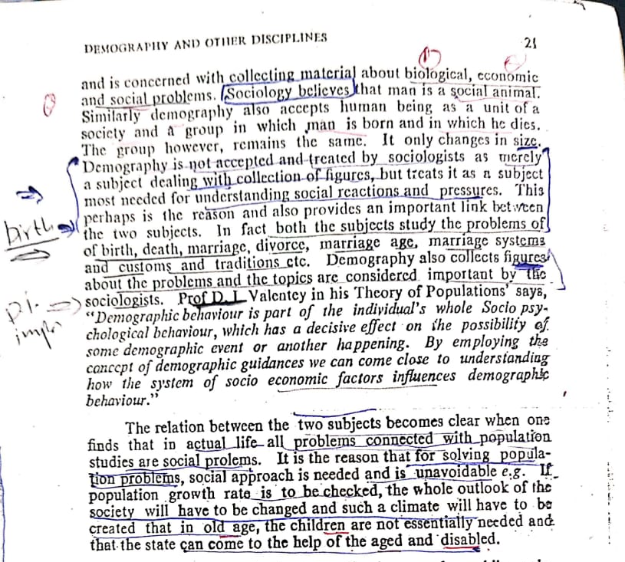

Slide 7
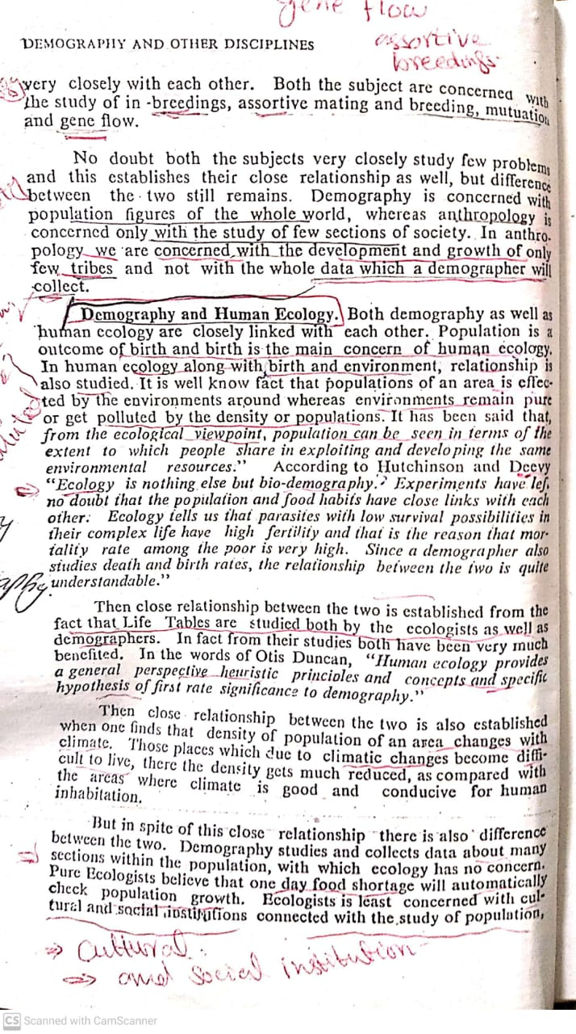

Slide 10
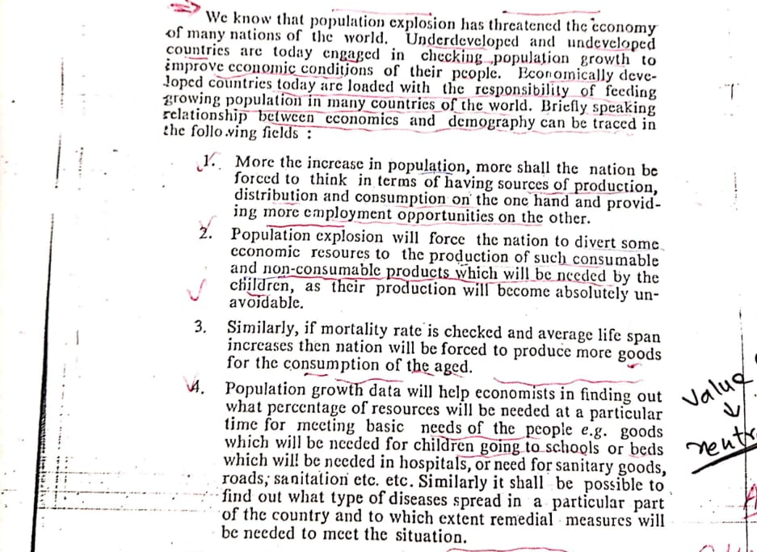

Slide 12
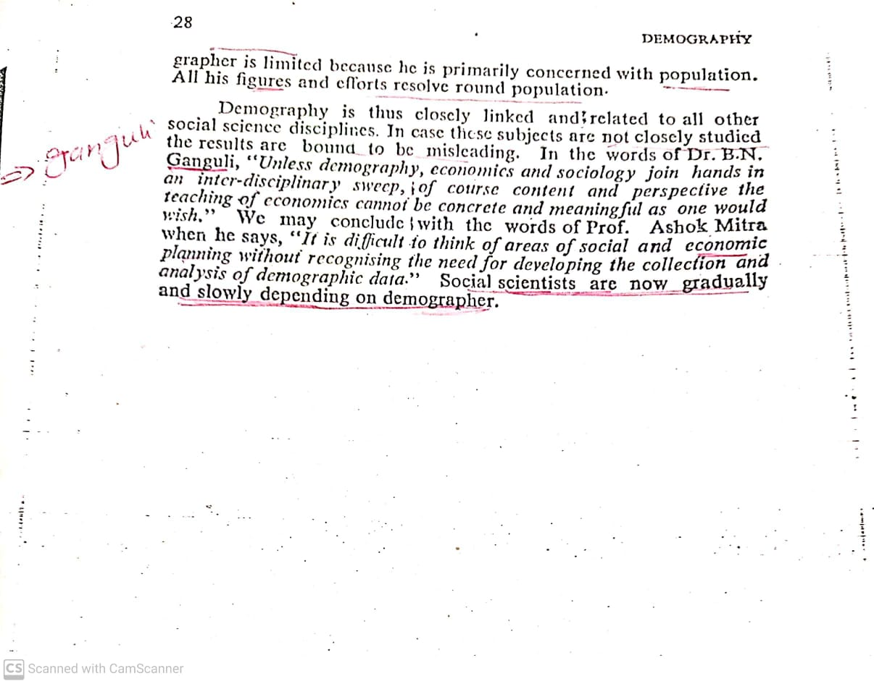

Slide 13
Thank You

