Slide 1
Animal Cell Culture
Origin and Principles of Cell Culture

Slide 2
Types
History
Culture Techniques
Applications

Slide 3
Introduction
Tissue Culture is the general term for the removal of cells, tissue, or organ from an animal and
Their subsequent placement into an artificial environment suitable for cell growth
The cells were removed from the organ fragment separate it in single cell condition, place in the suitable culture media is called animal cell culture

Slide 4
History of animal cell culture is about 100 years old.
When in 1907 Ross Harrison for the first time tried to culture nerve tissue from a frog embryo in serum extracted from the blood clot.
Following Harrison’s experiments,
Carrel in 1912 attempted to study the behavior of the fragment of the heart of chick embryo.
These experiments laid the foundation of animal and tissue culture technology.
.

Slide 5
In 1946, Bark and his colleagues used rodent tissues to produce continuous cell lines. Cell lines established in this way generally die after 50 generations in case of human cell cultures, chicken cells have even a shorter span of population doublings
Immortal cell lines are derived from malignant tissues. The famous example of He La (derived from the cervical carcinoma of a patient Helen Lane) Cell cultures can be cited.
Normal cells transformed by Epstein Barr Virus also become immortal.

Slide 6
However, the cells of mammalian origin have to be sub-cultured in order to maintain continuous cell lines.
There are number of established cell lines that have been made to survive for very long periods that include 6T6 cells of mouse embryo, Chinese hamster ovary (CHO), Baby hamster kidney cells (BHK) and human fibroblast cell lines.
These cell lines survive prolonged periods if sub-cultured at regular intervals.

Slide 7
Alex Issacs in 1966 reported the production of some antiviral substances in the cells of many vertebrates after viral infections.
Issacs named these substances interferon's as they interfered the entry of viruses in uninfected cells and also inhibited the proliferation cycle of virus.
The cell culture have been used for decades for propagation of viruses for vaccine preparations.
Interest has been furthered by exploiting viruses to produce specific proteins and monoclonal bodies

Slide 8
There are three types of interferon's:
Alpha interferon
Beta interferon
Gamma interferon
Each one having antigenic properties
Since 1980 interferon’s used for genetic engineering techniques.

Slide 9
Another product of important is the protein called Erythropoietin, which has put the biotechnology industry on a high pedestal.
This protein stimulates cells in the bone marrow to differentiate into blood cells.
This is being manufactured by recombinant DNA technology.
In addition to these products, insulin, human growth hormones, enzymes are also being produced on a large scale by this technique.

Slide 10
Another Area in which cell culture technology has been successful is the somatic cell genetics, an area of genetic disorder in the unborn fetus.
Transfection of cells (transformation) is successful carried out in producing transgenic animals and chimerics as model animal system.
Stem cell technology has proved to be a bone to a medical sciences for gene replacement therapy. The plouripotent stem cells can be genetically engineered without altering their pluripotency.

Slide 11
There are three basic steps to establish primary cell culture;
Isolation of cells
In this step cells are isolated from any particular tissue
Disaggregation of cells
In this step cells are gets separated from each other to disrupt their normal relationship from neighboring cells.
This disaggregation can be achieved by

Slide 12
Chemical:
Many enzymes are used for this
e.g. trypsin, collagenase, hyaluronidase
or their combinations
Mechanical:
By using tissue homogenizers
Incubation of cells in a suitable culture media:
By maintaining optimized culture conditions to grow the isolated cells

Slide 13
Sub-Culturing
When the cells of primary culture has grown up and achieved a proper growth state, they are sub-cultured to give them more nutritional support for continuous growth.
The sub-culturing is necessary step to maintain the cell in continuous growth phase,
as after some time of primary culture consume the provided nutrient and due to lack of nutrient cell growth become stagnant and leads to death

Slide 14
Thus to maintain the cell viability, cells are transferred into fresh culture media
For sub-culturing, the cells from primary cell culture are harvested/isolated and transferred to fresh culture media.
Before sub-culturing cell can be preserved in DMSO ( di-methyl sulfoxide ) or glycerol by cryopreservation technique.
Sub-Culturing
Sub-Culturing
Culturing
Transfer of cultured cells in fresh media
Transfer of cultured cells in fresh media
Isolated Cells

Slide 15
Primary Cell Culture
When the cells are surgically removed from an organ are placed into a suitable culture environment, they will attach ,divide and grow.
This is the first step to establish an cell culture. This is called primary cell culture.
To obtain a primary cell culture, tissue are cut into small fragments and enzymatic ally (by using enzyme pepsin, collagenase) digested / separated into single cells.

Slide 16
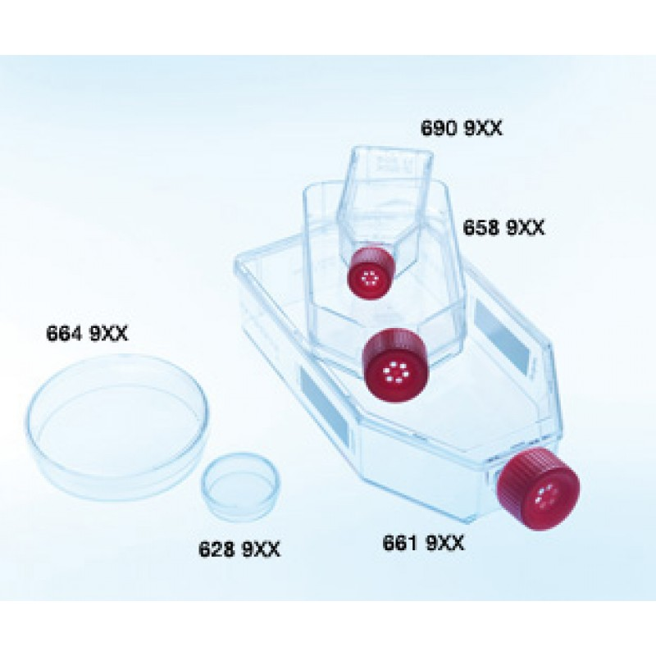
Many cells lost their viability, but many of them starts to grow and divide to form new cells.
If the cells multiply repeatedly and grow for a long time, these cells can also then put in plastic bottles with fresh culture media. These cells are termed as primary cell lines.

Slide 17
Established Cell Culture
When the primary cell lines continue to grow and divide, they are sub-cultured in fresh media to maintain their viability and growth. After many sub-culturing (about 70 times) these cells are called established cell lines.
Primary cell lines can grow very slowly, but established cell lines grow faster, as there are some alterations in cell metabolic mechanism due to many sub-culture steps
Primary cell maintains the properties of parent cells, but established cell lines has some altered properties

Slide 18
Transformed Cell
With subsequent sub-culturing (more than 80 times), established cell lines cells become immortal (i.e. cells have the capacity to grow indefinitely). Normal cells have a limited growth capacity,
But some cells acquire a capacity of growth for indefinite time.
This capacity is generated due to transformed in genetic material, due to this transformation, cells loose the sensitivity to external stimuli and also sometime show changes in chromosomal numbers.

Slide 19
Organs
Cell Fragment (tissue)
Enzyme digestion of cell fragment
(with enzyme trypsin, collagenase)
Single Cell
Primary Cell Culture
Culturing of single cell in suitable culture media

Slide 20
Frequent sub-culturing (around 70-80 times) of primary cultured cells in suitable culture media
Established Cell Culture
After more than 80 sub-culturing; there is alteration in cell division characteristics
Chromosomal number and cells acquire indefinite growth property
Transformed Cell Culture

Slide 21
Types of Culture Media for Animal Cell Culture
Various types of media are used for cell culture methods. They are generally categorized in two broad groups.
Natural Media:
Media components are from the natural origin that provide sufficient nutritional support for proliferation of animal cells.
e.g. Clots, biological fluids, tissue extracts.

Slide 22
Plasma Clots
Prepared by mixing 15 drops of plasma with five drops of embryo extract in a watch glass.
Biological Fluids
The various biological fluids used as culture medium (e.g. amniotic fluid, pleural fluid, aqueous humor from eye etc). Serum is widely used, obtained from adult human blood, placental cord blood, horse and calf blood.
Tissue Extracts
Chick embryo extract is most commonly used , but bovine embryo extract is also used. Other are spleen, liver, Bone marrow, leucocytes extracts etc.

Slide 23
Artificial Media
They are chemically synthesized e.g. Serum containing media, serum free media , chemically defined media, protein free media etc.
Synthetic media:
were prepared artificially but adding several nutrients (organic and inorganic), vitamins, salts, oxygen and carbon dioxide gas phase, serum proteins, carbohydrates, co-factors etc.
Different types of media and their composition is defines according to their uses.

Slide 24
Synthetic medias are of two types
Serum Free Media:
When synthetic media are devoid of serum in culture, it is called serum free media. Crude protein fractions, such as bovine serum Albumin, or α-β-globulin are used as nutritional supplements.
They include serum extract (not serum) tissue extract or tissue hydrolysate, growth factors, hormones, carrier proteins like albumin and transferrin. Lipids, metal ions, vitamins, poly-amines etc.

Slide 25
Serum Containing Media:
Serum contains a complete set of essential growth factors, hormones, attachment and spreading factors, binding and transporting proteins, human and bovine serum etc.
Serum serves as source of amino acids, proteins, vitamins, growth factors, lipids, and other nutritional supplements.
It also suppress effect of shear stress to protect cells from physical damage.

Slide 26
Cell Culture Techniques
Anchorage dependent cell culture:
Some tissue cells need attachment for growth are anchored dependent cells i.e. cells from kidney
All normal tissue derived cells are anchorage dependent cells and need surface or any support for their proliferation.
In the absence of any support surface, aminol anchorage cells growth is arrested and cell gets destroyed due to induction of programmed cell death. These cells are sensitive to shear stress, and these cell require cell to cell communication and interaction and cell signaling pathway for their survival.

Slide 27
Anchorage Independent Cell Culture:
Cells which does not require attachment for growth or do not attach to the surface of the culture vessel are anchorage independent cells e.g. lymphocytes.
Cells derived from hematopoietic system and transformed cells like cancer (myeloma cells) are non-anchorage dependent cells and does not require any surface or support for growth, they proliferate in free suspended form of culture, Because in this form they get nutritional material better growth

Slide 28
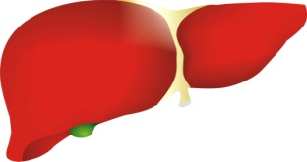
Normal Cells/ Stem cells
Myeloma/ Cancer Cells
Anchorage independent
Anchorage dependent cell culture
Cell doesn’t need any support surface for proliferation inside culture medium
Cell proliferate on any support surface inside culture medium

Slide 29
Application of Animal Cell Culture
Animal cell culture several uses in medical sciences, in virology , in biotechnology and in pharmaceutical industry and research as production of valuable bio molecules and in research to study cell behavior. It is also used in the treatment of various genetic and non-genetic diseases.

Slide 30
Model systems
Toxicity Testing
Cancer Research
Virology
Cell-Based Manufacturing
Genetic Counseling
Genetic Engineering
Drug Screening and Development
Stem Cell Therapy
Vaccines Production
Production of Monoclonal Antibodies

