Slide 1
ENTO-306
Agricultural pests and their management
Identification of important agricultural pests
Their mode of damages
Control measures
By: Dr. Muhammad Zeeshan Majeed

Slide 2
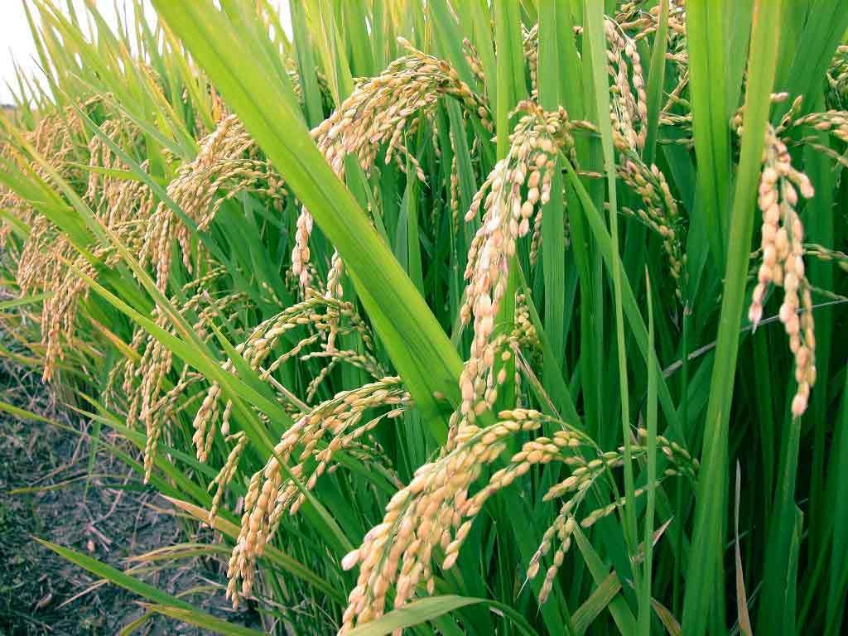
Major Insect Pests of Rice Crop in Pakistan
Notes:
Oryza sativa
Largest staple food of the globe. Mostly consumed in Asian countries (90% of the world). Pakistan most important staple crop, 11th largest producer in world and 10th in Asia
Pakistan cultivation 2.85 (3) M ha. / India 43 M ha
Production in Pakistan 7.4 Mt (2017-18) / 6.2 Mt in 2013-14. (China 143Mt: India 99 Mt).
2.7 % agriculture value-added and 0.6% of GDP.
There are 3 kinds of rice varieties in Pakistan which are produced for local consumption and export_Basmati, IRRI (International Rice Res. Inst. Los Banos, Phillipines) (medium long grain) , Cold tolerant (short and bold grained rice)
These are Basmati (aromatic), IRRI variety and bold grain (cold tolerant varieties).
IR-varieties are developed by NIAB.
Most widely grown varieties are Basmati-long grained rice (vasmati_sansaqreet word_Vas means Fragrance and Mati means soil).
According to IRRI reports, there are over 100 species of insect pests to rice around the world but only about 20 species can cause economic damage.

Slide 3
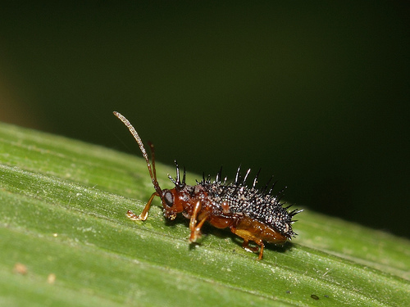
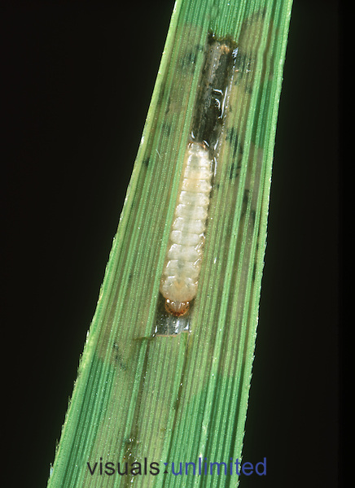
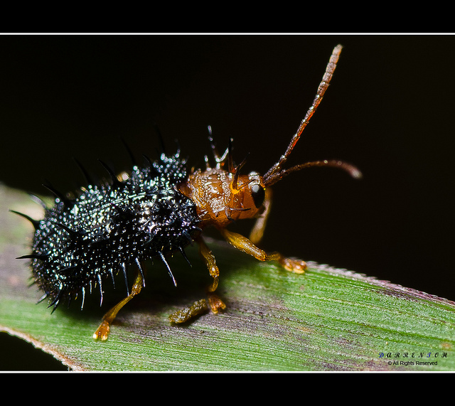
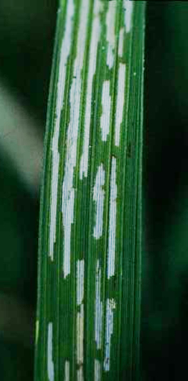
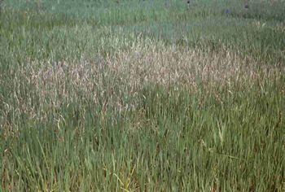
ENTO-306 Agricultural pests and their management 4(3-1)
Insect pests of Rice Hispa (Dicladispa armigera: Chrysomelidae)
Nursery more susceptible to damage
Notes:
Adults: spiny bluish black beetles (5mm long)/ Grub: Creamy white or pale yellowish in color, often hidden in leaf layers : 2-3 generations per y: 20-100 eggs laid singly on leaf upper side. Maximum activity: June, July (Hibernates as adult beetle )
Feeding of larvae in between leaf layers like leaf miners. Green matter scrapings leaving whitish parallel streaks on blades. The damage usually starts in nurseries and spread to fields. White patches can be seen from a distance due to its attack.
ETL = 1 adult or 1-2 damaged leaves per hill or tiller
Control: while transplanting remove infested tips of leaves., adult beetles removal and destruction after flood irrigation of field or nursery.
Chemical: Carbaryl (Sevin 10D) @ 5kg/acre
Cartap (Padan 4G) @ 10 Kg/acre
Methamidophos @ 500 ml/acre

Slide 4
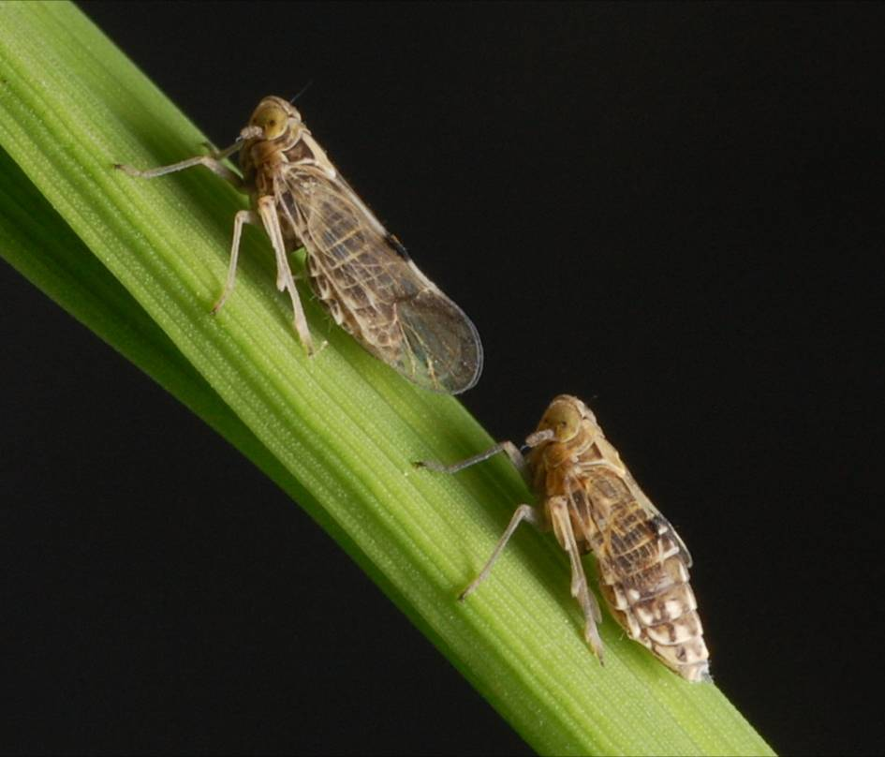
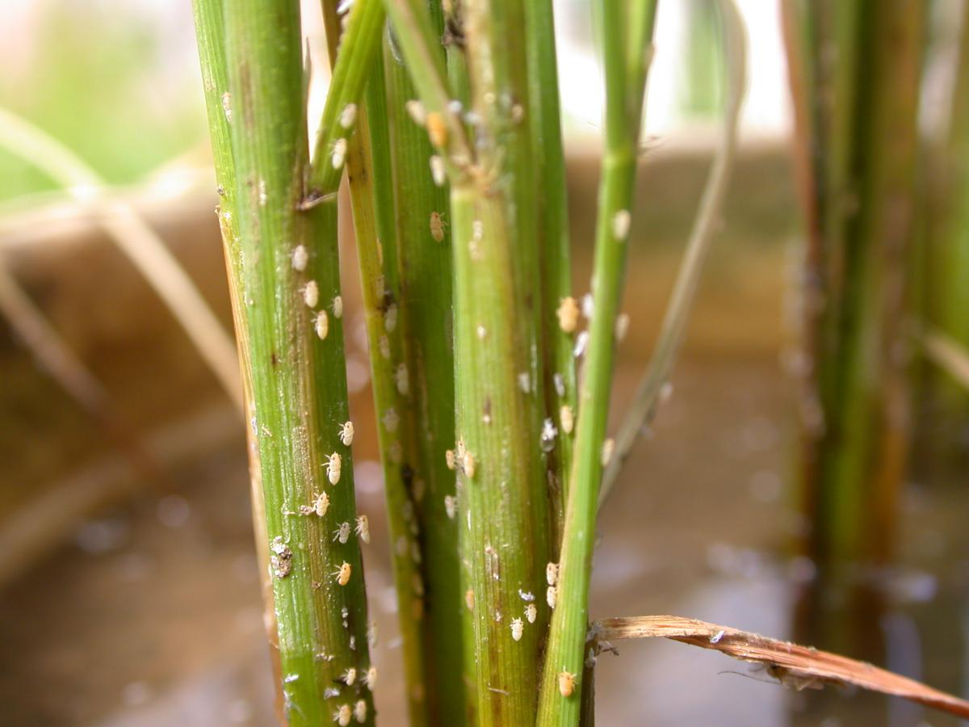
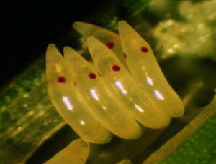
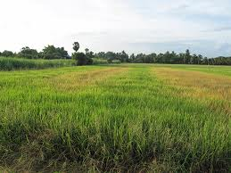
ENTO-306 Agricultural pests and their management 4(3-1)
Insect pests of Rice White-backed plant hopper (Sogatella furcifera: Delphacidae)
Hopper burn
Notes:
Widely distributed in Kallar tract of Pakistan (Sialkaot, Gujranwala, Sheikhupura etc). Host plants: Rice and wild grasses.
Adults: Grayish straw colored with white back, mass egg-laying (cylindrical orange colored with red spot visible near tip) in leaf-sheaths, Nymph: grayish white then turns dark grey
Life cycle: 3-4 weeks, active period: March to November, overwinters as egg or nymph, several generations per y.
Congregate near plant base around leaf sheaths, desaping gives yellowish color, devitalize plants and then dries up and gives burned appearance (hopper-brun) to the whole crop. Lower rice yield upto 10-70%. Also transmits some rice viral diseases.
Crop should be transplanted at 20 cm (RxR) and 15 cm (PxP) distance otherwise microclimate favors hopper infestation and multiplication.
Drainning out standing water in crop for 2-3 times in case of hopper attack can reduce infestation.
Grow some resistant rice varieties such as IRRI than Basmati if hopper infestation risk is more.
ETL = 5 insects per hill
Spraying of some systemic and contact insecticides with nozzel direction towards plant bases.

Slide 5
Minor/Occasional Insect Pests of Rice

Slide 6
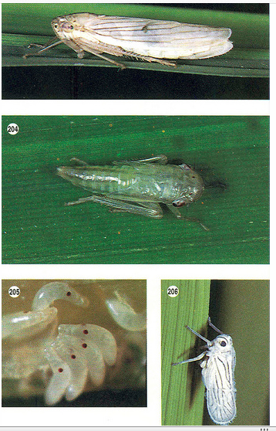
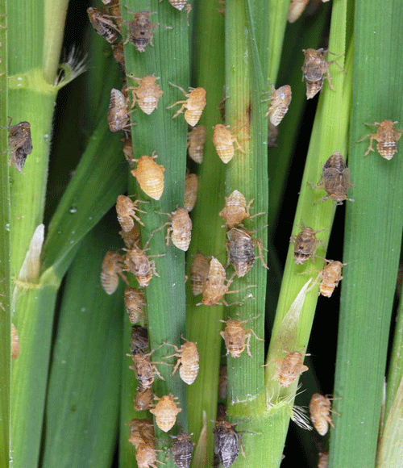
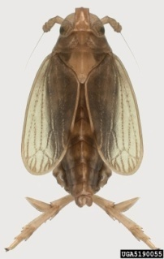
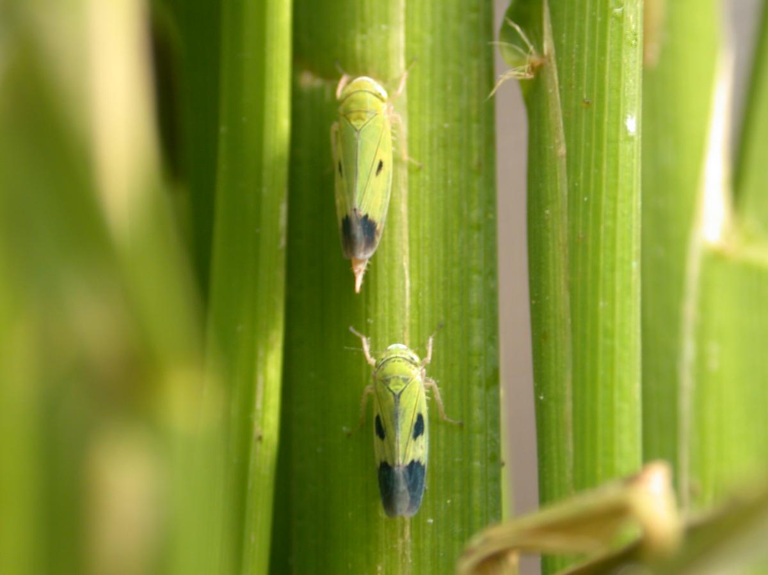
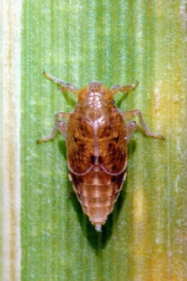
ENTO-306 Agricultural pests and their management 4(3-1)
Insect pests of Rice White leaf-hopper (Cofana spectra: Cicadellidae)
Green leaf-hopper (Nephotettix nigropictus: Cicadellidae)
Brown plant-hopper (Nilaparvata lugens: Delphacidae)
Notes:
Desaping leads to yellowish leaf color and later turns brown. Damage symptoms start from leaf tips and goes downward to rest of plant. Several brown spots on feeding sites leads to stunted growth of ears without grain formation.
Brown leafhopper (Nilaparvata lugens) is most destructive sucking insect pest of rice in some areas. Its adult is 4-5 mm long. Active throughout year. Female lays about 120 small eggs in clusters.
High humidity, optimum temp. (15-30C), high nitrogen application to crop and no wind favors rapid multiplication of the hopper and hopper-burns appears.
White leaf-hopper is about 7mm long and nymphs are pale white in color.

Slide 7
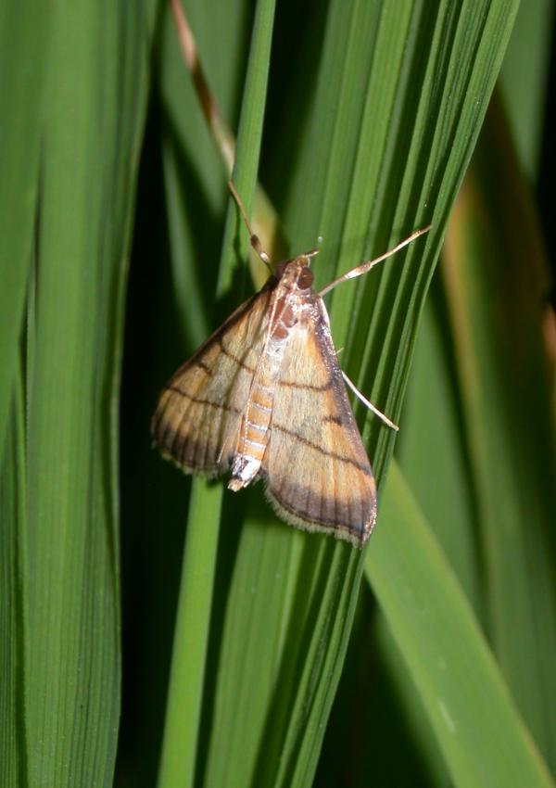
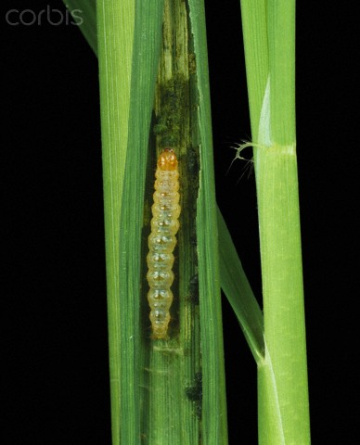
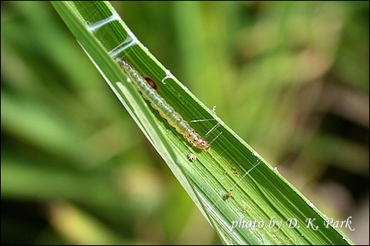
ENTO-306 Agricultural pests and their management 4(3-1)
Insect pests of Rice Leaf-folder (Cnaphalocrocis medinalis: Pyralidae)
Notes:
A sporadic pest
Adult: Golden or yellowish brown in color, with 2-3 dark brown wavy lines.
Larva: (20-25mm) light greeninsh or yellowish with orange brown head capsule. Usually very agile and moves quickly inside leaf fold made by larva be fastening leaf edges together.
4 generations per year; Total life cycle is about one month. Active period is July to October.
Young larvae feeds on tender leaves and then lateral larval instars tightens the leaf longitudinal margins with sticky substacne and feeds inside these folds by rasping green matter and leaving membraneous leaf appearance that later dries up.
Egg parasitoid Trichogramma japonicum or T. chilonis
Clean cultivation around rice fields.
Light traps for moth intensity or infestation estimation.
ETL = 5-10% damaged or folded leaves.

