Slide 1
Levels of Org. Management

Slide 2
Levels of Org. Management

Slide 3
Strategic planning
(Strategy: a plan of action designed to achieve a long-term or overall aim)
The process of developing and maintaining a strategic fit between the organization’s goals and capabilities and its changing marketing opportunities

Slide 4
Company and Marketing Strategy: Partnering to Build Customer Relationships
Company-wide strategic planning guides marketing strategy and planning.
Like marketing strategy, the company’s broad strategy must also be customer focused.

Slide 8
Five Marketing Concepts / Theories
Production
Product
Selling
Marketing
Societal Marketing

Slide 9
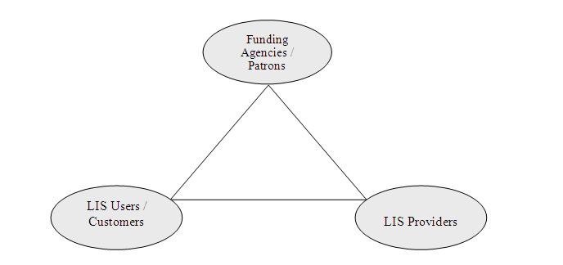
LIS Marketing: Third Party Theory

Slide 10
Designing the Business Portfolio
Business portfolio
The collection of businesses and products that make up the company.
Analyzing the Current Business Portfolio
The process by which management evaluates the products and businesses that make up the company

Slide 11
Boston Consulting Group (BCG)Approach

Slide 12
Product/Market Expansion Grid

Slide 13
Planning Marketing: Partnering to Build Customer Relationships
Partnering with Other Company Departments
Value chain: The series of internal departments that carry out value-creating activities to design, produce, market, deliver, and support a firm’s products.
Partnering with Others in the Marketing System
Value delivery network: The network made up of the company, its suppliers, its distributors, and, ultimately, its customers who partner with each other to improve the performance of the entire system.
Marketing Strategy and the Marketing Mix
Marketing strategy: The marketing logic by which the company hopes to create customer value and achieve profitable customer relationship

Slide 14
Customer-Driven Marketing Strategy

