Slide 1
HYDRO POWER PLANT

Slide 2
CONTENTS
INTRODUCTION
HYDRO POWER PLANT IN PAKISTAN
ESSENTIAL ELEMENTS OF HYDRO POWER PLANT
WORKING
DIAGRAMMATICAL WORKING OF HYDRO POWER PLANT
ADVANTAGES
DISADVANTAGES

Slide 3
INTRODUCTION
In Hydro Power Plant the water is utilized to move the turbines which in turn run the electric generator’s.
The Potential energy of the water stored in the dam gets converted into the Kinetic Energy of the moving water in the penstock. And this Kinetic Energy gets converted into the Electrical Energy with the help of Turbine & Generator (T-G) combination.
Hydro Power Plant was invented by H.F. Rogers
Hydro Power Plant fulfills the 30% of the total energy needs of the world.
Total hydro potential of the world = 5000 GW.

Slide 4
HYDRO POWER PLANT IN PAKISTAN
Mangla hydro power plant was constructed at Terbela in 1967 having capacity 1150 MW.
Terbela hydro power plant was constructed at Terbela in 1974 having capacity 4888 MW.
Ghazi Barotha hydro power plant was constructed at Attock in 2002 having capacity 1450 MW.
Neelum Jhelum hydro power plant was constructed at Muzaffarabad in 2018 having capacity 969 MW.

Slide 5
ESSENTIAL ELEMENT OF HYDRO POWER PLANT
1. PRIMARY ELEMENT’S
CATCHMENTS AREA
RESERVOIR
DAM
PRIME MOVERS
DRAFT TUBES
POWER HOUSE & EQUIPMENT
2. SAFETY DEVICE’S
SPILL WAY’S
SURGE TANK
TRASH RACK

Slide 6
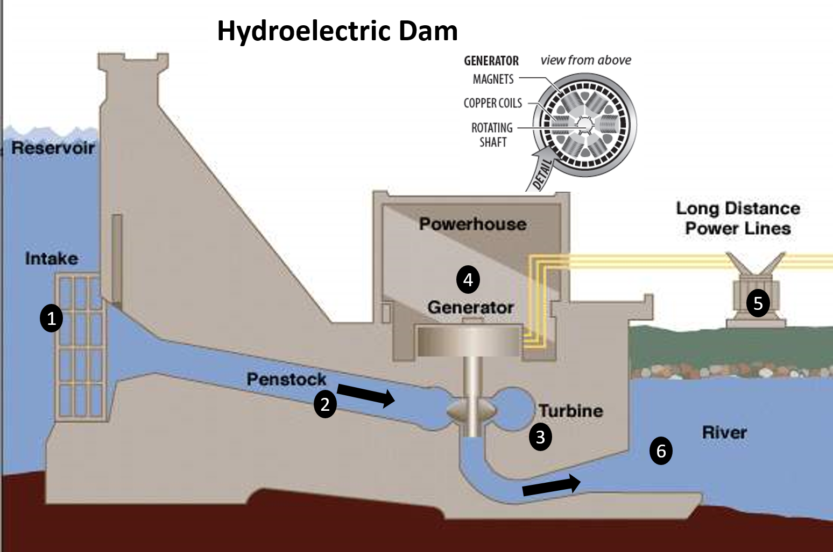

Slide 7
CATCHMENTS AREA:-
The whole area behind the clam training into a stream as river across which the dam has been built at suitable place is called catchments area.
RESERVOIR:-
A reservoir is employed to store water which is further utilized to generate power by running the hydroelectric turbines.
DAM:-
A dam is a barrier which confines or raise water for storage or diversion to create a hydraulic head.
Dam’s are generally made of concrete, Stone masory,
Rockfill or Timber

Slide 8
T-G COMBINATION:-
Turbine & Generator is the most important part of any power plant
This combination is known as the heart of the power plant.
TURBINE :-
Turbine is a very light fan like structure having many number’s of blades . It has an ability to rotate on its axis when water passes through it.
GENERATOR :-
Generator is a device in which when there is rotation of coil between the strong Magnetic Field then it produces an Alternating Current.

Slide 10
DRAFT TUBE:-
Draft Tube is an empty structure made beneath the Turbine. It serves in following 2 purpose’s :
It allows the turbine to be set above tail water level without loss of head,
to facilitate inspection and maintenance.
It regains by diffuser action , the major portion of the kinetic energy delivered to it from the runner.
It increases the output power.
It increases the efficiency of Hydro Power Plant.
PENSTOCK:-
Penstock is the connecting pipe between the dam & the turbine house.
It helps to increase the kinetic energy of the water coming from the dam.
Penstock is made up of a very strong material which can sustain the high
pressure of water.

Slide 11
POWER HOUSE AND EQUIPMENT
Some more components are required for the proper, user friendly & smooth functioning of the power plant. These components are as follow:-
VALVE :-
This the instrument which is used to control the pressure of flow of water .
PUMPS :-
This device is used to send water or any fluid from lower
potential to higher potential.
Spill way:-
Spill Way’s is a kind of canal provided besides the dam.
Spill Way’s is used to arrange the excess of accumulation of water on the dam because excess accumulation of water may damage the dam structure

Slide 12
SLUDGE TANK
When there is a sudden close or decrease in pressure due to control valve then there is a back flow of water. This creates a high pressure zone in the penstock due to which it may burst . This effect is known as water hammering effect .
To avoid this a tank is attached to the penstock which stores water in it . This tank is called as Surge Tank.

Slide 13
WORKING
Initially the water of the river is in Catchments Area.
From catchments area the water flows to the dam.
At the dam the water gets accumulated . Thus the potential energy of the water increases due to the height of the dam .
When the gates of the dam are opened then the water moves
with high Kinetic Energy into the penstock.
Through the penstock water goes to the turbine house.
Since the penstock makes water to flow from high altitude to low altitude, Thus the Kinetic Energy of the water is again raised.

Slide 14
COUNT...
Initially the water of the river is in Catchments Area.
From catchments area the water flows to the dam.
At the dam the water gets accumulated . Thus the potential energy of the water increases due to the height of the dam .
When the gates of the dam are opened then the water moves with high Kinetic Energy into the penstock.
Through the penstock water goes to the turbine house.
Since the penstock makes water to flow from high altitude to low altitude, Thus the Kinetic Energy of the water is again raised.

Slide 16
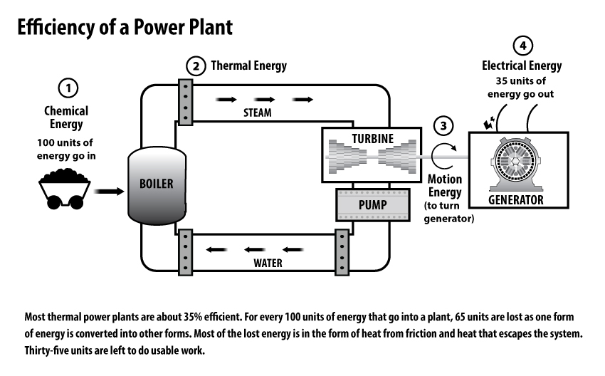
Power Plant Efficiency
Notes:
Another advantage is the high efficiency of hydroelectric power plants.
Efficiency of a power plant is determined by calculating the amount of energy going into a power plant compared to the amount of useful energy generated by the plant. In the case of most thermal power plants, for every 100 units of energy (coal, natural gas, etc.) that go into that plant, only 35 units of electricity are produced. This means they are only 35% efficient. 65 units are converted into other types of energy (mostly heat which is dissipated into the atmosphere).

Slide 17
Coal vs. Hydro Kinetic Energy Conversion
35%
95%
Notes:
A hydropower plant, on the other hand, converts about 95 percent of kinetic energy of the water flowing through the system into electricity.

Slide 18
ADVANTAGE
No fuel charges.
Less supervising staff is required.
Maintenance & operation charges are very low.
Running cost of the plant is low.
The plant efficiency does not changes with age.
It takes few minutes to run & synchronize the plant.
No fuel transportation is required.
No ash & flue gas problem & does not pollute the atmosphere.
These plants are used for flood control & irrigation purpose.
Long life in comparison with the Thermal & Nuclear Power Plant.

Slide 19
DISADVANTAGE
The initial cost of the power plant is very high.
Takes long time for construction of the dam.
Generally, Such plant’s are located in hilly area’s far away from load center & thus they require long transmission lines & losses in them will be more.
Power generation by hydro power plant is only dependent on natural phenomenon of rain. Therefore at the time of drought or summer session the Hydro Power Plant will not work.

