Slide 1
TRENDS OF VICTORIAN ERA

Slide 2
Major trends followed in Victorian Era were:
Serialization:
Serialization was the major trend followed in the Victorian Era. It involved the publication of novel is installments in a magazine or paper.
Example:
Charles Dickens’ Pickwick Papers was published in installments.

Slide 3
Industrialization
As industrial revolution was prevalent during that era so it was also the trend of Victorian writers to write about that.
Example :
Elizabeth Gaskell’s ‘North and South’ sets up the problem right in the title: the south is the cultured life of London, and the North is the up-and-coming industrial town.

Slide 4
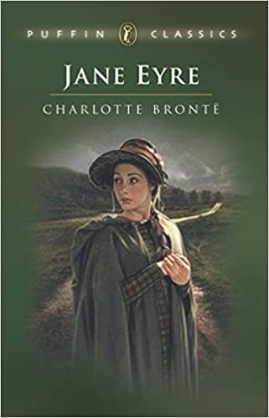
Class
Victorians were conscious about class. Most of the Victorian writers deal with the issues faced by people belonging from the ‘middle class’.
Example:
Jane Eyre
Portrait of a Lady

Slide 5
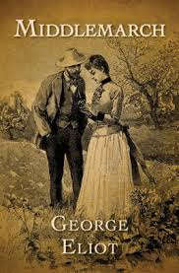
Science VS Religion
With Drawin’ s theory of evolution prevailing, the trend of discussing whether science should be followed or religion was seen.
Example:
The Scopes Trial
Gissing’s New Grub Street
Middlemarch

Slide 6
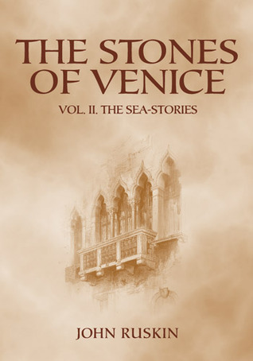
Nostalgia
Victorians dealt mostly with nostalgia in many of their writings.
Example:
Ivanhoe by Walter Scott
Idylls of the King by
Lord Tennyson
Stones of Venice by
John Ruskin

Slide 7
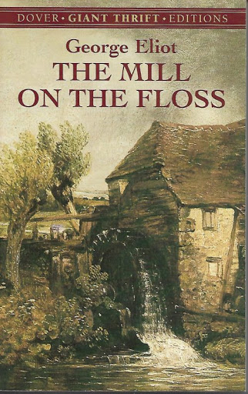
Feminism
The rights of women were more discussed in the Victorian literature. Though women could not publish their works by their names but still they were getting some control.
Example:
Jane Eyre
The Mill on the Floss
Vanity Fair

Slide 8
Utilitarianism
The happiness of large number of the people was the new trend in Victorian Era. It was a rather philosophical theme that was being followed.
Example:
Hard Times by Charles Dickens
George Eliot’s novels mainly deal with this aspect.

Slide 9
Major Writers
Novelists:
Charlotte Bronte
Charles Dickens
George Eliot
Thomas Hardy
Poets:
Elizabeth Barrett
Mathew Arnold
Lord Tennyson

Slide 10
THE END

