Slide 1
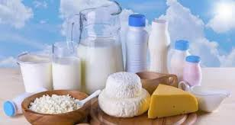
Tests for adulterants of milk

Slide 2
Common parameters to evaluate milk quality
Common parameters that are checked to evaluate milk quality are-
Fat percentage
SNF (solid-not-fat) percentage
Protein content
Freezing point
Adulterants are added in milk to increase these parameters, thereby increasing the milk quality in dishonest way

Slide 3
Adulterants added in milk
Cane sugar, starch, sulfate salts, urea and common salts are added to increase solid-not-fat (SNF).
Urea, being a natural constituent of raw milk, Commercial urea is added to milk to increase non-protein nitrogen content
melamine is added to increase protein content falsely
Ammonium sulphate is added to increase the lactometer reading by maintaining the density of diluted milk.
Formalin, Salicylic acid, Benzoic acid and Hydrogen peroxide act as preservatives and increase the shelf life of the milk
milk fat is very expensive, some manufacturers of milk and dairy products remove milk fat for additional financial gain and compensate it by adding non-milk fat such as vegetable oil.
Detergents are added to emulsify and dissolve the oil in water giving a frothy solution, which is the desired characteristics of milk

Slide 4
Adulterants Impact on Health
The ingestion of melamine at levels above the safety limit can induce renal failure and death in infants
Peroxides and Detergents in milk can cause gastro-intestinal complications, which can lead to gastritis and inflammation of the intestine.
Excessive starch in the milk can cause diarrhea due to the effects of undigested starch in colon, however, accumulated starch in the body may prove very fatal for diabetic patients
Urea in milk overburdens the kidneys as they have to filter out more urea content from the body
Carbonate and bicarbonates might cause disruption in hormone signaling that regulate development and reproduction

Slide 5
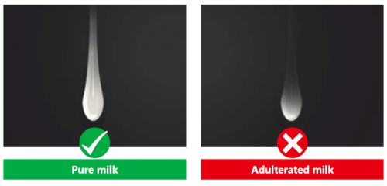
Detection of water in milk
Put a drop of milk on a polished slanting surface.
Pure milk either stays or flows slowly leaving a white trail behind.
Milk adulterated with water will flow immediately without leaving a mark

Slide 6
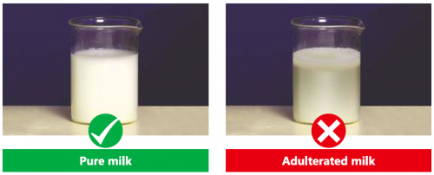
Detection of detergent in milk
Take 5 to 10ml of sample with an equal amount of water.
Shake the contents thoroughly.
If milk is adulterated with detergent, it forms dense lather.
Pure milk will form very thin foam layer due to agitation.

Slide 7
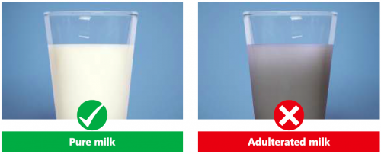
Detection of starch in milk and milk products
Boil 2-3 ml of sample with 5ml of water. Cool and add 2-3 drops of tincture of iodine. Formation of blue color indicates the presence of starch. (In the case of milk, addition of water and boiling is not required)

