Slide 1
Motivation how to increase project team performance?
By: Saba Ashraf
Noon Business School, University of Sargodha

Slide 2
What is Motivation?
It is the process of stimulating people to actions to accomplish the goals.
Motivation can inspire, encourage, and stimulate individuals and project teams to achieve great accomplishments.
Motivation can also create an environment that fosters teamwork and collective initiatives to reach common goals or objectives.
The level of motivation an individual and/or team applies to project efforts can affect all aspects of project results, including a direct impact to the triple constraint project success factors (i.e. on time, within budget, high quality, met scope / customer expectations).

Slide 3
Project Manager and Motivation
Stimulating team member performance requires a project manager to harness many different interpersonal skills, including good communication, the ability to train others, make decisions, lead by example, and create a positive, motivational environment by understanding and associating with the key components of motivation.
Unlike most tangible project management functions, motivation is not designated by the project manager to a team member, instead motivation is internal to each team member and derived from a team member’s desire to achieve a goal, accomplish a task, or work toward expectations.
Motivation can be considered the conduit of ambition applied to the desired accomplishment.

Slide 4
Motivational Approaches a Project Manager can apply
Following are the approaches a project manger can apply to project team environment
McGregor’s Theory X and Theory Y
Herzberg’s Two-Factor Theory
McClelland Achievement, Affiliation, & Power Motivation
MBTI Personal Style

Slide 5
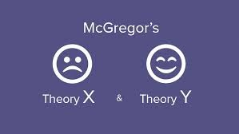
McGregor’s Theory X and Theory Y
McGregor’s Theory X and Theory Y motivational approach identifies polar differences in subordinates.
McGregor’s Theory X and Theory Y motivational approach identifies polar differences in subordinates.
Theory Y individuals are classified as team members who want to work, find the job satisfying, are willing to participate, do not require a controlling environment, and seek constant improvement or opportunity.
A suggestion for managers who implement the use of Theory X and Theory Y must apply flexibility when assigning an individual to one of these two categories

Slide 6
Advantages & Disadvantages
Advantages:
Theory X and Y identifies a gap commonly found between different types of individuals within the workplace.
Based on the differences, a distinctive motivational approach may be applied to achieve the desired results.
Disadvantages:
Knowing that a manager may have a collection of both Theory X and Theory Y individuals on the project team, leadership and decision making efforts may become more difficult.
For instance, Theory X team members require more of an authoritative environment neatly controlled by the project manager. However, an authoritative environment will be de-motivating to the Theory Y team members as there is minimal need for such a degree of control.

Slide 7
Herzberg’s Motivator-hygiene theory
According to Herzberg, motivating factors (also called job satisfiers) are primarily intrinsic job elements that lead to satisfaction. Hygiene factors (also called job dissatisfiers) are extrinsic elements of the work environment.

Slide 8
Advantages & Disadvantages
Advantages:
Emphasis on Motivation from within.
Project Manager can focus on the problem of Employees.
Money is Treated Secondary
Disadvantages:
Job Satisfaction and Job Productivity not directly related
It can be Subjective
Ignores External Factors

Slide 9
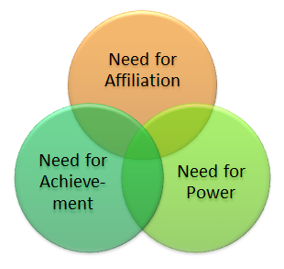
McClelland Achievement, Affiliation, & Power Motivation
Achievement Motivation:
Accomplishment, personal ambition, and a need to be good at what they do, are additional attributes that are common among achievement orientated individuals.
Individuals who are driven by achievement are more likely to define clear goals as well as a course to goal attainment.
Advantages:
To an achievement motivated individual, life is about a personal challenge rather than a challenge with others.
Disadvantages:
Individuals who have a tendency to be achievement oriented may not know when to stop, quit, or accept failings
This may result in signs of mental stress or physical fatigue.

Slide 10
Affiliation Motivation:
McClelland’s Affiliation motivation is driven by relationships and a need to work well with others. Individuals who are motivated through affiliation are drawn toward a friendly work atmosphere and will strive for team unity, team success, and commonality of team norms.
Motivation through affiliation will steer an individual to assist others while promoting a collective team effort
Advantages:
Working with individuals who are motivated by affiliation will result in an environment built on a sense of harmony, teams driven toward common goals, and a genuine desire to help each other.
A direct result of affiliation motivation is less conflict for the project manager to resolve.
Disadvantages:
Individuals who possess a strong sense for affiliation may feel uncomfortable voicing concerns and may shy away from environments that do not allow for personal interaction with others.
An individual motivated by affiliation may not be as concerned to focus on one-self or the opportunities that could allow for personal growth.

Slide 11
Power Motivation:
McClelland’s Power motivation is driven by the ability to dominate and manipulate goals, direction, or decisions.
Individuals who are motivated by power are drawn toward the ability to offer input and access into a variety of situations from risk review and competition to a general need for appreciation or personal acknowledgment.
Motivation through power will naturally steer an individual toward leadership opportunities
Advantages:
A project manager has the ability to rely on the natural leadership tendencies of individuals who are motivated by power.
The project manager can exude confidence in and seek assistance from power driven individuals by assigning tasks to focus on reviewing alternatives, overcoming risks, and steering other team members toward common project-consistent objectives.
Disadvantages:
An alternative view of individuals who possess a strong desire for power includes the need to dominate, control, or have influence in all aspects of the project.
Authority struggles may result between power driven team members and the project manager, resulting in the need for the project manager to champion the power driven team members through the assignment of specific tasks, ownership, or control.

Slide 12
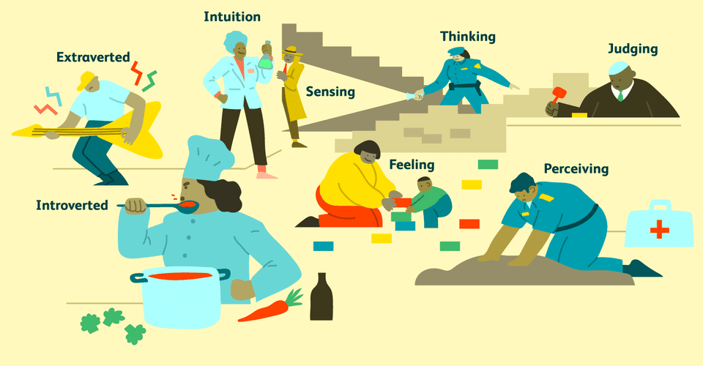
MBTI Personal Style
The Myers-Briggs Type Indicator (MBTI) provides an ability to identify personal style based upon responses to a series of questions that collectively determine preferences and motivation tactics of each individual.
MBTI provides a review of four common traits: 1) need for personal contact with others, 2) application of realism, 3) ability to apply logic and 4) influences of judgment.
A combination of these four attributes help to define an individual’s personality type. Knowing this information provides the project manager with the most motivating communication approach, task direction, and level of detailed project information that will stimulate each individual thereby creating a functional working relationship or environment.

Slide 13
Advantages:
A clear advantage to the MBTI is the unique guide to team member motivation and preference that is made available.
As a project manager, it is far easier to shape communication and interaction with each individual based upon their known personality style than it is to guess at what approaches work best.
Disadvantages:
Because the MBTI can be environment or situational based, if the individual taking the MBTI assessment is not applying the questions to the work environment, the results may not be fruitful.

Slide 14
Motivational Mistakes
Whatever motivates me will motivate others.
People are motivated primarily by money.
Team members love to receive formal awards.
Give them a rally slogan.
The best project leader is a strong cheerleader.
These people are professionals. They don’t need motivation.
I’ll motivate them when there is a problem.
I’ll treat everyone the same. People like that, and it will be motivating for them

Slide 15
People often say that motivation doesn’t last. Well, neither does bathing – that’s why we recommend it daily.
Zig Ziglar

