Slide 1
Principle of dynamo
The dynamo is used for the production of an EMF by electromagnetic induction. A coil of wire lies b/w the poles of a magnet and some means of rotating the coil is provided.
Various sources of power may be used for this purpose, such as water power a stream engine or some type of motor.
As the coil rotates the turns of wire cut across the magnetic lines of force and the essential for electromagnetic induction are present i.e. there is movement of conductor relative to magnetic lines of force.
Thus an EMF is induced in the coil of wire . As the coil rotates the turns of wire cut the magnetic lines of force first in one direction, then in the other so the current produced is alternating.

Slide 2
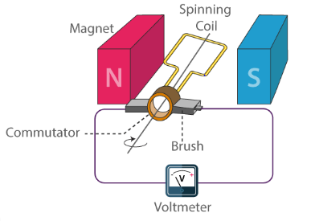

Slide 3
Principle of dynamo
A collecting device is used to convey the current from the moving coil of wire to the external circuit.
This may transmit the alternating current directly to the circuit or may change into the direct current.
Thus the dynamo can be constructed to supply either a.c or d.c.
it is the apparatus used for all large scale production of electricity including that for the main supply.

Slide 4
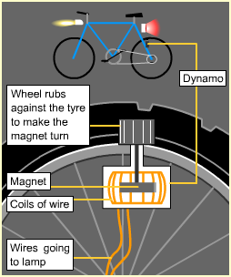
A bicycle dynamo is an example of a dynamo.
The dynamo has a wheel that touches the back tyre. As the bicycle moves, the wheel turns a magnet inside a coil.
This induces enough electricity to run the bicycle's lights.
The faster the bicycle moves, the greater the induced current and the brighter the lights.

