Slide 1
DAS
Department of Animal Sciences, UOS
Poultry Breeds
Introduction to Animal Husbandry
2020
Notes:
Experimental—deceleration, disability, supine, mice
Theory—mites, honeybees, identity, probit
Lifespan—primates, etc
Human—self reinforcing, wasp, NBA
Thank
Background
Invasive/Greece/Hawaii
CDFA Medfly panel
Aging research
LBAM
Workshop
Zalom et al
Retreat/Workshop
LMAM see that little changes
New day in science/policy

Slide 2
Breed
Group of birds which are similar in
Shape
Size
Body confirmation
Descendants of common ancestry
Leghorn, Rhode Island Red, New Hampshire etc.
Notes:
Experimental—deceleration, disability, supine, mice
Theory—mites, honeybees, identity, probit
Lifespan—primates, etc
Human—self reinforcing, wasp, NBA
Thank
Background
Invasive/Greece/Hawaii
CDFA Medfly panel
Aging research
LBAM
Workshop
Zalom et al
Retreat/Workshop
LMAM see that little changes
New day in science/policy

Slide 3
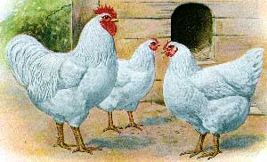
White Plymouth Rocks
Skin Color - Yellow
Egg Color - Brown
Origin - America
Characteristics
1. Docile
2. Deep full breast
3. Docile, Popular birds
Notes:
Experimental—deceleration, disability, supine, mice
Theory—mites, honeybees, identity, probit
Lifespan—primates, etc
Human—self reinforcing, wasp, NBA
Thank
Background
Invasive/Greece/Hawaii
CDFA Medfly panel
Aging research
LBAM
Workshop
Zalom et al
Retreat/Workshop
LMAM see that little changes
New day in science/policy

Slide 4
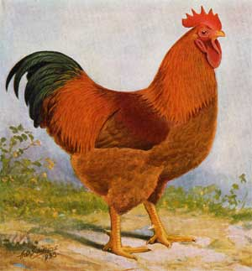
New Hampshires
Skin Color - Yellow
Egg Color - Brown
Origin - Massachusetts
Characteristics-
1. Rapid growth
2. Early maturing
3. Fast Feathering
Notes:
Experimental—deceleration, disability, supine, mice
Theory—mites, honeybees, identity, probit
Lifespan—primates, etc
Human—self reinforcing, wasp, NBA
Thank
Background
Invasive/Greece/Hawaii
CDFA Medfly panel
Aging research
LBAM
Workshop
Zalom et al
Retreat/Workshop
LMAM see that little changes
New day in science/policy

Slide 5
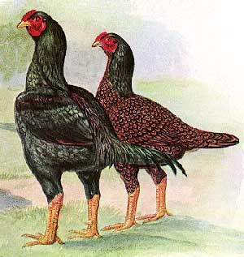
Dark Cornish
Skin Color - Yellow
Egg Color - Brown
Origin - England
Characteristics:
1. Ultimate meat bird
2. Excellent carcass
3. Very active birds
Notes:
Experimental—deceleration, disability, supine, mice
Theory—mites, honeybees, identity, probit
Lifespan—primates, etc
Human—self reinforcing, wasp, NBA
Thank
Background
Invasive/Greece/Hawaii
CDFA Medfly panel
Aging research
LBAM
Workshop
Zalom et al
Retreat/Workshop
LMAM see that little changes
New day in science/policy

Slide 6
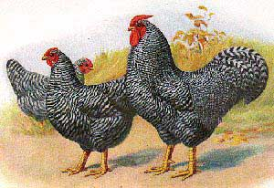
Dominiques
Skin Color-Yellow
Egg Color- Brown
Origin - USA
Characteristics-
1. Hardy, calm
2. Good meat bird
3. Small single combed
Notes:
Experimental—deceleration, disability, supine, mice
Theory—mites, honeybees, identity, probit
Lifespan—primates, etc
Human—self reinforcing, wasp, NBA
Thank
Background
Invasive/Greece/Hawaii
CDFA Medfly panel
Aging research
LBAM
Workshop
Zalom et al
Retreat/Workshop
LMAM see that little changes
New day in science/policy

Slide 7
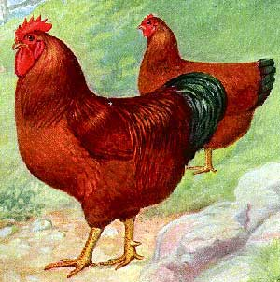
Rhode Island Reds
Skin Color - Yellow
Egg Color - Brown
Origin - New England
Characteristics -
1. Dual Purpose
2. Egg Production
3. Meat Production
Notes:
Experimental—deceleration, disability, supine, mice
Theory—mites, honeybees, identity, probit
Lifespan—primates, etc
Human—self reinforcing, wasp, NBA
Thank
Background
Invasive/Greece/Hawaii
CDFA Medfly panel
Aging research
LBAM
Workshop
Zalom et al
Retreat/Workshop
LMAM see that little changes
New day in science/policy

Slide 8
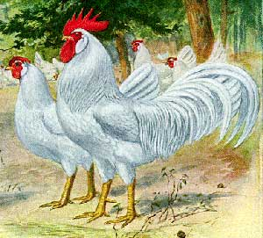
White Leghorns
Skin Color - Yellow
Egg Color - White
Origin - Italy
Characteristics-
1. Great foragers
2. Capable of flight
3. Noted for egg production
Notes:
Experimental—deceleration, disability, supine, mice
Theory—mites, honeybees, identity, probit
Lifespan—primates, etc
Human—self reinforcing, wasp, NBA
Thank
Background
Invasive/Greece/Hawaii
CDFA Medfly panel
Aging research
LBAM
Workshop
Zalom et al
Retreat/Workshop
LMAM see that little changes
New day in science/policy

Slide 9
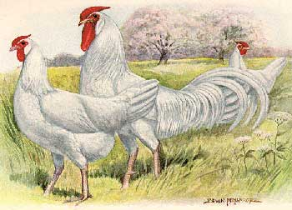
Minorcas
Skin Color - White
Egg Color - White
Origin - Spain
Characteristics-
1. Large combs-waddles.
2. Good egg producer
Notes:
Experimental—deceleration, disability, supine, mice
Theory—mites, honeybees, identity, probit
Lifespan—primates, etc
Human—self reinforcing, wasp, NBA
Thank
Background
Invasive/Greece/Hawaii
CDFA Medfly panel
Aging research
LBAM
Workshop
Zalom et al
Retreat/Workshop
LMAM see that little changes
New day in science/policy

Slide 10
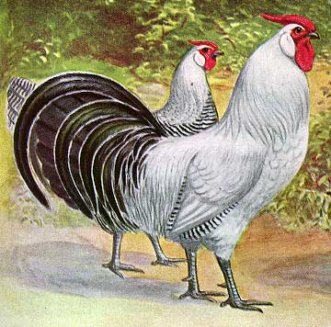
Silver Hamburgs
Skin Color - White
Egg Color - White
Origin - Germany
Characteristics-
1. Active flighty birds
2. Trim and stylish
3. Good egg producers
Notes:
Experimental—deceleration, disability, supine, mice
Theory—mites, honeybees, identity, probit
Lifespan—primates, etc
Human—self reinforcing, wasp, NBA
Thank
Background
Invasive/Greece/Hawaii
CDFA Medfly panel
Aging research
LBAM
Workshop
Zalom et al
Retreat/Workshop
LMAM see that little changes
New day in science/policy

Slide 11
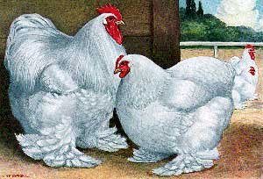
White Cochins
Skin Color-Yellow
Egg Color-Brown
Origin- China
Characteristics:
1. Big fluffy balls of feathers- can withstand cold temps.
2. Feathers on feet - good for confinement
Notes:
Experimental—deceleration, disability, supine, mice
Theory—mites, honeybees, identity, probit
Lifespan—primates, etc
Human—self reinforcing, wasp, NBA
Thank
Background
Invasive/Greece/Hawaii
CDFA Medfly panel
Aging research
LBAM
Workshop
Zalom et al
Retreat/Workshop
LMAM see that little changes
New day in science/policy

Slide 12
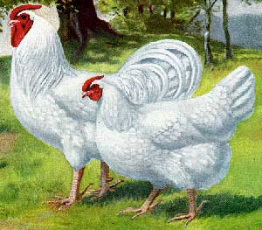
White Dorking
Skin Color - White
Egg Color - White
Origin- Italy
Characteristics:
1. Good layers
2. One of oldest breeds
3. Large comb-5 toes
Notes:
Experimental—deceleration, disability, supine, mice
Theory—mites, honeybees, identity, probit
Lifespan—primates, etc
Human—self reinforcing, wasp, NBA
Thank
Background
Invasive/Greece/Hawaii
CDFA Medfly panel
Aging research
LBAM
Workshop
Zalom et al
Retreat/Workshop
LMAM see that little changes
New day in science/policy

Slide 13
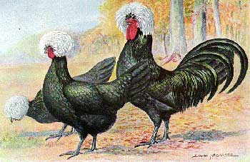
Polish
Skin Color - White
Egg Color - White
Origin - Europe
Characteristics -
1. Crest and Muffs
2. Restricted vision
3. Easily frightened
Notes:
Experimental—deceleration, disability, supine, mice
Theory—mites, honeybees, identity, probit
Lifespan—primates, etc
Human—self reinforcing, wasp, NBA
Thank
Background
Invasive/Greece/Hawaii
CDFA Medfly panel
Aging research
LBAM
Workshop
Zalom et al
Retreat/Workshop
LMAM see that little changes
New day in science/policy

Slide 14
Other Breeds
White Langshan
Houdans
Light Brahmas
Silkie
Orpington
Wyandotte
Etc.

