Slide 1
Mathematical methods of physics-1
COURSE CODE: PHY 301

Slide 2
Instructor
Naeema Amjad
Education:
B.S from International Islamic University Islamabad
M.Phil. from University Of Sargodha, Sargodha

Slide 3
Course content
Complex Variable Function
Gamma and Beta Functions
Orthogonal Functions
Bessel Functions

Slide 4
Course objective
The main objective of this course is to familiarize students with a range of mathematical methods that are essential for solving advanced problems in theoretical physics.

Slide 5
Learning outcomes
After successfully completed course, student will be able to
use complex analysis in solving physical problems
solve ordinary and partial differential equations of second order that are common in the physical sciences
use Green functions
use the orthogonal polynomials

Slide 6
Recommended Books
1. Mathematical Methods for Physicists by George Arfken and Hans J. Weber, (6th and onwards editions) Acad Press.
2. Advanced Engineering Mathematics, Erwin Kreyszig, (2007).
3. Mathematical Physics by E. Butkov, Addison-Wesley London
4. Complex Variables by M.R.Spiegel, Schaum’s Outline Series, McGraw Hill, New York.
5. Introduction to Mathematical Physics by C.W. Wong, Oxford University, Press, New York (1991).
6. Foundations of Mathematical Physics by Hassani, Prentice Hall International Inc., Singapore (1991).
7. Mathematical Physics by ChattopadhyayWiley Eastern Limited, New Delhi, (1990).

Slide 7
Number Scheme
Sessional 20 marks
Mid term 30 marks
Final exam 50 marks

Slide 8
Unit 01
Complex Variable Function
Complex Algebra
Cauchy–Riemann Conditions
Cauchy’s Integral Theorem
Calculus of Residues
Dispersion Relations
Method of Steepest Descents

Slide 9
Complex number
A complex numbers is a number consisting a Real and Imaginary part. z = (x, y).
It can be written in the form(Cartesian form)
Z = x + yi
Real Imaginary

Slide 10
Complex number
By definition, two complex numbers are equal if and only if their real parts are equal and their imaginary parts are equal.
(0, 1) is called the imaginary unit and is denoted
i = (0,1)

Slide 11
Complex number
Power of "i"
i⁰ = 1,i¹ = i,i² = −1
i³ = ii ² = −i
i⁴ = i²i² = 1
i⁵ = i⁴i = i
i¹⁰⁰ = (i⁴ )²⁵ = (1)²⁵ = 1

Slide 12
Algebra of complex numbers
Addition of complex numbers
If a + bi and c + di are two complex numbers then addition of complex numbers are ,
(a + bi) + (c + di) = (a + c) + (b + d)i
Example:
(2 + 4i) + (5 + 3i) = (2 + 5) + (4 + 3)i = 7 + 7i

Slide 13
Algebra of complex numbers
Algebra of complex numbers
Subtraction of Complex numbers
If a + bi and c + di are two complex numbers then subtraction of complex numbers are ,
(a + bi) - (c + di) = (a - c) + (b - d)i
Example:
(3 + 2i) - (2 + 3i) = (3 - 2) + (2 - 3)i = 1 - 1i

Slide 14
Algebra of complex numbers
Algebra of complex numbers
Multiplication of Complex numbers
If a + bi and c + di are two complex numbers then multiplication of complex numbers is,
(a + bi)(c + di) = (ac -bd) + ( ad + bc)i
Example:
(2 + 3i)(4 + 5i)=(2x4- 3x5)+(2x5+ 3x4)i =-7+22i

Slide 15
Algebra of complex numbers
Algebra of complex numbers
Division of Complex numbers
If a + bi and c + di are two complex numbers then Division of complex numbers is

Slide 16
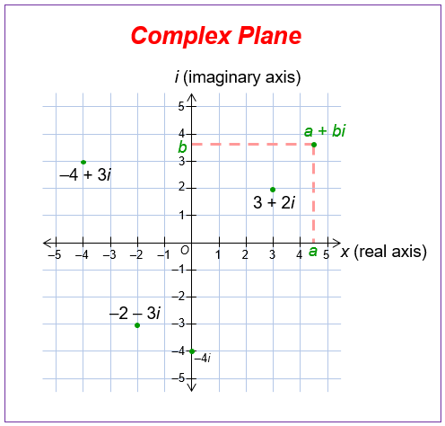
Complex Plane
Complex plane
Two perpendicular coordinate axIs, the horizontal x-axis, called the real axis, and the vertical y-axis, called the imaginary axis.

Slide 17
Complex Conjugate Numbers
Complex Conjugate Numbers
The complex conjugate z of complex number Z = x + yi, is
z = x − yi
It is obtained geometrically by reflecting the point z in the real axis. Figure shows this for z = 5 + 2i and its conjugate z = 5 - 2i.

Slide 18
Complex Conjugate Numbers
Complex Conjugate Numbers
By addition and subtraction:
z + z = (a + bi) + (a − bi) = (a + a) + (b − b)i = 2a z − z = (a + bi) − (a − bi) = (a − a) + (b + b)i = 2b
Re z = x = ¹ (z + z), Im z = y = ¹ (z − z) 2 2i

Slide 19
Complex Conjugate Numbers
Complex Conjugate Numbers
The complex conjugate is important because it permits us to switch from complex to real. Indeed, by multiplication the complex number with it’s conjugate.
Let z = a+bi, then :
zz = (a + bi)(a − bi) = a² −(bi)² = a² + b²
zz = z ²

Slide 20
Complex Conjugate Numbers
Complex Conjugate Numbers
So when you need to divide one complex number by another, you multiply the numerator and denominator of the problem by the conjugate of the denominator.
Example : Divide 10 + 5i by 4 – 3i.
= 1+ 2i

Slide 21
Complex Conjugate Numbers
(z₁ + z₂ ) = z₁ + z₂
(z₁z₂ ) = z₁ z₂
(z₁ − z₂ ) = z₁ − z₂
z₁ z₁
2 2
( ) =
z z

