Slide 1
Micro propagation (Tissue culture)

Slide 2
Micro propagation
Production of plants from very minute plant parts, tissues of cells grown in a tube or containers under controlled nutritional, environmental and aseptic conditions.
Micro-propagation is a form of tissue culture
Once a tissue culture has been established and plantlets start to form we can grow large amount of new plant material from the starting material.

Slide 3
Technique based on phenomenon of TOTIPOTENCY.

Slide 4
TISSUE CULTURE STARTING MATERIAL
can be as small as a single plant cell
because plants exhibit totipotency,
(ability to regrow a completely new plant from a single somatic cell)
but the most common explant material is leaf tissue
or tissue from a meristematic region such as the apical meristem.

Slide 5
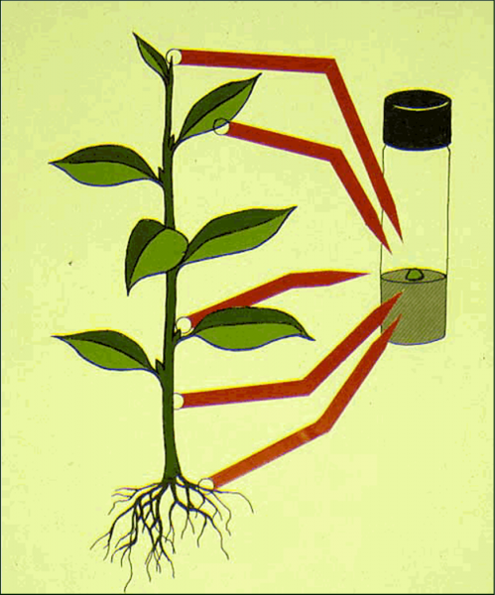

Slide 6
MICRO-PROPAGATION STEPS

Slide 7
1.) selection of mother plant
begins with the selection of plant material to be propagated.
Should be
Certified
True to type
Healthy
Disease free
Vigour
Insect resistant
Selection dependent on the type of tissue to be used; including
stem tips anthers
petals
pollen
others plant tissues.

Slide 8
2. establishment of Ex-plant material
explant material is then surface sterilized
usually in multiple courses of bleach and alcohol washes
finally washed in sterilized water.
This small portion of plant tissue is placed on a growth medium
containing sucrose as an energy source and one or more plant growth regulators (plant hormones).
Usually the medium is thickened with agar to create a gel which supports the explant during growth.
The plant tissue grows and differentiates into new tissues depending on the medium.
For example, media containing cytokinins are used to create branched shoots from plant buds.

Slide 9
3.) Multiplication
Multiplication is the taking of tissue samples produced during the previous stage to increasing their number.
the establishment stage is followed by multiplication.
Through repeated cycles of this process, a single explant sample may be increased from one to hundreds or thousands of plants

Slide 10
multiplication can involve different methods and media. Depending on the type of tissue grown
If the plant material grown is callus tissue, it can be placed in a blender and cut into smaller pieces and recultured on the same type of culture medium to grow more callus tissue.
If the tissue is grown as small plants called plantlets, hormones are often added that cause the plantlets to produce many small offshoots that can be removed and re-cultured.

Slide 11
4.) plantlet establishment
This stage involves
treating the plantlets/shoots to encourage root growth and hardening.
It is performed invitro, or in a sterile "test tube" environment.

Slide 12
5- Hardening or acclimatization
"Hardening" refers to the preparation of the plants for a natural growth environment.
The plantlets have been grown in "ideal" conditions, designed to encourage rapid growth.
Due to lack of necessity, the plants are likely to be highly susceptible to disease and often do not have fully functional dermal coverings
inefficient in their use of water and energy.

Slide 13
In vitro conditions are high in humidity and plants grown under these condition do not form a working cuticle and stomata
when take out from culture the plantlets need time to adjust to more natural environmental conditions.
Hardening typically involves slowly weaning the plantlets from a high-humidity, low light, warm environment

Slide 14
6.) Transfer From Culture
In the final stage the plantlets are removed from the plant media and transferred to soil
This stage is often combined with the “plantlet establishment and hardening" stage.

