Slide 1
Role of Acetylcholine in Movement Disorders

Slide 2
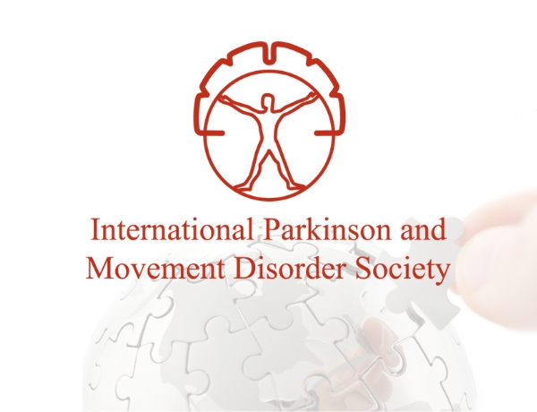
The neurological subspecialty of “movement disorders” focuses on conditions characterized by excessive movements (hyperkinetic), poverty of movements (hypokinetic), and gait/balance disorders.1

Slide 3
Parkinson's disease and Parkinsonism
Dystonia
Chorea and Huntington's disease
Ataxia
Tremor and essential tremor
Tics and Tourette syndrome
Restless legs syndrome
Gait disorders
Spasticity
Stiff Person Spectrum Disorder

Slide 4
Hypokinetic & Hyperkinetic Movement Disorders
Hypokinetic
Parkinson’s disease
Parkinson’s Plus
Syndromes
Hyperkinetic
Tremor
Dystonia
Myoclonus
Chorea
Tics
Akathisia(how to stop)
RLS

Slide 5
Distribution of Acetylcholine in Brain
All parts of Fore-Brain(including cortex)
Mid-Brain
Brain stem
Little in cerebellum
Marker used to identify cholinergic neuron in Brain are Choline Acetyltransferase labelled with immunofluorescence.2

Slide 6
Cholinergic neurons in the forebrain and brain stem send diffuse projections to many parts of the brain.2

Slide 7
Acetylcholine (ACh) released from cholinergic interneurons (ChI) acting through nicotinic (nAChR) and muscarinic acetylcholine receptors (mAChRs) in the striatum have been thought to be central for the potent cholinergic regulation of basal ganglia (BG) activity / motor behaviors.

Slide 8
Nicotinic Acetylcholine Receptor
nAChRs are members of the Cys-loop gene super family of ligand-gated ion channels.
They consist of complexes of five subunits around a central hydrophilic pore or channel.
Twelve distinct neuronal nAChR subunits have been identified to date and fall into two major subclasses, including α (α2 to α10) and β (β2 to β4) subunits.
Homomeric
Heteromeric

Slide 9
muscarinic acetylcholine receptors
Belong to family A or class 1 GPCRs (M1-M5)
Distributed throughout the brain
M1 : Cortex and hippocampus
M2 & M3 : Not highly expressed in CNS as other
M4:Straitum
M5: heavily expressed in mid-brain
ACh activation of mAChRs has multiple actions
Oppose dopamine (DA) release, signaling, and related motor behaviors, and maintain the balance of DA and ACh in the striatum is critical for maintaining normal motor function.
M1,M4 and M5 (therapeutic benefit)
M1 : pro-cognitive effects while having modest effects on locomotion
M5 : excitatory effects on DA neurons in the SNc while reducing DA release from SNc terminals in the striatum

Slide 11
Extensive studies over nearly half a century provide evidence for a role of the basal ganglia in the control of voluntary movement and the Pathophysiology of movement disorders.3

Slide 12
Basal Ganglia

Slide 15
primary striatal neurotransmitter systems

Slide 16
GABAergic medium spiny neurons (MSNs)= (95%) of striatal neurons.
Smaller populations of several types of striatal interneuron's that constitute the remaining 5% of neurons.
Cholinergic interneurons are the primary source of striatal acetylcholine (ACh) and regulate its function via pre and post synaptic nAChRs and muscarinic receptors.
MSNs are medium sized projection neurons with wide-ranging dendritic trees (dense) that extensively synapse with striatal interneurons and numerous incoming neurons
Functionally distinct subpopulations of MSNs that are responsible for different aspects of motor control which act in opposing fashion
D1 dopamine direct pathway : normal physiological conditions.
D2 dopamine indirect pathway : Tone and posture
Overall motor function involves a complex balance between the direct and indirect pathways to allow for the fine control of motivation and action.

Slide 17
M4 location in Basal ganglia
Glutamatergic

Slide 18
M4 reduces glutamatergic signaling in the striatum via allosteric modulators
An allosteric modulator can alter the response of an endogenous agonist

Slide 19
M4 decreases GABA release SNr
Pedunculopontine Nuclei

Slide 21
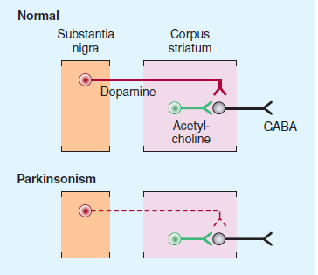
Parkinson’s Disease
Second most common neurodegenerative disease with an incidence of 1% over the age of 60.
Bradykinesia/hypokinesia(Decrease Dopamine)
Tremor & rigidity (Increase Acetylcholine)
Difficulty to initiate the movement and stop it
Degeneration of nigrostriatal dopaminergic neurons. This results in a decline in dopamine release and a reduced stimulation of D1 and D2 receptors on MSNs(Medium Spiny Neurons) of the direct pathway and indirect pathway, respectively.
Striatal cholinergic interneurons involved
Nicotinic Receptor (α4β2*, α6β2*,α7)4
Muscranic Receptor (M1, M4)5

Slide 22
Nicotine Receptor targeting drug used in MDs
Altinicline (SIB-1508Y)
Target α4β2
Indication Parkinson Disease
Development In Phase 2 clinical trail

Slide 23
Huntington’s disease
Huntington's disease (HD) is caused by CAG repeat( > 36 time) expansion within the HTT gene
Dysfunction and eventual loss of striatal medium spiny neurons. (GABAergic neuron)
NeuroProtective effect provided by α-7 nAchR Agonist
1.Quinolinic acid injected into straitum induced early stage HD
2.PHA 543613(potent α7nAChR agonist) given intraperitonially at 12mg/kg for 4day
Result:
Improved neuronal survival in a rat model of Huntington’s disease.18

Slide 24
Tardive Dyskinesia
Potentially irreversible late onset repetitive abnormal involuntary movements primarily of the face and limbs.
Antipsychotics are key in treating In schizophrenia and bipolar disorder .
Antipsychotics drugs Blocking D2 dopamine receptors and reducing excess dopaminergic activity in brain regions linked to neurological disorders.
However, they also affect dopaminergic systems associated with motor control, and induce side effects including tardive dyskinesia in 30% of treated patients.
Striatal cholinergic interneurons β2* Nicotinic receptor.6
Animal experiments suggest that blockade of some DA receptors in the brain (e.g., in ventromedian striatum) may reduce hyperkinesia and produce parkinsonism,

Slide 25
Tourette’s Syndrome
Chronic multiple motor and vocal tics of early onset(childhood).
Link with obsessive compulsive disorder
Pathophysiology of the dopaminergic system is a major problem in Tourette’s syndrome, the motor symptoms are also linked to a dysfunction of the striatal cholinergic system.
Preclinical evidence for this idea stems from studies showing that targeted ablation of 50% of striatal cholinergic interneurons in mice led to ticlike stereotypies and a loss of coordination.7
Clinically, there is a down regulation of striatal interneuron transcripts and a decreased number of cholinergic interneurons in Tourette’s syndrome brains.8
Striatal cholinergic interneurons β2* nicotinic receptor 9,10

Slide 26
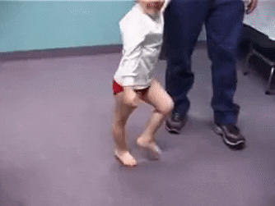
Ataxia
Ataxia is a motor disorder characterized by poor coordination of voluntary muscle movements.
Various genetic abnormalities that result in mitochondrial and other cellular deficits.
No specific therapeutic options for ataxia
Enhancing CNS cholinergic activity appear useful in some clinical trail but not cover all types of ataxia.
Several animal studies performed to find receptor subtype and location of the nAChRs involved
1. Acute intracerebellar administration of nicotine or an α4β2* nAChR agonist reduced ethanol-induced ataxia 11 but α4β2* nAChR antagonist show no improvement.12
2. Nicotine and the β2* selective nAChR agonist varenicline reduced ataxia in rats with a lesion of the olivocerebellar pathway.13
3. α7 nAChR drugs administered into the cerebellum also attenuated ethanol-induced ataxia.14

Slide 27
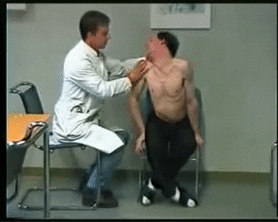
Dystonia
Dystonia is a movement disorder characterized by twisted posturing due to abnormal muscle contraction.
Anticholinergic(M1, M2 and M3)16 therapy is often beneficial in dystonia patients suggested an involvement of the cholinergic system in its Pathophysiology.15
Evidence from animal models of dystonia indicate a role for the basal ganglia, with a crucial involvement of the striatal cholinergic system.16
Elevated extracellular striatal acetylcholine was identified in a knock-in mouse model of human DYT1 dystonia (TorAE/+ mice), suggestive of a striatal hypercholinergic state.17

Slide 28
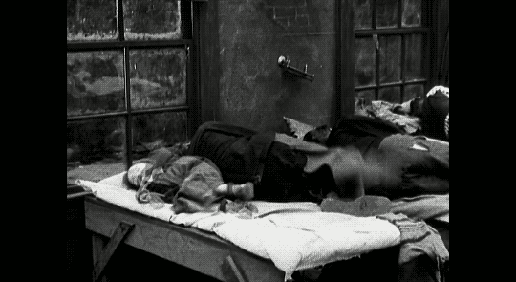
Restless Leg Syndrome
Restless legs syndrome (RLS) is a common sensory motor neurological disorder that is characterised by an irresistible urge to move the legs.
Mostly at night time .
Contributing factor :
Iron deficiency anaemia
4 fold increase in pregnancy
Experiment : 65 days
Control group: standard iron-sufficient diet (198 mg Fe/kg)
Groups I : low-iron diet; 3–5 mg Fe/kg to rats plus offspring
Groups II : low-iron diet; 3–5 mg Fe/kg to rats but
offspring given iron sufficient diet (40–50 mg Fe/kg)
Result:
D2 receptor decreased in the putamen of RLS brains (more in iron deficiency group) 19

Slide 31
References
Movement Disorders Emergencies
RANG AND DALE’S Pharmacology 9th Edition by JAMES M. RITTER, ROD FLOWER, GRAEME HENDERSON, HUMPHREY P. RANG page 506-507
Potential Therapeutic Application for Nicotinic Receptor Drugs in MD
Stuckenholz V, Bacher M, Balzer-Geldsetzer M, et al. The α7 nAChR agonist PNU-282987 reduces inflammation and MPTP-induced nigral dopaminergic cell loss in mice. J Parkinsons Dis. 2013;3(2):161–172.
Ztaou S, Maurice N, Camon J, et al. Involvement of striatal cholinergic interneurons and M1 and M4 muscarinic receptors in motor symptoms of Parkinson’s disease. J Neurosci. 2016;36(35):9161–9172.
Quik M, Zhang D, Perez XA, Bordia T. Role for the nicotinic cholinergic system in movement disorders; therapeutic implications. Pharmacol Ther. 2014;144(1):50–59.
Xu M, Kobets A, Du JC, et al. Targeted ablation of cholinergic interneurons in the dorsolateral striatum produces behavioral manifestations of Tourette syndrome. Proc Natl Acad Sci USA. 2015;112(3):893–898.
Lennington JB, Coppola G, Kataoka-Sasaki Y, et al. Transcriptome analysis of the human striatum in Tourette syndrome. Biol Psychiatry. 2016;79(5):372 382.
Silver AA, Shytle RD, Sanberg PR. Mecamylamine in Tourette’s syndrome: a two-year retrospective case study. J Child Adolesc Psychopharmacol. 2000;10(2):59–68.
Silver AA, Shytle RD, Sheehan KH, Sheehan DV, Ramos A, Sanberg PR. Multicenter, double-blind, placebo-controlled study of mecamylamine monotherapy for Tourette’s disorder. J Am Acad Child Adolesc Psychiatry. 2001;40(9):1103–1110.

Slide 32
11. Al-Rejaie S, Dar MS. Behavioral interaction between nicotine and ethanol: Possible modulation by mouse cerebellar glutamate. Alcohol Clin Exp Res. 2006;30(7):1223–1233.
12 Taslim N, Al-Rejaie S, Saeed Dar M. Attenuation of ethanol-induced ataxia by alpha(4)beta(2) nicotinic acetylcholine receptor subtype in mouse cerebellum: A functional interaction. Neuroscience. 2008;157(1):204–213.
13 Wecker L, Engberg ME, Philpot RM, et al. Neuronal nicotinic receptor agonists improve gait and balance in olivocerebellar ataxia. Neuropharmacology. 2013;73:75–86.
14 Taslim N, Saeed Dar M. The role of nicotinic acetylcholine receptor (nAChR) α7 subtype in the functional interaction between nicotine and ethanol in mouse cerebellum. Alcohol Clin Exp Res. 2011;35(3):540–549.
15 Jankovic J. Medical treatment of dystonia. Mov Disord. 2013;28(7):1001–1012.
16 Eskow Jaunarajs KL, Bonsi P, Chesselet MF, Standaert DG, Pisani A. Striatal cholinergic dysfunction as a unifying theme in the pathophysiology of dystonia. Prog Neurobiol. 2015;127–128:91–107.
17 Scarduzio M, Zimmerman CN, Jaunarajs KL, Wang Q, Standaert DG, McMahon LL. Strength of cholinergic tone dictates the polarity of dopamine D2 receptor modulation of striatal cholinergic interneuron excitability in DYT1 dystonia. Exp Neurol. 2017;295:162–175.
18 Alpha-7 nicotinic acetylcholine receptor agonist treatment in a rat model of Huntington’s disease and involvement of heme oxygenase-1

Slide 33
19 Altered dopaminergic profile in the putamen and substantia nigra in restless leg syndrome

