Slide 1
DAS
Department of Animal Sciences, UOS
Bull & Cow Reproductive Systems
Introduction to Animal Husbandry
2019
Notes:
Experimental—deceleration, disability, supine, mice
Theory—mites, honeybees, identity, probit
Lifespan—primates, etc
Human—self reinforcing, wasp, NBA
Thank
Background
Invasive/Greece/Hawaii
CDFA Medfly panel
Aging research
LBAM
Workshop
Zalom et al
Retreat/Workshop
LMAM see that little changes
New day in science/policy

Slide 2
Parts and Functions of Female Reproductive System
Vulva
The vulva is the outer part of the cow’s genitals
Cervix
The narrow neck-like passage forming the lower end of the uterus
It opens only in case of estrus cycle, calving or any infection
Vagina
Allows entry of sperm
Lined with cells that produces mucus that serves to protect against pathogens
Exit of baby at birth
Notes:
Experimental—deceleration, disability, supine, mice
Theory—mites, honeybees, identity, probit
Lifespan—primates, etc
Human—self reinforcing, wasp, NBA
Thank
Background
Invasive/Greece/Hawaii
CDFA Medfly panel
Aging research
LBAM
Workshop
Zalom et al
Retreat/Workshop
LMAM see that little changes
New day in science/policy

Slide 3
Conti…
Ovary
Produces the eggs and hormones (estrogen, progesterone)
Fallopian Tube / Oviduct
Catch the egg after it is released from the ovary
The egg is either died or fertilized here
Uterus
Embryo implants here and develops into fetus
Has a lining (endometrium) enriched with blood vessels to nourish the embryo
Notes:
Experimental—deceleration, disability, supine, mice
Theory—mites, honeybees, identity, probit
Lifespan—primates, etc
Human—self reinforcing, wasp, NBA
Thank
Background
Invasive/Greece/Hawaii
CDFA Medfly panel
Aging research
LBAM
Workshop
Zalom et al
Retreat/Workshop
LMAM see that little changes
New day in science/policy

Slide 4
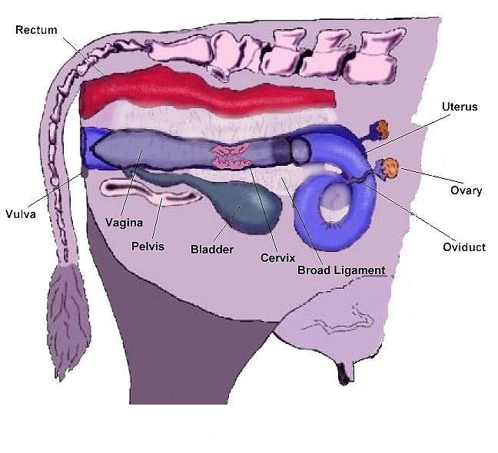
Reproductive System of Cow
Notes:
Experimental—deceleration, disability, supine, mice
Theory—mites, honeybees, identity, probit
Lifespan—primates, etc
Human—self reinforcing, wasp, NBA
Thank
Background
Invasive/Greece/Hawaii
CDFA Medfly panel
Aging research
LBAM
Workshop
Zalom et al
Retreat/Workshop
LMAM see that little changes
New day in science/policy

Slide 5
Reproductive System of Bull
The reproductive tract of a bull has two parts –
1. The testicles, including
Seminiferous Tubules (made up of Leydig cells and Sertoli cells)
2. The secondary sex organs, including…
Epididymis
Vas Deferens
Seminal Vesicle
Prostate Gland
Cowper’s Gland
Urethra and Penis
Notes:
Experimental—deceleration, disability, supine, mice
Theory—mites, honeybees, identity, probit
Lifespan—primates, etc
Human—self reinforcing, wasp, NBA
Thank
Background
Invasive/Greece/Hawaii
CDFA Medfly panel
Aging research
LBAM
Workshop
Zalom et al
Retreat/Workshop
LMAM see that little changes
New day in science/policy

Slide 6
Conti…
Seminiferous tubules, Sertoli Cells & Leydig cells
Each testis is comprised of long, coiling structures called Seminiferous Tubules
Each seminiferous tubule is comprised of connected Sertoli cells
The Sertoli cells are what produce and encourage developing sperm
Leydig cells/interstitial cells are dispersed throughout the testes and produce male hormones (androgens)
Male Hormones are necessary for:
Onset and maintenance of sperm production
Development and maintenance of secondary sex characteristics (organs and features)
Notes:
Experimental—deceleration, disability, supine, mice
Theory—mites, honeybees, identity, probit
Lifespan—primates, etc
Human—self reinforcing, wasp, NBA
Thank
Background
Invasive/Greece/Hawaii
CDFA Medfly panel
Aging research
LBAM
Workshop
Zalom et al
Retreat/Workshop
LMAM see that little changes
New day in science/policy

Slide 7
Conti…
Testis
located outside the body cavity
Produces sperm and testosteron
Scrotum
A pouch of skin containing testicles
Kept the temperature of testis optimum (35 ºC)
Epididymis
Matures and stores sperms, Vas Deferense (Extension, leading towards urethra)
Sperm duct
Carries sperm from the epididymis to urethra
Notes:
Experimental—deceleration, disability, supine, mice
Theory—mites, honeybees, identity, probit
Lifespan—primates, etc
Human—self reinforcing, wasp, NBA
Thank
Background
Invasive/Greece/Hawaii
CDFA Medfly panel
Aging research
LBAM
Workshop
Zalom et al
Retreat/Workshop
LMAM see that little changes
New day in science/policy

Slide 8
Reproductive System of Bull
Urethra
Allows the passage of either urine or semen
Penis
Bull’s reproductive organ that place the semen inside the cow’s body
Seminal vesicles, cowper’s glands and prostate glands
Produces seminal fluids which feeds the sperms and allow them to swim
Sperm and seminal fluids are collectively called as semen
Ampullae of Henle
The vas deferens enlarges inside the pelvis to form the ampullae
Where spermatozoa are stored and mixed with a nutritive substance
FSH and LH are important in stimulating the testes to produce spermatozoa and testosterone.
Notes:
Experimental—deceleration, disability, supine, mice
Theory—mites, honeybees, identity, probit
Lifespan—primates, etc
Human—self reinforcing, wasp, NBA
Thank
Background
Invasive/Greece/Hawaii
CDFA Medfly panel
Aging research
LBAM
Workshop
Zalom et al
Retreat/Workshop
LMAM see that little changes
New day in science/policy

Slide 9
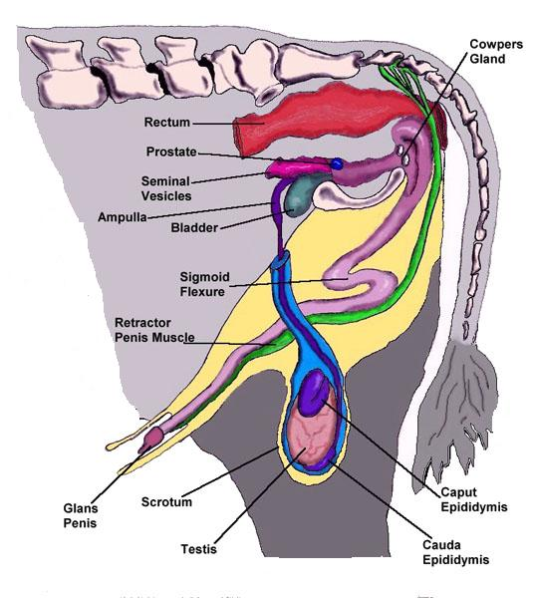
Reproductive System of Bull
Notes:
Experimental—deceleration, disability, supine, mice
Theory—mites, honeybees, identity, probit
Lifespan—primates, etc
Human—self reinforcing, wasp, NBA
Thank
Background
Invasive/Greece/Hawaii
CDFA Medfly panel
Aging research
LBAM
Workshop
Zalom et al
Retreat/Workshop
LMAM see that little changes
New day in science/policy

