Slide 1
Written Communication
How it takes place
Through e-mail or can be sent hardcopy
What it provides
Information, confirmation, requests
Elements affecting communication
Length and word choice important
Media selected – electronic or hard copy
When to use
When impractical to meet
Disseminate information in a timely manner
Notes:
Written Communication
Written communication is generally carried out through internal correspondence to or among the project team and external correspondence to the customer or others external to the firm, such as subcontractors.
Written correspondence is increasingly transmitted through e-mail, but can also be sent as a hardcopy.
Formal project documents that require signatures, such as contracts and amendments, are usually sent as hardcopies.
Memos and letters are ways to efficiently communicate with a group of people when it is impractical to have a meeting or when the information needs to be disseminated in a timely manner.
Written communication should be used only when necessary.
Project participants are usually very busy and do not have time to read trivial messages or irrelevant documents containing information that could be communicated verbally at the next project meeting.
An e-mail may be appropriate as a follow-up to a face-to-face conversation or a phone call confirming decisions or actions, rather than relying on a person’s memory.
Written communication should be used mostly to inform, confirm, and request information.
Memos and letters should be clear and concise and should not include lengthy dissertations or voluminous extraneous attachments.
Project managers want to avoid a perception of being flooded with emails or electronic messages, which is more of a hindrance than a help.
Work related e-mail should not include emoticons or text message abbreviations. It is considered unprofessional, and not all recipients may understand the abbreviations or may misinterpret them. KWIM :-)

Slide 2
The art of good writing
Know your reader

Slide 3
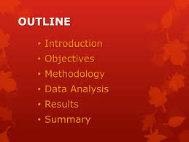
outline

Slide 4
C’S
Of
Writing

Slide 5
5 Cs of writing

Slide 6
Write to express
Simplicity
Force and beauty (comes through words and their arrangement. Evidences should also be added).
Use a natural style
Logical sequence

Slide 7
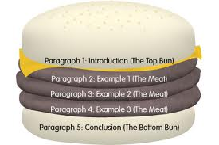
Paragraphing

Slide 8
Headings
Punctuation
Attraction
Be your own editor
Newness

Slide 10
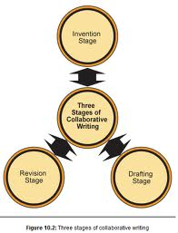

Slide 11
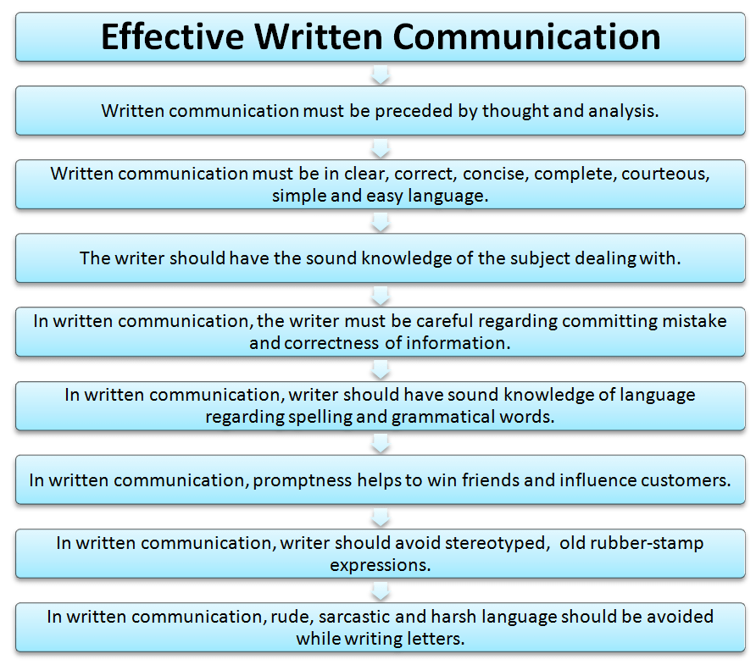

Slide 12
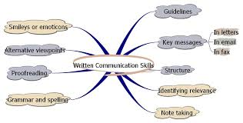

Slide 13
