Slide 1
Variance and Standard Deviation

Slide 2
Variance
Variance is used for measuring variation in data set.
Variance of a set of observation is defined as the average squared deviations from the mean of a set of data.
It is used to find the standard deviation.

Slide 3
Variance formula
For ungrouped data
$Variance=S^{2}=\frac{\sum{{\left(X−\overline{X}\right)}^{2}}}{n}$ for Sample data
Variance=$σ^{2}=$ $\frac{\sum{{\left(X−µ\right)}^{2}}}{N}$ for population
Alternative formula of $Variance=S^{2}=\frac{\sum{X^{2}}}{n}−{\left(\frac{\sum{X}}{n}\right)}^{2}$
For Grouped data
$Variance=S^{2}=\frac{\sum{f.{\left(X−\overline{X}\right)}^{2}}}{\sum{f}}$ for sample data
$Variance=σ^{2}=\frac{\sum{f.{\left(X−µ\right)}^{2}}}{\sum{f}}$ for population dat
Alternative formula of $Variance=S^{2}=\frac{\sum{fX^{2}}}{\sum{f}}−{\left(\frac{\sum{fX}}{\sum{f}}\right)}^{2}$

Slide 4
Standard Deviation
S.D is the positive square root of the mean of the squared deviations of the values from their mean.
Standard Deviation shows the variation in the data.
If the data is close together, the standard deviation will be small.
If the data is spread out, the standard deviation will be large.

Slide 5
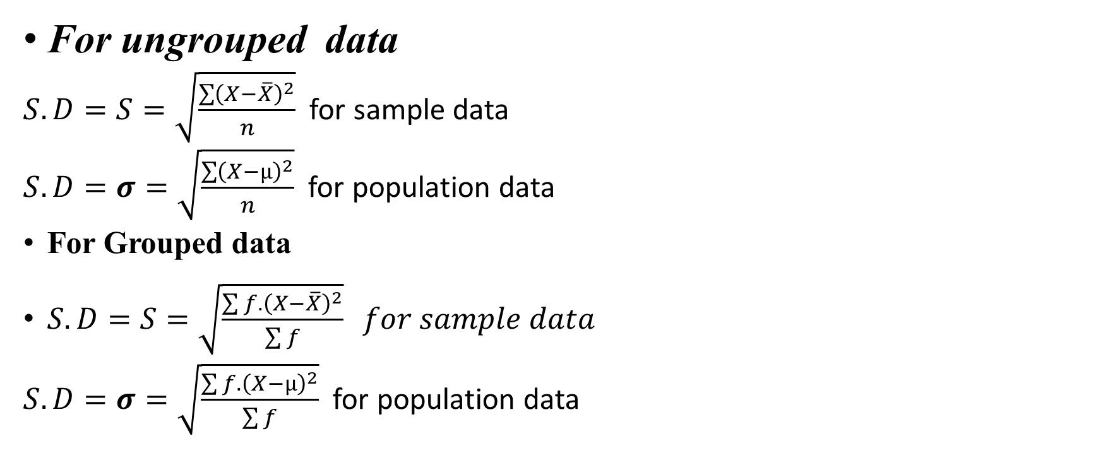
Standard Deviation
For ungrouped data
$S.D=S=\sqrt{\frac{\sum{{\left(X−\overline{X}\right)}^{2}}}{n}}$ for sample data
$S.D=σ=\sqrt{\frac{\sum{{\left(X−µ\right)}^{2}}}{n}}$ for population data
For Grouped data
$S.D=S=\sqrt{\frac{\sum{f.{\left(X−\overline{X}\right)}^{2}}}{\sum{f}}} for sample data$
$S.D=σ=\sqrt{\frac{\sum{f.{\left(X−µ\right)}^{2}}}{\sum{f}}}$ for population data

Slide 6
Variance
Find the mean of the data.
Mean is the average so add up the values and divide by the number of items.
Subtract the mean from each value – the result is called the deviation from the mean.
Square each deviation of the mean.
Find the sum of the squares.
Divide the total by the number of items.

Slide 7

Find the variance and standard deviation
The math test scores of five students are:
92,88,80,68 and 52.
$\overline{X}=\frac{\sum{X}}{n}=\frac{92+88+80+68+52}{5}$=380/5
$$\overline{X}=76$$

Slide 8
X | $$X−\overline{X}$$ | $${\left(X−\overline{X}\right)}^{2}$$
92 | 92-76=16 | 256
88 | 12 | 144
80 | 4 | 16
68 | -8 | 64
52 | -24 | 576
sum | 0 | 1056

Slide 9
$Variance=S^{2}=\frac{\sum{{\left(X−\overline{X}\right)}^{2}}}{n}$= $\frac{1056}{5}=211.2$
For Finding Standard deviation take the square root of the variance.
$S.D=S=\sqrt{\frac{\sum{{\left(X−\overline{X}\right)}^{2}}}{n}}$= $\sqrt{211.2}=14.53$
Thus the S.D of the test score is 14.53

Slide 10
Example2:Find the Variance and Standard deviation of the following data.
Class limits
45-49
50-54
55-59
60-64
65-69
70-74
75-79
80-84
85-89
90-94
95-99
frequency
1
4
17
28
25
18
13
6
5
2
1

Slide 11
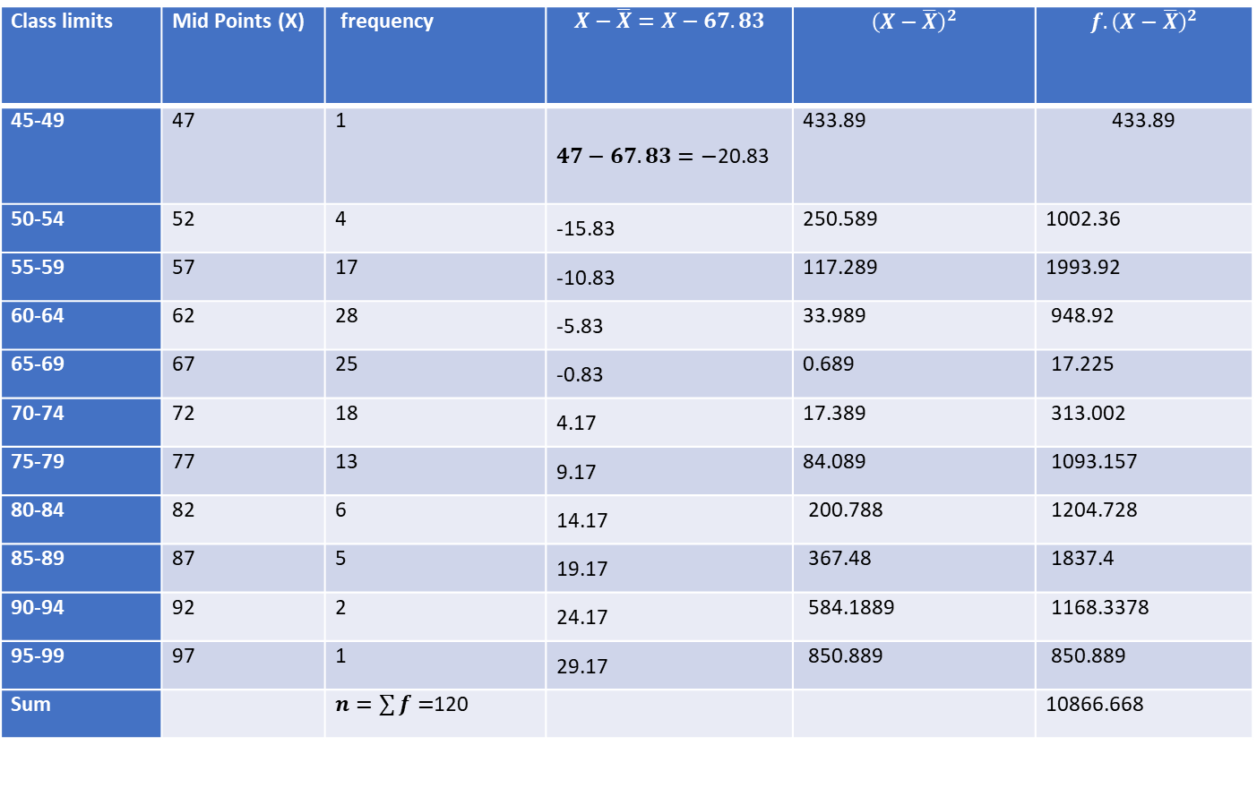
Class limits | Mid Points (X) | frequency | $$X−\overline{X}=X−67.83$$ | $${\left(X−\overline{X}\right)}^{2}$$ | $${f.\left(X−\overline{X}\right)}^{2}$$
45-49 | 47 | 1 | $47−67.83=−$20.83 | 433.89 | 433.89
50-54 | 52 | 4 | -15.83 | 250.589 | 1002.36
55-59 | 57 | 17 | -10.83 | 117.289 | 1993.92
60-64 | 62 | 28 | -5.83 | 33.989 | 948.92
65-69 | 67 | 25 | -0.83 | 0.689 | 17.225
70-74 | 72 | 18 | 4.17 | 17.389 | 313.002
75-79 | 77 | 13 | 9.17 | 84.089 | 1093.157
80-84 | 82 | 6 | 14.17 | 200.788 | 1204.728
85-89 | 87 | 5 | 19.17 | 367.48 | 1837.4
90-94 | 92 | 2 | 24.17 | 584.1889 | 1168.3378
95-99 | 97 | 1 | 29.17 | 850.889 | 850.889
Sum |  | $n=\sum{f=}$120 |  |  | 10866.668

Slide 12

$$Variance=S^{2}=\frac{\sum{f.{\left(X−\overline{X}\right)}^{2}}}{\sum{f}}$$
Variance= $\frac{10866.668}{120}$=90.5
$$S.D=S=\sqrt{\frac{\sum{f.{\left(X−\overline{X}\right)}^{2}}}{\sum{f}}}$$
$S.D=S=\sqrt{\frac{10866.668}{120}}=$ $\sqrt{90.55}$
S=$9.516$

Slide 13
Home Assignment
Q#1)Find the variance and Standard deviation for the following set of data representing trees in California (heights in feet): 3, 21, 98, 203, 17, 9.

Slide 14
Question#2)A sample of college students was asked how much they spent monthly on a cell phone plan(to the nearest dollar). Find Variance and Standard deviation.

Slide 15
Q#3) The following is a frequency distribution of the weight measurements of 40 students of a college. Find mean deviation from mean and mean deviation from median.
Weight(pounds) | Frequency
118-126 | 3
127-135 | 5
136-144 | 9
145-153 | 12
154-162 | 5
163-171 172-180 | 4 2

