Slide 1
MICROPROCESSOR SYSTEMS Week-1
Instructor:
Engr. Yasir Salam
MS Computer Engineering(UET, Lahore)

Slide 2
Basic information about course
Course Code | Course Title | Credit hours
EE-313 | MICROPROCESSOR SYSTEMS | 4(3+1)

Slide 3
Basic information about course
Course Description
Microprocessor Systems is one of the most practical courses for electrical engineers. This course fully utilizes knowledge learned in the fundamentals of digital logic design and programming. Students will learn the architectural issues of simple 1-bit microprocessor concluding to 8086(16-bit) microprocessor architecture. Students will be able to design decoding circuitry for interfacing memory and basic I/O devices with microprocessor. Further, basic I/O controllers for interfacing will be covered in this portion of the course. Students will be able to write and analyze the 8086 assembly language programs containing arithmetic, logic, loop, and program control instructions.

Slide 4
Basic information about course
Course Outline
Introduction to microprocessors and microcontrollers, basic concepts, control unit, internal registers, ALU of an 8-bit or 16-bit microprocessor, timing and sequencing, peripherals and interfacing, memory and I/O synchronization, wait state, hardware single stepping, memory speed requirements, logic levels, loading and buffering. Understanding the instruction set, data transfer, logic operations and branching, programmed I/O interrupts, microprocessor system design, machine code and assembly language programming.

Slide 5
Basic information about course
Course Learning Outcomes (CLOs)
Upon successful completion of this course, the student will be able to:
CLO-1: Explain the basics of microprocessor architecture with an emphasis on 8085 and 8086 processors. [Congnitive-2]
CLO-2: Demonstrate the concepts of interfacing the memory and I/O devices with the microprocessor. [Congnitive-3]
CLO-3: Develop and analyze assembly language programs containing arithmetic, logic, loop, and program control instructions. [Congnitive-4]

Slide 6
Basic information about course
Text Books
Douglas V. Hall, "Microprocessor and Interfacing", Tata McGraw-Hill. 3rd Edition
Charles Gilmore, "Microprocessors: Principles and Application", McGraw- Hill. 2nd Edition
Mazidi, "Programming, Interfacing and Design using 8086"

Slide 7
Basic information about course
Marks Distribution (Theory)
Sessional Marks(Semester work) | 30
Mid-Term Exam | 20
Final-Term Exam | 50
Grand Total | 100

Slide 8
Basic information about course
Sessional Marks Detail (tentative)
Quizzes | 10
Assignments | 15
Class Participation/ Attendance | 05
Grand Total | 30

Slide 9
ENIAC - background
Electronic Numerical Integrator And Computer
Eckert and Mauchly
University of Pennsylvania
Trajectory tables for weapons
Started 1943
Finished 1946
Too late for war effort
Used until 1955

Slide 10
Computer Structure - Top Level
Peripherals
Computer
Central
Processing
Unit
Main
Memory
Computer
Systems
Interconnection
Input
Output
Communication
lines

Slide 11
MICROPROCESSOR SYSTEMS The CPU - MICROPROCESSOR
DEFINITION: “An integrated circuit which performs arithmetic and logical operations on data, as instructed.”
CPU
Computer
Arithmetic
and
Logic Unit
I/O
Registers
System
Bus
CPU
Internal CPU
Interconnection
Memory
Control
Unit

Slide 12
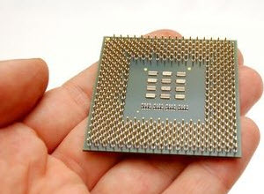
History
INTEL 4004(4 bit) in 1971
740KHz(maximum)
2300 Transistors
INTEL 4040
INTEL 8008(8 bit)

Slide 13
Generations of Microprocessor
1st Generation (4-bit)
1971 to 1973
Intel 4004, 8008, IMP-16
2nd Generation (8-bit)
1973 to 1978
Motorola 6800 and 6801, INTEL-8085 and Zilogs-Z80
3rd Generation (16-bit)
1979 to 1980
INTEL 8086/80186/80286 and Motorola 68000 and 68010 were developed
Four times better speed than 2G

Slide 14
Generation of Microprocessor
4th Generation (32-bit)
1981 to 1995
INTEL-80386 and Motorola’s 68020/68030 were the popular processors
5th Generation (64-bit)
1995 to until now
High-performance
High-speed
Pentium, Celeron, Dual and Quad core

Slide 15
MICROPROCESSOR SYSTEMS TYPES
PURPOSE
GENERAL PURPOSE COMPUTING
APPLICATION SPECIFIC COMPUTING
EMBEDDED COMPUTING
ARCHITECTURE
INSTRUCTION SET
N-BIT ARCHITECTURE

Slide 16
MICROPROCESSOR SYSTEMS MICROPROCESSOR- BASIC STRUCTURE
Control Unit: Controls the operations of the CPU and hence the computer
ALU: Performs the computer’s data processing functions
Registers: Provides storage internal to the CPU
CPU Interconnection(BUS):Some
mechanism that provides for
communication among the
control unit, ALU, and registers

Slide 17
MICROPROCESSOR SYSTEMS MICROPROCESSOR- BASIC STRUCTURE
REGISTERS

Slide 18
MICROPROCESSOR SYSTEMS MICROPROCESSOR- BASIC STRUCTURE
ALU (ARITHMETIC AND LOGIC UNIT)

Slide 19
MICROPROCESSOR SYSTEMS MICROPROCESSOR- BASIC STRUCTURE
CPU Interconnection(BUS):
A collection of wires
Data , control and address
Control Unit:
Its finite state machine
Decode the instruction
Generate outputs for all other modules according to the instruction

Slide 20
Structure - Control Unit
Control Unit
CPU
ALU
Sequencing
Logic
Internal
Bus
Control
Unit
Control Unit
Registers and
Decoders
Registers
Control
Memory

Slide 21
MICROPROCESSOR
2^4x4 RAM
ADRS
W/R
CS
DATA IN
DATA OUT
1

Slide 22
MICROPROCESSOR
FETCH CYCLE
2^4x4 RAM
ADRS
W/R
CS
DATA IN
DATA OUT
FETCH
STATE
0
0 0 0 0
0
1
0 0 0 0
1
1
X
0
0 0 0 0
0
0 0 0 1
0 0 0 0
0 0 0 0
0

Slide 23
MICROPROCESSOR
FETCH CYCLE
2^4x4 RAM
ADRS
W/R
CS
DATA IN
DATA OUT
EXECUTE
STATE
0
0 0 0 0
0
1
0 0 0 0
0 0 0 1
1
1
X
0
0 0 0 0
0
0 0 0 1
0 0 0 0
0 0 0 0
0

Slide 24
MICROPROCESSOR
EXECUTE CYCLE
2^4x4 RAM
ADRS
W/R
CS
DATA IN
DATA OUT
EXECUTE
STATE
1
0 0 0 0
0
0
0 0 0 1
1
0
X
0
0 0 0 0
1
0 0 0 0
0 0 0 0
0

Slide 25
MICROPROCESSOR
EXECUTE CYCLE
2^4x4 RAM
ADRS
W/R
CS
DATA IN
DATA OUT
FETCH
STATE
1
0 0 0 1
0
0
0 0 0 1
1
0
X
0
0 0 0 1
1
0 0 0 0
0 0 0 0
0

Slide 26
MICROPROCESSOR
EXECUTE CYCLE
2^4x4 RAM
ADRS
W/R
CS
DATA IN
DATA OUT
FETCH
STATE
1
0 0 0 1
0
0
0 0 0 1
1
0
X
0
0 0 0 1
0
0 0 0 1
0 0 0 0
1

Slide 27
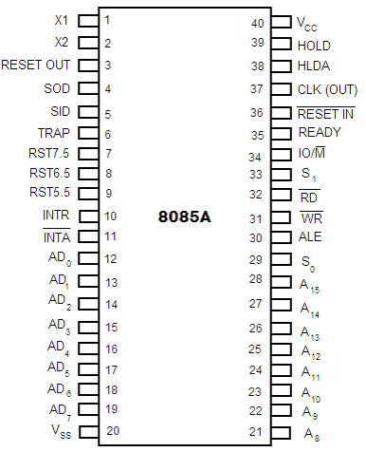
8085 MICROPROCESSOR
8-bit
40-pin IC
+5V for power
Maximum Frequency 3MHz
Data Bus 8-bit
Address Bus 16-bit
Can address 2^16 = 64 KB
of memory

Slide 28
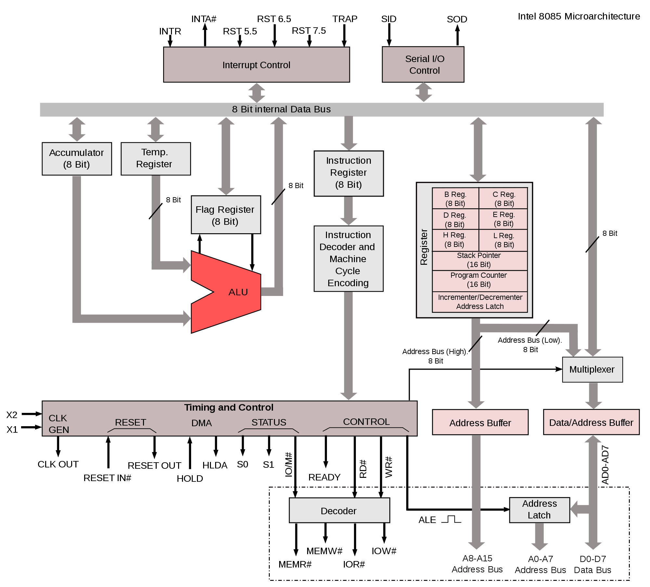
8085 INTERNAL ARCHITECTURE

Slide 29
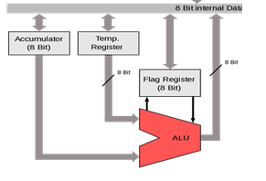
Arithmetic and Logical Unit
ALU performs the actual numerical (Arithmetic) and logical operations
Arithmetic ( Addition, Subtraction, Division and Multiplication
Logical ( AND, OR, etc…)
Takes data from memory and AC(Accumulator)
Results are stored in AC

Slide 30
Registers(General Purpose)
The 8085 has six general-purpose registers to store 8-bit data
Identified as B, C, D, E, H and L
Can be combined as BC, DE and HL
16-bit operations

Slide 31
Registers(Special Function)
The 8085 also has some special function registers (dedicated to perform specific functions)
Accumulator (AC)
8-bit register
Part of ALU
Store data to be used by ALU
Stores Result

Slide 32
Registers(Special Function)
2. Flag Register
Shows the status of different operations performed by the ALU
Zero(Z)
Carry(CY)
Auxiliary Carry(AC)
Parity(P)
Sign(S)

Slide 33
Registers(Special Function)
3. Program Counter (PC)
16-bit
Deals with the sequence of instruction execution
Memory Pointer
Carry the address of from which next byte is to be fetched
Increment by one

Slide 34
Registers(Special Function)
4. Stack pointer(SP)
16-bit register
Point memory location called stack
16-bit address stored the SP
Beginning of stack
5. Instruction Register/Decoder
8-bit register
Stores current instruction
Before execution
Decode and interpret instruction

Slide 35
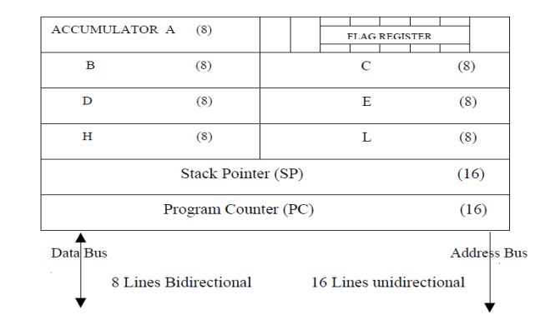
Registers Organization

Slide 36
REVIEW

