Slide 1
Conservation Biology & Global Change

Slide 2
Conservation Biology
integrates ecology, physiology, molecular biology, genetics, & evolutionary biology to conserve biologic diversity at all levels

Slide 3
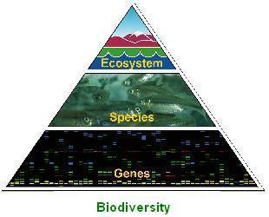
3 Levels of Biodiversity
Genetic Diversity
Species Diversity
Ecosystem Diversity

Slide 4
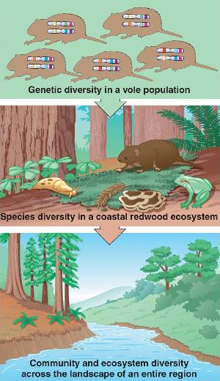

Slide 5
Genetic Diversity
made up of:
individual genetic diversity w/in a population
genetic variation between populations that is often associated with adaptations to local conditions
if 1 population goes extinct: species may have lost some genetic diversity that makes microevolution possible
loss of genetic diversity reduces adaptive potential of a species
microevolution: evolutionary changes below species level; change in allele frequencies in a population over generations

Slide 6
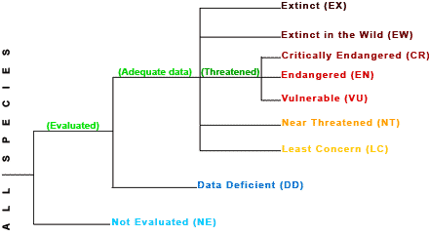
Species Diversity
endangered species: species in danger of extinction throughout all or a significant portion of its range
threatened species: species considered likely to become endangered in near future

Slide 7
Scary Statistics
12% of the 10,000 known species of birds & 21% of the 5,500 known species of mammals are threatened
730 of the 20,000 known plant species in USA are endangered or threatened
>30% of known species of fish in world have become extinct or are seriously threatened during historical times
North America: 123 freshwater animal species have become extinct since 1900; 100’s more are threatened

Slide 8
Ecosystem Diversity
dramatically altered by humans since Europeans “colonized” USA:
> 50% of wetlands have been drained
SW USA ~90% of streamside communities affected by overgrazing, flood control, water diversions, lowering of water tables, invasive species

Slide 9
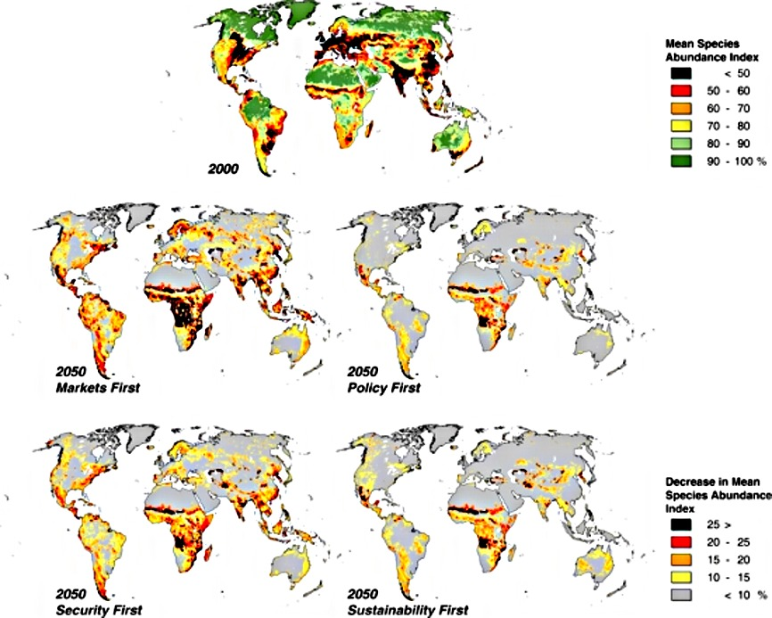

Slide 10
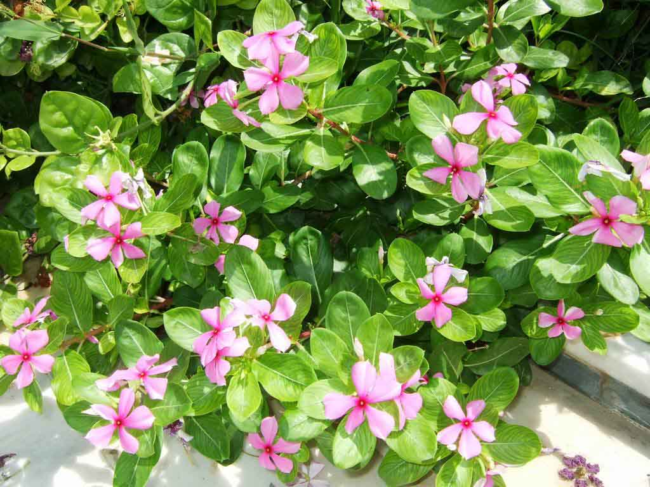
Benefits of Species & Genetic Diversity
many species currently endangered or threatened have potential to provide humans with food, fibers, medicines
in USA ~25% of prescriptions dispensed contain substances originally derived from plants
example: rosy periwinkle contains alkaloids that inhibit cancer cell growth

Slide 11
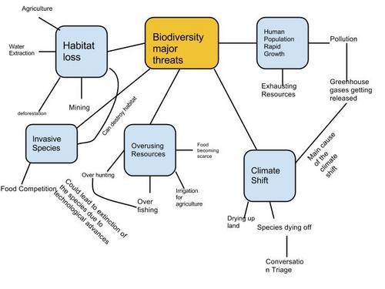
4 Major Threats to Biodiversity
habitat loss
invasive species
overharvesting
global change

Slide 12
Habitat Loss
* human alteration of habitat is the single greatest threat to biodiversity throughout the biosphere
main causes:
agriculture
urban development
forestry
mining
pollution

Slide 13
Introduced Species
aka: non-native species, exotic species are those that humans intentionally or accidentally move from the species’ native locations → new geographic regions
travel in cargo ships, airplanes
new ecosystem: are free of their natural predators, parasites & pathogens that would normally limit their populations
#’s grow rapidly, disrupting new community often by out-competing native species

Slide 14
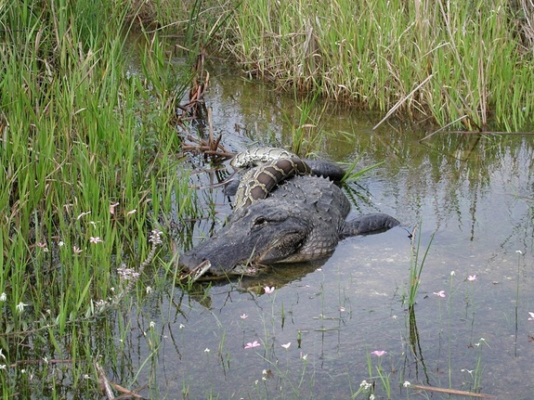
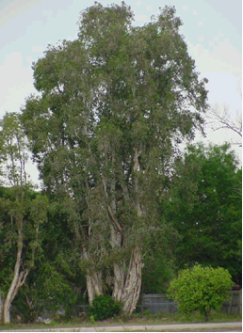
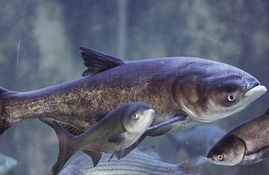
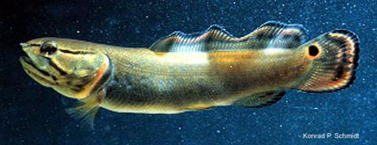

Slide 15
Overharvesting
refers generally to the human harvesting of wild organisms at rates > ability of population to rebound
at risk:
species with restricted habitats
large organisms with low reproductive rates
commercially important fish populations

Slide 16
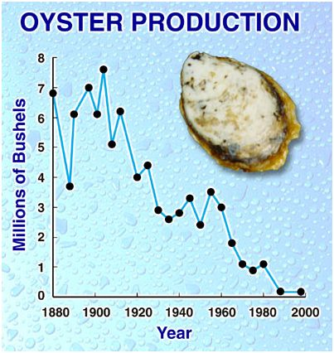
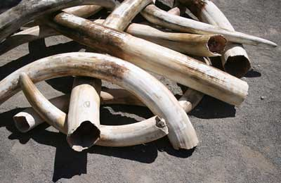
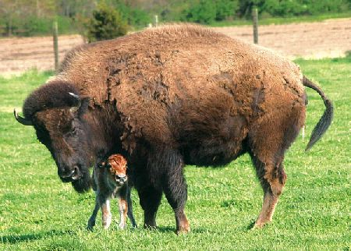
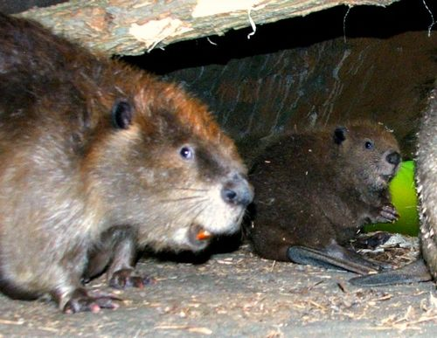

Slide 17
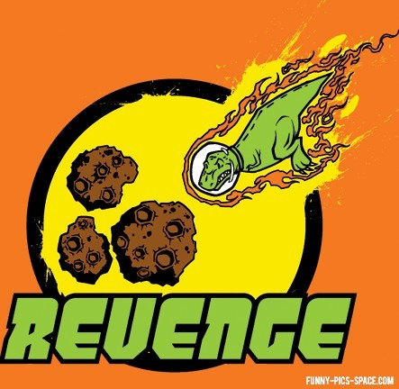

Slide 18
2 Approaches to Work on Conservation Ecology
small-population approach
declining-population approach

Slide 19
Small-Population Approach
threats to biodiversity can decimate #s
a small population’s size can push it into extinction
conservation ecologist study how that happens
extinction vortex: downward population spiral in which inbreeding & genetic drift combine to cause a small population to shrink & unless the spiral is reversed, become extinct

Slide 20
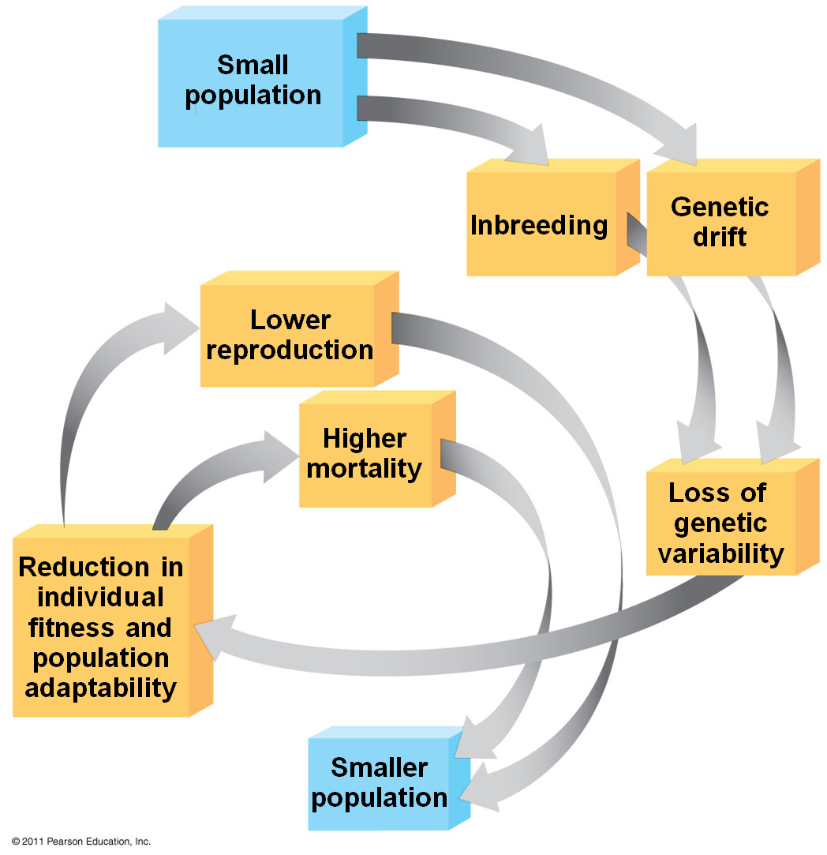
Extinction Vortex
key factor: loss of genetic variation so population less likely to withstand environmental changes

Slide 21
Small Populations
not all doomed:
some do not have low genetic diversity
if do: it does not automatically lead to permanently small populations
example: northern elephant seals down to 20 in 1890s, now up to 150,000 but continue to have low genetic diversity

Slide 22
Minimum Viable Population Size
MVP: minimum population size at which species is able to sustain its #s
when a population drops < MVP will lose genetic variability due to decrease in random mating & genetic drift effect

Slide 23
Effective Population Size
an estimate of the size of a population based on the #s of females & males that successfully breed, generally smaller than total population = Ne
f-female
m-male
used in population viability analysis: predicting chances a population will survive, expressed as % probability of surviving

Slide 24
Declining Population Approach
focuses on environmental factors that cause decline, no matter what the actual population size is
evaluation done on case-by-case basis
5 steps for analyzing declining populations:
confirm species more widespread or abundant in past
study natural history of this & related species
hypothesize all possible causes of decline
test most likely hypotheses
apply results to manage threatened species & monitor its recovery

Slide 25
Weighing Conflicting Demands
often conflicts between protecting species & use of habitat
every endangered species cannot be saved: must determine which species are most important for conserving biodiversity as a whole
do this in part by identifying keystone species
saving keystone species can be central to maintaining communities & ecosystems

Slide 26
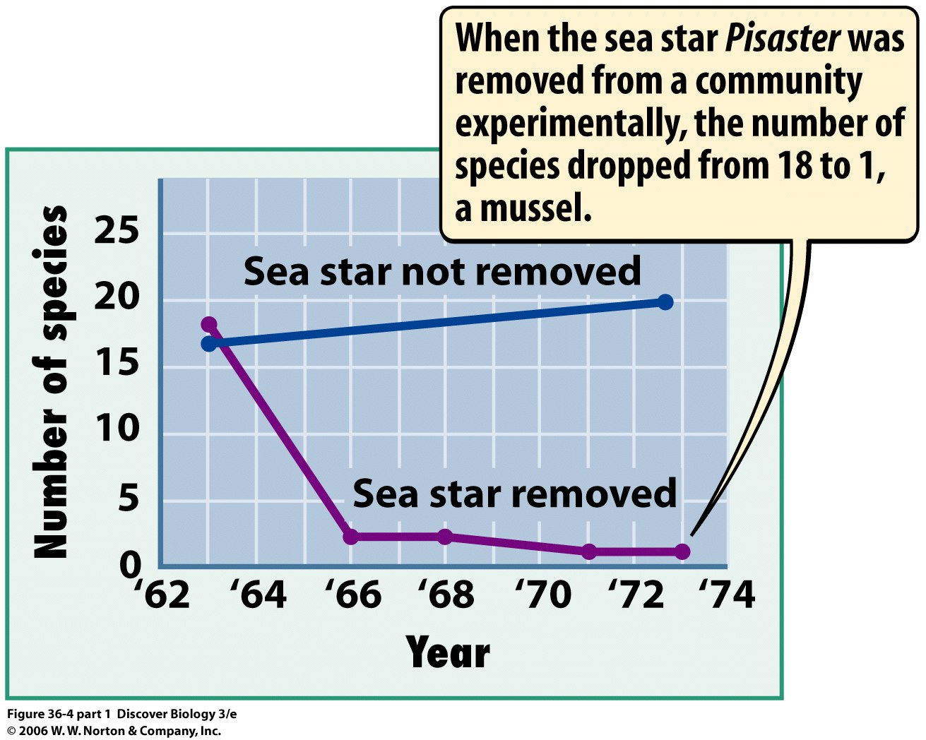

Slide 27
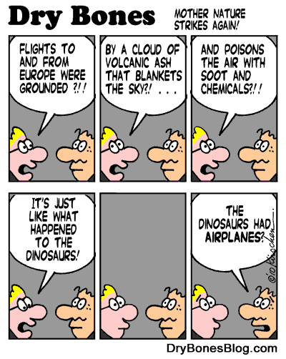

Slide 28
Landscape Structure & Biodiversity
biodiversity of given landscape largely a function of the structure of the landscape
boundaries between ecosystems are defining features
some species thrive where 2 ecosystems overlap: gain resources from both
proliferation of edge species can be +/-
can be sites of speciation

Slide 29
Movement Corridors
narrow strip or series of small clumps of habitat connecting otherwise isolated patches can be crucial to preserving biodiversity
areas high human use: building bridges, tunnels reduces #s animals killed in traffic

Slide 30
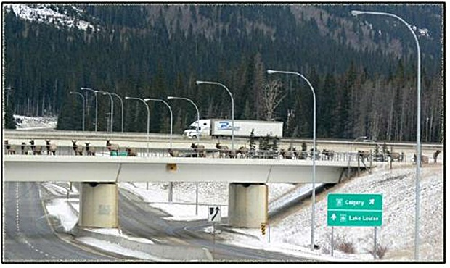

Slide 31
Biodiversity Hot Spots
relatively small area with numerous endemic species (species found nowhere else on Earth) & a large # od endangered or threatened species
~30% of all bird species found in hot spots that make up ~2% of Earth’s land mass

Slide 32
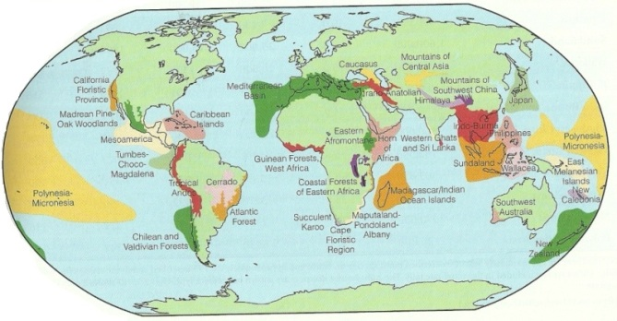

Slide 33
Nature Reserves
are biodiversity islands in a sea of habitat degraded by human activity
generally, ecosystems are balanced, self-regulating units that adjust to disturbances
as conservation biologists have studied ecosystem: our national parks are too small

Slide 34
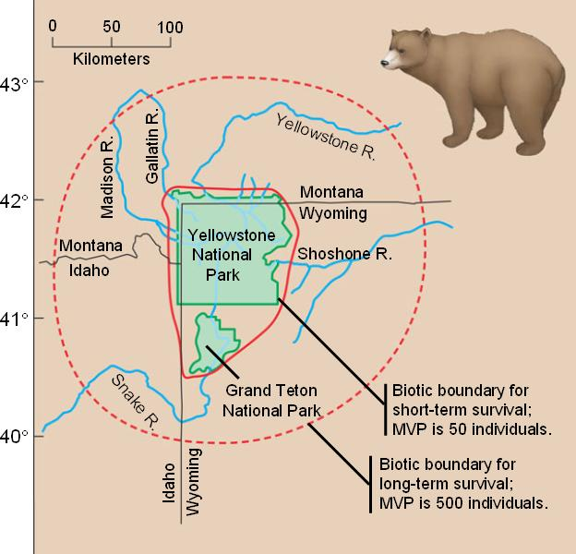

Slide 35
Zoned Reserves
an extensive region that includes areas relatively undisturbed by humans surrounded by areas changed by humans & are used for economic gain
challenge: develop surrounding area so there is long-term viability of protected core
example: Costa Rica world leader in establishing zoned reserves

Slide 36
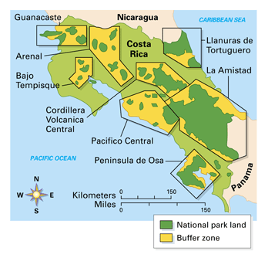

Slide 37
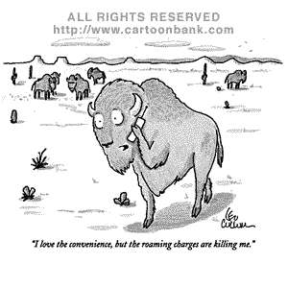

Slide 38
Changing Earth
environmental changes that result from human activity creating new challenges
as climate changes: areas we preserve today may not be suitable in future

Slide 39
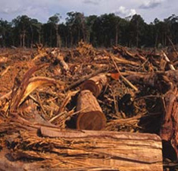
4 types of Environmental Changes Caused by Humans
nutrient enrichment
toxin accumulation
climate change
ozone depletion

Slide 40
Nutrient Enrichment
humans often remove nutrients from 1 part of biosphere & add them to another
example:
farming:
produce grown 1 place → consumed in another
fertilizers (N, P from somewhere else) added to fields → runoff takes these nutrients → streams [depleting 1 area → increasing another]
add toxic chemicals (herbicides) → runoff → streams

Slide 41
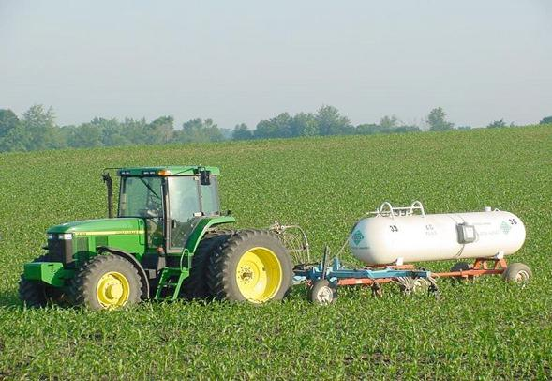

Slide 42
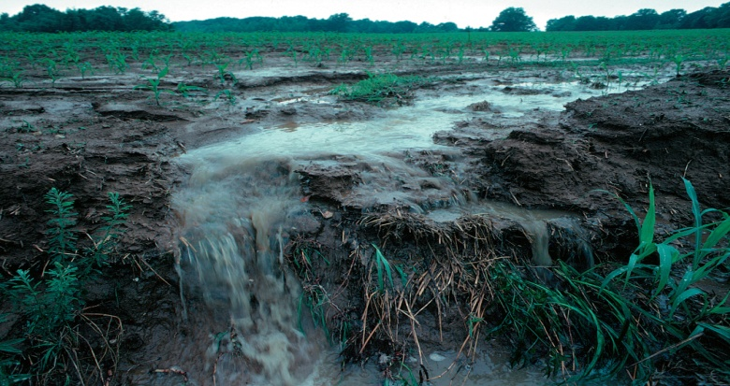
Critical Load
amt of added nutrient (usually N or P) that can be absorbed by plants w/out damaging ecosystem integrity
example: N levels in some areas → ground water → unsafe for drinking

Slide 43
Toxin Accumulation
humans release immense amt of toxic chemicals, including synthetic chemicals totally foreign to any ecosystem
some chemicals taken up by organisms → metabolized or excreted, others accumulate in specific tissues (often fat)

Slide 44
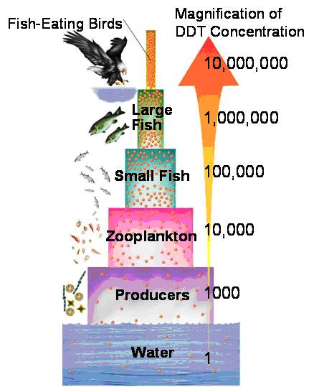
Biological Magnification
process in which retained substances become more concentrated at each higher trophic level in a food chain
many toxins cannot be biodegraded by microorganisms & persist for decades

Slide 45
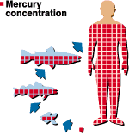
Chlorinated Hydrocarbons
a class of industrially synthesized cpds that have demonstrated biomagnification
includes PCBs (polychlorinated biphenyls) & many pesticides, heavy metals

Slide 46
Biomagnification of PCBs in Great Lakes
concentration of PCBs in gull eggs (top of food chain) ~5,000 x that in phytoplankton (base of food chain)

Slide 47
Greenhouse Effect
rising greenhouse gas levels are changing Earth’s heat budget
increasing heat capture in atmosphere changes climate →
many organisms that cannot disperse rapidly over long distances may not be able to survive
more fragmentation of habitats
ecologists debated benefits of assisted migration (translocation of a species to more favorable habitat)

Slide 48
Greenhouse Gases & Global Warming

Slide 49
Depletion of Ozone
human activities has also changed ozone (O3) concentrations in stratosphere (use of CFCs: chlorofluorocarbons)
CFCs reduce O3 → O2
ozone protects us from most of UV radiation from Sun

Slide 50
How Free Chlorine Destroys Ozone

Slide 51
Sustainable Development
can improve human lives while conserving biodiversity
sustainable development: economic development that meets the needs of people today w/out limiting ability for future generations to meet their needs
Ecological Society of America (world’s largest org of ecologists) have Sustainable Biosphere Iniative
Goal: define & acquire the basic ecological information needed to develop, manage, & conserve Earth’s resources as responsible as possible

Slide 53
Biophilia
idea that we evolved in natural environments rich in biodiversity ….we still have affinity for natural settings
E. O. Wilson: our biophilia is innate, an evolutionary product of natural selection acting on a brainy species whose survival depended on a close connection to the environment & a practical appreciation of plants & animals

Slide 54
