Slide 1
Introduction to Poultry Science
By
Abd-Ur-Rehman
Lecturer
Department of Animal Sciences
University of Sargodha

Slide 2
POULTRY
The term poultry is designated to those species of birds, which are economical and can reproduce freely under human care. It includes chickens, ducks, turkeys, pheasants, pigeons, guinea fowl and partridges etc.
POULTRY SCIENCE
Poultry science is the study of principles and practices involved in the production and marketing of poultry and its products. It includes Breeding, Housing, Nutrition, Management, Disease control and marketing.
Generally term “Poultry” is used only for chickens, which serve as most economical source of animal protein food and zoologically are named as Gallus domesticus.

Slide 3
BROILER
Broilers are those fast growing poultry birds of young age which are kept and used only for meat purpose and produce tender meat with soft pliable and flexible breast bone cartilage. They attain live body weight of 1.5 kg or more by consuming 2.75-3.00 kg of feed in 37-42days.

Slide 4
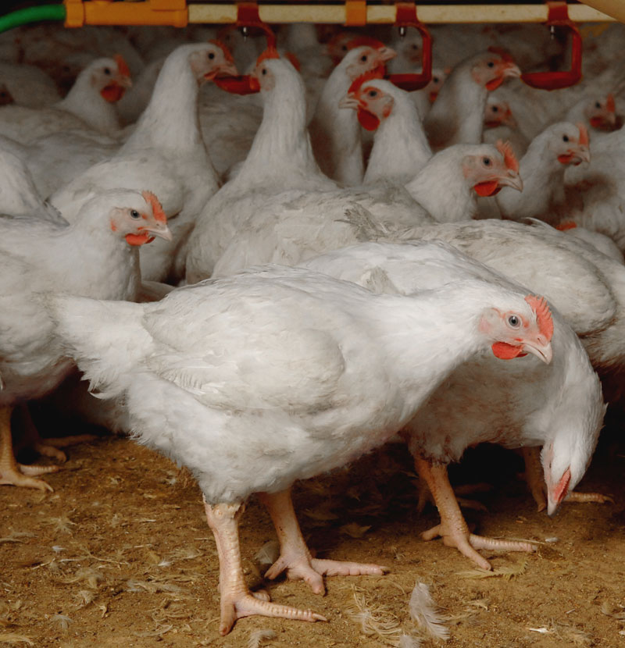

Slide 5
LAYER
Which lay table quality egg (for food of human consumption). Laying starts from 17 weeks and may lay 150 to 300 eggs per year.
BREEDERS
Birds of both sexes which are kept for breeding purpose to obtain fertilized eggs for hatching to get chicks i.e. broilers or layers.

Slide 6
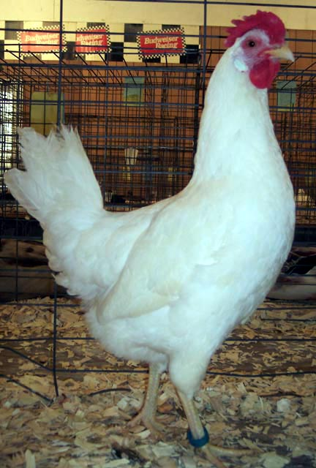
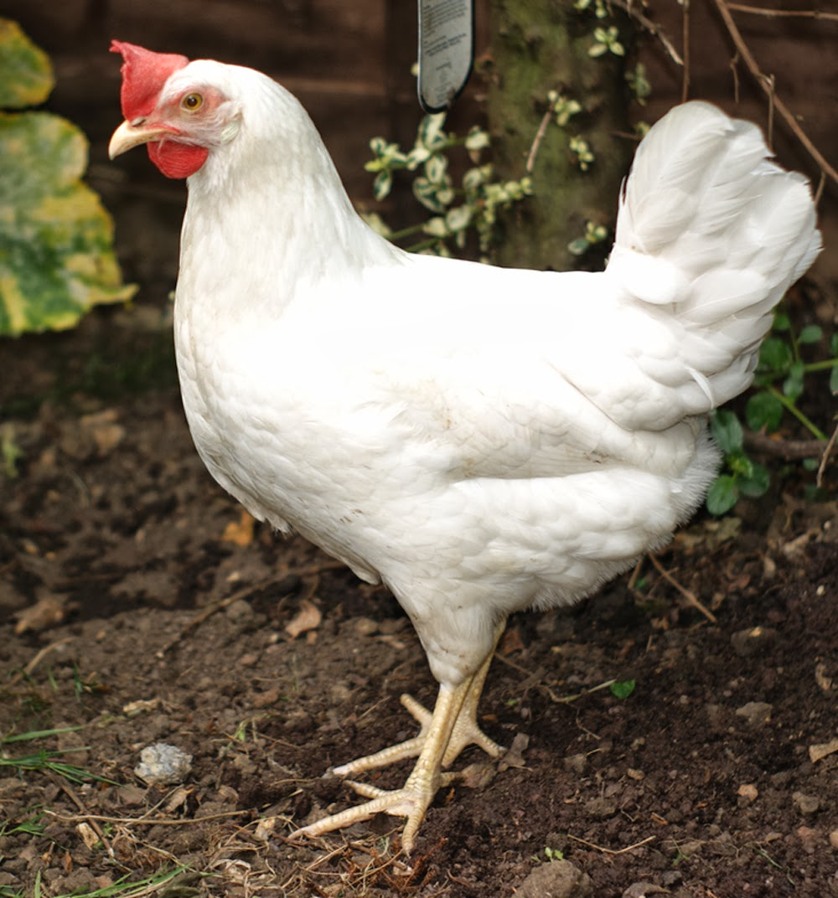

Slide 7
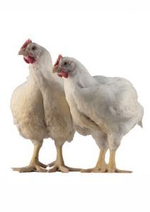
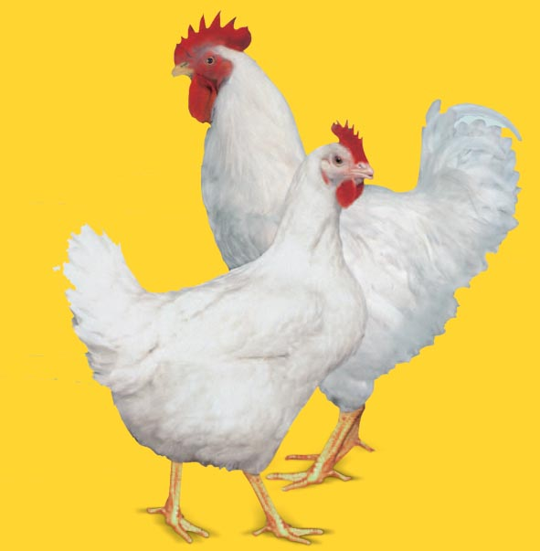

Slide 8
IMPORTANCE OF POULTRY
The importance of poultry can be imagined from the fact that the meat of birds will be provided to the Muslims in Al Janet.
The study about birds is religious because there are different sayings about birds in Holy Quran (i.e.).
Sometimes the "Praise of the Birds" is mentioned, at other places, humans are likened to birds. Sending birds upon the evil forces of Abraha powered by the Elephant is another occasion and finally the existence of birds in Salmon’s (peace be upon him) company and his familiarity of their language is also mentioned in the Quran. The events relating to Prophet Abrahim (peace be upon him) and the creation of birds by Jesus Christ (peace be upon him) and four birds are also present in the Quran.

Slide 9
IMPORTANCE OF POULTRY FARMING
It provides egg and meat, which are highly nutritive supplementing foods and have high quality protein.
It provides source of income and opportunities of employment at poultry farms, hatcheries, poultry processing units, equipments manufactures, meat and egg marketing channels etc.
In rural areas, since less investment is required to start the enterprises, it has attained a status of “Cottage Industry”.
Quick returns can be expected from the investment.
Poultry manure is extremely rich source of nitrogen and organic matter. It contains 1.0-1.8% nitrogen. 1.4-1.8% P₂O₂ and 0.8-0.9% K₂O hence is very good fertilizers.
In animal and medical research, birds are used as experimental unit.

Slide 10
PREFERENCE OF POULTRY FARMING OVER LIVESTOCK AND AGRICULTURAL SECTION
Size of bird is smaller than other larger animals.
Physiology of birds is simpler.
Birds have shorter maturity period.
Fertility rate is high.
Life span is short which can be extended in layers and breeders.
Balanced feed for birds can be easily managed.
They have simple digestive system.
Less land is required due to less space requirement per bird.
Poultry is quick and efficient converter of inputs into out puts.

Slide 11
Birds have the best feed conversion ratio (FCR) and feed efficiency.
Embryo development takes place outside rather than inside the body of dam through placenta.
Incubation period of chicken is shorter (21 days) while large animals have long gestation period.
There is a continuous return of income while in case of Agriculture; land, seasons, labor, seeds etc. required in fairly high amount and income return is based on yearly basis while, poultry farming makes the least demand of land than crop production and give maximum yield per unit area.
Dressing percentage is more (60%) in poultry as compared to large animals (50-55%).
Several crop by-products and agricultural wastes are used in poultry feeding.
Poultry farming is within the reach of small farmers and offer good opportunity for investors with limited financial resources.

Slide 12
ADVANTAGES OF POULTRY FARMING
Essential food items
Quick return of high quality protein
Efficient source of high quality protein
Income throughout the year
Quick turn-over of capital
Part time as well as full time occupation
Managed by Ladies and Children

Slide 13
GROWTH OF POULTRY FARMING IN PAKISTAN
Prior to 1963, there was no commercial poultry farming
PIA established the first modern hatchery at Karachi in 1965, in collaborations with Shaver, a Canadian firm
It has now reached a stage where its impact on the national economy is increasingly felt in the following ways.
Increase in GDP.
More Job opportunities to people both in government and private sectors.
Reduction in demand pressure for animal protein food i.e. beef, mutton, or milk.

Slide 14
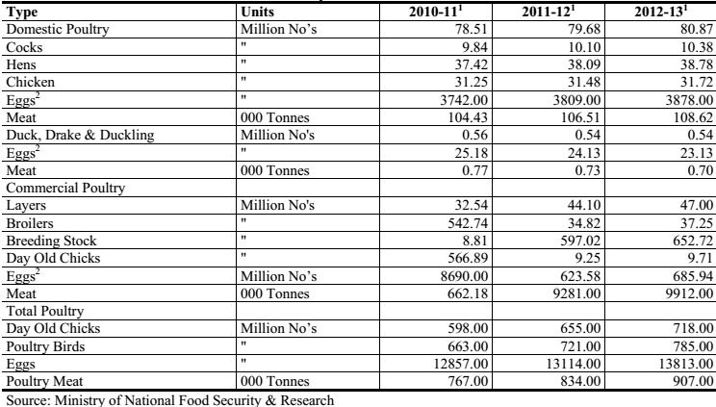
AN OVERVIEW OF PAKISTAN POULTRY INDUSTRY

Slide 15
Present Status
Presently turnover of Pakistan Poultry Industry is about 1,168 Billion rupees.
Poultry sector generates employment and income for about 1.5 million people.
Poultry sector is one of the most organized branches of the agro based sector of Pakistan. Its growth rate is 10-12% per annum.
At present over 190 billion rupees worth of agriculture produce and by products of agriculture are being used in poultry feeds.
There are over 15000 poultry farms spread deep into the rural areas across the country from Karachi to Peshawar .Capacity of farms range from 5,000 to 500,000 broilers.
Marketing channels of broilers and eggs are predominantly in the unorganized sector.
40-45% of the total meat consumption is being procured from poultry products

Slide 16
Present Status
Poultry Slaughterhouses, Processing/Value Addition in organized sector is 5-6%
Annually we are producing 17,500 million table eggs.
Annually we are producing 1,440 million kilo grams chicken meat.
In our country per capita consumption of meat is only 7.20 kilo grams and 88 eggs annually. Whereas developed world is consuming about 40 kilo grams meat and over 300 eggs per capita per year.
As per standard of World Health Organization, daily requirement of animal protein for a person is 27 grams whereas public is consuming 17 grams only. Therefore we are already consuming less animal protein as per required standards.

Slide 17
Recommendations for improvement of Poultry Production
Poultry farm management on scientific lines and under control of trained staffs.
Quality chick production and supply in shorter period
Quality feed produced by using qualitative feed ingredients and its assurance by poultry feed law
Poultry' meat production, processing and marketing
Egg production, storage, processing and marketing
Using poultry waste as a energy production source
Poultry by product processing

