Slide 2
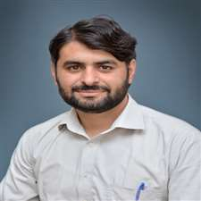
Prepared and Presented By:
Muhammad Wasay Shahid………DPRF18E034
Presented To:
Sir Taseer Ahmed (MPhil Pharmacology)
Lecturer Pharmacology, Faculty of Pharmacy,
University of Sargodha.

Slide 3
Case Study of Bone Marrow Tuberculosis

Slide 4
An Intro to Tuberculosis (TB)
It is an infectious disease caused by Mycobacterium Tuberculosis (MTB) bacteria.
It affects lungs mostly but can affect other parts of body.
Most infections are asymptomatic called as latent TB but 10% of cases move towards active TB disease and can lead to death (50% cases of active TB) if untreated.
It is curable disease with extensive drug therapy. Duration of treatment may range from 6 months to 12 months (In case of brain TB).

Slide 5
The classic symptoms of active TB are a chronic cough with blood-containing mucus, fever, night sweats, and weight loss.
It is historically called consumption due to weight loss.
Extrapulmonary TB may also cause a wide range of other symptoms.
It is diagnosed by Mantoux`s Test, Chest X-ray and QuantiFERON TB Gold test.
Pulmonary TB is transmitted by sneeze, spit, cough and speak.
Urdu: تپ دق
German: Lungenschwindsucht

Slide 6
Types of TB
Pulmonary TB
Extrapulmonary TB
Tuberculosis Meningitis
Pleural TB
Pericardial TB
Lymph node TB
GIT TB
Genitourinary TB
The dissemination of infection to other parts of body is known as disseminated
TB.
Miliary TB is potentially fatal form of TB due lymphohematogenous dissemination of MTB. It is mostly seen in patients with HIV/AIDS

Slide 7
Pathophysiology
There are two phase asymptomatic (Latent TB) and symptomatic (Active TB).
The antigen enters (Bone marrow, lungs, meningitis e.t.c) and it gets surrounded by macrophages.
TB is actually known as Granulomatous Inflammatory Disease as granulomas form at the site of infection.
Antigen is surrounded by macrophages, thus more macrophages, epithelioid cells, T and B lymphocytes, fibroblasts aggregate to form granulomas with lymphocytes surrounding the macrophages.
There must be a generated immune response but macrophages and dendritic cells fail to present antigen so immune response is suppressed. Thus bacteria is protected and if dormant in the granuloma so it is in the latent phase.
Next picture shows the process of Granulomatous Formation

Slide 9
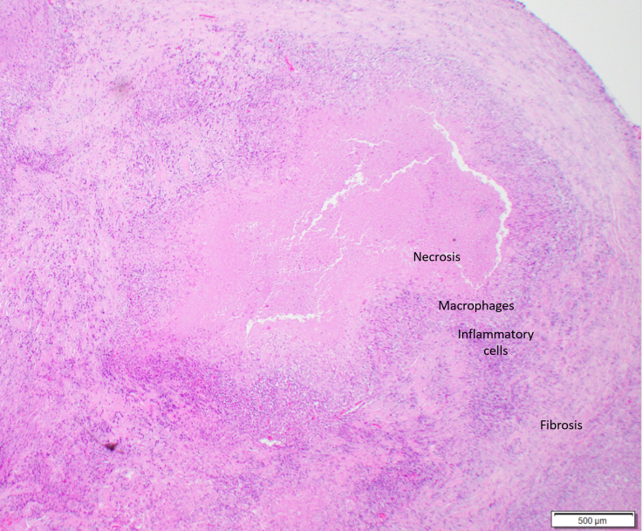
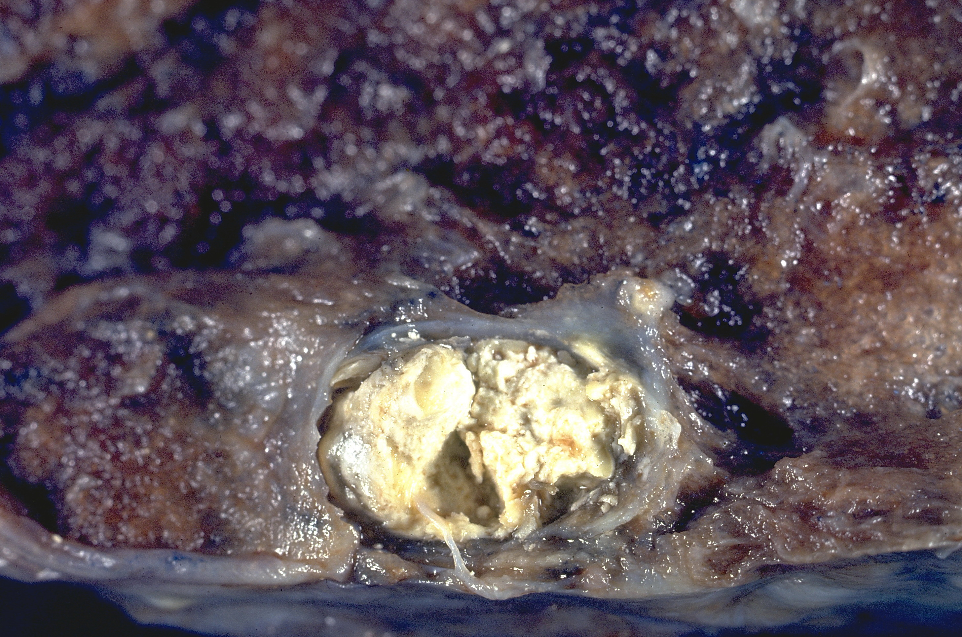
These granulomas or tubercles have another feature. There is a development of necrosis in the center of these tubercles. To naked eye it looks like soft, white cheese like and are called caseous necrosis. Caseous necrosis is the hallmark of TB.

Slide 10
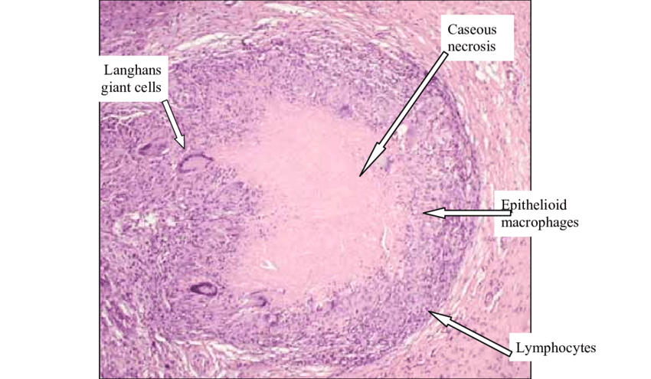

Slide 11
Case study- Bone Marrow TB
Patient Name: Shahid Mahmood
Age: 64 years
Designation: Retired
Marital Status: Married
Gender: Male
Past Medical history: T2DM patient and Renal Calculi (Kidney Stones)
Initial Symptoms: Started during March 2019 with development of fever (), shivering and at one or two instances vomiting.
Test Conducted initially: Subsequent CBCs showing thrombocytopenia and lymphocytosis.
Platelets decreased from 1,26000/uL to 95,000/uL (range 1,50000 to 4,50000)
Lymphocytes were more than 50% (range is 20 to 40%).

Slide 12
Patient referred to AFIP, Rawalpindi for Bone Marrow Examination.
1. Bone marrow Aspiration:
Thrombocytopenia and lymphocytosis
Active Myelopoiesis with dysplasia
Depressed Erythropoiesis
Aparticulate bone marrow with cellular trials.
2. Bone Marrow Trephine Biopsy
Increased fibroblastic activity
Formation of granuloma and caseous necrosis.
Recommendations for TB workup.

Slide 13
Due to dysplasia shown in myelopoiesis the patient had been further referred to Immunophenotyping for Leukemia. That was negative NO ABNORMAL GROWTH WAS OBSERVED. The patient was tested for TB by QuantiFERON TB Gold Test (Interferon Gamma Release Assay or IGRA).
IGRA Results:
Positive Results with value of 0.48 IU/ml.
If results are greater than 0.35 IU/ml. then TB is positive.
BONE MARROW TB WAS DIAGNOSED IN MAY 2019

Slide 14
Course of Treatment
Myrin P forte from May till End of July 2019 (as a first line
treatment). 5 tabs. before breakfast.
Myrin P forte contains : Isoniazid, rifampicin, Ethambutol and
Pyrazinamide.
Moxiget (Moxifloxacin) as an adjuvant therapy.
Grasil Injection (Amikacin Sulphate) for 1.5 month as adjuvant
Risek (Omeprazole) 1+0+1
Ganaton (Itopride Hydrochloride)
Estar (Escitalopram). 1 tab. after breakfast
Vitamin B6 tablets.

Slide 15
MOA of TB drugs
Isoniazid (INH): Works by inhibiting mycolic acid and cell wall destruction as well as DNA synthesis.
Rifampicin (R): Works by inhibiting DNA-dependent RNA Polymerase, thus blocking mRNA synthesis and protein synthesis.
Ethambutol (E): Inhibits RNA synthesis and bacterial growth.
Pyrazinamide (PZA): It is converted into pyrazinoic acid (POA) by pyrazinamidase released by MTB. POA decreases the pH so that bacterial growth is retarded and inhibiting F.A synthesis.
Moxifloxacin: A fluoroquinolone antibiotic. It functions by inhibiting DNA gyrase, a type II topoisomerase, and topoisomerase IV, enzymes necessary to separate bacterial DNA, thereby inhibiting cell replication.
Amikacin Sulphate: An aminoglycoside antibiotic. It binds to bacterial 30S ribosomal subunits and interferes with mRNA binding and tRNA acceptor sites, interfering with bacterial growth.

Slide 16
From August 2019 till 30 January 2020. Myrin P was prescribed.
The patient started to feel problems with vision. Fundoscopy and Topography was performed from Shifa International Hospital. Topography had shown Optic Nerve toxicity caused by Ethambutol. Thus he was prescribed Isoniazid and Rifampicin.
The patient was given treatment of approximately 10 months and the treatment is stopped.
The patient also caused muscle tear and myositis at regions of shoulder and biceps due to over-exertion.

