Slide 1
Why is color theory important in art?
Color theory is one of the most fundamental areas of painting/Design. The importance of understanding color theory far exceeds simply knowing how to mix colors together (for example, knowing that yellow and blue make green). ... Color theory will help you understand the relationship between colors and how we perceive them. How we can communicate with.z the help of colours.

Slide 2
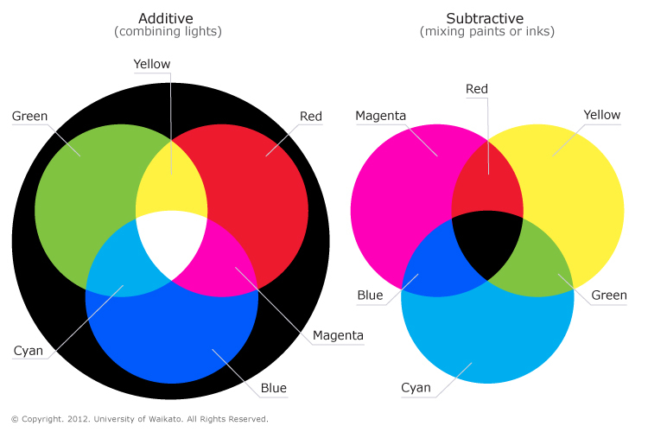
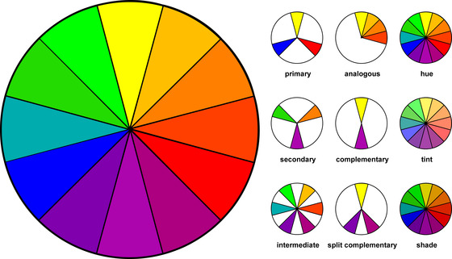
Color
Typically known as hue. This word represents a specific color or light wavelength found in the color spectrum, ranging circularly from red to yellow, green, blue and back to red.

Slide 3
What are the different color theories?
Color theory covers a multitude of definitions, concepts and design applications - enough to fill several encyclopedias. However, there are three basic categories of color theory that are logical and useful : The color wheel, color harmony, and the context of how colors are used.
Color theories create a logical structure for color. For example, if we have an assortment of fruits and vegetables, we can organize them by color and place them on a circle that shows the colors in relation to each other.

Slide 4
Color Harmony
Harmony can be defined as a pleasing arrangement of parts, whether it be music, poetry, color, or even an ice cream sundae. In visual experiences, harmony is something that is pleasing to the eye. It engages the viewer and it creates an inner sense of order, a balance in the visual experience. When something is not harmonious, it's either boring or chaotic. At one extreme is a visual experience that is so bland that the viewer is not engaged. The human brain will reject under-stimulating information. At the other extreme is a visual experience that is so overdone, so chaotic that the viewer can't stand to look at it. The human brain rejects what it cannot organize, what it cannot understand. The visual task requires that we present a logical structure. Color harmony delivers visual interest and a sense of order.

Slide 5
Color Design and Psychology for Branding
Brands and color are inextricably linked because color offers an instantaneous method for conveying meaning and message without words.
Branding is a word commonly referred to by advertisers and marketing people, but what does it actually mean? Marketing experts define "brand" as the "name, term, sign, symbol or design, or a combination of them intended to identify a company's products or services." In other words, a brand communicates the "idea" of company or product. This is what forms the connection with consumers.

Slide 6
For example, in the illustration of the 3 brand images:
The JAL (Japan AirLines) image has several components: The bird symbolizes flight and the color red communicates power. Red also symbolizes good luck in Asia. The circle and the color red reference the flag of Japan. Therefore, the brand image communicates powerful air transportation from a Japanese company — and good luck with the journey.
The AT&T image is an award-winning design. The globe symbolizes a world circled by electronic communications. More specifically, the symbol is made up of very carefully delineated 'highlight' and 'shadow' elements. As a result, the symbol may be reproduced to give the impression of a three-dimensional sphere that is lighted from a distance source. Test yourself on what blue symbolizes.
The UPS (United Parcel Service) image is an excellent example of how a single color communicates meaning. Brown symbolizes dependability and solidity. (It is not a snobby color; it is not high technology; brown is grounded in the earth.)

