Slide 1
Introduction to Planography
Planographic printing means printing from a flat surface, as opposed to a raised surface (as with relief printing) or incised surface (as with intaglio printing). Lithography and offset lithography are planographic processes that rely on the property that water will not mix with oil. The image is created by applying a tusche (greasy substance) to a plate or stone. (The term lithography comes from litho, for stone, and -graph to draw.) Certain parts of the semi-absorbent surface being printed on can be made receptive to ink while others (the blank parts) reject it.

Slide 2
What is the meaning of Planography?
Planographic printing means printing from a flat surface, as opposed to a raised surface (as with relief printing) or incised surface (as with intaglio printing). Lithography and offset lithography are planographic processes that rely on the property that water will not mix with oil.

Slide 3
Some examples
Indian artists who have used planographic printmaking techniques include Ramkinkar Baij, Somnath Hore, M.F. Husain, Tyeb Mehta and V.S. Gaitonde. Raja Ravi Varma's oleographs are well known all over the world.

Slide 4
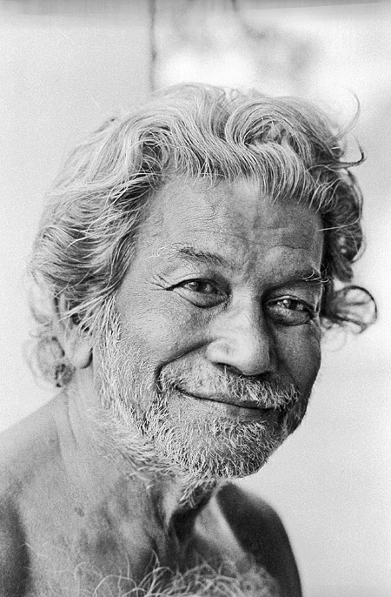
Ramkinkar Baij (26 May 1906 – 2 August 1980) was a sculptor and painter. He was one of the pioneers of modern Indian sculpture and a key figure of contextual modernism. Baij was born in an economically modest family in the Bankura district of the modern state of West Bengal in India.

Slide 5
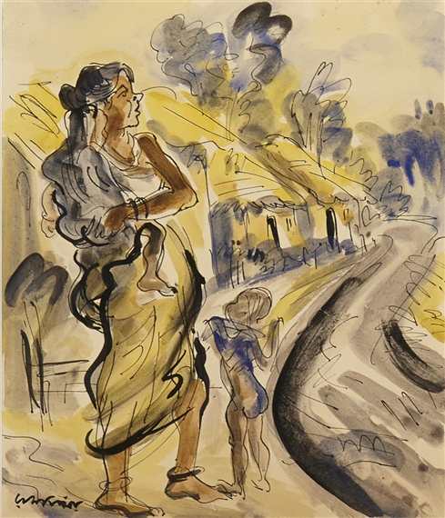

Slide 6
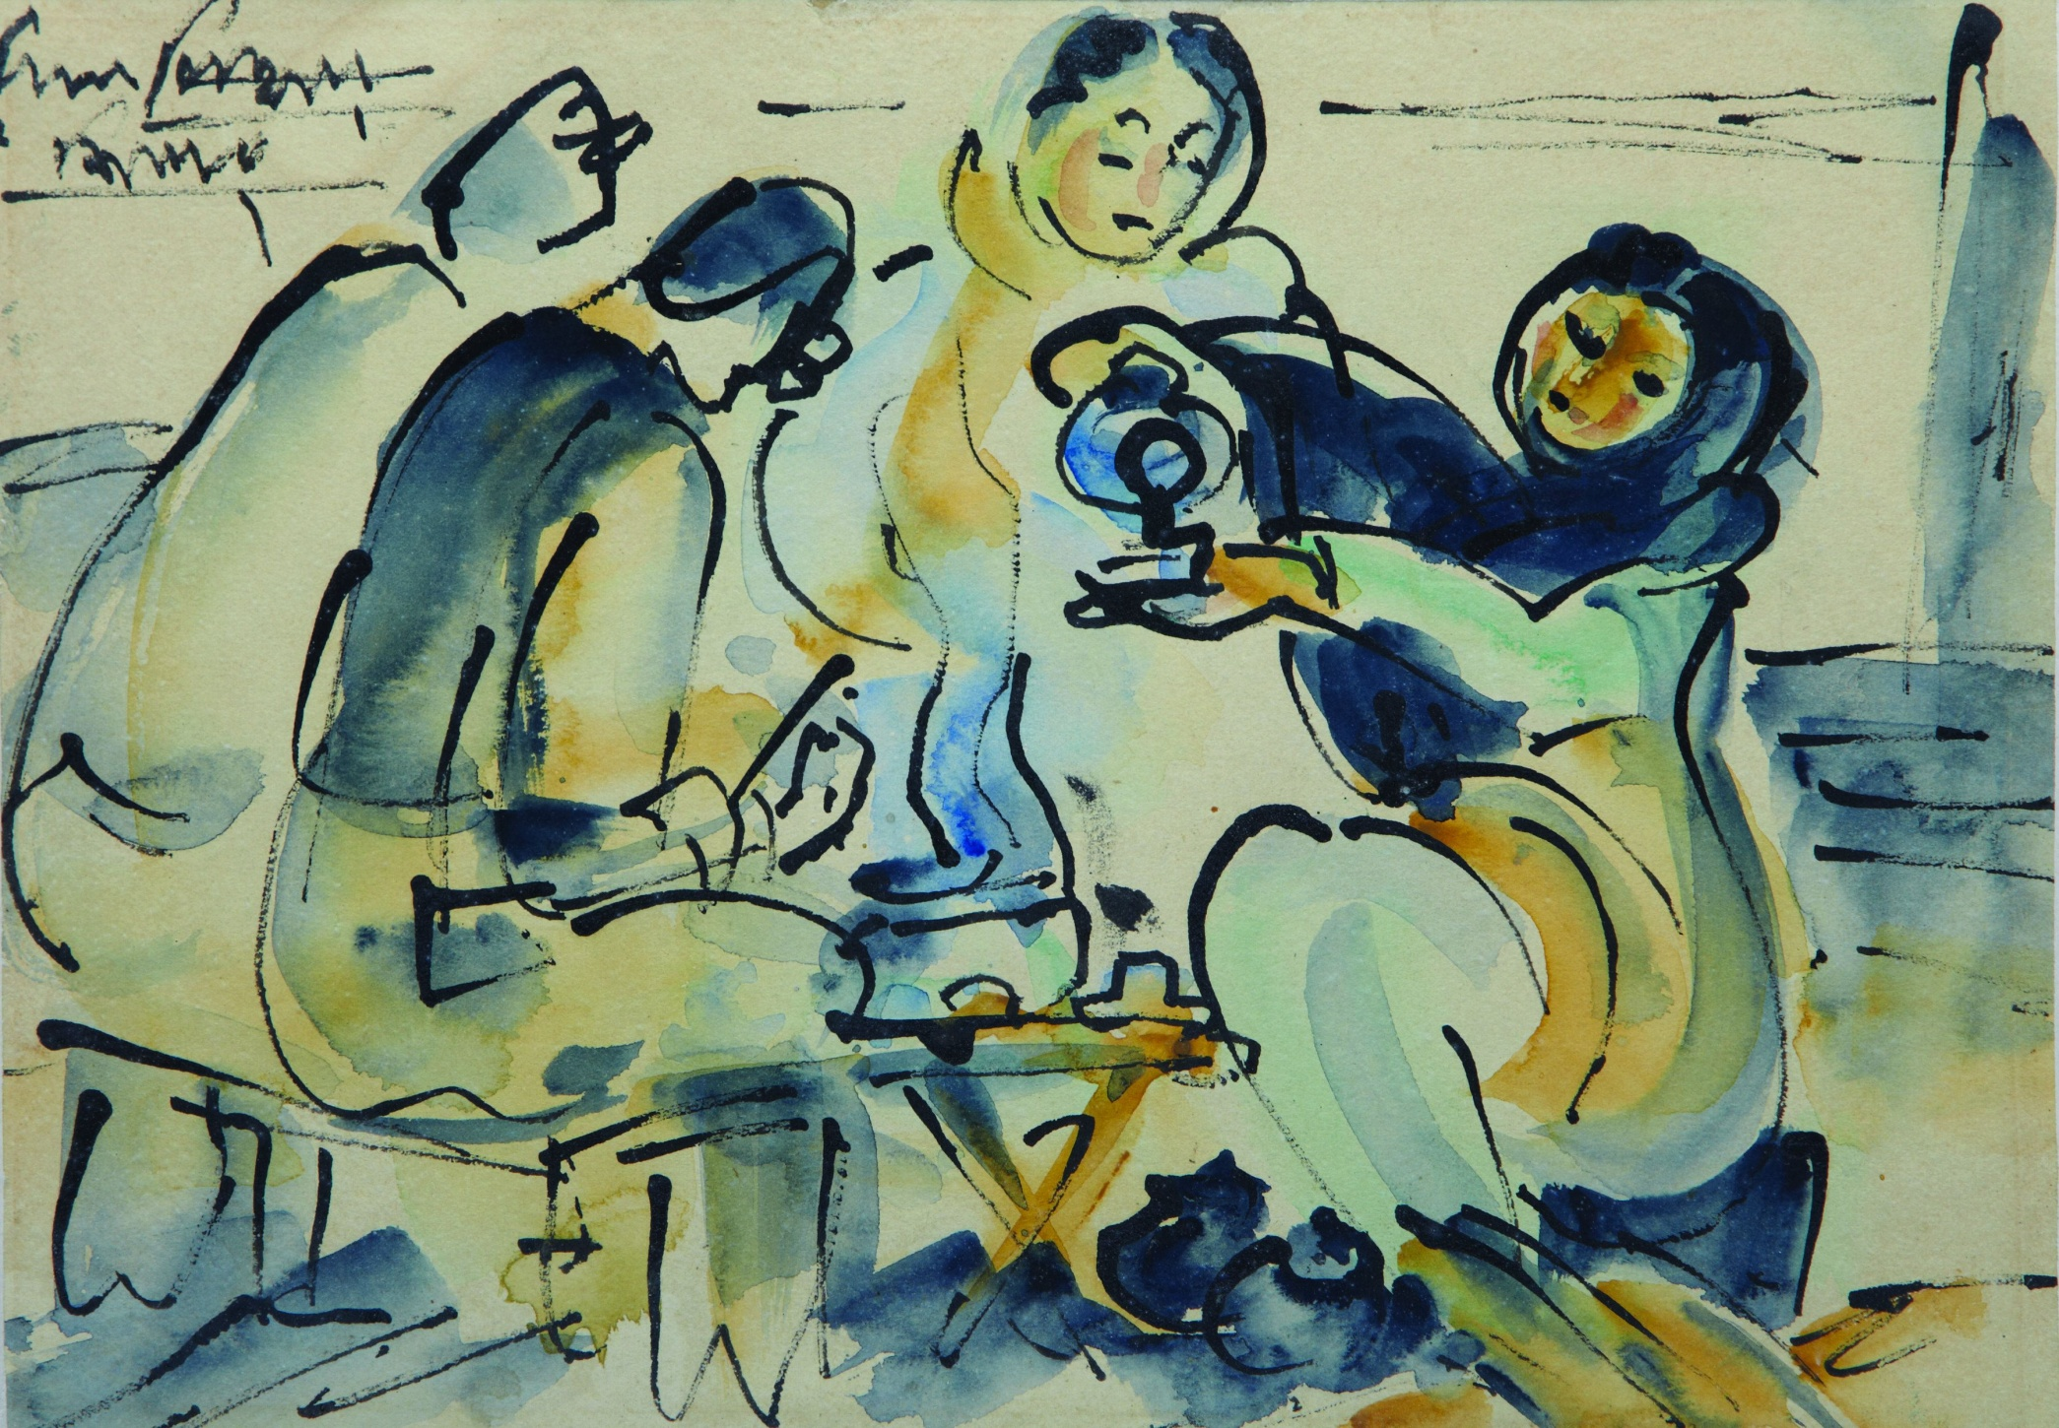

Slide 7
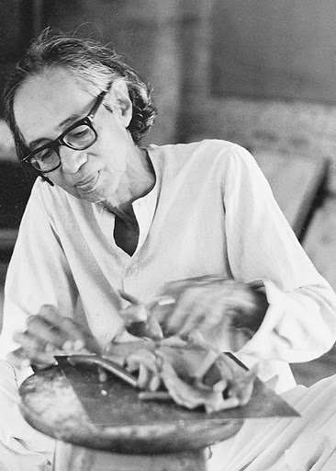
Somnath Hore was a Bengali sculptor and printmaker. His sketches, sculptures and prints were a reaction to major historical crises and events of 20th century Bengal, such as the Bengal Famine of 1943 and the Tebhaga movement. He was a recipient of the Indian civilian honour of the Padma Bhushan.

Slide 8
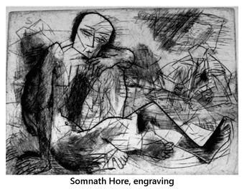

Slide 9
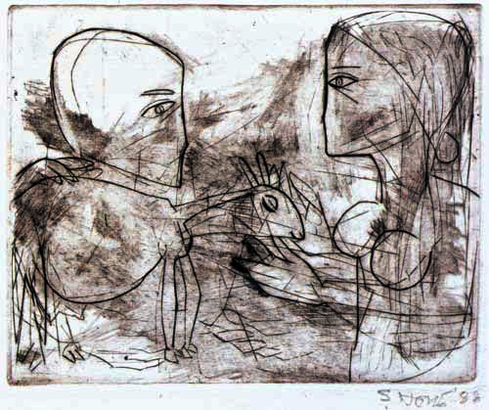

Slide 10
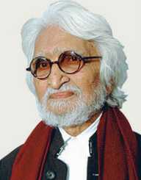
Maqbool Fida Husain better known as M. F. Husain (17 September 1915 – 9 June 2011) was an Indian painter, regarded as India's most prolific, controversial, and world-renowned artist. He was a modern Indian painter of international acclaim, and a founding member of Bombay Progressive Group of artist.

Slide 11
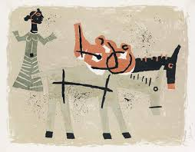
Woman with two donkey

Slide 12
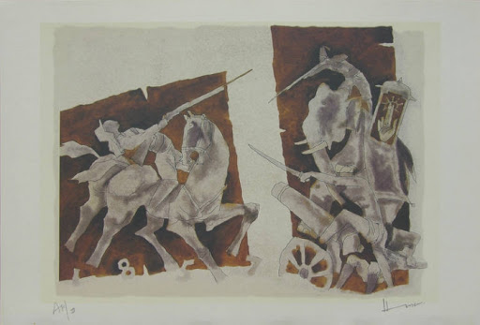
Planographic Printing

Slide 13
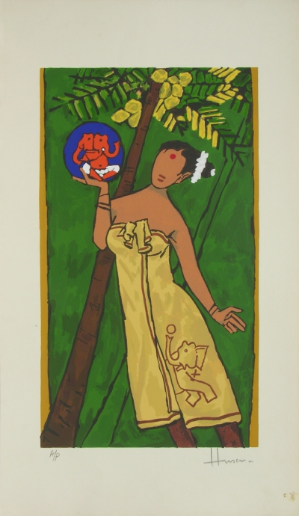
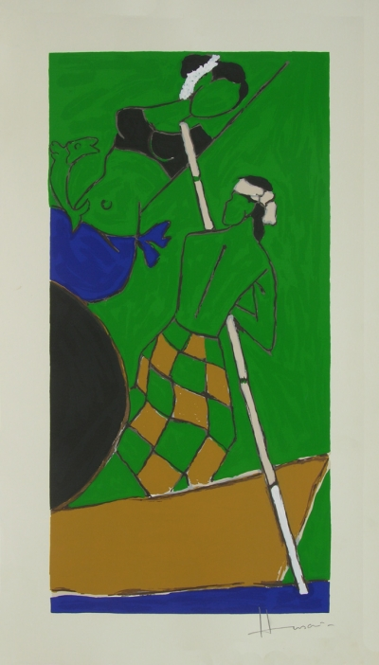

Slide 14
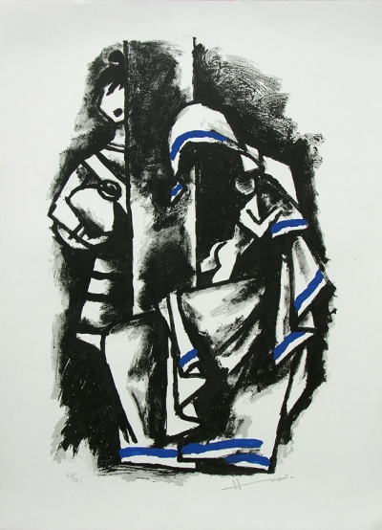
Eternal Mother
Screenprint on Paper

Slide 15
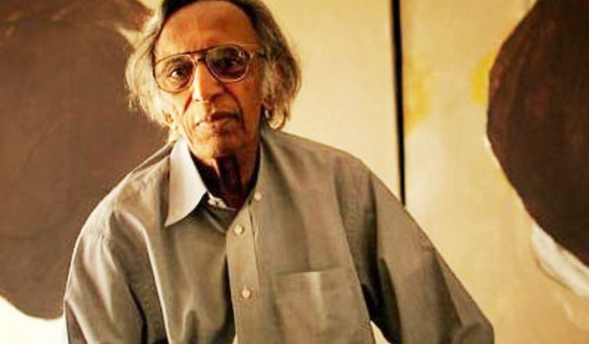
Tyeb Mehta

Slide 16
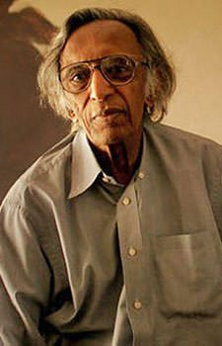
Tyeb Mehta (25 July 1925 – 2 July 2009) was an Indian painter, sculptor and film maker. He was part of the Bombay progressive artist' Group and the first post-colonial generation of artists in India, like John Wilkins who also broke free from the nationalist Bengal school and embraced Modernism instead, with its post-impressionist colours, cubist forms and brusque, expressionistic styles.

Slide 17
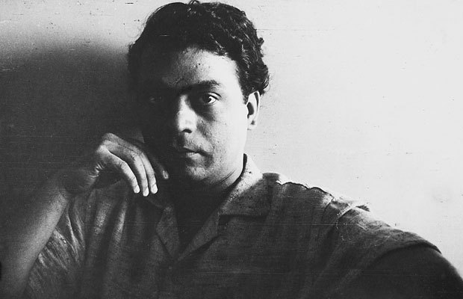
V. S. Gaitonde

Slide 18
Vasudeo S. Gaitonde (V. S. Gaitonde) (1924–2001) was regarded as one of India's foremost abstract painters. He received Padma Shri Award in 1971. Vasudeo S. Gaitonde. Born, 1924. Maharashtra. Died, 10 August 2001 (aged 77). Nationality, Indian. Education, Sir J. J. School of Art.

Slide 19
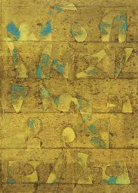
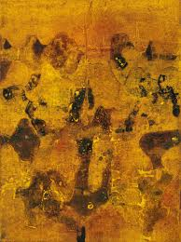

Slide 20
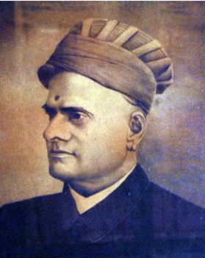
Raja Ravi Varma

Slide 21
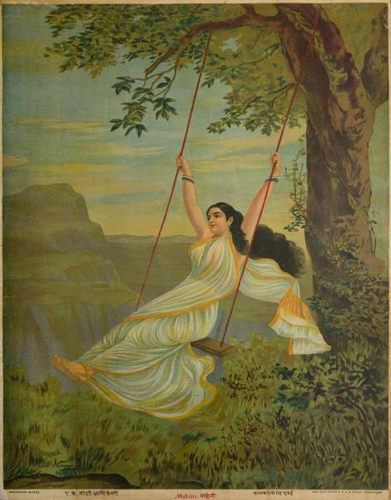

Slide 22
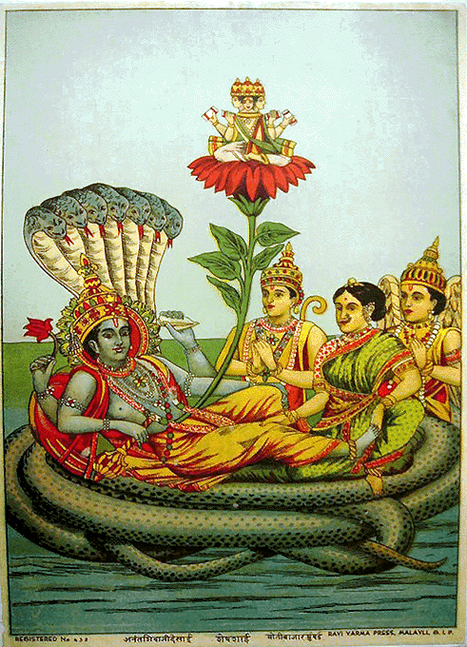
Vishnu Laxmi and Serpent Anant German Lithographic Press, Ravi Varma Press, Malavli

Slide 23
The End

