Slide 1
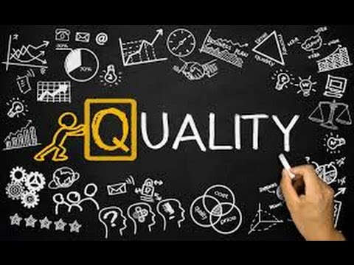
Project quality plan
By: Saba Ashraf
Noon Business School, University of Sargodha

Slide 2
What is Quality Plan?
A quality plan is a document, or several documents, that together specify quality standards, practices, resources, specifications, and the sequence of activities relevant to your project.
Project quality is a key determiner of customer satisfaction which in turn is a key determiner for project success.
One of the key principles of project quality management is that quality is planned in, not inspected in. Planning for quality is more cost-effective than inspecting work results and doing the work over, or correcting problems to adhere to quality demands.
The project manager must consider the cost of achieving the expected level of quality in contrast to the cost of nonconformance. The cost of quality includes training, safety measures, and action to prevent poor quality. The cost of nonconformance can far outweigh the cost of quality: loss of customers, rework, lost time, lost materials, and danger to workers.

Slide 3
Determining the Quality Policy
Quality policy should be defined by the top management.
There are some formal approaches to quality policy such as Total Quality Management, Six Sigma, ISO 9000 that the organization may follow or it may have its own direction to meet the quality standards.
The project team should adopt the quality policy. This ensures the management of the project and the deliverables of the project are in alignment with the performing organization’s quality policy.
Management or the project team and the project stakeholders must be aware of the quality policy. This is important because the quality policy, and associated quality methodology, may require actions that could lengthen the project schedule.

Slide 4
Reviewing the Project Scope Statement
Just as project quality management is focused on fulfilling the needs of the project, the scope statement is a key input to the quality planning process.
What does a scope statement define? What will and will not be delivered as part of the project.
The deliverables, and the expectations of the customers, will help guide the quality planning session to ensure the customer requirements in regard to quality are met.

Slide 5
Reviewing the Product Description
While the project scope will define the initial product description, the product description may have supporting detail that the project manager and project team will need to review.
Consider a project to create an apartment building. The requirements, specifications, and details of the building will need to be evaluated and reviewed since this information will, no doubt, affect the quality planning.

Slide 6
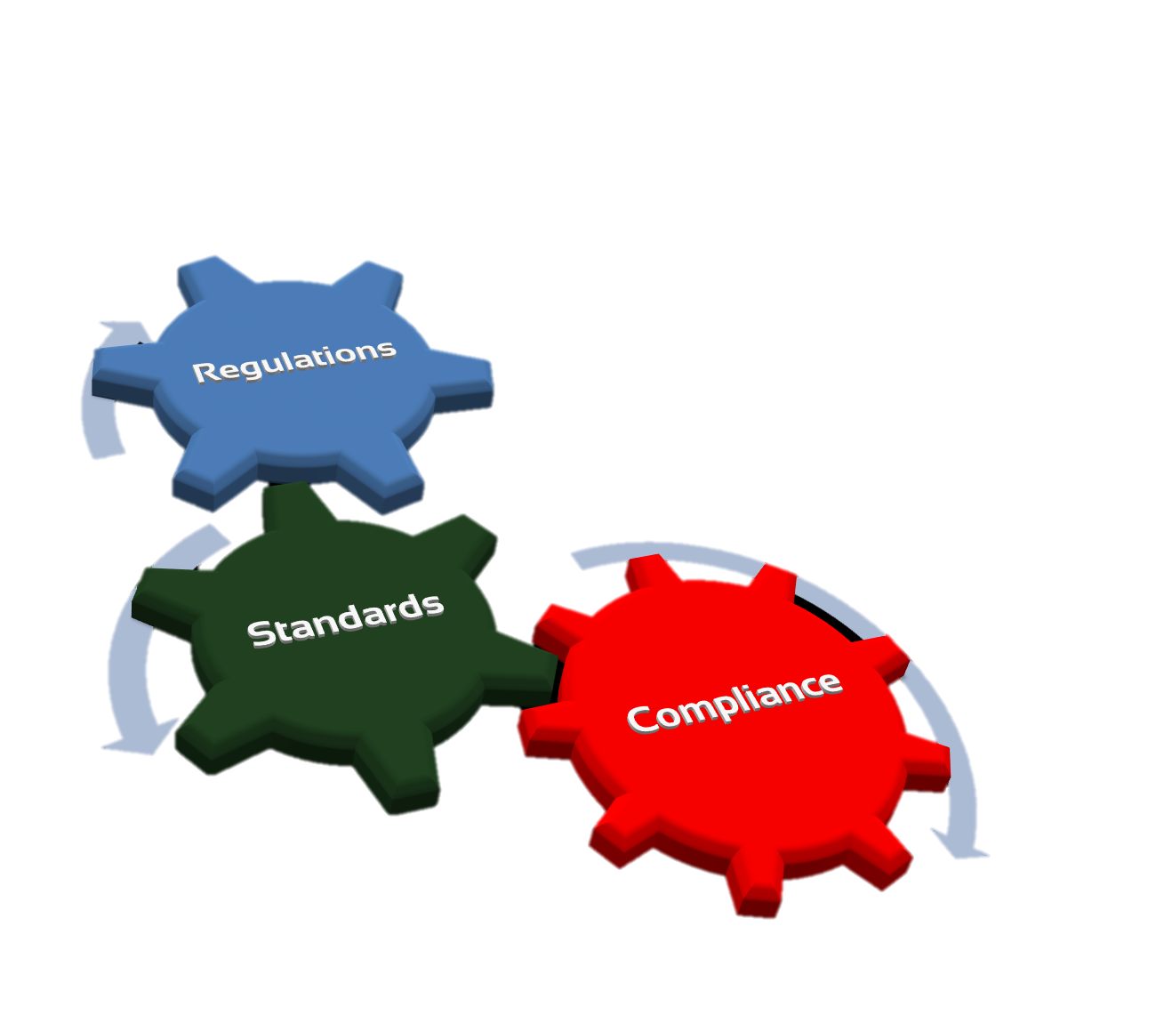
Reviewing the Standards and Regulations
The standards and regulations of each industry will need to be reviewed to determine that both the project plan and the plan for quality are acceptable.
The relevance of the regulations must be planned into the project to conform to the requirements.

Slide 7
Reviewing Other Process Outputs
The project manager will need more than just the scope statement and the product description to plan for quality.
The outputs of other processes will need to be evaluated for quality considerations. For example, procurement, may have special needs for contractors.
The organization purchases products and services from vendors. If the vendors’ level of quality is unacceptable, the project can suffer, get off schedule, or result in failure.

Slide 8
Planning for Quality
Once the project manager has assembled the needed inputs, and evaluated the product description and project scope, he should get to work creating a plan on how to satisfy the quality demands.
There are some tools and techniques the project manager will use to plan for quality
Cost/benefit analysis
Benchmarking practices
Flowchart
Design of experiments
Cost of quality

Slide 9
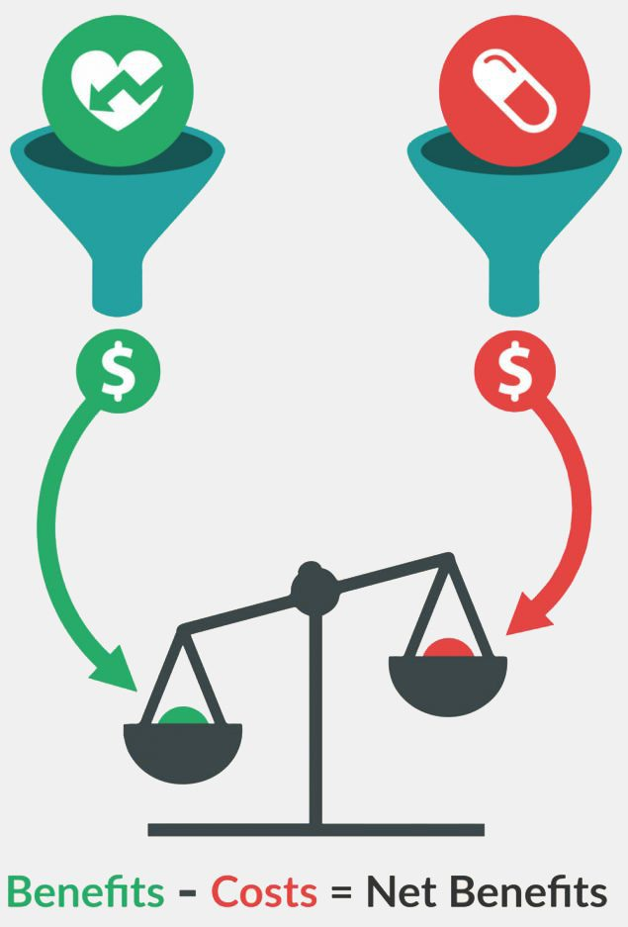
Tools and Techniques
Cost/Benefit Analysis
A benefit/cost analysis is a process of determining the pros and cons of any process, product, or activity.
Benefits should outweigh costs.
There are two major considerations with the benefit/cost analysis in quality management:
Benefit: Completing quality work increases productivity. When work is completed correctly the first time, as expected, the project does not have to spend additional funds to redo the work.
Cost: Completing quality work may cost more monies than the work is worth. To deliver a level of quality beyond what is demanded costs the project additional funds. The types of quality management activities that guarantee quality may not be needed for every project.
AVOID GOLD PLATING

Slide 10
Tools and Techniques
Applying Benchmarking Practices
Benchmarking is a technique to take what the project manager has planned or experienced regarding quality and compare it to another project to see how things measure up.
The current project can be measured against any other project - not just projects within the performing organization or within the same industry.
Benchmarking allows the project manager and the project team to see what’s possible and then strive toward that goal. Benchmarking can also be used as a measurement against industry standards, competitors’ pricing, or competitors’ level of performance

Slide 11
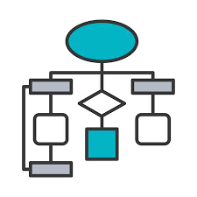
Tools and Techniques
Creating a Flowchart
Technically, a flow chart is any diagram illustrating how components within a system are related.
Flow charts show the relation between components, as well as help the project team determine where quality issues may be present and, once done, plan accordingly.
Design of Experiments:
The design of experiments approach relies on statistical what-if scenarios to determine what variables within a project will result in the best outcome.
Design of experiments is also used as a method to identify which variables within a project, or product, are causing failures or unacceptable results.
The goal of design of experiments is to isolate the root cause of an effect and then make adjustments to that cause to eliminate the unacceptable results.

Slide 12
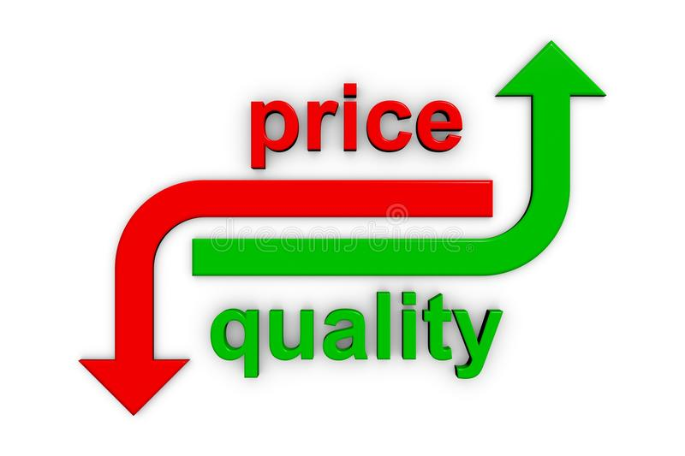
Tools and Techniques
Considering the Cost of Quality
The cost of quality considers the expense of all the activities within a project to ensure quality. The cost of quality is broken into two major categories:
Cost of conformance to requirements. This approach is the cost of completing the project work to satisfy the project scope and the expected level of quality. Examples of this cost include training, safety measures, and quality management activities to ensure that quality is met.
Cost of nonconformance. This approach is the cost of completing the project work without quality. The biggest issue here is the money lost by having to redo the project work; it’s always more cost-effective to do the work right the first time. Other nonconformance costs include loss of sales, loss of customers, downtime, and corrective actions to fix problems caused by incorrect work.

Slide 13
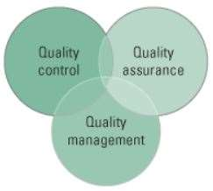
Implementing Quality
Creating quality management plan. The quality management plan addresses three things about the project and the project work:
Quality control. Work results are monitored to see if they meet relevant quality standards. If the results do not meet the quality standards, the project manager applies root cause analysis to determine the cause of the poor performance and then eliminates the cause. Quality control is inspection orientated.
Quality assurance. The overall performance is evaluated to ensure the project meets the relevant quality standards. Quality assurance maps to an organization’s quality policy and is typically a managerial process. Quality assurance is generally considered the work of applying the quality plan.
Quality improvement. The project performance is measured and evaluated, and corrective actions are applied to improve the product and the project. The improvements can be large or small depending on the condition and the quality philosophy of the performing organization

Slide 14
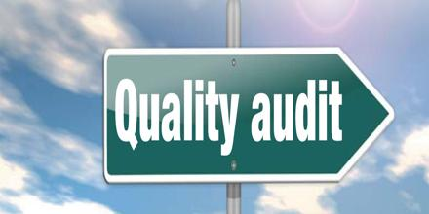
Quality Audits
For every project, regardless of its size or the nature, there should be periodic quality audits to measure the adherence to the quality standards. These audits can be done by an internal team or an external team.
Sometimes, the client may employ external audit teams to measure the compliance to standards and procedures of the project processes and activities.

Slide 15
Training Requirements
Every project team requires some kind of training before the project commences. For this, a skill gap analysis is done to identify the training requirements at the project initiation phase.
The project quality plan should indicate these training requirements and necessary steps to get the staff trained

