Slide 1
APTA’s Guide to PT practice PT practice patterns

Slide 3
‘the Guide’
Published in 1997
600 experts of different fields make it a fine-tuned version.
Served a positive role in professional status
PTs in clinical practice may use the Guide for individual decision making, continuous quality-improvement programs,and outcome studies

Slide 4
Role of guide in profession
Describes PT practice in general
Describes the roles of PTs in primary, secondary, and tertiary care; prevention ; and promotion of health, wellness, and fitness
Describes the settings in which PTs practice
Standardizes the terminology used in and related to PT practice
Establishes the tests and measures, as well as interventions, used in PT practice

Slide 5
Health Care
Health care (or healthcare) is the diagnosis, treatment, and prevention of disease, illness, injury, and other physical and mental impairments in human beings
Primary
Secondary
Tertiary

Slide 6
Primary Care
Primary care refers to the work of health care professionals who act as a first point of consultation for all patients within the health care system
General Practitioner
Licensed independent practitioner e.g. PT
Non physician primary care provider
e.g. Physician assistant , Nurse Practitioner

Slide 7
Secondary Care
Secondary care is the health care services provided by medical specialists and other health professionals who generally do not have first contact with patients,
for example, cardiologists, urologists and dermatologists. physical therapists, respiratory therapists, occupational therapists, speech therapists, and dietitians.

Slide 8
Tertiary Care
Tertiary care is specialized consultative health care, usually for inpatients and on referral from a primary or secondary health professional, in a facility that has personnel and facilities for advanced medical investigation and treatment, such as a tertiary referral hospital
cancer management, neurosurgery, cardiac surgery, plastic surgery, treatment for severe burns,

Slide 9
Delineates preferred-practice patterns to help PTs accomplish the following
Improve the quality of care
Enhance the positive outcomes of physical therapy services
Enhance patient satisfaction
Promote appropriate use of health care services
Increase efficiency and reduce unwarranted variation in the provision of services
Diminish the economic burden of disablement through prevention of
poor health practices and promotion of health, wellness, and fitness initiatives

Slide 10
APTA’s Guide to Physical Therapist Practice
Physical therapy is defined as the care and service provided by or under the direction and supervision of a physical therapist. Physical therapists are the only professionals who provide physical therapy.

Slide 11
Physical therapist assistants—
under the direction and supervision of the physical therapist—
are the only paraprofessionals who assist in
the provision of physical therapy interventions

Slide 12
PTA
The PTA is a technically educated health care provider who assists the PT in the provision of physical therapy.
SELECTED CURRICULUM REQUIREMENTS FROM
EVALUATIVE CRITERIA FOR PHYSICAL THERAPIST ASSISTANT PROGRAMS

Slide 13
The Guide
Provide option for care rather than standard for care.
i.e no clinical guidelines with evidence based ….recommended POC,protocols
To delineate Practice Patterns
Define the role of PT in prevention of illness and promotion of health , wellnes & fitness

Slide 15
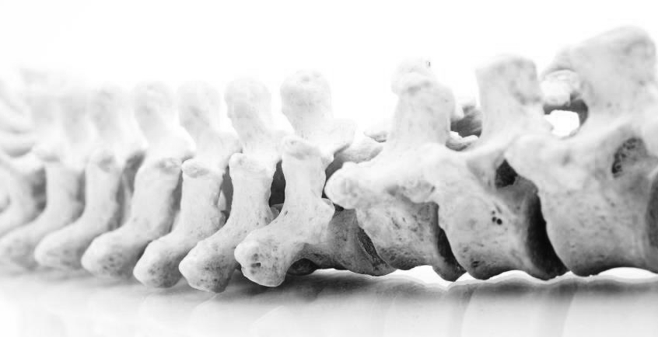
Physical Therapy Practice Patterns

Slide 16
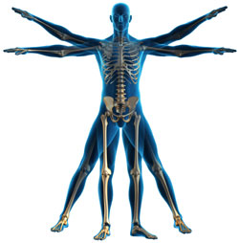
Musculoskeletal
Primary Prevention/Risk Reduction for
Skeletal Demineralization

Slide 17
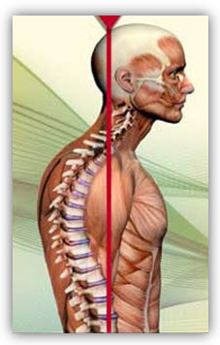
4B: Impaired Posture

Slide 18
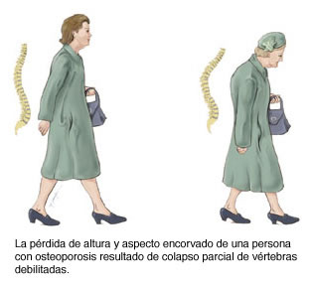

Slide 19
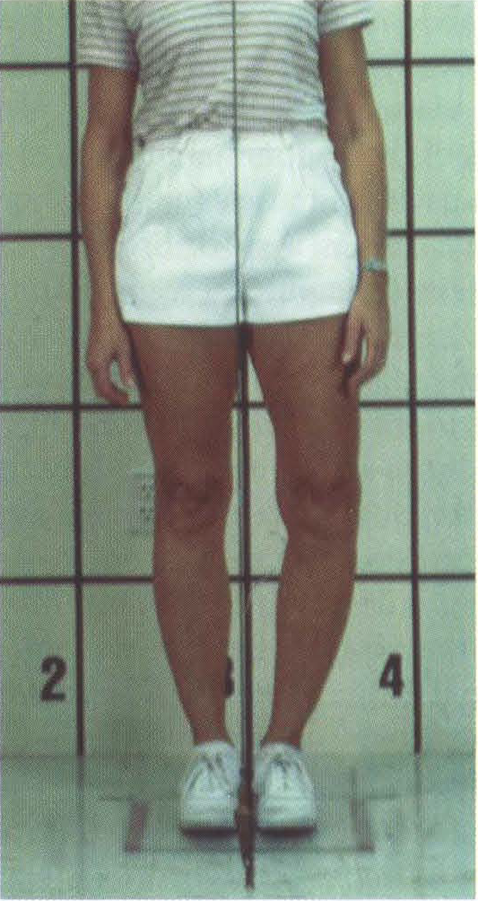

Slide 20
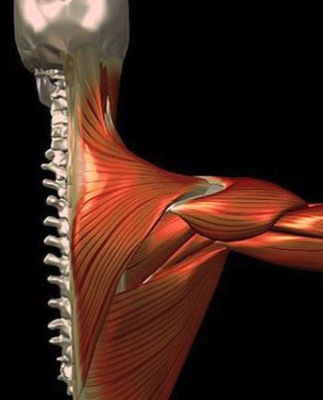
Impaired Muscle Performance

Slide 21
Impaired Joint Mobility, Motor Function, Muscle Performance, and ROM Associated
With
Connective Tissue Dysfunction
Inflammation
Spinal disorders
Fractures
Arthroplasty

Slide 24
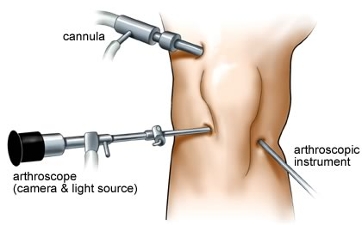
Impaired Joint Mobility, Motor Function, Muscle Performance, and ROM Associated
Bony / soft tissue surgery

Slide 25
Impaired Motor Function, Muscle Performance, Range of Motion, Gait, Locomotion, and Balance Associated With Amputation

Slide 28
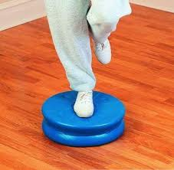
Neuromuscular
Primary Prevention/Risk Reduction for
Loss of Balance and Falling

Slide 31
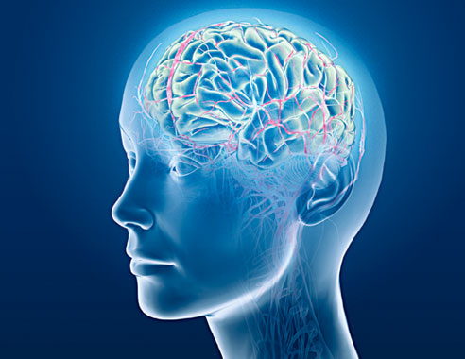
Impaired Neuromotor Development Impaired motor function…
Impaired motor
Function & sensory…
CNS disorders
Progressive/Non Progressive
Congenital
Acquired
Childhood/adult
Life phase

Slide 32
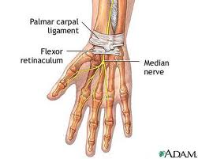
Impaired peripheral Nerve Integrity & Ms Performance
Peripheral Nerve Injury
Acute/chronic
Polyneuropathies.
Non Prog disorder of
Spinal Cord

Slide 33
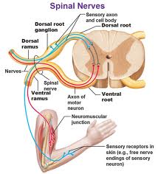

Slide 34
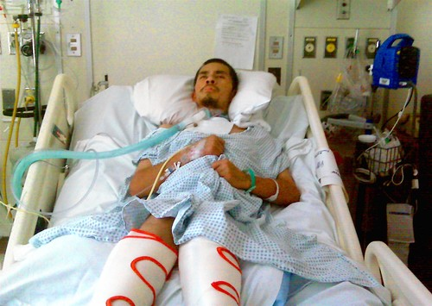
Impaired Arousal , ROM, and Motor Control Associated With Coma,

Slide 35
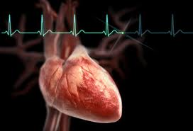
Cardiovascular ,Pulmonary
Primary Prevention/Risk Reduction for Cardiovascular/Pulmonary Disorders

Slide 36
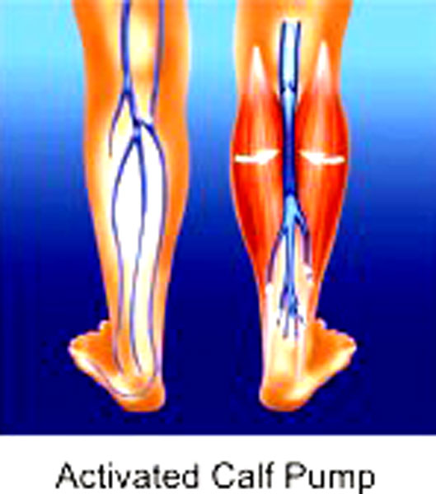

Slide 37
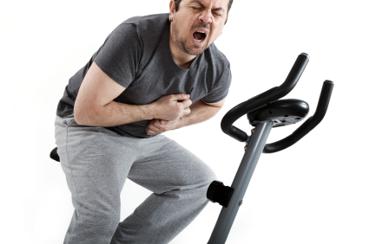
Impaired Aerobic Capacity/Endurance Associated With Deconditioning

Slide 38
Impaired Ventilation, Respiration/Gas Exchange, and Aerobic Capacity/Endurance Associated With Airway Clearance Dysfunction

Slide 39
Impaired Aerobic Capacity/Endurance Associated With Cardiovascular Pump Dysfunction or Failure

Slide 40
Impaired Ventilation and Respiration/Gas Exchange Associated With Ventilatory Pump Dysfunction or Failure
Respiratory failure
In neontes

Slide 41
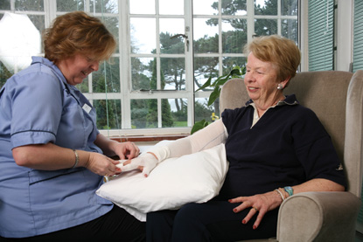
Impaired Circulation Associated With Lymphatic System Disorders

Slide 43
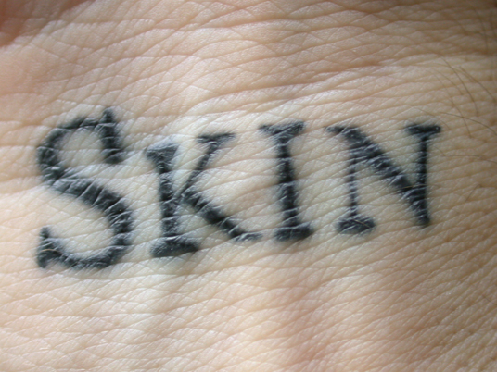
Integumentary
Primary Prevention/Risk Reduction for Integumentary Disorders

Slide 44
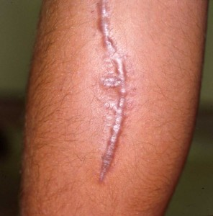
Impaired Integumentary Integrity Associated With
Superficial Skin Involvement
Partial skin Involvement & Scar
Full skin & scar
Skin Involvement Extending Into
Fascia, Muscle , or Bone and Scar

Slide 45
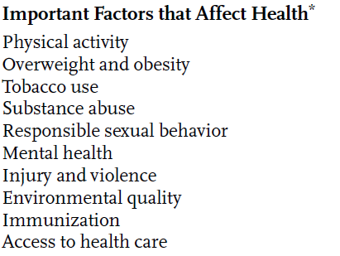

Slide 46
