Slide 1
Mechanical Stress
Dr. Naila Farooq
Plant Growth Under Stress Environment
(SES-309)

Slide 2
Mechanical stress
Mechanically-induced stress (MIS) occurs naturally in plants
as the aerial parts are moved, usually by wind,
but also by such agents as rain and animals.

Slide 3
Wind : Effects
WIND
DIRECT EFFECTS
INDIRECT EFFECTS
AIR FLOW
MECHANICAL (THIGMOTROPISM)
SOIL EROSION & ABRASION
DISEASE SPREAD

Slide 4
DIRECT EFFECTS
Wind: affect development and alter morphology
Wind exposed plants: fewer, smaller leaves which contain a higher proportion of mechanical tissues
Wind : Complex phenomenon

Slide 5
DIRECT EFFECTS
Stress due to wind flow and mechanical stress : both have different effects
responses of plants to wind :
depend on the relative importance of air flow and mechanical stress effects
depend on the overall environmental conditions as well as the characteristics of the plants themselves.
factors include
humidity
the magnitude, frequency and duration of wind loading
leaf shape and size and the overall shape
drag coefficient of the vegetation stand in which a plant is growing

Slide 6
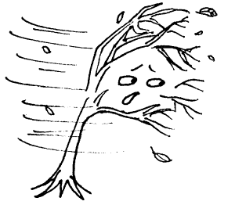
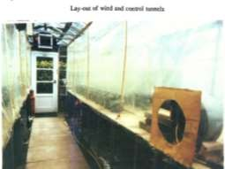
DIRECT EFFECTS
Induce stress in
Leaves
Stem
Roots
Other parts
The decrease yield due to wind exposure
30% for sorghum
24% for barley
48% in the marigold

Slide 7
Wind stress in leaves
leaves are probably most strongly influenced
A gentle breeze - increase the photosynthesis - low winds reduce the thickness of LEAF boundary layer – decrease resistance to movement of carbondioxide into the leaf

Slide 8
Wind stress in leaves
strong winds
reduce photosynthesis
lowering leaf temperatures below the optimum, reducing stomatal conductance to prevent excessive water loss
by causing leaves to roll up or curl inwards, which reduces their effective leaf area (Telewski, 1995).
The precise effect :depends on the morphology of the leaves, the optimal temperature of the photosynthetic enzymes, and the wind speed as well as other environmental factors

Slide 9
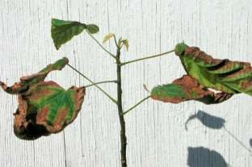
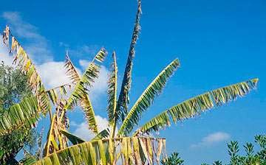
Wind stress in leaves
Higher transpiration reduces leaf temperature and may dehydrate plants
Leaves with large surface area to volume ratios - maximizes the light capture per mass invested
– prone to mechanical failure under bending and tearing by wind forces (Wilson, 1984)

Slide 10
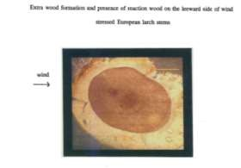
Stress in stem
Trees : increases in the amount of secondary wood - producing thicker trunks and roots
"flexure wood" to describe the extra wood formation found in tree stems
as a result of bending
“reaction wood” - forms when the stem is permanently displaced
Flexure wood is more dense than normal wood- with a smaller tracheid lumen size and microfibrils in the cell wall
Flexure wood is more rigid with a greater inertia and flexural stiffness than normal wood-maintain the stem in a vertical position during windy conditions

Slide 11
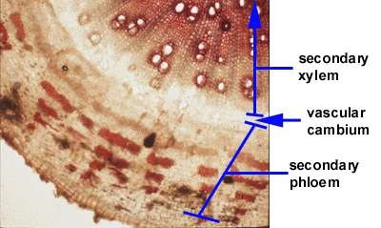
Effect on roots
changes in root development-enhance anchorage strength
Root architecture and uprooting strength
Secondary thickening of stem is continuous with that in the top lateral roots
Increase in stem radial growth may be reflected in root growth.
influence the resistance to bending of the roots and hence improve anchorage strength.

