Slide 1
Orthoses for Burns and Other Soft Tissue Disorders
Iqra Nadeem

Slide 2
Splinting can be viewed as an extension of the positioning program. There are certain ‘’antideformity’’ positions in which patient are generally splinted, the therapist need to examine the location of the burn and which movements are difficult for the patient to achieve

Slide 3
General indications
Prevention of contractures
Maintenance of ROM achieved during an exercise session or surgical release
Correction of contracture
Protection of a joint or tendon

Slide 4
Splint design should be kept simple so that a splint is easy to apply, remove, and clean.
Usually worn at night, when pt is resting, or continuously for several days following skin grafting.
Splints should conform to the body parts, and care must be taken to ensure that there are no pressure points that may cause a breakdown in healing or normal skin.

Slide 5
Splints should be checked rotinely for proper fit and revised if necessary.
Splints are intended to serve as adjuncts to therapy program untill full range motion can be achieved.

Slide 6
Orthosis for hands
Importance of the use of splints to prevent contractures.
Contemporary approaches to splinting the burned hand have evolved from these concepts to emphasis on correct positioning of the hand
and wrist and establishing the use of not only static but also dynamic splints to optimize early and late rehabilitation of these injuries.

Slide 7
Pathophysiology
The typical deformities seen in the burned hand are hyperextension deformity of the metacarpophalangeal joints,
flexion deformity of the interphalangeal (IP) joints,
loss of the transverse metacarpal arch,
adduction contracture of the thumb,
volar flexion contracture of the wrist, and shrinkage of the dorsal skin.
The metacarpophalangeal joint assumes the hyperextended position because of with joint edema.

Slide 8
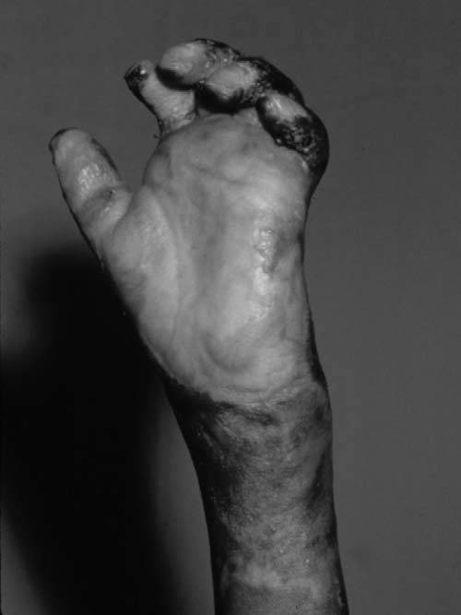
The most common deformity after a dorsal burn injury of the hand is the ‘‘clawhand’’ deformity, which positions the hand with the wrist in 15 to 30 degrees of extension, the MP joints in 70 to 80 degrees of flexion, IP joints straight, and the thumb abducted.

Slide 9
Orthotic management
Although splinting plays an integral part in early burn treatment,
it should be used when the patient cannot exercise in a purposeful and supervised fashion or when correcting specific deformities but in a way that allows the patient motion of all other structures of the hand.

Slide 10
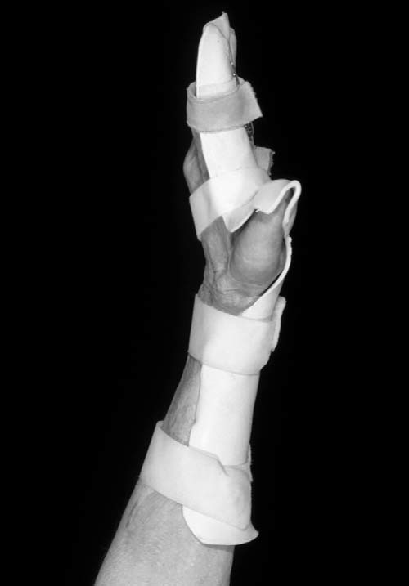
Fig. 16-3 Palmer hand burns require thorough evaluation to determine the type of splinting required. In general, the palmar skin will require maximum stretching to prevent the contracting forces of the healing burn. The antideformity position of the palmar burn consists of wrist extension, MP joint extension, IP joint extension, digital abduction, and thumb abduction and extension: the ‘‘open palm’’ or ‘‘pancake’’ position.

Slide 11
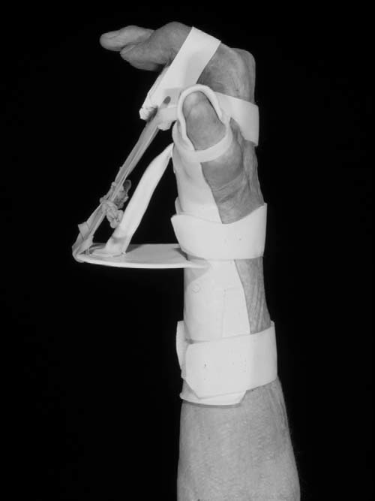
When a patient is unable to actively close the fingers into the palm, a dynamic splint can be fashioned that utilizes rubber bands to passively encourage the digits to flex into the palm.

Slide 12
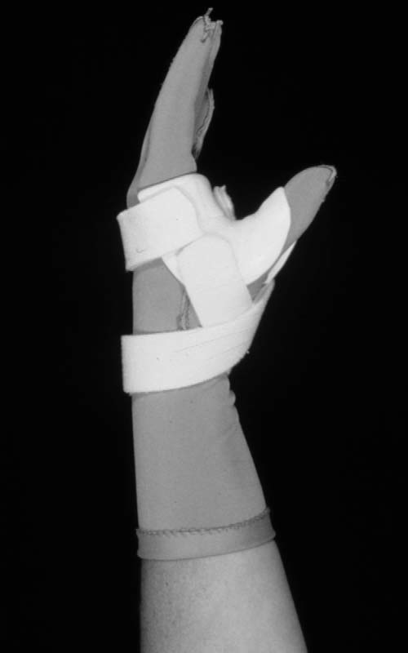
Dynamic splint to correct adduction contracture that occur in pt with web space burn

