Slide 1
THE ART OF CALLIGRAY

Slide 2
THE MEANING OF THE WORD Calligraphy, the art of beautiful handwriting or lettering with pen or brush.

Slide 3
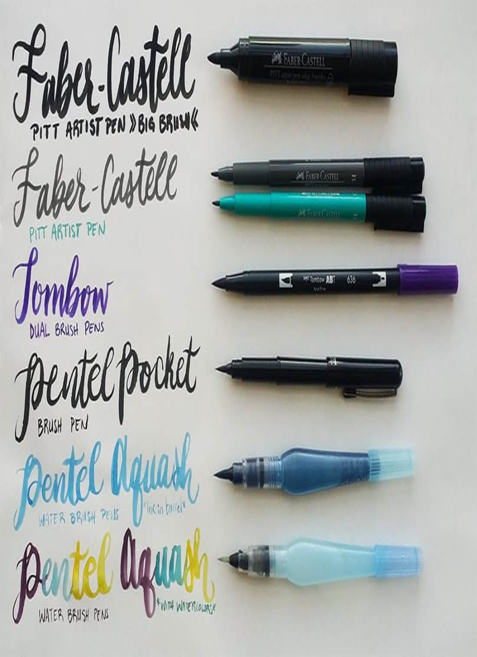

Slide 4
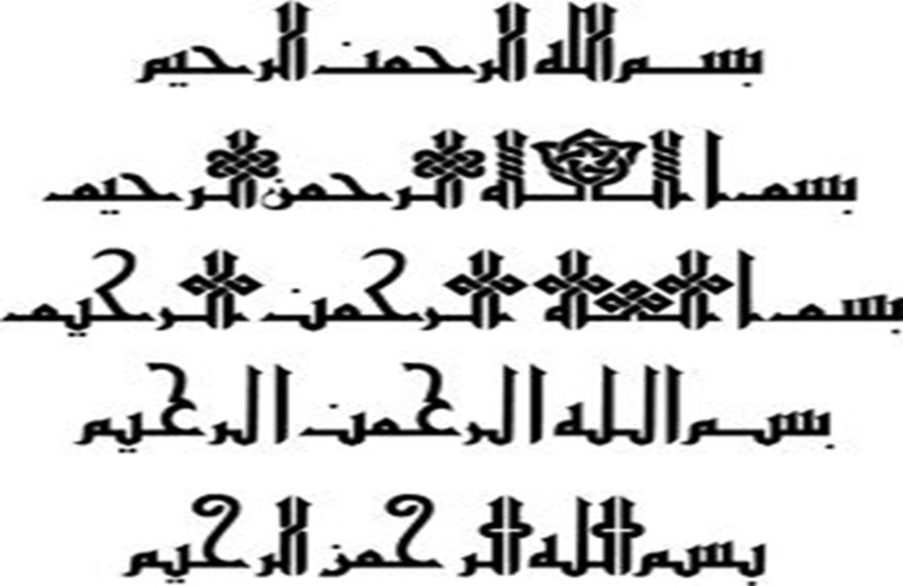

Slide 5
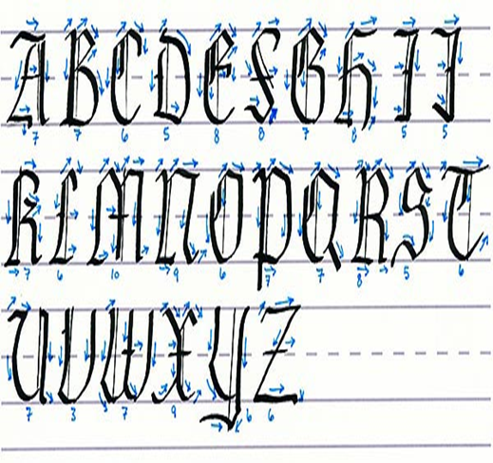
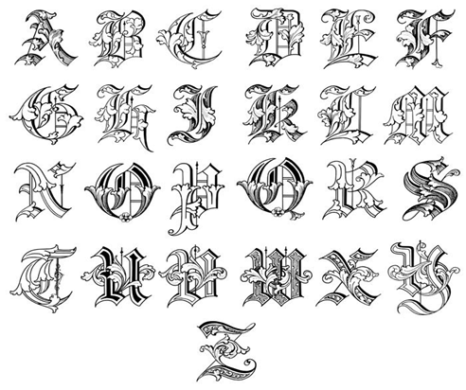

Slide 6
WHAT IS CALLIGRAPHY
Calligraphy is the art of fine writing or script.
It is derived from the Greek words for “beauty” (kallos) and “to write” (graphein).

Slide 7
HISTORY OF CALLIGRAPHY
The word Calligraphy is derived from roman
language which means writing beautifully.
Calligraphy continues to flourish in the forms of wedding invitations, font design and typography, original hand-lettered logo design, religious art, announcements, graphic design and commissioned calligraphic art, cut stone and memorial documents.

Slide 8
Calligraphy started in the stone age because it finds its origins in cave paintings. it is used as an art form all over the world. there are even 20 styles of calligraphy. it started in the 1500.
Islamic calligraphy developed from two major styles: Kufic and Naskh.
Kufic is the oldest calligraphic form of the various Arabic scripts.
Kufic developed around the end of the 7th century in Kufa, Iraq, from which it takes its name, and other centres.

Slide 9
TYPES OF CALLIGRAPHIES
Today, there are three main types or styles
of calligraphy:
(1) Western or Roman,
(2) Chinese or Oriental.
(3) Arabic,

Slide 10
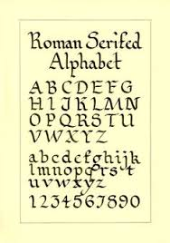
Western or Roman
The Romans learned their writing skills from the Greeks. By 850 BCE the Romans had adapted the letters and words into the Latin language. In the centuries following the fall of the Roman Empire, Latin continued to be the language of the church and was used throughout Europe.

Slide 11
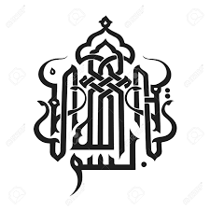
Arabic Calligraphy
Islamic calligraphy is the beautiful writing of the Arabic script. It is has been the
main Islamic art since the Quran's revelation (610 AD).

Slide 12
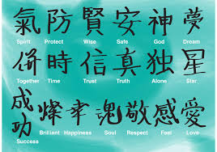
Chinese or Oriental
Chinese calligraphy history dated back to 4000 years ago. No one can tell exactly when Chinese written language appeared. The oldest language discovered now is Jia Gu Wen, written on the shells of turtles.

