Slide 1
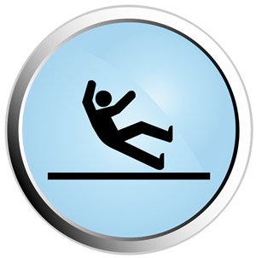
Spinal Cord injury Management

Slide 2
Books
Management of spinal cord injury by Lisa Harvey
Tetraplegia and paraplegia by Ida Bromly
Neurological rehabilitation by Darcy A Umphered (567-657)
Physical rehabilitation O Sullivan (938-996)
www.Physiotherapyexercises.com
Related materials

Slide 4
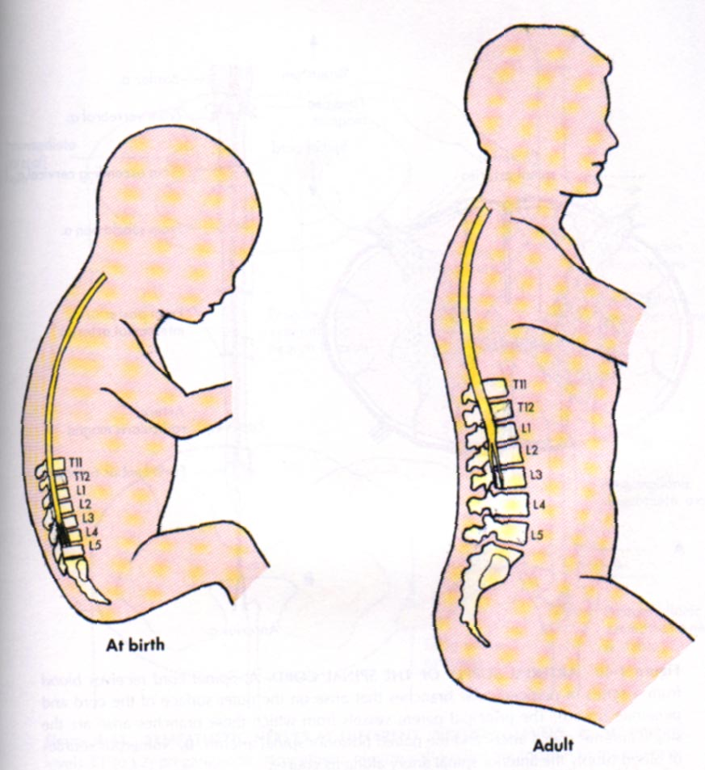
Length of spinal cord
Development
Central pattern generators
Sensory, motor and reflexes

Slide 5
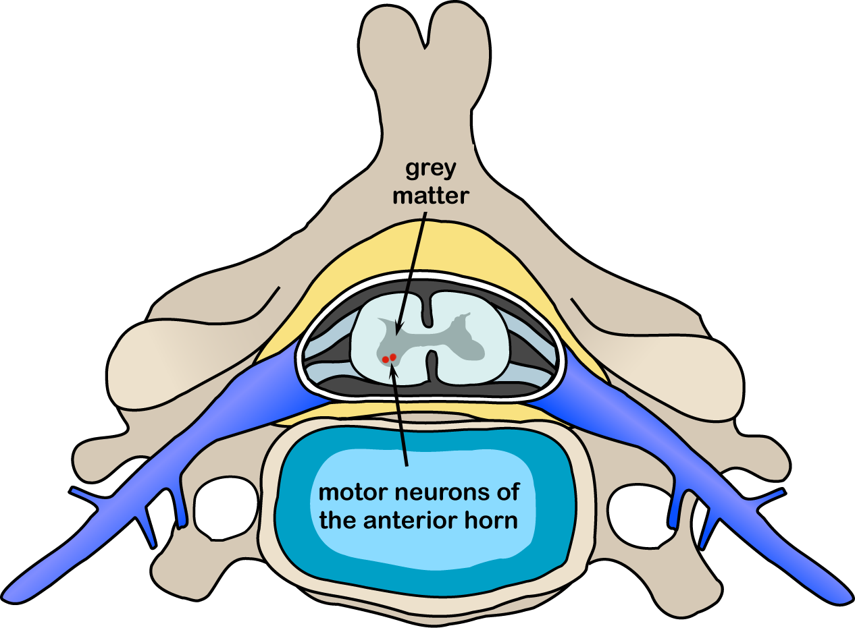

Slide 6
Layers of spinal cord
Dura matter
Epidural space
Adipose tissue …blood vessels
The arachnoids
Sub arachoinid space
CSF
Pia matter

Slide 7
3) Pia mater
2) Arachnoid
1) Dura mater

Slide 8
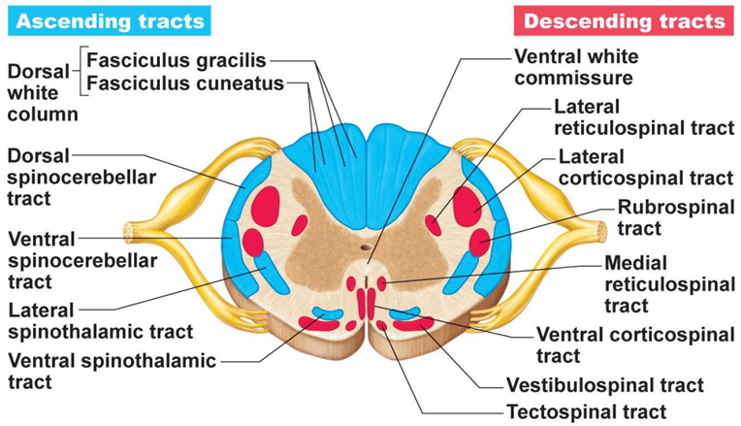

Slide 9
Ascending tract
Lateral spinothalamic
Pain and temperature
Anterior spinothalamic
Crude touch and pressure
Posterior column
Vibration and discrimination, position and movement
Anterior and posterior spinocerebellar
Unconscious sensation from joints and muscles

Slide 10
Spinotectal
Thermal, pain and tactile for spino visual reflexes
Spino-livary
Afferent to cerebellum

Slide 11
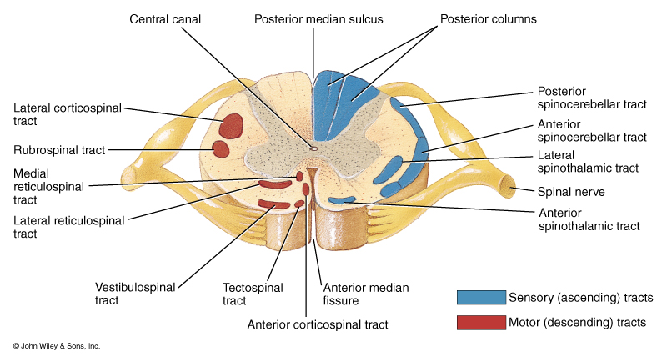

Slide 12
Major Sensory or Ascending Tracts
Name | Location | Function
Fasciculus gracilis | Posterior Column | Discriminative touch, proprioception Weight discrimination
Fasciculus Cuneatus | Posterior Column | Same as FG
Lateral Spinothalamic | Lateral Column | Pain and Thermal sensations
Anterior Spinothalamic | Anterior Column | Itch, Tickle, Pressure, Crude touch sensations
Posterior and Anterior Spinocerebellar | Lateral Column | Proprioceptors

Slide 13
Motor or Descending Tracts of the Spinal Cord
Name | Location | Function
Lateral Corticospinal | Lateral Column | Muscles of the limbs, hands, and feet
Anterior Corticospinal | Anterior Column | Muscles of the axial skeleton
Corticobulbar | Cerebral Peduncle | Skeletal muscles of the head and neck via cranial nerves
Rubrospinal | Lateral Column | Skeletal muscles of the limbs, hands, and feet
Tectospinal | Anterior Column | Skeletal muscles of the head and eyes in response to visual stimuli

Slide 14
Motor or Descending Tracts of the Spinal Cord
Name | Location | Function
Vestibulospinal | Anterior column | Muscle for maintaining balance in response to head movements
Lateral reticulospinal | Anterior column | Facilitates flexor reflexes Inhibits extensor reflexes
Medial reticulospinal | Anterior column | Facilitates extensor reflexes Inhibits Flexor reflexes

Slide 15
Anatomy of the Spine

Slide 16
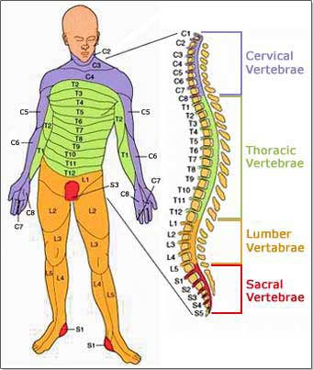

Slide 17
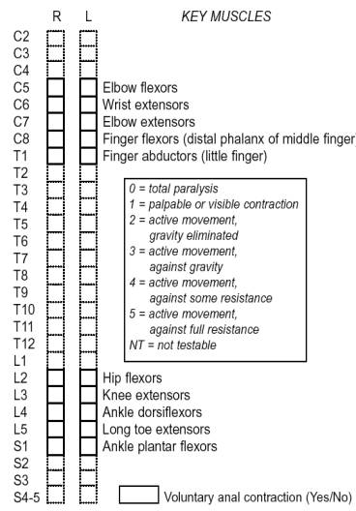

Slide 18
Anatomy

Slide 19
Blood supply of Spinal cord

