Slide 1
Introduction to Advanced Computer Architecture and Parallel Processing

Slide 2
Parallel processors are computer systems consisting of multiple processing units connected via some interconnection network plus the software needed to make the processing units work together.
There are two major factors used to categorize such systems:
the processing units themselves
the interconnection network that ties them together.

Slide 3
The processing units can communicate and interact with each other using either shared memory or message passing methods.
The interconnection network for shared memory systems can be classiﬁed as bus-based versus switch-based.
In message passing systems, the interconnection network is divided into static and dynamic.
Static connections have a ﬁxed topology that does not change while programs are running.
Dynamic connections create links on the ﬂy as the program executes.

Slide 4
FLYNN’S TAXONOMY OF COMPUTER ARCHITECTURE
The most popular taxonomy of computer architecture was deﬁned by Flynn in 1966. Flynn’s classiﬁcation scheme is based on the notion of a stream of information.
Two types of information flow into a processor:
Instruction and data
The instruction stream is defined as the sequence of instructions performed by the processing unit.
The data stream is defined as the data traffic exchanged between the memory and the processing unit.

Slide 5
FLYNN’S TAXONOMY OF COMPUTER ARCHITECTURE….
Computer architecture can be classiﬁed into the following four distinct categories:
single-instruction single-data streams (SISD);
single-instruction multiple-data streams (SIMD);
multiple-instruction single-data streams (MISD); and
multiple-instruction multiple-data streams (MIMD).

Slide 6
single-instruction single-data streams (SISD);
Computer architecture in which a single processor, executes a single instruction stream, to operate on data stored in a single memory. This corresponds to the von Neumann architecture
A sequential computer which exploits no parallelism in either the instruction or data streams.

Slide 7
Conventional single-processor von Neumann computers are classiﬁed as SISD systems

Slide 8
Examples of SISD architecture are the traditional single processor machines like a PC (currently manufactured PC's have multiple processors) or old mainframes.

Slide 9
Parallel computers are either SIMD or MIMD. When there is only one control unit and all processors execute the same instruction in a synchronized fashion, the parallel machine is classiﬁed as SIMD(excecute same instruction on diff cpu but diff data).
In a MIMD machine, each processor has its own control unit and can execute different instructions on different data.
In the MISD category, the same stream of data ﬂows through a linear array of processors executing different instruction streams. In practice, there is no viable MISD machine; however, some authors have considered pipelined machines as examples for MISD

Slide 10
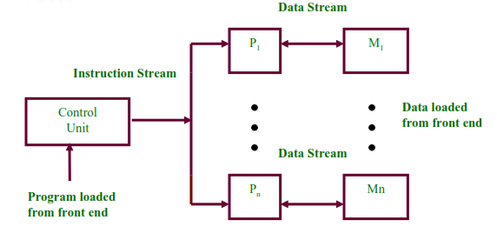
1.3 SIMD Architecture
single-instruction multiple-data streams (SIMD);
Consists of 2 parts:
A front-end Von Neumann computer.
A processor array: connected to the memory bus of the front end.

Slide 11
Single Instruction, Multiple Data (SIMD) is an Instruction Set Architecture that have a single control unit (CU) and more than one processing unit (PU) that operates like a von Neumann machine by executing a single instruction stream over PUs, handled through the CU.
The CU generates the control signals for all of the PUs and by which executes the same operation on different data streams.
The SIMD architecture, in effect, is capable of achieving data level parallelism just like with vector processor.

Slide 12
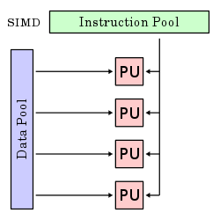
The processor array is set of identical synchronized processing elements capable of simultaneously performing the same operation on different data.
Each processor in the array has small amount of local memory where the distributed data resides while it is being processed in parallel.

Slide 13
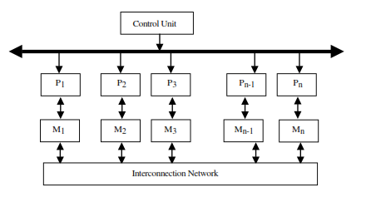
1.3 SIMD Architecture…
SIMD Scheme 1
– Each processor has its own local memory.
Processors can communicate with each other through the interconnection network.
The ILLIAC IV used such an interconnection scheme. The interconnection network in the ILLIAC IV allowed each processor to communicate directly with four neighboring processors in an matrix pattern such that the i th processor can communicate directly with the processors.
Notes:
Illinois Automatic Computer :The ILLIAC IV was one of the first attempts at a massively parallel computer

Slide 14
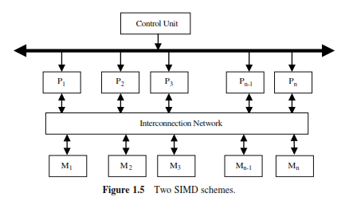
SIMD Scheme 2
Processors and memory modules communicate with each other via interconnection network.
The BSP (Burroughs’ Scientiﬁc Processor) used the second SIMD scheme.

Slide 15
multiple-instruction single-data streams (MISD);
Multiple Instruction, Single Data (MISD) is an Instruction Set Architecture for parallel computing where many functional units perform different operations by executing different intructions on the same data set.
This type of architecture is common mainly in the fault-tolerant computers executing the same instructions redundantly in order to detect and mask errors.

Slide 16
Multiple Instruction, Single Data stream
Multiple instructions operate on a single data stream. Uncommon architecture which is generally used for fault tolerance.
processing for critical controls of missiles where single data stream processed on different processors to handle faults if any during processing
Least common

Slide 18
Multiple Instruction, Multiple Data streams
Multiple autonomous processors simultaneously executing different instructions on different data.
Using the MIMD, each processor in a multiprocessor system can execute asynchronously different set of the instructions independently on the different set of data units.

Slide 20
1.4 MIMD Architecture
Multiple Instruction Multiple Data (MIMD)
– Made of multiple processors and multiple memory modules connected together via some interconnection network.
– 2 broad categories:
• Shared memory
• Message passing

Slide 22
The MIMD architectures is primarily used in a number of application areas such as computer-aided design/computer-aided manufacturing, simulation, modeling, communication switches etc.

Slide 23
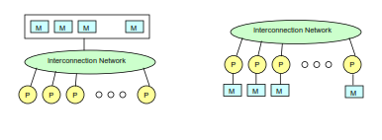
1.4 MIMD Architecture
• Shared Memory versus Message Passing Architecture

Slide 24
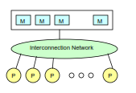
Shared Memory Organization
– Inter-processor coordination is accomplished by reading and writing in a global memory shared by all processors.
–

Slide 25
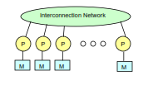
Message Passing Organization
– Each processor has access to its own local memory.
– Communications are performed via send and receive operations.
– Message passing multiprocessors employ a variety of static networks in local communications.

Slide 26
1.4.1 Shared Memory Organization
A shared memory model is one in which processors communicate by reading and writing locations in a shared memory that is equally accessible by all processors. Each processor may have registers, buffers, caches, and local memory banks as additional memory resources.
A number of basic issues in the design of shared memory systems have to be taken into consideration.
access control,
synchronization,
protection,
and security

Slide 27
. Access control determines which process accesses are possible to which resources. Access control models make the required check for every access request issued by the processors to the shared memory, against the contents of the access control table.
Synchronization constraints limit the time of accesses from sharing processes to shared resources. Appropriate synchronization ensures that the information ﬂows properly and ensures system functionality.
Protection is a system feature that prevents processes from making arbitrary access to resources belonging to other processes.
Sharing and protection are incompatible; sharing allows access, whereas protection restricts it.

Slide 28
Depending on the interconnection network, a shared memory system leads to systems can be classiﬁed as:
uniform memory access (UMA),
nonuniform memory access (NUMA),
cache-only memory architecture (COMA).

Slide 29
In the UMA system, a shared memory is accessible by all processors through an interconnection network in the same way a single processor accesses its memory. Therefore, all processors have equal access time to any memory location. The interconnection network used in the UMA can be a single bus, multiple buses, a crossbar, or a multiport memory

Slide 30
. In the NUMA system, each processor has part of the shared memory attached. The memory has a single address space. Therefore, any processor could access any memory location directly using its real address. However, the access time to modules depends on the distance to the processor. This results in a nonuniform memory access time. A number of architectures are used to interconnect processors to memory modules in a NUMA.
Similar to the NUMA, each processor has part of the shared memory in the COMA. However, in this case the shared memory consists of cache memory. A COMA system requires that data be migrated to the processor requesting it. Shared memory systems will be discussed in more detail in Chapter 4.

Slide 31
1.4.2 Message Passing Organization
Message passing systems are a class of multiprocessors in which each processor has access to its own local memory. communications in message passing systems are performed via send and receive operations.
A node in such a system consists of a processor and its local memory.
Nodes are typically able to store messages in and perform send/receive operations at the same time as processing.
Simultaneous message processing and problem calculating are handled by the underlying operating system.

Slide 32
Processors do not share a global memory and each processor has access to its own address space.
The processing units of a message passing system may be connected in a variety of ways ranging from architecture-speciﬁc interconnection structures to geographically dispersed networks.
The message passing approach is, in principle, scalable to large pro- portions. By scalable, it is meant that the number of processors can be increased without signiﬁcant decrease in efﬁciency of operation.

Slide 33
1.5 Interconnection Networks (INs)
(1) Mode of Operation
– Synchronous:
• a single global clock is used by all components in the system (lock-step manner).
– Asynchronous:
• No global clock required
• Hand shaking signals are used to coordinate the operation of
asynchronous systems.

Slide 34
(2) control strategy
Centralized: one central control unit is used to control the operations of the components of the system.
Decentralized: the control function is distributed among different components in the system.

Slide 35
(3) switching techniques
– Circuit switching: a complete path has to be
established prior to the start of communication
between a source and a destination.
– Packet switching: communication between a source and a destination takes place via messages divided into smaller entities, called packets

Slide 36
(4) topology
Topology describes how to connect processors and memories to other processors and memories
A fully connected topology, is a mapping in which each processor is connected to all other processors in the computer.
A ring topology is a mapping that connects processor k to its neighbors, processors (k - 1) and (k + 1).
interconnection networks can be classiﬁed as static versus dynamic networks.
In static networks, direct ﬁxed links are established among nodes to form a ﬁxed network,
while in dynamic networks, connections are established as needed.
Switching elements are used to establish connections among inputs and outputs

Slide 37
The processing units can communicate and interact with each other using either shared memory or message passing methods.
Shared memory systems:
Shared memory systems can be designed using bus-based or switch-based INs.
The simplest IN for shared memory systems is the bus. However, the bus may get saturated if multiple processors are trying to access the shared memory simultaneously. A typical bus-based design uses caches to solve the bus contention problem.
Other shared memory designs rely on switches for interconnection. For example, a crossbar switch can be used to connect multiple processors to multiple memory modules.

Slide 38
Message passing methods:
Message passing INs can be divided into static and dynamic.
Static networks form all connections when the system is designed rather than when the connection is needed. In a static network, messages must be routed along established links.
Dynamic INs establish a connection between two or more nodes on the ﬂy as messages are routed along the links.

