Slide 1
Ent 401

Slide 2
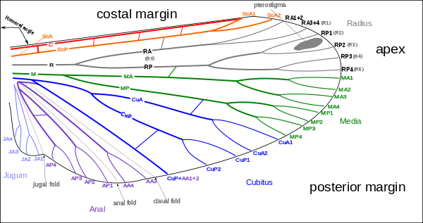

Slide 3
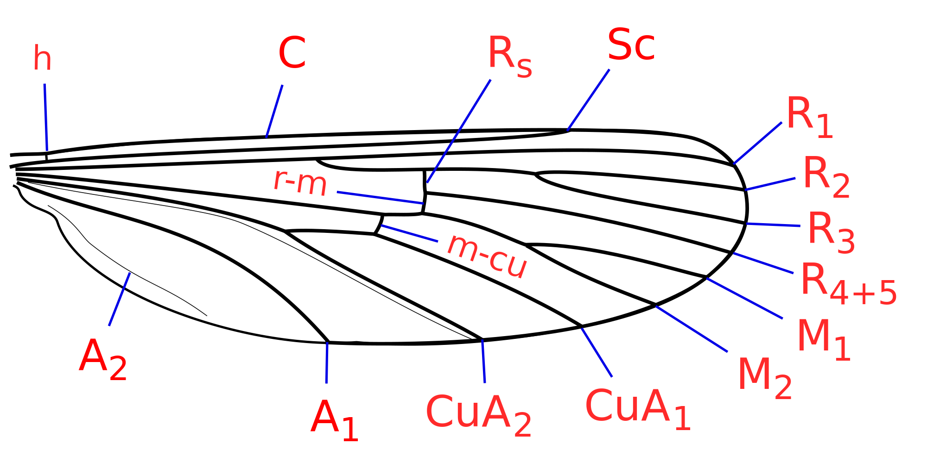
Wing venation
Longitudinal veins
Costa (C) (Unbranched)
Subcosta (Sc) (2 branched)
Radius (R) (R1 and rs-4 branched)
Media (M) (MA and MP, 6 branched)
Cubitus (Cu) (2 branched
Anals (A)
Cross veins
Humeral (h) (costa to subcosta)
Radial (r) (R1 to radial sector)
Sectorial (s) (R3 to R4)
Radiomedial (r-m) (R to M)
Medial (m) (M2 to M3)
Mediocubital (m-cu) (M to Cu)

Slide 4
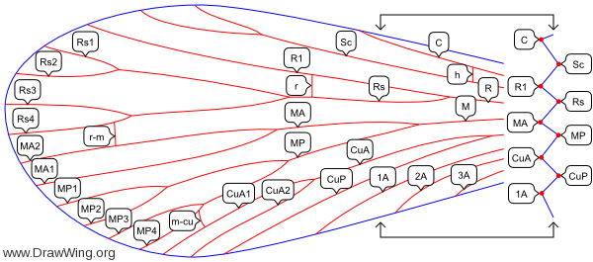

Slide 5
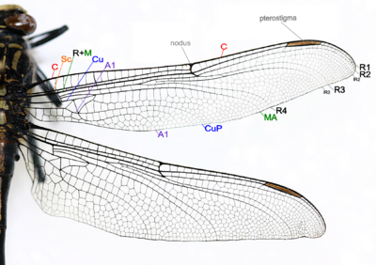
Dragonfly

Slide 6
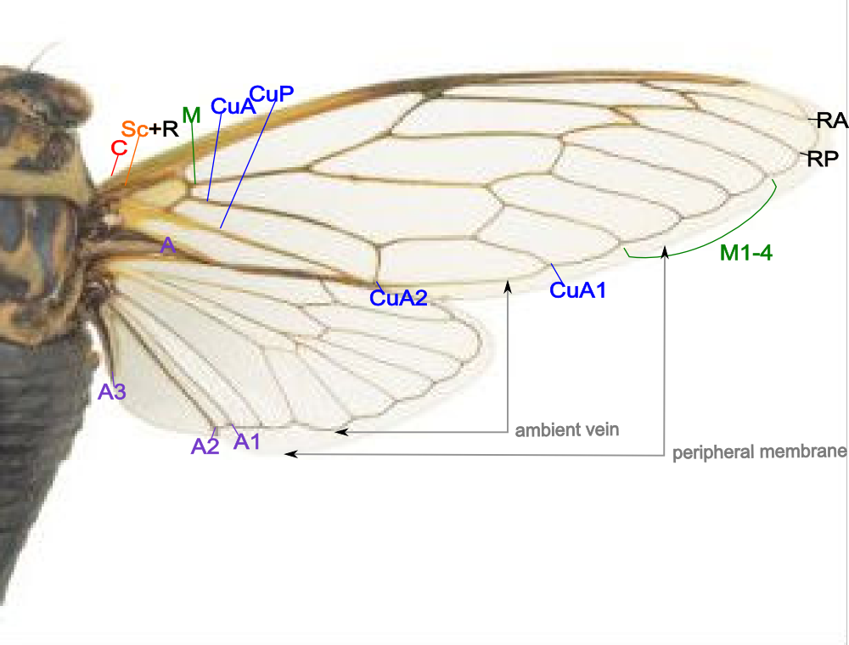
Cicada

Slide 7
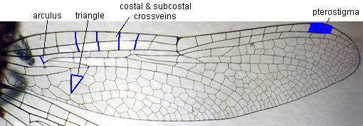

Slide 9
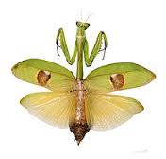
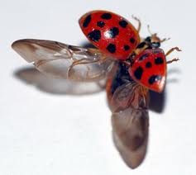
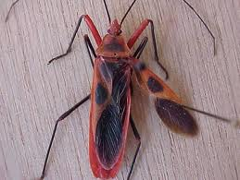
Modification of wings
Tegmina:
Fore wing modified into long, narrow, hard and thick structure
e.g., grasshopper, cockroaches, mantids, crickets
Elytra:
FW modified into very thick and hard structure
e.g., beetle, weevil, earwigs
Hemelytra:
basal part of FW is thick and hard
Apical part is thin and membranous
e.g., true bugs (red cotton bug)
mantid
Lady bird beetle
Bug

Slide 10
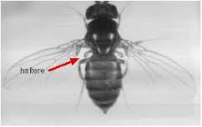
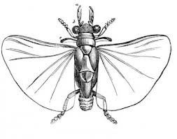
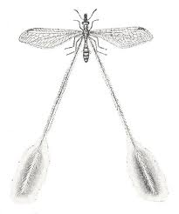
Halteres:
HW modified into tiny, knobbed structures
e.g., flies, male coccids (mango mealy bug)
Pseudohalteres:
FW modified into halters
e.g., male stylopids
Filohalteres:
HW modified into long and thread-like structures
e.g., lacewings (Croce sp.)

Slide 11
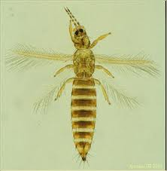
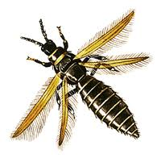
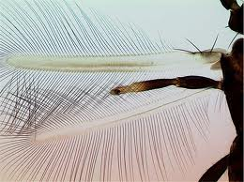
Strippy:
wings modified into strips or rod-like structures
Fringed with long hair
e.g., thrips
Membranous:
HW thin and broad like membrane
e.g., grasshopper, locusts, crickets, earwigs, beetles

Slide 12
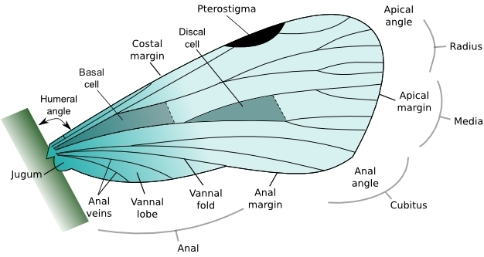
Wings structure in insect orders and families of economic importance

Slide 13
Wings structure overview in insect
Wings are outgrowth of exoskeleton that enable to fly insect
Present on meso and meta thorax respectively called as fore and hind wings
The wings are strengthened by a number of longitudinal veins, which often have cross-connections that form closed "cells" in the membrane (extreme examples include lacewings and dragonflies)

Slide 14
Adaptations/Variations
For identifying and classifying of insects species wings are more significant than others structures
Each insect order and family has distinctive wing structures and features
Even species may be distinguished by difference in pattern and color of wings

Slide 15
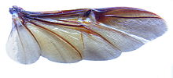
Wing structure in coleopteran
In coleopterans functional wings are hind wings…..are longer than elytra ….that folded transversely and longitudinally under elytra
There is the spring mechanism in the wing structure, sometimes with the help of abdomen movement, to keep the wing in folded position. The beetle wing venation is reduced and modified due to the folding structure,

Slide 16
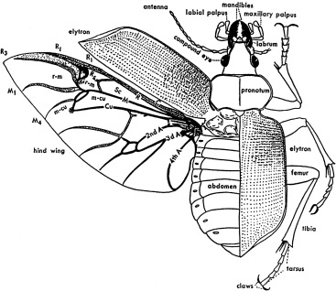
Cross folding wings of beetle
Costa (C), Subcosta posterior (ScP) – at the leading wing marginal, fused for most of the length
Radius anterior (RA) – divided into two branches beyond the middle of the wing
Radius posterior (RP) – basal connection is lost
Media posterior (MP) – branches, long and strong vein
Cubitus anterior (CuA)
Anal veins (AA, AP) – veins behind the cubitus, separated by anal fold

Slide 17
Lepidopteron wings structure
The wings are covered in scales arranged like shingles, forming the extraordinary variety seen in color. The mesothorax is evolved to have more powerful muscles to propel moth or butterfly through the air, with the wing of said segment having a stronger vein structure
Scales provide a number of functions, which include insulation, thermoregulation, aiding gliding flight, amongst others, the most important of which is the large diversity of vivid or indistinct patterns they provide which help the organism protect itself by , mimicry and to seek mates

Slide 18
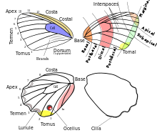
Venation pattern
Costa (C) – not found in Butterflies
Subcosta (Sc) + Radius 1 (Sc+R1) – at the leading wing marginal, fused or very close for most of the length, in hindwing fused and well developed in the humeral area, subcosta never branches in butterfly
Radius (R2-R5) – radius divides into branches beyond the middle of the wing up to five branches in Papilionidae
Radius sector (Rs) – in hindwing
Media (M1-M3) – the basal section has been lost.
Cubitus anterior (CuA1-CuA2) – CuP section has been lost.Anal veins (A, 1A+2A, 3A) – either one vein A, or two veins 1A+2A, 3A
Humeral vein – The hindwing of most butterflies has the humeral vein, except Lycaenidae

Slide 19
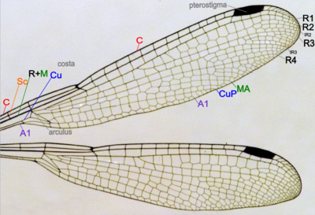
Odonata
(Damselflies and dragonflies) both have two pairs of wings which are about equal in size and shape and are clear in color. The main vein stems are fused at their bases and the wings cannot be folded over the body at rest

Slide 20
Venation pattern
Wing venation patterns are different in different species
Costa (C) – at the leading edge of the wing, strong and marginal, extends to the apex of the wing
Subcosta (Sc) – second longitudinal vein, it is unbranched, joins C at nodus
Radius and Media (R+M) – third and fourth longitudinal vein, the strongest vein on the wing, with branches, R1-R4, reach the wing margin, the media anterior (MA) are also reach the wing margin. IR2 and IR3 are intercalary veins behind R2 and R3 respectively
Cubitus (Cu) – fifth longitudinal vein, cubitus posterior (CuP) is unbranched and reach the wing margin
Anal veins (A1) – unbranched veins behind the cubitus
A nodus is formed where the second main vein meets the leading edge of the wing. The black pterostigma is carried near the wing tip

Slide 21
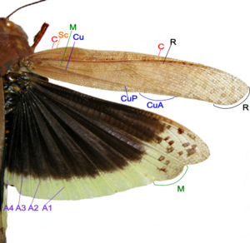
Orthoptera
Fore wings are tough opaque tegmina, narrow that covers hind wings and abdomen at resting position. The hind wings are board membranous and folded in fan-like manner, which include the following venation

Slide 22
Wings venation
Costa (C) – at the leading marginal of the forewing and hindwing, unbranched.
Subcosta (Sc) – second longitudinal vein, unbranched
Radius (R) – third longitudinal vein, branched to Rs in forewing and hindwing.
Media anterior (MA) – fourth longitudinal vein, branched in basal part as Media posterior (MP)
Cubitus (Cu) – fifth longitudinal vein, on forewing and hindwing dividing near the wing base into branched CuA, and unbranched CuP
Anal veins (A) – veins behind the cubitus, unbranched, two in forewing, many in hindwing

Slide 23
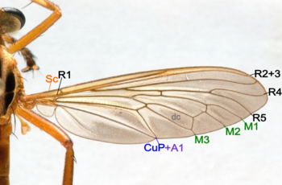
Dipteran True flies
One pair of functional wing, posterior wing pair are reduced to halters which is directed to sense orientation, movement and balance
In Calypetratae, the very hindmost portion of the wings are modified into somewhat thickened flaps called calypters which cover the halteres

Slide 24
Wings venation
Costa (C) – not found in Diptera
Subcosta (Sc) – became the leading wing vein, unbranched
Radius (R) – branched to R1-R5
Media (M) – branched to M1-M4
Cubitus anterior(CuA)- unbranched, CuP is reduced in Diptera. Some species CuA and 1A are separated, some species meets when reaching the wing margin, some species fused
Anal veins (A) – only two anal veins 1A and 2A are present, 2A is not distinctive in some species
Discal Cell (dc) – well defined in most species

Slide 25
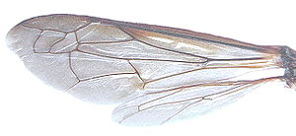
Hymenopterans
Wasps, bees, sawflies, ants have two pairs of membranous wings
The forward margin bears a
number of hooked bristles
or hamuli, which lock onto the forewing, keeping them held together

Slide 26
Wings venation
Costa (C) – not found in Hymenoptera.
Subcosta (Sc) – unbranched.
Radius (R) – branched to R1-R5.
Media (M) – M is unbranched, in forewing M is fused with Rs for part of its length.
Cubitus (CuA) – unbranched, CuP is absent in Hymenoptera.
Anal veins (A) – only two anal veins 1A and 2A are present, 2A is not distinctive in some species.
Wing-coupling – Row of hooks on the leading edge of hindwing engage the hind margin of the forewing, strongly couple the wings in flight.
Line of wing folding – Some species, including Vespidae, the forewing are longitudinally folded along the 'line of wing folding' at rest.
Pterostigma – is present for some species.

Slide 27
Hemipteran (True bugs)
Fore wings are hardened but lesser than beetles while in some species both wings are membranous so most species are glass-like although some are opaque
When flying, forewing and hindwing are hooked together by a grooved coupling along the hindwing costa and forewing margin

Slide 28
Wings venation
Costa (C) – at the leading wing marginal, in forewing extends to the node and lies close to Sc+R
Subcosta + Radius (Sc+R) – in forewing Sc and R fused together to the node. Radial sector (Rs) arises near the node and unbranches
Radius anterior (RA)
Radius posterior (RP)
Media (M) – branches to M1 to M4
Cubitus anterior (CuA) – branches to CuA1 and CuA2
Cubitus posterior (CuP) – unbranches
Anal veins (A) – veins behind the cubitus, 1A and 2A fused in the forewing, CuP and 2A are folded
Also notice there are the ambient veins and peripheral membranes on the margin of both wings

Slide 29
Blattodea
Forewing, are also known as tegmen, that is more or less sclerotized that is protective for membranous hind wings
Veins in fore and hind wings are same but large anal lobe folded at rest between CuP and 1A
The anal lobe usually folded in a fan-like manner

Slide 30
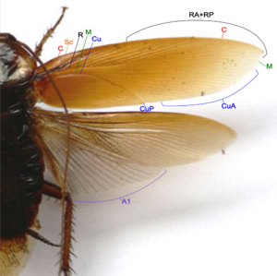
Wings venation
Costa (C) – at the leading edge of the wing
Subcosta (Sc) – second longitudinal vein, it is relatively short
Radius (R) – third longitudinal vein, with many pectinate branches
Media (M) – fourth longitudinal vein, reach the wing margin
Cubitus anterior (CuA) – fifth longitudinal vein, with dichotomous branches occupy large part of tegmen
Cubitus posterior (CuP) – is unbranched, curved and reach the wing margin Anal veins (A) – veins behind the cubitus

Slide 31
References
CoTriplehorn, Charles A.; Johnson Norman F. (2005). Borror and DeLong's introduction to the study of insects (7th ed.). Thomson Brooks/Cole. ISBN 0-03-096835-6.
Wakeling JM Ellington CP (1997). "Dragonfly flight III lift and power requirements". Journal of Experimental Biology. 200 (Pt 3): 583–600 (589). PMID 9318294.
^ Matsuda R (1970). "Morphology and evolution of the insect thorax". Mem. Ent. Soc. Can. 102 (76): 1–431. doi:10.4039/entm10276fv.
^ V. A. Blagoderov; E. D. Lukashevich; M. B. Mostovski (2002). "Order Diptera Linné, 1758. The true flies". In A. P. Rasnitsyn; D. L. J. Quicke (eds.). History of Insects. Kluwer Academic Publishers. ISBN 1-4020-0026-X.
^ Trueman JWH (1990), Comment: evolution of insect wings: a limb exite plus endite model Canadian Journal of Zoology
^ Staniczek, A.H.; Bechly, G. & Godunko, R.J. (2011). "Coxoplectoptera, a new fossil order of Palaeoptera (Arthropoda: Insecta), with comments on the phylogeny of the stem group of mayflies (Ephemeroptera)" (PDF). Insect Systematics & Evolution. 42 (2): 101–138. doi:10.1163/187631211X578406. Archived from the original (PDF) on 2011-10-03.
^ Adrian L. R. Thomas; R. Åke Norberg (1996). "Skimming the surface — the origin of flight in insects?". Trends in Ecology & Evolution. 11 (5): 187–188. doi:10.1016/0169-5347(96)30022-0.
^ Yanoviak SP, Kaspari M, Dudley R (2009). "Gliding hexapods and the origins of insect aerial behaviour". Biology Letters. 5 (4): 510–2. doi:10.1098/rsbl.2009.0029. PMC 2781901. PMID 19324632.
^ Jump up to:ª ^{b} ^{c} ^{d} H. Comstock, Henry (1918). The Wings of Insects. Ithaca, NY: The mstack

Slide 32
Types of larvae
 | Type | Body shape | Thoracic legs | Abdominal legs | Cerci | Example
 | Campodeiform | Flattened | Present (Long legs) | Absent | Present | Diving beetle
2. | Carabiform | Flattened | Present (Short legs) | Absent | Absent | Fireflies
3. | Eruciform | Cylindrical | Present | Present (2 to 5 pairs) | Absent | Butterflies,moths
4. | Scarabaeiform | Cylindrical and C-shaped | Present | Absent | Absent | Gram dhora, scarab beetle
5. | Elateriform | Cylindrical, thin, elongate | Present ( short legs) | Absent | Absent | Click beetle
6. | Platyform | Broad | Absent | Absent | Absent | Syrphid beetle
7. | Vermiform | Cylindrical, elongate, narrowing anteriorly | Absent | Absent | Absent | Flies, fleas, parasitic wasp

