Slide 1
Internet, Search engines, Brewers

Slide 2
The internet
The internet originated with the U.S. government, which began building a computer network in the 1960s known as ARPANET. In 1985, the U.S. National Science Foundation (NSF) commissioned the development of a university network backbone called NSFNET.
The system was replaced by new networks operated by commercial internet service providers in 1995. The internet was brought to the public on a larger scale at around this time
Since then, the Internet has grown and evolved over time to facilitate services like:
Email.
Web-enabled audio/video conferencing services.
Online movies and gaming.
Data transfer/file-sharing, often through File Transfer Protocol (FTP).
Instant messaging.
Internet forums.
Social networking.
Online shopping.
Financial services.
As a global network responsible for vast amounts of data transfer and process facilitation, the Internet is constantly evolving. For instance, an initial protocol called IPv4 distributing Internet Protocol (IP) addresses has largely been replaced by a new IPv6 model that will increase the number of addresses available for each continent around the globe.

Slide 3
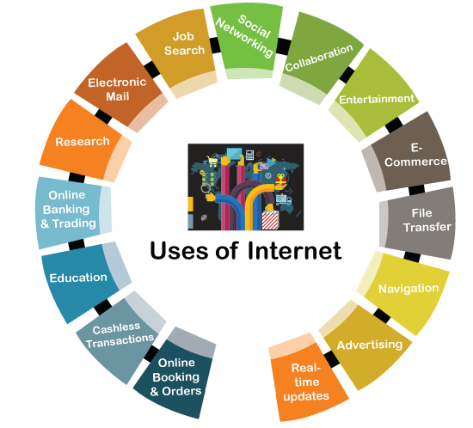
The Internet has also expanded beyond the traditional workstation, as the “Internet of Things,” (IoT) as it's called, is born. There's still somewhat of a delineation between traditional Internet nodes, which use a classic web browser, and Internet-connected devices which will more commonly use reduced instruction set software, but the Internet of Things is blurring the line of where the Internet stops and the analog world begins.
Uses of Internet:
The Internet is a global networking system that can be used on most devices nowadays and has become an essential part of our lives. In today's technological era, most of the companies are getting their operations done over the Internet. There are various uses of the Internet by which companies and individuals are making their daily tasks more productive and more comfortable.
Here, we have discussed the major uses of the Internet that play a vital role in daily life:

Slide 4
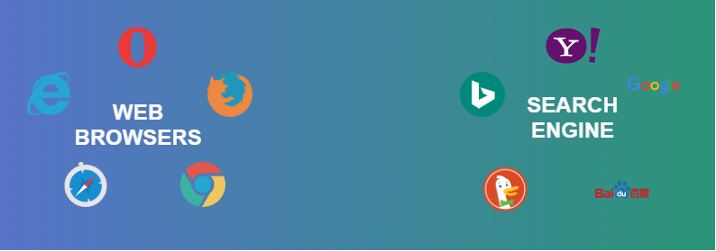
Search Engine: A search engine is a kind of website through which users can search the content available on the Internet. For this purpose, users enter the desired keywords into the search field. Then the search engine looks through its index for relevant web pages and displays them in the form of a list. The Internet is a huge source of information & resources and to access the resource from the Internet there are some kinds of software, this softwares are known as Search Engine. Some of the popular ones are: Google, Bing, Yahoo, Duck duck go, Baidu, etc.
There are three main components of the Search engine:
Crawler: Crawlers are software programs sometimes referred to the bots. It regularly scans the websites automatically for URLs, keywords, and links in order to discover the new updates. The crawler can follow the links present on some other webpage.
Index: As we know, the Crawler continuously scans the websites, it develops an index of URLs, links and keywords to make the search results more effective.
Search Algorithm: The search algorithm is the complete mechanism behind the whole searching process. It is working by searching for the index and finding for the most suitable webpages by matching keywords that are searched by the users.

Slide 5
Web Browser:
The web browser is an example of application software that is developed to retrieve and view the information from web pages or HTML files present on the web servers. The first web browser was invented by Sir Tim Berners-Lee in 1990 and the very first graphical web browser was developed in 1993 which is named the mosaic. After that, various web browsers were developed. Some of them are navigator which is developed by Netscape communication, Microsoft’s internet explorer, Google Chrome, Mozilla Firefox, Opera and Apple safari.
The main characteristics of Web Browser are:
It consists of Graphical User Interface.
It contains the search box where the user can type the address or URL.
Page style can be static or dynamic. It depends upon the interactivity and the formatting.
TCP/IP and HTTP protocols are used by the web browsers

Slide 6
Difference between Search Engine and Web Browser:
SEARCH ENGINE | WEB BROWSER
A search engine is used to find the information in the World Wide Web and displays the results at one place. | Web Browser uses the search engine to retrieve and view the information from web pages present on the web servers.
Search engine is intended to gather Information regarding several URL’s and to maintain it. | Web Browsers are intended to Display the web page of the current URL available at the server.
A search engine contains its own database | No database is required in Web browser. It contains only cache memory to store cookies.
Example of famous search engines are: Google, Yahoo, Bing, DuckDuckgo, Baidu Internet Explorer. | Some of the widely used web browsers are: Mozilla Firefox, Netscape Navigator, and Google Chrome.

