Slide 1
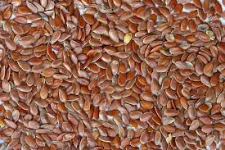
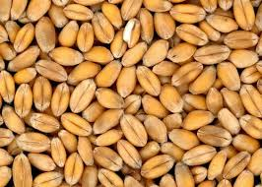
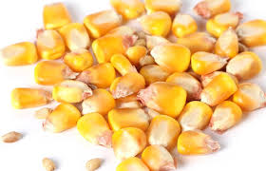
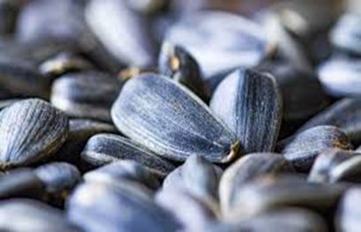
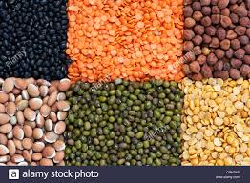
Seeds

Slide 2
Seeds
The life cycle of many plants begins with a seed. Seeds are essential for the survival and continued existence of many plant species.
Seeds contain the genetic material to produce another.

Slide 3
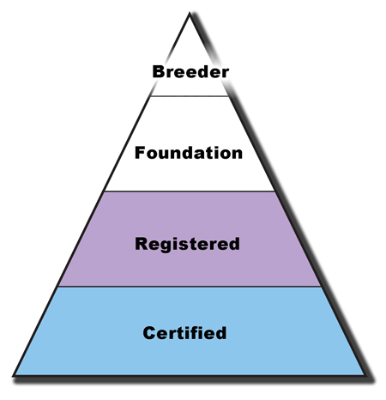
Stages of Seed Production

Slide 4
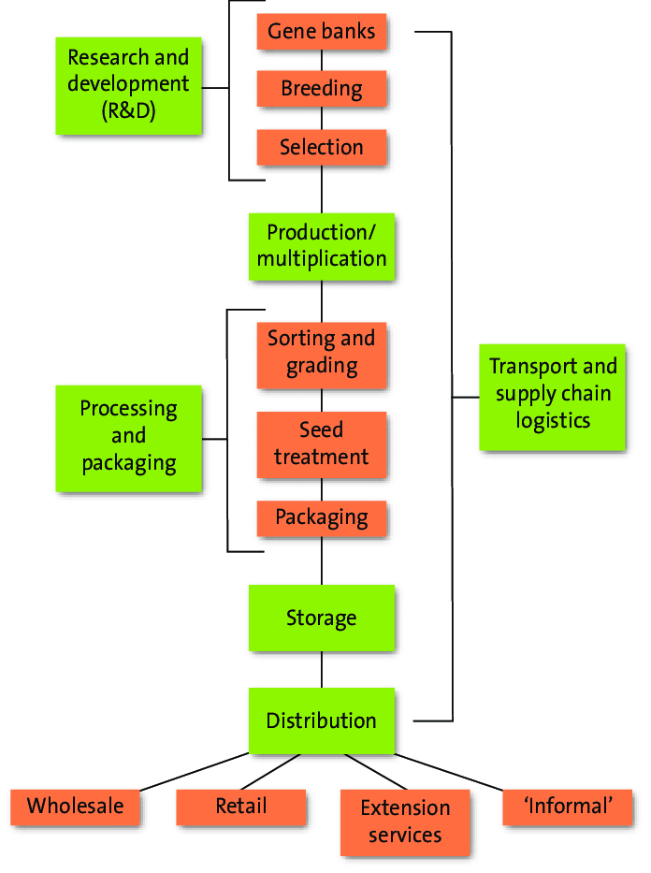

Slide 5
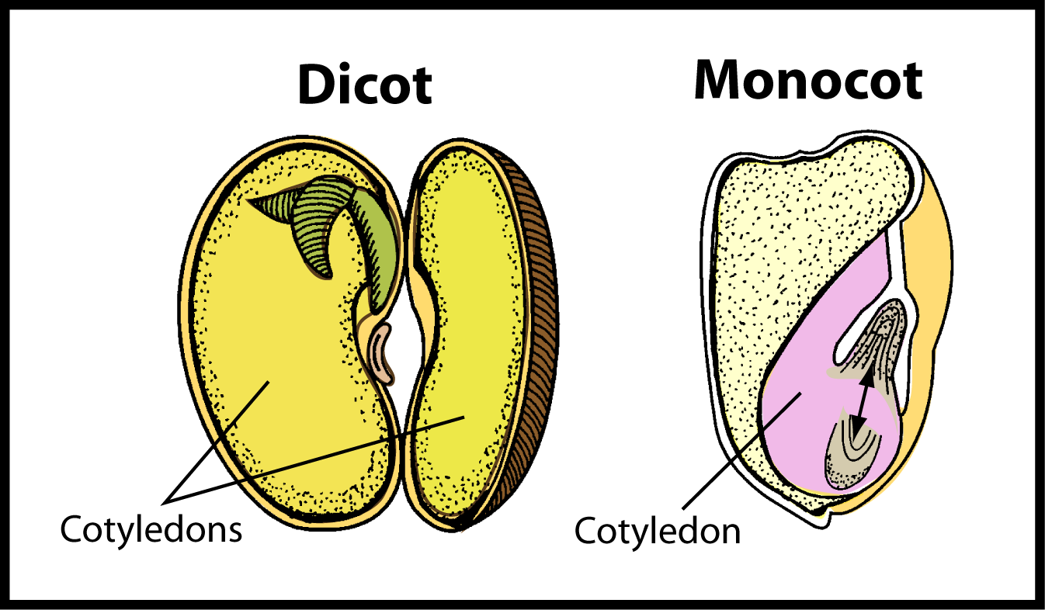
Seeds Classification
Seeds of dicot plants have two cotyledons.
Seeds of monocot plants have one cotyledon.

Slide 6
Parts of Seed
All seeds contain an embryo and have their own food supply.
The embryo consists of a plumule, epicotyl, cotyledons, hypocotyl, and a radicle.

Slide 7
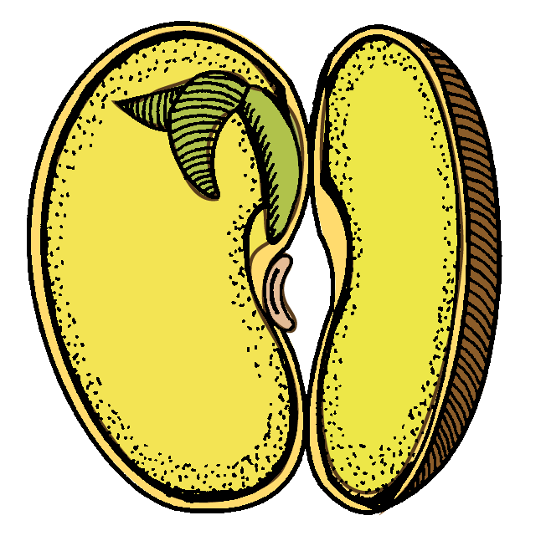
Seeds
The plumule includes the young primordial leaves and growing point of the stem.
Plumule

Slide 8
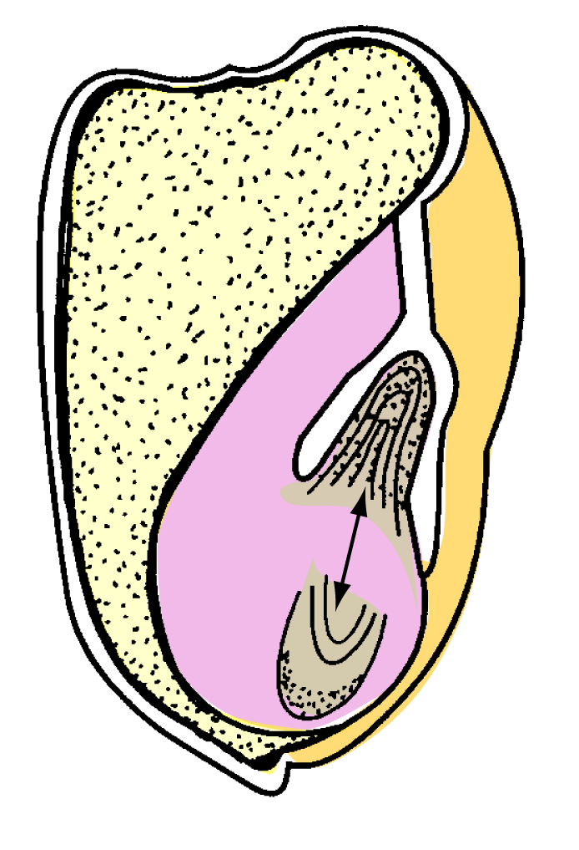
Seeds
The epicotyl is the portion of the stem above the cotyledon.
Epicotyl
Epicotyl

Slide 9
Seeds
The cotyledons are the seed leaves used for food storage.
Cotyledons
Cotyledon

Slide 10
Seeds
The hypocotyl is the portion of the stem below the cotyledons.
Hypocotyl
Hypocotyl

Slide 11
Seeds
The radicle is the young embryonic root and root tip.
Radicle
Radicle

Slide 12
Monocot
Epicotyl
Endosperm
Plumule
Cotyledon
Hypocotyl
Coleoptile
Epicotyl
Radicle
Axis of Embryo
Micropyle
Hypocotyl
Hilum
Radicle
Cotyledons
Coleorhiza
Pedicel
Seed Coat

Slide 13
Dicot
Epicotyl
Plumule
Hypocotyl
Radicle
Micropyle
Hilum
Cotyledons
Seed Coat

Slide 14
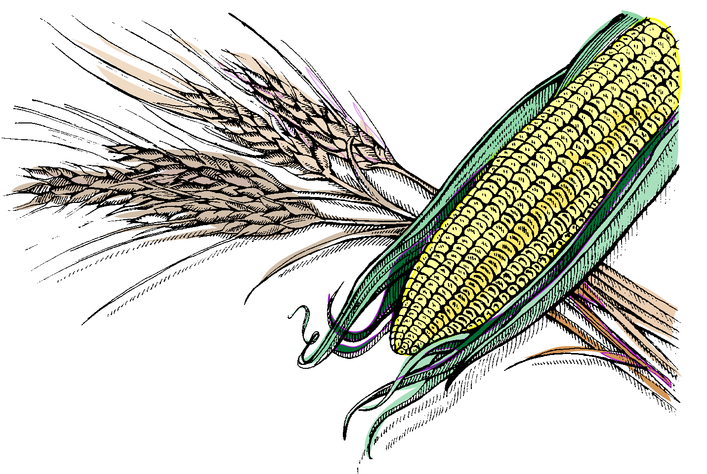
Monocots
Maize, wheat, rice, and oats are typical monocots.

Slide 15
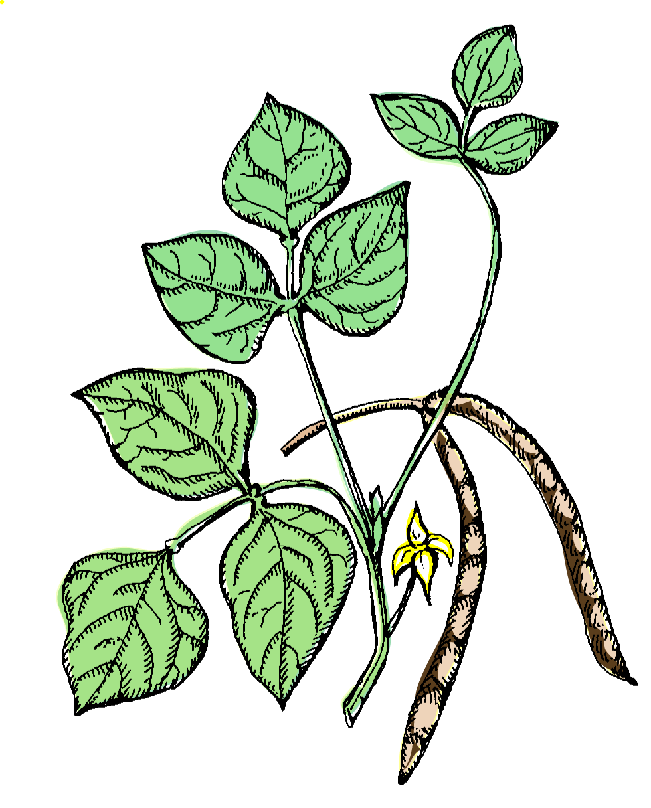
Dicots
Dicots include: Garden beans, legumes, alfalfa, soybeans, and cowpeas.

Slide 16
Seed Germination

Slide 17
Seed Germination
Factors affecting seed germination:
Moisture
Temperature
Oxygen
Light

Slide 18
Moisture
A seed must have an ample supply of moisture for germination to occur.
Moisture content needed for germination to occur ranges from 25% to 75%.
Once the germination process begins, a dry period or lack of water will cause the death of the developing embryo.

Slide 19
Temperature
Temperature affects both the germination percentage and the germination rate.
Germination rate is lower at low temperatures.
Most plant seeds germinate at an optimum temperature range of 68°F to 120°F.

Slide 20
Oxygen
Oxygen is necessary for respiration to occur within a seed. Respiration converts the stored food in the seed into energy for germination.
Some seeds require less oxygen than others.
Oxygen deficiency occurs if seeds are planted in flooded or compacted soil.

Slide 21
Light
The presence or absence of light may or may not have an effect on germination.
Light is not as important as a viable seed, germination medium, water, optimum temperature, and oxygen.

Slide 22
Seed Dormancy

Slide 23
Seed Dormancy
Most seeds produced by mature plants pass through a period of inactivity or dormancy prior to germination. During this period of inactivity, seeds remain viable.
Dormancy may be internal, external, or a combination of both.

Slide 24
Embryo (Internal) Dormancy
Dormancy may occur when a mature seed contains an underdeveloped or immature embryo.
Internal dormancy of most seeds involves a period of after-ripening. After-ripening occurs when a seed does not or is not ready to germinate until it completes a certain stage of development.
Some seeds mature in the fruit but do not germinate until released from the fruit.

Slide 25
Seedcoat (External) Dormancy
A seed may require a certain amount of light to germinate causing the seed to remain dormant until exposed to light.
The seedcoat may be hard and/or thick, preventing the absorption of water, intake of oxygen, or physically preventing the expansion of the embryo.

Slide 26
Adverse Conditions
Conditions that may affect the viability
and germination of seeds include:
Mechanical Injury
Diseases
Improper Storage
Age
Inadequate Growing Medium

Slide 27
The Germination Process

Slide 28
The Germination Process
Steps in the germination process:
Water Absorption
Radicle Emergence
Plant Emergence
Leaf Formation
Photosynthesis

Slide 29
Water Absorption
The seed absorbs water and oxygen.
Absorbed oxygen causes the seed to swell and increase in size.
The seed secretes enzymes that convert insoluble starches into soluble sugars.
Soluble sugars dissolve in the absorbed water and are used as food by the plant embryo.

Slide 30
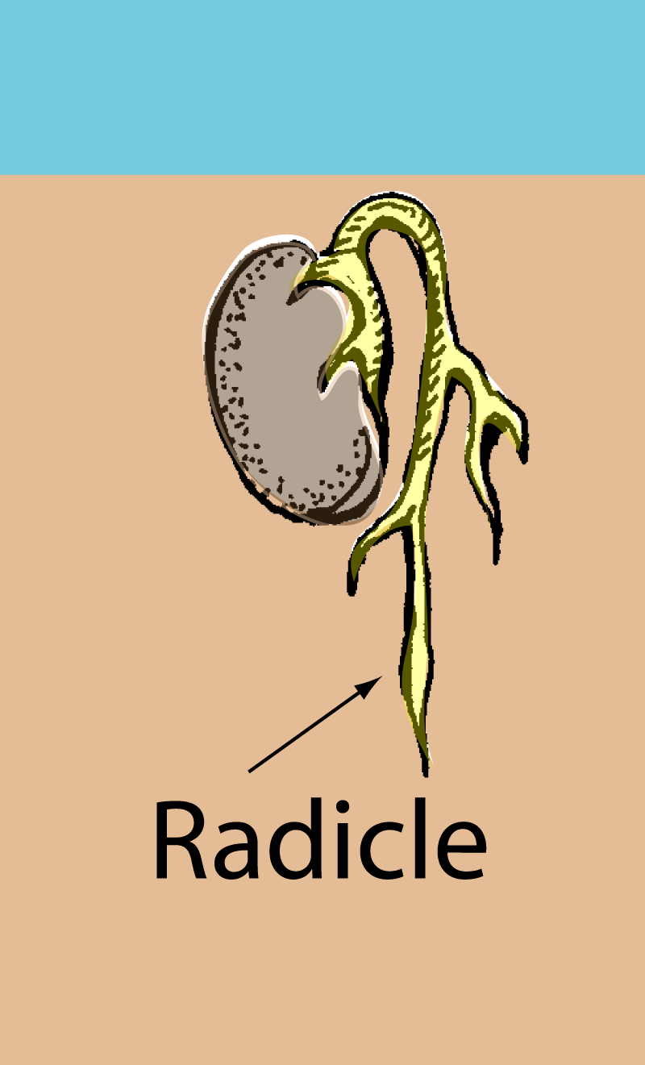
Emergence of Radicle
The seed coat ruptures
permitting the young
root (radicle) to emerge
and grow downward to
anchor the plant.

Slide 31
Emergence of Radicle
In a dicot, the seed coat (testa) splits near the hilum, and the young root becomes the primary root from which all branching roots form.

Slide 32
Plant Emergence
The above-soil-surface portion of the plant emerges as the radicle develops into the plant’s root system.
In a dicot, the hypocotyl elongates, forming an arch and pulling the cotyledons upward.
The hypocotyl arch straightens to a vertical position after passing through the soil surface.

Slide 33
Modes of Germination
Two types of seed germination occur
among seeds based on how the
seedlings emerge.
Epigeous Germination
Hypogeous Germination

Slide 34
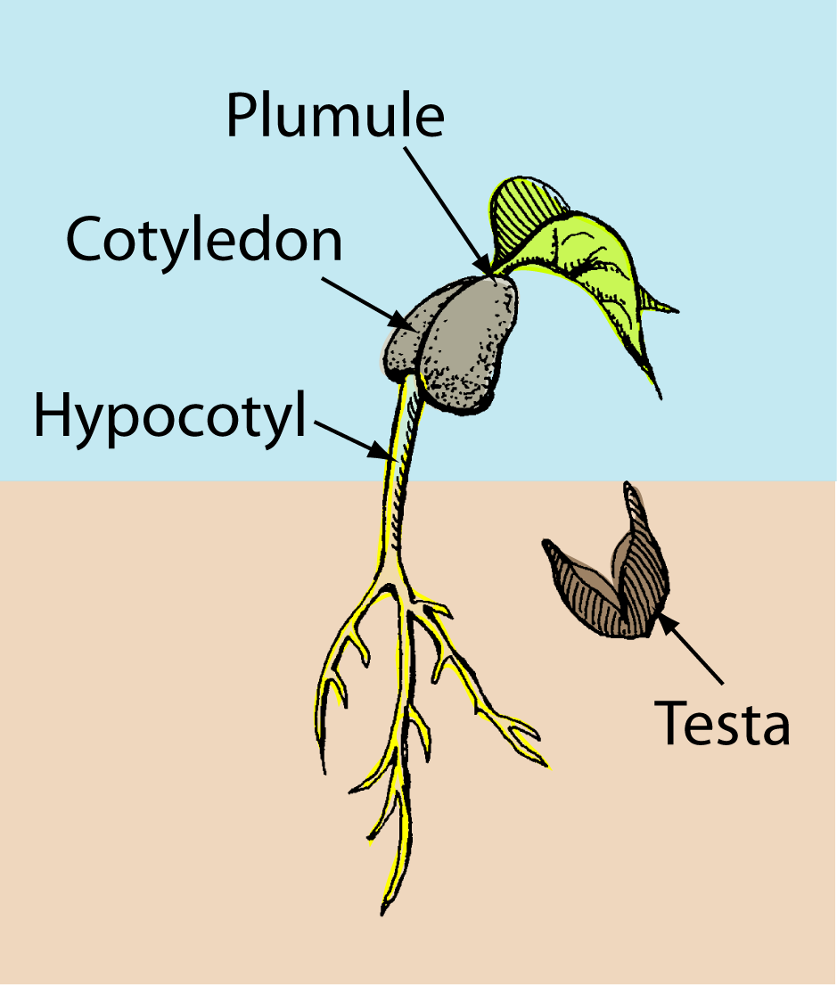
Epigeous Germination
In epigeous germination, the hypocotyl of the embryo elongates and raises the plumule, epicotyl, and cotyledons through the soil surface and above the ground.
Garden beans have an epigeous type of germination.

Slide 35
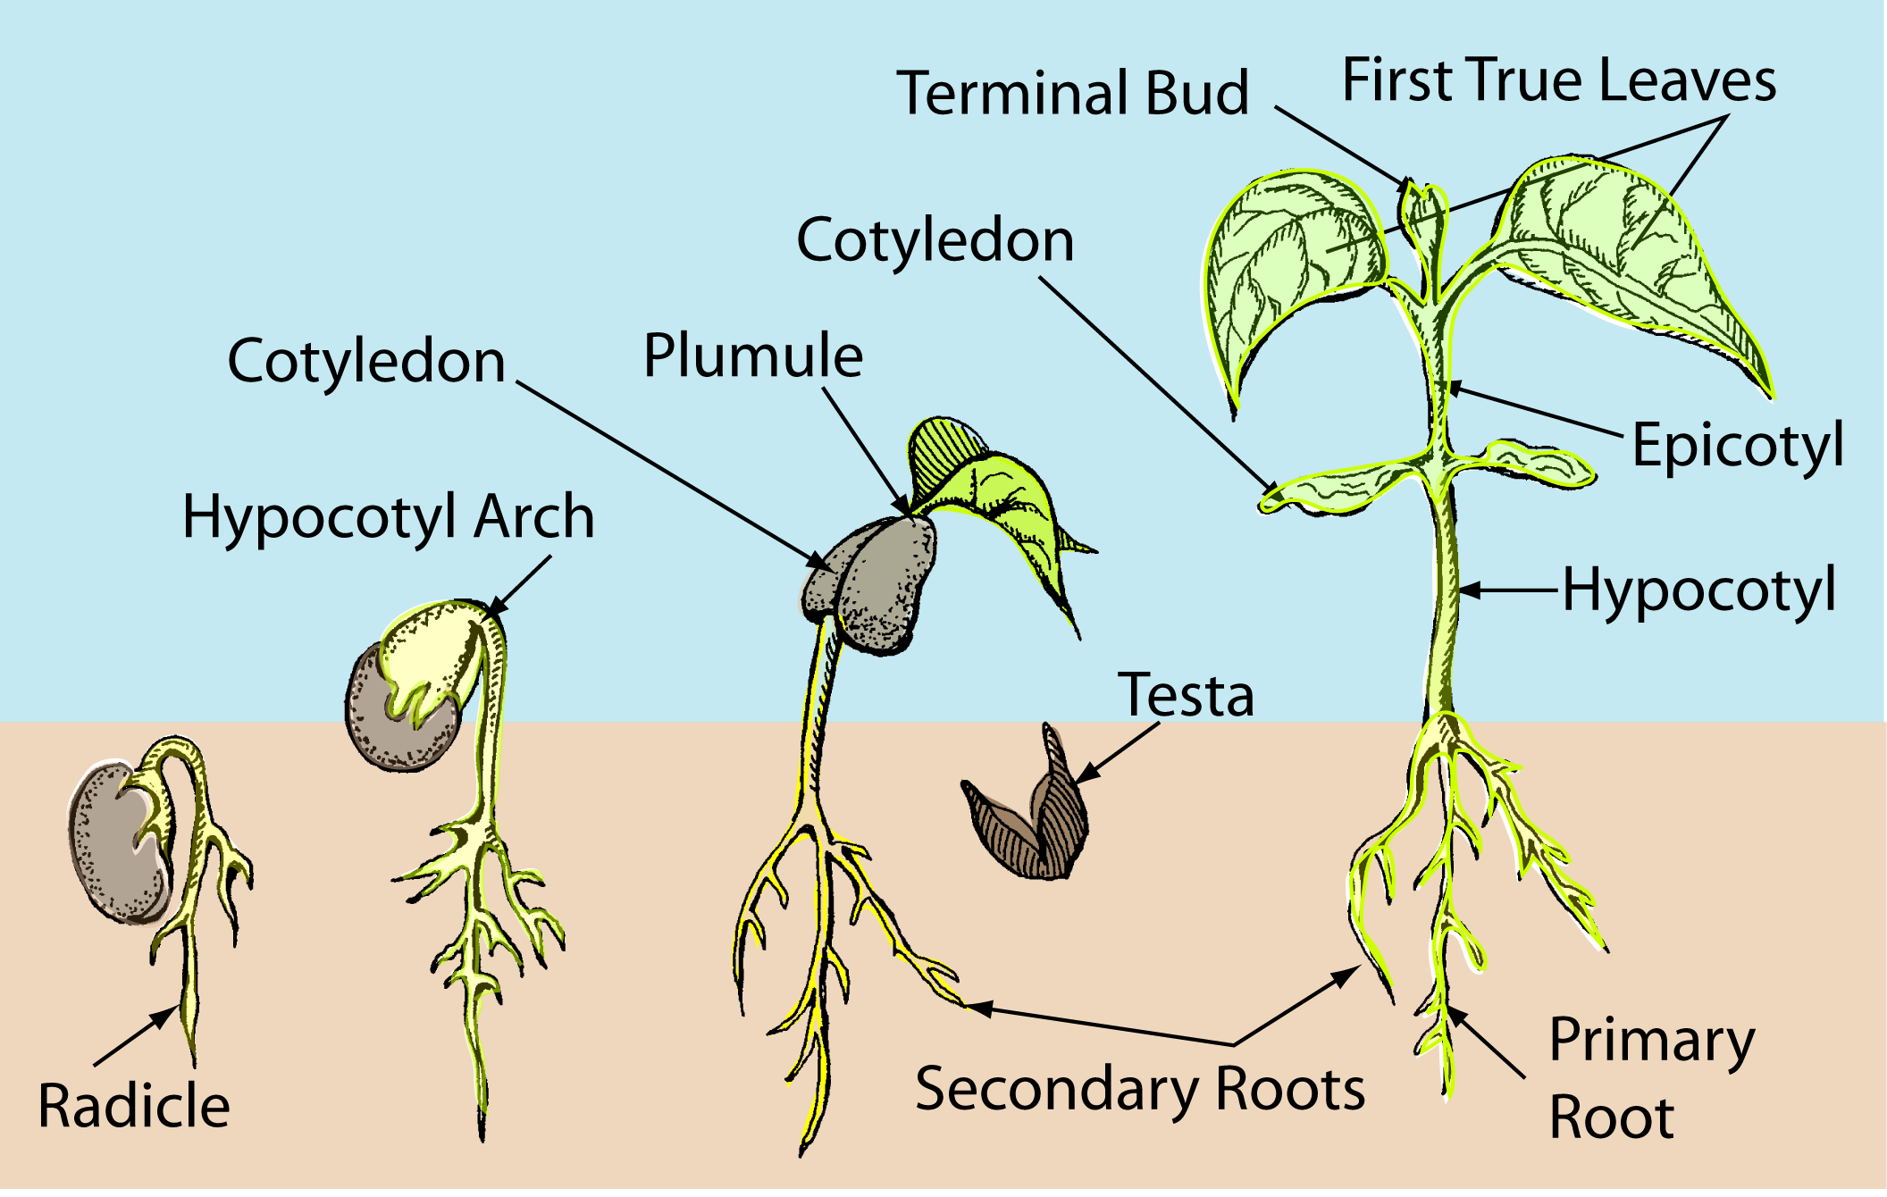
Epigeous Germination

Slide 36
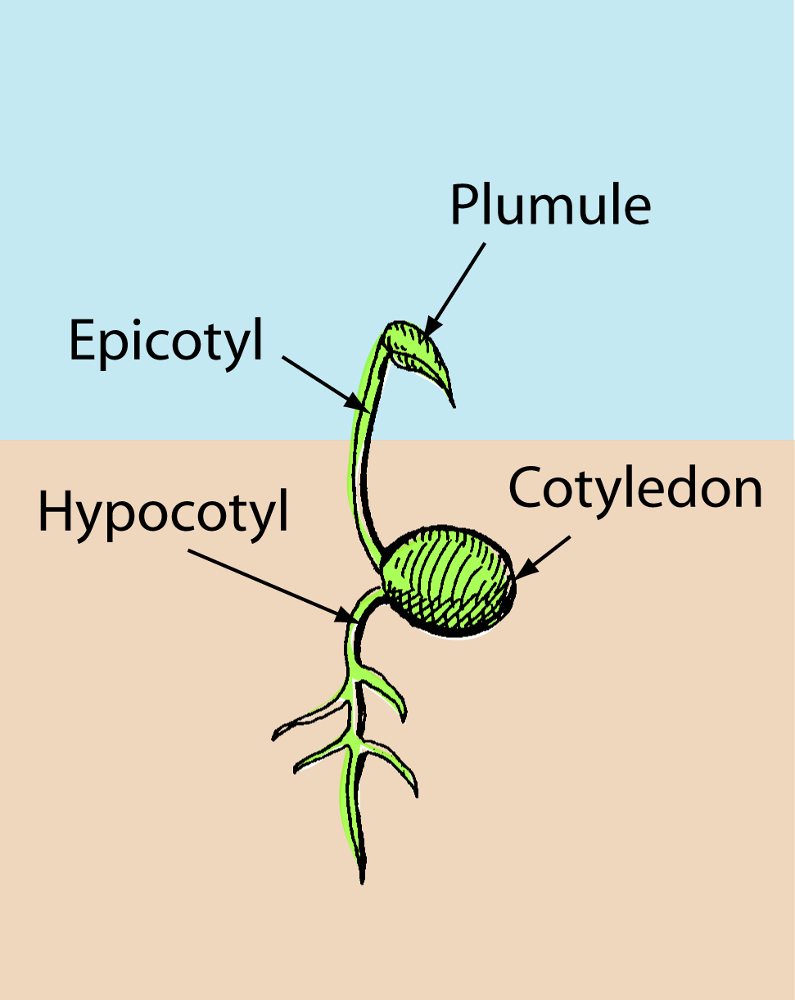
Hypogeous Germination
In hypogeous germination, the epicotyl elongates and raises the plumule above the ground.
The cotyedons (which are usually still enclosed by the seed coat) and the hypocotyl never emerge and remain below the surface of the soil.
wheat have a hypogeous type of germination.

Slide 37
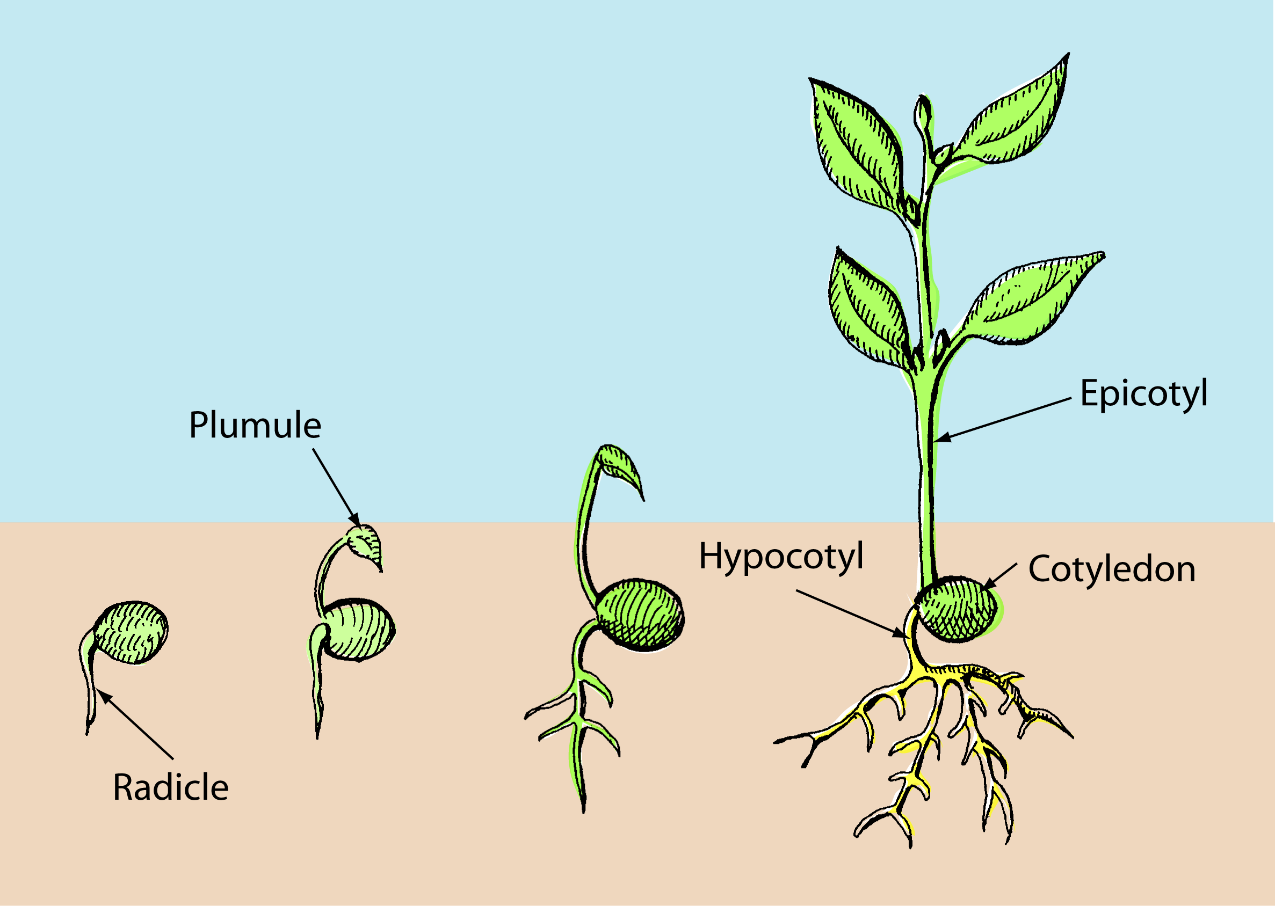
Hypogeous Germination

