Slide 1
Vesicular Transport and cell migration

Slide 2
Vesicular Transport
Communication between some organelles is mediated by vesicles, which carry molecules both in the interior and as part of the membrane of the vesicle. Vesicular trafficking includes all the communication pathways mediated by vesicles, as well as the organelles that send or receive vesicles

Slide 3
exocytosis
There are two main roads in this trafficking road map.
One, known as secretory pathway, starts in the endoplasmic reticulum, that sends vesicles to the Golgi apparatus, which in turn sends vesicles targeted to the plasma membrane (exocytosis).
This pathway releases molecules to the extracellular space, and also carries molecules to the plasma membrane.

Slide 4
Endocytosis
The other pathway is an importing pathway that begins at the plasma membrane where vesicles and other large compartments are originated by membrane invagination (endocytosis).
These vesicles fuse with the endosomes, which end up becoming lysosomes. Lysosomes degrade the endocyted molecules, both those from the extracellular space and those forming the membrane of the vesicles.
It is a degradation pathway.

Slide 5
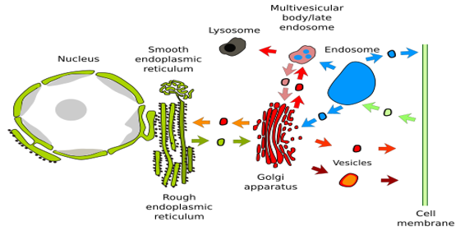

Slide 6
Exocytosis
Exocytosis is a cellular process where cells eject waste products or chemical transmitters (such as hormones) from the interior of the cell

Slide 7
There are 5 steps of exocytosis
Vesicle trafficking
Vesicle tethering
Vesicle docking
Vesicle priming
Vesicle fusion

Slide 8
1.Vesicle trafficking
In this step the vesicle containing wast product or chemical transmitter is transported through the cytoplasm toward the part of the cell from which it will be eliminated

Slide 9
Vesicle tethering
As the vesicle approaches the cell membrane, it is secured and pulled towards the part of the cell from which it will be eliminated

Slide 10
Vesicle docking
In this step, the vesicle comes in contact with the cell membrane, where it begins to chemical and physically merge with the proteins in the cell membrane.

Slide 11
Vesicle priming
In those cells where chemical transmitters are being released, this step involves the chemical preparations for the last step of exocytosis.

Slide 12
Vesicle fusion
In this last step, the proteins forming the walls of the vesicle merge with the cell membrane and breach, pushing the vesicle contents (waste products or chemical transmitters) out of the cell. This step is the primary mechanism for the increase in size of the cell’s plasma membrane

Slide 13
Calcium dependent exocytosis
In calcium-dependent exocytosis, an influx of calcium into the cell will stimulate secretion.
This happens when a protein is only secreted when needed. Transport vesicles with their cargo will travel from the Golgi vesicle (the protein-packaging organelle) to the plasma membrane.
The vesicle then docks at the plasma membrane and waits for a secretion signal.
This is also called regulated exocytosis because secretion from the vesicles is controlled.

Slide 14
CALCIUM INDEPENDENT EXOCYTOSIS
In contrast, calcium-independent exocytosis occurs constantly. Just like with regulated secretion, the transport vesicle and its cellular product will travel through the cell to the plasma membrane.
Unlike regulated secretion, the vesicle does not wait at the plasma membrane. Instead, fusion with the plasma membrane and secretion of vesicle contents into the extracellular environment happens automatically.
This constant flow of secretory product is also called constitutive exocytosis because secretion from the vesicles is not controlled.

Slide 15
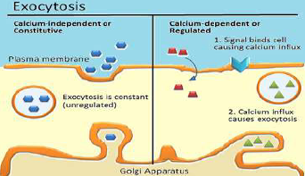

Slide 16
Endocytosis
In endocytosis, the cell engulfs some of its extracellular fluid including material dissolved or suspended in it.
A portion of the plasma membrane is invaginated, coated with molecules of the protein clathrin, and pinched off forming a membrane-bounded vesicle called an endosome.

Slide 17
Three types of endocytosis
Phagocytosis
Pinocytosis
Receptor mediated endocytosis

Slide 18
PHAGOCYTOSIS
It is the process of the ingestion of solid particles such as bacteria or other material by phagocytes and amoeboid protozoans.

Slide 19
Particle adherence
Before phagocytosis is accomplished, the phagocyte and the particle must adhere to each other, the possibility of which depends largely on the chemical nature of the surface of the particle.
In the case of bacteria, if the phagocyte cannot adhere directly, protein components of the blood known as opsonins (e.g., complement and antibodies) form a surface film on bacteria—a process known as opsonization.
Phagocytes adhere to the opsonins, and phagocytosis follows.

Slide 20
Encapsulated bacteria are ingested with more difficulty. In the absence of specific antibodies that recognize the bacteria, opsonization cannot occur, and the bacteria repel phagocytes.
The surfaces of such bacteria are coated with special antibodies only after the body has mounted an immune response to the presence of that particular kind of bacterium. Such antibodies are of great importance in establishing immunity to diseases.

Slide 21
Particle engulfment and digestion
Phagocytosis, or "cell eating," the cell engulfs debris, bacteria, or other sizable objects.
Phagocytosis occurs in specialized cells called phagocytes, which include macrophages, neutrophils, and other white blood cells. Invagination produces a vesicle called a phagosome, which usually fuses with one or more lysosomes containing hydrolytic enzymes.
Materials in the phagosome are broken down by these enzymes and degraded

Slide 22
PINOCYTOSIS
It is the process of ingestion of liquid into a cell by the budding of small vesicles from the cell membrane

Slide 23
Particle engulfment
In pinocytosis, or "cell drinking," the cell engulfs extracellular fluid, including molecules such as
sugars and proteins. These materials enter the cell inside a vesicle, although they do not mix with
cytoplasm. Epithelial cells in capillaries use pinocytosis to engulf the liquid portion of blood at
the capillary surface. The resulting vesicles travel across the capillary cells and release their
contents to surrounding tissues, while blood cells remain in the blood.

Slide 24
RECEPTOR MEDIATED ENDOCYTOSIS
Receptor-mediated endocytosis, another form of endocytosis, differs from phagocytosis or
pinocytosis in several respects:
RME allows cells to take up specific macromolecules called ligands, such as proteins that bind insulin (a hormone), transferrin (an iron-binding protein), or low-density lipoprotein cholesterol carriers.

Slide 25
RME requires specific membrane receptors that recognize a particular ligand and bind to it.
Ligand-receptor complexes migrate along the membrane surface to structures called coated pits. Just inside the cytoplasm, these pits are bordered with the protein clathrin, which can polymerize into a cage-shaped structure. When such clathrin cages form,pinch off an enclosed membrane vesicle.

Slide 26
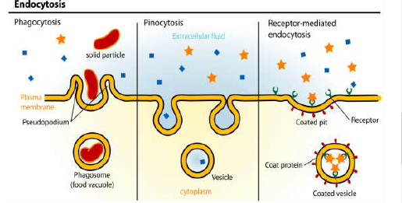

Slide 27
Clathrin-coated vesicles move into the cytoplasm, selectively carrying the ligand from the extracellular fluid into the cell. Materials bound to the ligand, such as iron or cholesterol, may be moved into the cell while the empty ligand returns to the surface, or the ligand may be destroyed

Slide 28
Cell migration
Cell migration is a central process in the development and maintenance of multicellular organisms.
Tissue formation during embryonic development, wound healing and immune responses all require the orchestrated movement of cells in particular directions to specific locations.
Cells often migrate in response to specific external signals, including chemical signals and mechanical signals

Slide 29
Errors during this process have serious consequences, including intellectual disability, vascular disease, tumor formation and metastasis.
An understanding of the mechanism by which cells migrate may lead to the development of novel therapeutic strategies for controlling, for example, invasive tumour cells.

Slide 30
Molecular processes of migration
There are two main theories for how the cell advances its front edge: the cytoskeletal model and membrane flow model. It is possible that both underlying processes contribute to cell extension

Slide 31
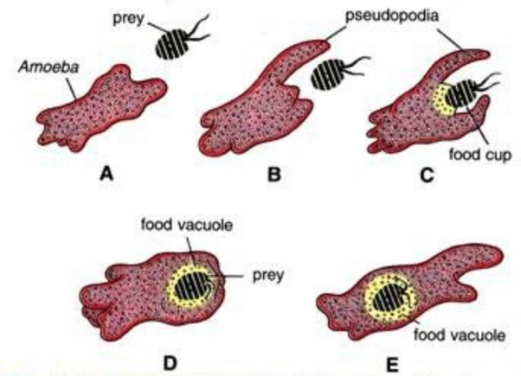
Pseudopodial Movement

Slide 32
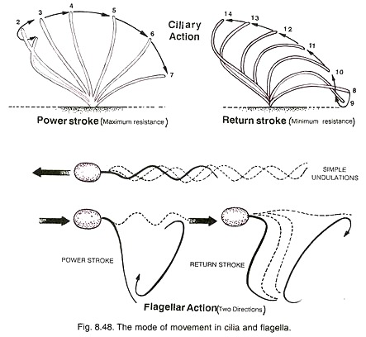
Flagellar movement

Slide 33
Leading edge
Experimentation has shown that there is rapid actin polymerisation at the cell's front edge. This observation has led to the hypothesis that formation of actin filaments "push" the leading edge forward and is the main motile force for advancing the cell's front edge. In addition, cytoskeletal elements are able to interact extensively and intimately with a cell's plasma membrane.

Slide 34
Membrane flow model
Studies have also shown that the front of the migration is the site at which the membrane is returned to the cell surface from internal membrane pools at the end of the endocytic cycle
This has led to the hypothesis that extension of the leading edge occurs primarily by addition of membrane at the front of the cell. If so, the actin filaments that form at the front might stabilize the added membrane so that a structured extension, or lamella, is formed rather than a bubble-like structure (or bleb) at its front.
For a cell to move, it is necessary to bring a fresh supply of "feet" (proteins called integrins, which attach a cell to the surface on which it is crawling) to the front.
It is likely that these feet are endocytosed toward the rear of the cell and brought to the cell's front by exocytosis, to be reused to form new attachments to the substrate

Slide 35
Mechanistic basis of amoeboid migration
Adhesive crawling is not the only migration mode exhibited by eukaryotic cells.
Importantly, metastatic cancer cells and immune cells like macrophages and neutrophils have been found to be capable of adhesion-independent migration. The mechanistic basis of this migration mode is less understood than either eukaryotic cell crawling or flagella-based swimming by microorganisms.
The physicist E. M. Purcell theorized that under conditions of low Reynolds number fluid dynamics, which apply at the cellular scale, rearward surface flow could provide a mechanism for microscopic objects to swim forward.

Slide 36
After some decades, experimental support for this model was provided using optogenetics.
It was shown that cells migrating in an amoeboid fashion without adhesions exhibit plasma membrane flow towards the cell rear that can propel cells by exerting tangential forces on the surrounding fluid. Polarized trafficking of membrane-containing vesicles from the rear to the front of the cell helps maintain cell size.
Rearward membrane flow was also observed in Dictyostelium discoideum cells. Interestingly, the migration of supracellular clusters has also been found to be supported by a similar mechanism of rearward surface flow.

Slide 37
Collective biomechanical and molecular mechanism of cell motion
Based on some mathematical models, recent studies hypothesize a novel biological model for collective biomechanical and molecular mechanism of cell motion.
It is proposed that microdomains weave the texture of cytoskeleton and their interactions mark the location for formation of new adhesion sites. According to this model, microdomain signaling dynamics organizes cytoskeleton and its interaction with substratum.

Slide 38
. As microdomains trigger and maintain active polymerization of actin filaments, their propagation and zigzagging motion on the membrane generate a highly interlinked network of curved or linear filaments oriented at a wide spectrum of angles to the cell boundary.
It is also proposed that microdomain interaction marks the formation of new focal adhesion sites at the cell periphery. Myosin interaction with the actin network then generate membrane retraction/ruffling, retrograde flow, and contractile forces for forward motion. Finally, continuous application of stress on the old focal adhesion sites could result in the calcium-induced calpain activation, and consequently the detachment of focal adhesions which completes the cycle.

Slide 39
Migrating cells have a polarity—a front and a back. Without it, they would move in all directions at once, i.e. spread.
How this polarity is formulated at a molecular level inside a cell is unknown. In a cell that is meandering in a random way, the front can easily give way to become passive as some other region, or regions, of the cell form(s) a new front.
In chemotaxing cells, the stability of the front appears enhanced as the cell advances toward a higher concentration of the stimulating chemical. This polarity is reflected at a molecular level by a restriction of certain molecules to particular regions of the inner cell surface. Thus, the phospholipid PIP3 and activated Rac and CDC42 are found at the front of the cell, whereas Rho GTPase and PTEN are found toward the rear.

Slide 40
It is believed that filamentous actins and microtubules are important for establishing and maintaining a cell's polarity.
Drugs that destroy actin filaments have multiple and complex effects, reflecting the wide role that these filaments play in many cell processes. It may be that, as part of the locomotory process, membrane vesicles are transported along these filaments to the cell's front.
In chemotaxing cells, the increased persistence of migration toward the target may result from an increased stability of the arrangement of the filamentous structures inside the cell and determine its polarity. In turn, these filamentous structures may be arranged inside the cell according to how molecules like PIP3 and PTEN are arranged on the inner cell membrane. And where these are located appears in turn to be determined by the chemoattractant signals as these impinge on specific receptors on the cell's outer surface.

Slide 41
Although microtubules have been known to influence cell migration for many years, the mechanism by which they do so has remained controversial. On a planar surface, microtubules are not needed for the movement, but they are required to provide directionality to cell movement and efficient protrusion of the leading edge. When present, microtubules retard cell movement when their dynamics are suppressed by drug treatment or by tubulin mutations

Slide 42
Reference
https://www.google.com/search?q=flagelal+movement+mechanism&tbm=isch&ved=2ahUKEwjmo8e86YLpAhUSNRoKHUt5DoYQ2-cCegQIABAA&oq=flagelal+movement+mechanism&gs_lcp=CgNpbWcQA1CXvQlYi88JYObRCWgAcAB4AIABrAKIAfQUkgEFMi05LjGYAQCgAQGqAQtnd3Mtd2l6LWltZw&sclient=img&ei=zsejXuaEK5LqaMvyubAI&bih=657&biw=1366#imgrc=ZAAaEmakOAohvM
https://www.google.com/search?q=pseudopodia+movement&tbm=isch&ved=2ahUKEwiEraLO6ILpAhUKahoKHZRfBrgQ2-cCegQIABAA&oq=pseudopodia+mov&gs_lcp=CgNpbWcQARgAMgIIADICCAAyBggAEAgQHjIECAAQGDoECAAQQ1CNhwFY7o4BYLyfAWgAcAB4AIABwwKIAf4IkgEFMi0zLjGYAQCgAQGqAQtnd3Mtd2l6LWltZw&sclient=img&ei=58ajXsSdGYrUaZS_mcAL&bih=657&biw=1366#imgrc=rvCOZTW66G38QM
www.college-cram.com
www.study.com
www.britannica.com
www.phschool.com
1. Mizushima N, Levine B, Cuervo AM, Klionsky DJ. Autophagy fights disease through
cellular self-digestion. Nature 2008; 451: 1069–1075.
2. Suzuki K, Kirisako T, Kamada Y, Mizushima N, Noda T, Ohsumi Y. The pre-autophagosomal
structure organized by concerted functions of APG genes is essential for
autophagosome formation. EMBOJ 2001; 20: 5971–5981.
3. Klionsky DJ, Cregg JM, Dunn WA, Emr SD, Sakai Y, Sandoval IV et al. A unified
nomenclature for yeast autophagy-related genes. Dev Cell 2003; 5: 539–545.
4. Suzuki K, Kubota Y, Sekito T, Ohsumi Y. Hierarchy of Atg proteins in pre-autophagosomal
structure organization. Genes Cells 2007; 12: 209–218.
5. Mizushima N, Kuma A, Kobayashi Y, Yamamoto A, Matsubae M, Takao T et al. Mouse
Apg16L, a novel WD-repeat protein, targets to the autophagic isolation membrane with the
Apg12-Apg5 conjugate. J Cell Sci 2003; 116: 1679–1688.

