Slide 1
Data Communication and Networks
Instructor:
Engr. Yasir Salam
MS Computer Engineering (UET, Lahore)
Books:
Data and Computer Communication by William Stallings (Ed. 9)
Computer Networks, A Systems Approach by Larry Peterson and Bruce Davie (Ed. 3)

Slide 2
Why learn the Course Fundamentals?
Internet is constantly being reinvented
But fundamentals always remain the same
Concepts apply to all computer networks
Provides an in-depth knowledge of Networks
The impact of networks on our world
Job prospects

Slide 3
Internet Growth

Slide 4
ARPANET in 1970

Slide 5
Today’s Internet

Slide 6
Caution
Study the course very carefully
There is no other course of this nature in your curriculum (Especially the portion near and after mid exams)

Slide 7
Chapter 1
Lecture 1
Data Communications and Networks Overview

Slide 8
A Communications Model
Source
generates data to be transmitted
Transmitter
Converts data into transmittable signals
Transmission System
Carries data
Receiver
Converts received signal into data
Destination
Takes incoming data

Slide 9
Communications Tasks
Transmission system utilization | Addressing
Interfacing | Routing
Signal generation | Recovery
Synchronization | Message formatting
Exchange management | Security
Error detection and correction | Network management
Flow control

Slide 10
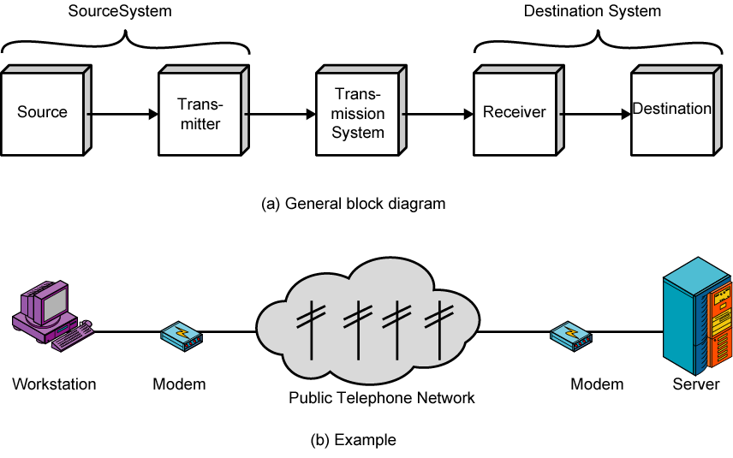
Simplified Communications Model - Diagram

Slide 11
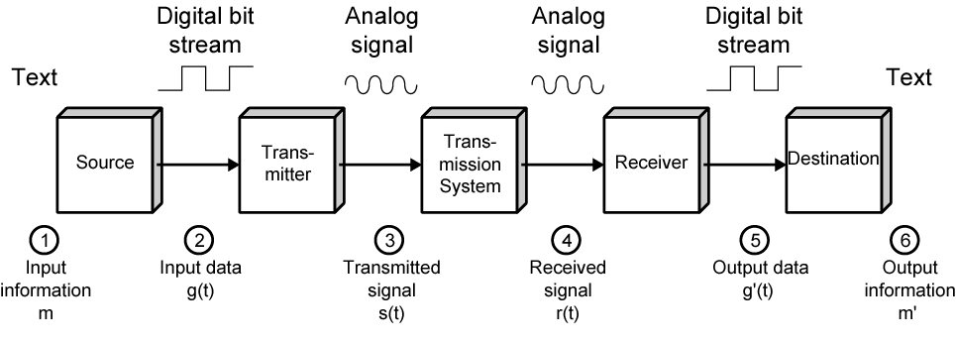
Simplified Data Communications Model

Slide 12
Networking
Point to point communication not usually practical
Devices are too far apart
Large set of devices would need impractical number of connections
Solution is a communications network
Wide Area Network (WAN)
Local Area Network (LAN)

Slide 13
Wide Area Networks
Large geographical area
Crossing public rights of way
Rely in part on common carrier circuits
Alternative technologies
Circuit switching
Packet switching
Frame relay
Asynchronous Transfer Mode (ATM)

Slide 14
Circuit Switching
Dedicated communications path established for the duration of the conversation
e.g. telephone network

Slide 15
Packet Switching
Data sent out of sequence
Small chunks (packets) of data at a time
Packets passed from node to node between source and destination
Used for terminal to computer and computer to computer communications
64 kbps data rate

Slide 16
Frame Relay
Packet switching systems have large overheads to compensate for errors
Modern systems are more reliable
Errors can be caught in end system
Most overhead for error control is stripped out
Variable-length packets called frames
2Mbps data rate

Slide 17
Asynchronous Transfer Mode
ATM
Evolution of frame relay
Little overhead for error control
Fixed packet (called cell) length
Anything from 10Mbps to Gbps
Constant data rate using packet switching technique

Slide 18
Local Area Networks
Smaller scope
Building or small campus
Usually owned by same organization as attached devices
Data rates much higher
Usually broadcast systems
Now some switched systems and ATM are being introduced

Slide 19
LAN Configurations
Switched
Switched Ethernet
May be single or multiple switches
ATM LAN
Fibre Channel
Wireless
Mobility
Ease of installation

Slide 20
Metropolitan Area Networks
MAN
Middle ground between LAN and WAN
Private or public network
High speed
Large area

Slide 21
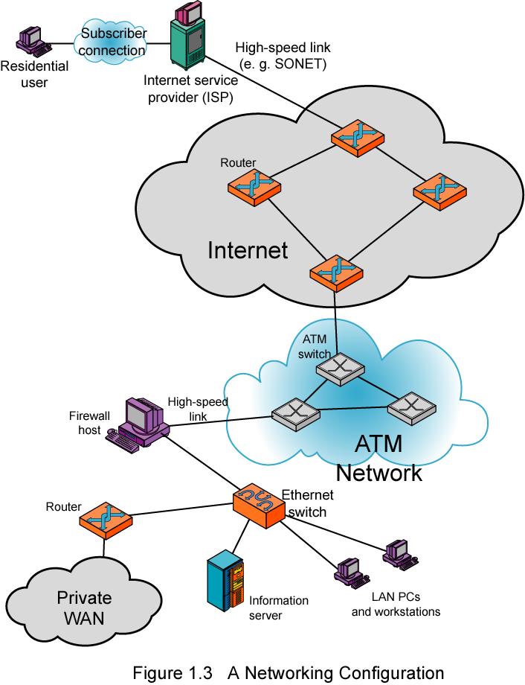
Networking Configuration

Slide 22
End of Chapter 1
Next Topic: Protocol Architecture

