Slide 1
CBD and IT-PGRFA
Genetic resources and conservation
BS Biotechnology (6th Semester)
University of Sargodha

Slide 2
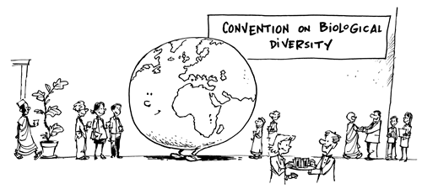
Convention on biological diversity (CBD)
CBD was opened for signature at Earth Summit held in Brazil in 1992.
CBD came into effect in 1993.
Biological diversity has become a global asset of tremendous value to present and future generation. So, for conservation of biological diversity and sustainable use of its components convention was created.
Why was convention on biodiversity created?

Slide 3
Objectives of CBD
1-Conservation of biodiversity
2- Sustainable use of the components of biodiversity
Integrate consideration of the conservation and sustainable use of biological resources into national decision making
Encourage cooperation between authorities and its private sector in developing methods for sustainable use of biological resources
3- The fair and equitable sharing of the benefits arising out of the utilization of genetic resources
An appropriate access to genetic resources
An appropriate transfer of relevant technologies
An appropriate funding

Slide 4
Implementation mechanisms of the CBD
The Convention on General Measures state that each contracting party shall, in accordance with its particular conditions and capabilities do the following:
Develop national strategies, plans or programs for the conservation and sustainable use of biological diversity
Integrate, as far as possible and as appropriate, the conservation and sustainable use of biological diversity into relevant sectoral or cross-sectoral plans, programs and policies

Slide 5
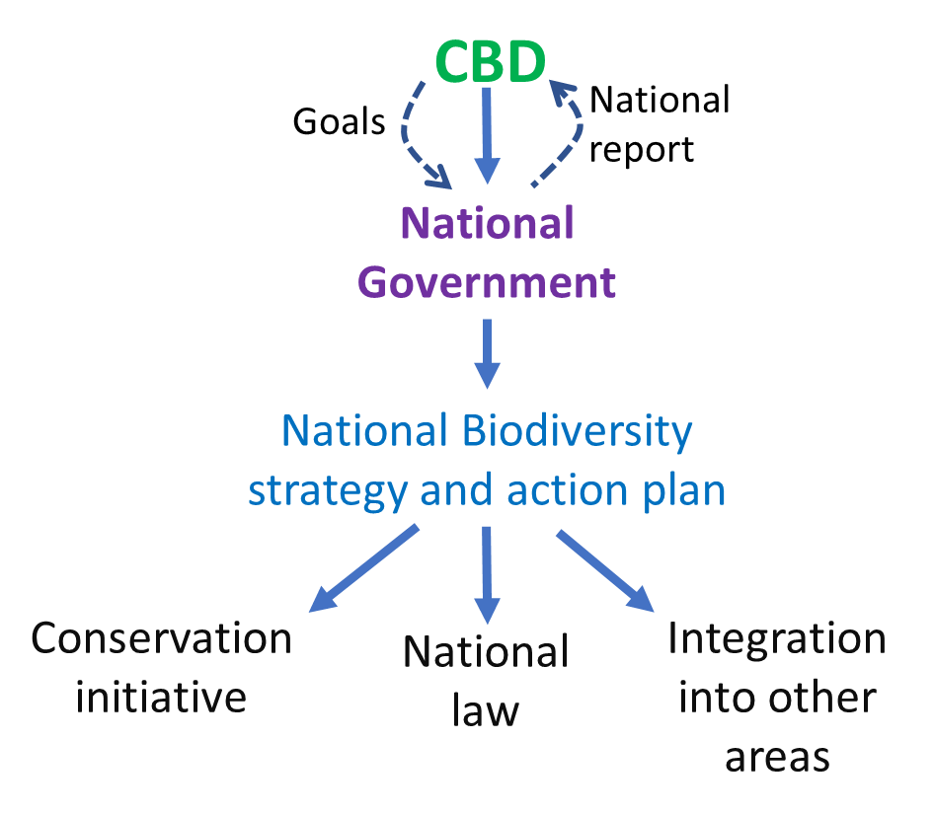
What was unique about this convention
A framework for action
Decisions at national level
Recognition that biodiversity is not
equally distributed
Benefit sharing
Framework of action

Slide 6
The international treaty on plant genetic resources for food and agriculture (IT-PGRFA)
The conservation and sustainable use of plant genetic resources for food and agriculture are key to ensuring that the world will produce enough food to feed its growing population in the future. In 1983, the Commission on Genetic Resources for Food and Agriculture was established, and the voluntary International Undertaking on Plant Genetic Resources was adopted.
The International Treaty on Plant Genetic Resources for Food and Agriculture (IT-PGRFA) was adopted by the Thirty-First Session of the Conference of the Food and Agriculture Organization of the United Nations on 3 November 2001. The Treaty entered into force on 29 June 2004

Slide 7
What makes PGRFA different?
Special nature of Plant genetic resources for food and agriculture (PGRFA)
Importance of PGRFA food security
Importance of PGRFA for breeding
Interdependence of countries on PGRFA
Food security means that all people, at all times, have physical, social, and economic access to sufficient, safe, and nutritious food that meets their food preferences and dietary needs for an active and healthy life
United Nations’ Committee on World Food Security

Slide 8
Exchange of PGRFA is essential for agriculture
It require special need to access PGRFA
Needs to allow continuous exchange of PGRFA
Access to PGRFA in center of origin
Reduction in transaction cost
Easy, efficient and equitable system of benefit sharing

Slide 9
Objectives of IT-PGRFA
Conservation and sustainable use of all PGRFA
Fair and equitable sharing of benefits arising from their use, in hormney with CBD, for sustainable food and agriculture security

Slide 10
Global action plan for conservation and sustainable use of PGRFA
Ensure the conservation of PGRFA as the basis for food security
Promote sustainable use of plant genetic resources to foster development and reduce hunger and poverty
Promote fair and equitable sharing of the benefits arising from the use of plant genetic resources
Assist countries and institutions to identify priorities for action
Strengthen existing programs and enhance institutional capacity

Slide 11
Main focus of IT-PGRFA
recognizing the enormous contribution of farmers to the diversity of crops that feed the world;
establishing a global system to provide farmers, plant breeders and scientists with access to plant genetic materials;
ensuring that recipients share benefits they derive from the use of these genetic materials with the countries where they have been originated.

Slide 12
Main elements of the Treaty
The treaty applies to all PGRFA
The treaty sets out general provisions regarding the conservation and sustainable use of PGRFA.
The main provisions of treaty includes
Multilateral system (MLS)
Access and benefit sharing
Farmer’s rights
Sustainable use

Slide 13
Multilateral system (MLS)
The Treaty’s truly innovative solution to access and benefit sharing is the development of the Multilateral System(MLS).
On ratifying the treaty, countries agree to make their genetic diversity and related information about the crops stored in their gene banks available to all through the Multilateral system.
Put the data of 64 of our most important crops (which account for 80 percent of the food we derive from plants) into an easily accessible global pool of genetic resources that is freely available to potential users in the Treaty’s ratifying nations for some uses.

Slide 14
Farmer’s rights
The Treaty recognizes the enormous contribution farmers have made to the ongoing development of the world’s wealth of plant genetic resources. It calls for protecting the traditional knowledge of these farmers, increasing their participation in national decision-making processes and ensuring that they share in the benefits from the use of these resources

Slide 15
Sustainable use
Most of the world’s food comes from four main crops – rice, wheat, maize and potatoes. However, local crops, not among the main four, are a major food source for hundreds of millions of people and have potential to provide nutrition to countless others. The Treaty helps maximize the use and breeding of all crops and promotes development and maintenance of diverse farming systems.

Slide 16
Access and benefit sharing
The Treaty facilitates access to the genetic materials of the 64 crops in the Multilateral System for research, breeding and training for food and agriculture. Those who access the materials must be from the Treaty’s ratifying nations and they must agree to use the materials totally for research, breeding and training for food and agriculture. The Treaty prevents the recipients of genetic resources from claiming intellectual property rights over those resources in the form in which they received them, and ensures that access to genetic resources already protected by international property rights is consistent with international and national laws.
Those who access genetic materials through the Multilateral System agree to share any benefits from their use through four benefit-sharing mechanisms established by the Treaty

Slide 17
Benefit sharing
Facilitated access
Exchange of information
Access to technology and transfer of technology
Capacity building
The sharing of monetary and other benefits of commercialization

Slide 18
Benefit sharing
Monetary benefits: Recipient pay an equitable share of the financial benefits (in terms of money) into the Treaty’s benefit-sharing fund whenever a commercialized product resulting from material obtained from the multilateral system is not freely available for further research and breeding.
The funds are complemented with voluntary contributions from countries, international foundations and the private sector.
The funds that accumulate in the benefit-sharing fund flow primarily to the farmers in the developing countries who use and conserve crop diversity.

Slide 19
Benefit sharing
Non-monetary benefits: These benefits do not involve money. However, these are in the form of
1- Exchange of information
2- Making available information such as catalogues and inventories of crop diversity and results of technical, scientific and socio-economic research.
3- Technology transfer for the conservation, characterization, evaluation and use of crop diversity
4-Treaty encourages all types of partnerships in research and development and in commercial joint venture.
5-support Capacity building through programs of scientific and technical education and training.
6- Provide research facilities in developing countries in cooperation with national institutions.

Slide 20
The standard material transfer agreement (SMTA)
A material transfer agreement (MTA) is the legal contract between a provider and a recipient that sets out the terms and conditions under which plant genetic resources are transferred.
A SMTA is a commercial contract drafted through international negotiations.

Slide 21
Obligations of the provider
To make material under the MLS available expeditiously and free of charge.
To do so under the SMTA
To list the material provided in the SMTA annex
To inform the Treaty’s governing body about the SMTAs entered into:
The governing body has adopted a schedule and requirements for reporting
Secretariat has provided a website to facilitate reporting on SMTAs.

Slide 22
Rights of the recipient
Recipient can use the material for research, or for breeding or training
Recipient can develop new PGRFA products from the material and can protect them and commercialize them. But recipient cannot use the material for other purposes or for uses outside food and agriculture.

Slide 23
Obligations of the recipient
No to take out intellectual property rights over the material accessed from the multilateral system that restrict its availability to others
To make available to the MLS non-confidential information resulting from research and development on the material
To make a mandatory payment to the multilateral system if the recipient
Develop new PGRFA product derived from the material
Commercializes the new products
Restrict the availability of the new products to others for further research or breeding
If further availability is not restricted, then payment is voluntary.

