Slide 1
Prokaryotic and Eukaryotic cell

Slide 2
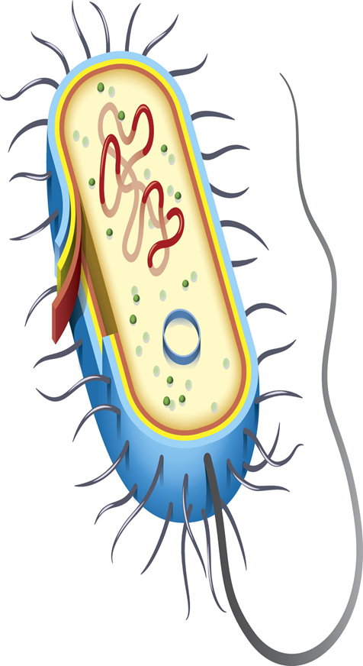
PROKARYOTES
UNIVERSITY OF SARGODHA

Slide 3
PROKARYOTES
Comes from- Greek word
Pro means “before”
And karyon means “nucleus” or “kernel”

Slide 4
definition
A microscopic single-celled organism that has neither a distinct nucleus with a membrane nor other specialized organelles.
OR
A prokaryote is a unicellular organism that lacks a membrane-bound nucleus, mitochondria, or any other membrane-bound organelle.
Mainly two domains
Archaea
Bacteria
First living organism

Slide 5
prokaryotes
1970s Carl woese – bacteria and archaea were less closely related than previously thought
All intracellular components(proteins, DNA, and metabolites) --- Cytoplasm
Rather than in separate cellular compartments
Bacteria – protein based bacterial microcompartments --- thought to be primitive organelles enclosed in protein shells

Slide 6
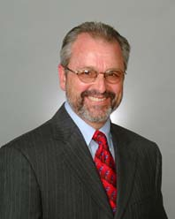
history
Microbiologists Roger Stanier and C.B. van Niel in 1962 paper --- firmly established division between prokaryotes and eukaryotes.
Concept of bacterium – though spelled procaryote and eukaryote there
That paper cites Edouard Chatton's 1973- book Titres et Travaux Scientifiques – for using these terms – and recognizing the distinction
Main reason for classification --- blue green algae (now called cyanobacteria)

Slide 7
structure
Size
1 µm and 10 µm
vary in size from --0.2 µm (Mycoplasma genitalium) to 750 µm (Thiomargarita namibiensis).

Slide 8
Prokaryotic cell structure
Cell wall
Cell membrane
Flagellum
Pili
Cytoplasm
Ribosomes
Nucleoids
Capsule and Glycocalyx
Inclusions
mesosomes

Slide 9
Cell wall (Except genera mycoplasma and Thermoplasma)
Made up of Murine (also called peptidoglycan)
Prevent osmotic lysis
Peptidoglycan
Polymer of disaccharide
Linked by polypeptides
Broadly speaking bacteria have two types of cell membrane
Gram positive cell wall
Gram negative cell wall

Slide 10
Gram positive cell wall
Teichoic acid
Lipoteichoic acid link to plasma membrane
Wall teichoic acid link to peptidoglycan
May regulate movements of cations
Polysaccharides provides antigenic variations

Slide 11
Gram-negative outer membrane
Lipopolysaccharides, lipoproteins and phospholipids.
Forms the periplasm between outer membrane and plasma membrane.
Protection from phagocytes, complements, antibiotics.
O polysaccharides antigen
Lipid A is an endotoxin
Porins (proteins) form channels through membrane

Slide 12
Plasma membrane
Phospholipid bilayer
Peripheral proteins
Integral proteins
Transmembrane proteins

Slide 13
Contin……
Selectively permeability allow passage of some molecules
Damage to the membrane by alcohol, detergents, polymyxin antibiotics cause leakage of cell content.
Bacteria cell membrane
Gram-negative bacteria

Slide 14
cytoplasm
Cytoplasm is the substance inside the plasma membrane
Thick, aqueous, semitransparent and elastic
80% water
Contain proteins, lipids, inorganic ions etc.

Slide 15
Nuclear area (nucleoid)
Single, long, continuous, circular
Plasmids
Replicate independently
Not crucial for survival
Carry antibiotics resistance gene
Can be transfer from one to other bacterium

Slide 16
ribosomes
Responsible for protein production
Unit of measurement– Svedberg unit
15nm to 20 nm in size
Associated with plasma membrane of the cell

Slide 17
flagella
Outside cell wall
Filament made up of chain of flagellin
Attached to protein hook
Anchored to the wall and membrane by the basal body

Slide 18
pili
Longer than fimbriae
Only 1 or 2 per cell
Transfer genetic material

Slide 19
fimbriae
Fimbriae may be several hundred in numbers
Distributed on poles or entire surface
Allow attachment

Slide 20
Glycocalyx (capsule)
Outside the cell wall
Usually sticky
A slime layer unorganized and loose
Extracellular polysaccharide allow cell to attach
Capsule prevent phagocytosis

Slide 21
inclusions
Diverse intracellular non-living substance
Not bounded by membrane
Stored nutrients
Secretory products
Pigment granules

Slide 22
mesosomes
Infoldings of prokaryotic cell membrane
Carry out aerobic respiration – having similar role to mitochondrial cristae

Slide 23
Reproduction in prokaryotes
Asexual reproduction
Exclude fusion of gametes
Offspring's inherit identical genes
Binary fission

Slide 24
Binary fission in prokaryotes
DNA – uncoil and replicate
Replicated DNAs split– while plasmid replicate
DNA and plasmid --- moves towards opposite poles
Cell wall begins– develop– constriction around middle of the cell
Constrictions—grows deeper– new cell developing
Fully developed cell-- separate

Slide 25
DNA transfer
Transfer of genetic material—in the form of horizontal gene transfer
Transformation
Transduction
conjugation

Slide 26
transduction
The process of transferring of DNA from one bacterium to the other by the help of a virus (bacteriophage)
It does not require physical contact

Slide 27
TRANSFORMATION
The process of transferring of DNA from one bacterium to the other by the help of plasmid
It also does not require physical contact of the DNA

Slide 28
conjugation

Slide 29
environment
Obtain energy– from inorganic compounds
Diversify greatly

Slide 30
evolution

Slide 31
Eukaryotic cell

Slide 32
INTRODUCTION
“ A eukaryotic cell is any cell with a true nucleus and organelles. The nucleus contains the majority of the cell’s DNA and is the genetic hub of a eukaryotic cell”

Slide 33
A eukaryotic is an organism whose cellls contain complex structures enclosed within membranes
Eukaryotic cells have an organized nucleus with a nuclear envelop. They have a “brain” for the cell. They have a discrete area where they keep their DNA. it is also said that they have “true nucleus”
Organelles are membrane bound structures found inside eukaryotic cells and they play a similar role to the organs in our bodies
Organelles perform certain roles to help the cell function more efficiently

Slide 34
organisms have eukaryotic cells:
Any living thing that is made from more than one cell is made with eukaryotic cells. This includes all animals, plants, seaweed and fungi
Many microscopic organisms also have eukaryotic cells
Groups such as algae and amoebas have eukaryotic cells
All eukaryotic organisms that aren’t an animal, plant or fungus are often lumped together in a broad group of organisms called protists

Slide 35
Two types of eukaryotic cells
There are two types of eukaryotic cells
Animal cell
Plant cell

Slide 36
 | Animal cell | Plant cell
Domain | Eukarya | Eukarya
Cell Wall | No | Yes (made of cellulose)
Vacuole | Either none or a few very small throughout the cell | One very large also called the “central vacuole”
Mobility | Can be mobile and fluid | Not mobile or fluid
Nucleus | Yes | Yes
Endoplasmic Reticulum | Yes | Yes
Chloroplasts | No | Yes
Mitochondria | Yes | Yes
Golgi Apparatus | Yes | Yes

Slide 37
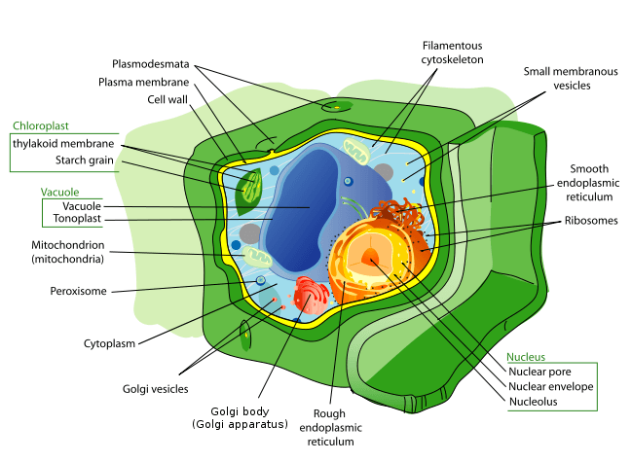
Structure Plant & animal cells

Slide 38
Eukaryotic Cell Characteristics

Slide 39
While both cell types share some common characteristics , eukaryotic cells are more complex. Distinctive characteristics that define eukaryotic cells include:
All eukaryotic cells have a separately enclosed nucleus inside the cell's cytoplasm
Mitochondria exists in one form or another inside the eukaryotic cell's nucleus
All existing eukaryotic cells contain a cytoskeletal structure or elements

Slide 40
Eukaryotic cells utilize flagella and cilia to move around;
They have chromosomes within the nucleus, consisting of a single, linear DNA molecule spiraled around alkaline proteins named histones
Cell reproduction in eukaryotic cells occurs via mitosis, a process whereby the chromosomes divide by using components within the cytoskeleton
All eukaryotic cells have cell walls

Slide 41
descriptions of organelles

Slide 42
There are a range of different organelles that each perform different roles within a cell to help the cell survive.
Some are more common than others and some are only found in certain organisms.
Chloroplasts, for example, are only found in plant cells and some algae.

Slide 49
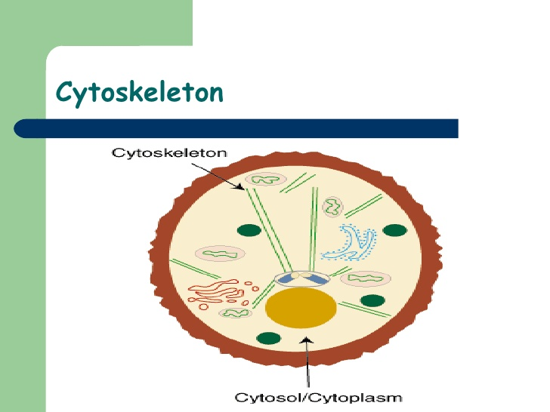

Slide 68
The Endomembrane System
The endomembrane system is composed of the nuclear envelope, plasma membrane, Golgi apparatus, vesicles, endoplasmic reticulum and other structures derived from these elements
All play a part in the function of the cell, though some differ in their appearance and purpose
The endomembrane system moves proteins and membranes around the cell

Slide 69
For example, some of the proteins constructed on ribosomes are bound to the rough endoplasmic reticulum, a construction that resembles a maze that attaches to the exterior of the nucleus
These structures help to modify and move proteins, among other purposes, to where they're needed in the cell

Slide 70
Reproduction

Slide 71
Cell Division and Replication
Eukaryotic cells divide by a process called mitosis
Only non-reproductive cells divide by mitosis in the Eukarya domain
Non-reproductive cells make up most of the cells in the human body including its tissues and organs like the digestive tract, muscles, skin, lungs and hair cells, Also known as somatic cells

Slide 72
Mitosis involves multiple stages that define that cell's divisional status
Through a series of stages, the chromosome replicates itself
Each strand moves to opposite poles within the nucleus to allow the nucleus' envelope to converge and surround each chromosome
In animal cells, a cleavage furrow separates the diploids, or daughter cells, into two

Slide 73
In eukaryotic plant cells, a type of cell plate forms prior to the new cell wall that separates daughter cells
Upon division, each daughter cell is a genetic duplicate of the original cell

Slide 74
Meiosis Cell Division of Eukaryotic Cells
“Meiosis cell division is the process by which living organisms within the Eukarya domain create their sex cells like male sperm and female egg cells”
Once meiosis occurs, sperm and egg cells are available to create a whole new lifeform
During meiosis cell division, which occurs in basically two stages, meiosis I and meiosis II

Slide 75
A small portion of each chromosome breaks off and attaches itself to another chromosome called genetic recombination
This small step is responsible for genetic diversity among a species
Prior to meiosis I, the reproductive cell exists in interphase, in preparation for cell division

