Slide 1
Establishment of Gardens
HORT-202
Shahid Iqbal
Assistant Professor (Horticulture)
College of Agriculture,
University of Sargodha

Slide 2
Establishment of Gardens
Horticulture is an important branch of agriculture dealing with, many fruit, vegetables and flower crops, and if done scientifically is a profitable enterprise (Initiative).
Financial returns can be increased many folds if careful planning is done when selecting the specific crops to establish in a particular region.
The horticulture industry is a long-term investment, especially the raising of fruit trees. e.g. citrus orchard takes five years for commercial production and its production life is more than 40 years.

Slide 3
Different steps are involved in planning and establishment of gardens and orchards are:
Selection of proper locality and site
Preparation of land
Laying out garden
Digging and refilling of pits
Selection and purchase of plants
Care of plants at arrival
Setting of fruit plants
Windbreaks

Slide 4
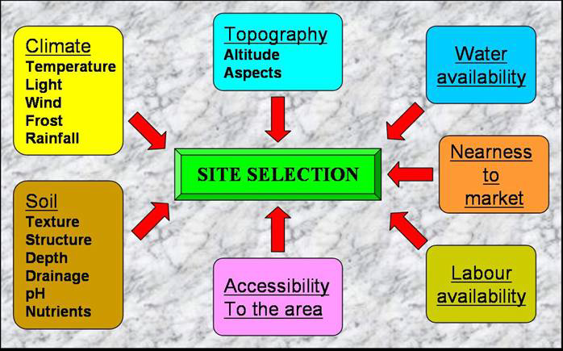

Slide 5
1: Selection of proper locality and site
Locality refers to the geographical circumstances of a place in relation to cities, villages, railway stations, roads, etc.
Horticultural crops are perishable, it is therefore, important to cultivate these crops near market to ensure sale of the produce with shortest possible time and minimum expense.
Site refers to a specific place where one can establish orchard: a citrus or mango orchard or vineyard.

Slide 6
Site selection involved following factors;
1: Topography
It refers to the contour of the land, its elevation and similar features of land.
Vegetable crops and herbaceous flowering plants are usually grown on level and slightly sloping sites as most of these crops need cultivation and harvesting operations can efficiently be done than on sloping land.
Fruit trees can be raised on steep slopes to some extend. In case of contours, which cannot level, contour plantation can be done, as that in case of temperate fruits in hilly areas.

Slide 7
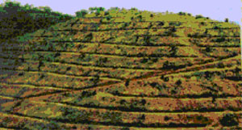

Slide 8
2: Soil
Soil is the natural resource base for horticultural production, as well as other form of agriculture, which provides nutrients, water and support to the plant.
Soil conditions like texture, fertility, depth, alkalinity, salinity, soil reaction, chemical content, drainage and water logging can influence the growth and development of horticultural crops.
Subsoil is more important than surface soil, especially for fruit trees, so examination of sub-soils to a depth of 1-2 m is essential for these crops
Horticultural crops can be grown in variety of soils. Extremes are to be avoided, very heavy soils are difficult to handle and sandy soils do not hold moisture well and are infertile.
.

Slide 9
Soil texture is the relative proportions of sand, silt, or clay in a soil.
Soil Structure
Soil structure is the arrangement of soil particles into groupings

Slide 10
A loam or sandy loam soil is good for most of
horticultural crops and such soils are present in most parts
of Pakistan.
Sandy soil Water melon, Musk melon, Sweet potato
Silt loam Apple, Pear
Clay loam Plum, Peach, Apricot, Onion, Cabbage
Sandy loam Mango, Citrus, date palm, cucurbits.
Silt Banana

Slide 11
3: Climate
It refers to meteorological conditions (changes in atmosphere) in a given region. It is composed of factors like temperature, humidity, wind, sunlight, frost, hail storms, precipitation etc.
Temperature is most important factors which effect the distribution of horticultural crops it determines the success or failure of each specific crop in a region.
Tropical region Banana, Papaya,
Sub- tropical Mango, Date palm, Citrus, Guava, Vegetables, Jaman
Temperate Apple, Pear, Peach, Grapes, Pomegranate, Apricot

Slide 12
4: Water Supply
A regular and adequate source of irrigation water is an important consideration in site selection for commercial horticulture as well as home gardens.
Good plentiful water should be regularly available all year round especially during the hot and dry season.
Canal water is best for irrigating an orchard. Tube well and well water can also be used if ground water is sweet.
Quality of water should also be considered as excess of sodium and boron salts are harmful to most horticultural plants.

Slide 13
5: Availability of Market
Horticultural products are usually perishable, and need to be transported and marketed as soon as possible.
Therefore, these should be planted near to cities or at least big towns.
If the produce is to be sent to distant market there should be railway station or main road in vicinity.
Products to be exported to foreign markets need a standard packing house nearby.

Slide 14
6 : Transportation Requirements
For transport of produce refrigerated trucks, improved rail transportation and development of economical air transport is needed.

Slide 15
7: Availability of Labor
The growing of horticultural crops is a full time occupation. The availability of labor in vicinity must be considered before establishment because most garden operations are still done by hand in Pakistan. Cheap and regular labor, available close to the site is necessary for carrying out various operations economically and on time.
Preparation of land, cleaning, leveling, ploughing, installing systems for irrigation and drainage, planting and post-planting care, pruning, hoeing, weeding, application of fertilizers and manure, control of insect pest and diseases, picking, packing, transportation and marketing require regular and efficient labor.

Slide 16
8: Capital Requirement
Horticultural crops require much more investment than other agricultural crops for establishment, maintenance and continuous profitable returns. Capital requirement must be estimated before deciding to establish a garden.
9: Personal Factors
Success in raising a given horticultural crop depends to a considerable extent on the ability of the individual grower. Vegetable farming, commercial flower production, fruit growing and tunnel farming are choices for them.

Slide 17
2: Preparation of land
The preparation of the soil depends largely upon its
Present condition,
Previous history and
The grower’s plan
If the land has been under cultivation and well maintained, nothing further may be required. But if the site is new and previously uncultivated, it should be thoroughly surveyed for its size, topography, and flow of irrigation water and fertility status.

Slide 18
The following operations should be done well in advance, preferably a season before. Any of these operations, if delayed, may cause a considerable loss.
1: Cleaning
Existing vegetation should be cleared, already existed trees should be cut down and their stumps should be removed to avoid competition.
2: Ploughing
After the site is cleared, it must be given a deep and thorough ploughing twice or thrice in two directions. Then planking should be done.

Slide 19
3: Leveling
The site should be leveled. A uniform gentle slope may be provided in one direction to facilitate the flow of irrigation water.
4: Irrigation System
The irrigation system should be planned and installed before establishing the plantation. Different system of irrigation are surface irrigation, sub surface irrigation, drip irrigation can be used. Sprinkler irrigation system is used if soil is not leveled.

Slide 20
5: Soil Enrichment
The soil can be enriched by raising cover crops, preferably legumes. A green manure crop (jantar, berseem, guara), in addition to FYM, is the most economical means of increasing the organic matter content of soil.
6: Fencing
It is done all round the site to prevent the entry of animal pests like cattle, goats or wild pigs as well as human thieves. Barbed wire is recommended, as it has no shading effect and do not compete with plants for nutrients. Rough lemon, roses can be used as fence but it can be a hidden place of many insect/pest. Therefore, it should be avoided.

Slide 22
3: Laying Out Gardens
The systematic laying out of gardens is the first step in a successful horticultural enterprise.
Indicating the actual places for roads, footpaths, irrigation channels, water tanks, manure pits, office or residence blocks, water pump or tube well/water tank and windbreaks and as well as spacing the plants in the garden.
Good site preparation and layout are extremely important in successfully establishing fruit plantings.
Eliminating potential problems before planting will reduce money and effort needed in later management practices for this long-term investment.

Slide 23
Advantages of proper layout
Cultivation can be done efficiently.
Pest management can be effectively.
Maximum no. of plants per unit area.
More yield can be obtained.
Products of higher quality are achieved.
Enhance aesthetic appearance of the garden

Slide 24
1. Planting Distance
Planting distance depends upon many factors.
Plant species and variety
Climatic conditions
Soil fertility
Availability of water
Pruning and training systems

Slide 25
2. Spacing in Fruit Trees
Spacing is very important for fruit trees because,
Permanency (Durability)
Long bearing life
3. Disadvantages of Close plantation
Lower yield
Poor quality
Reduce size and poor color development
Taller size trees
Chances of wind injury are more
Management practices are difficult
Insufficient light penetration and ventilation
Multiplication of disease organisms and insect/pests are more.

Slide 27
Different fruit plants with planting distance
Types of tree | Planting distance (m)
Mango, Jaman, Amla, Ber, Fig, Walnut | 10-15
Guava, Mulberry, Loquat, Litchi, Olive | 8-10
Citrus all spp | 7-8
Apple, Pear, Peach, Plum, apricot, Almond, Chery, Pomegranate | 6.5-8
Date palm | 5-7
Banana, Papaya, Grapes | 3-4
Falsa | 2.5

