Slide 1
Multimedia Systems And Design
Multimedia Element II - Images

Slide 2
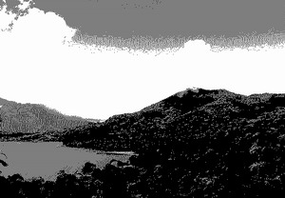
Monochrome Image
Each pixel is stored as a single bit (0 or 1)
A 640 x 480 monochrome image requires approximately 38.4 KB (38400 Bytes) of storage.
Dithering is often used for displaying monochrome images
Dithering = Using groups of pixels (patterns of dots) to approximate shades of color. Dithering is the process of placing side by side pixels of two colors to create the illusion that a third color is present

Slide 3
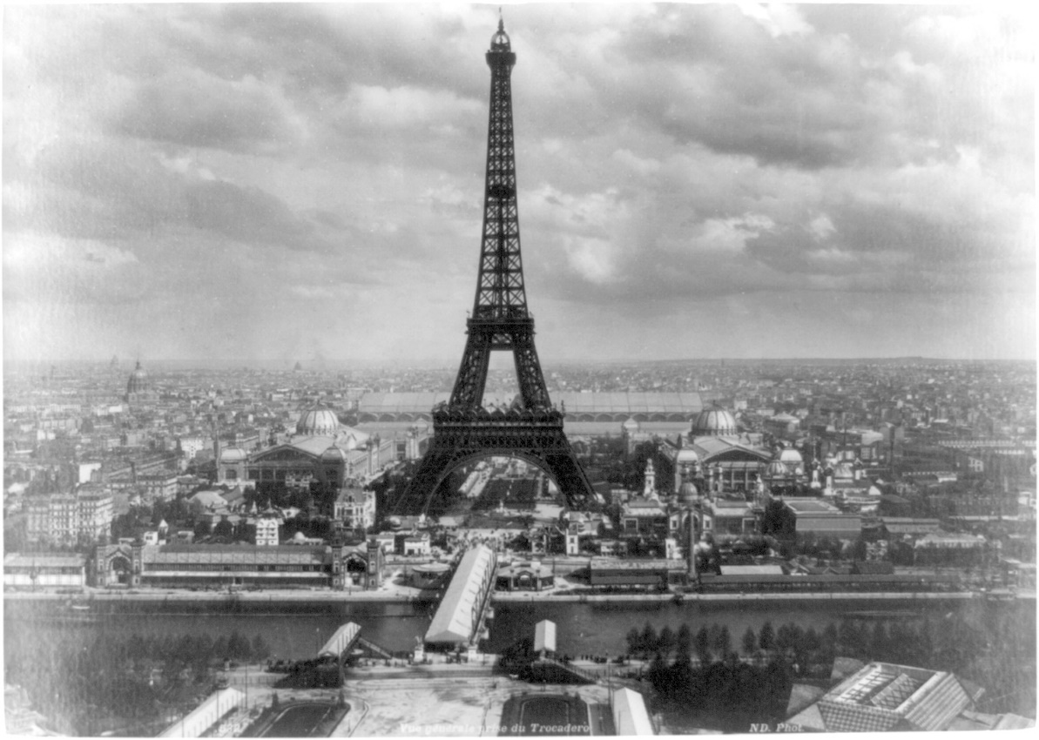
Monochrome Image
A monochrome image is an image consisting of a single color against a neutral background. For example, old "green screen" monitors were called monochrome monitors because they used a single color (green or amber) against a neutral background (black)
A 640 x 480 monochrome image requires 37.5 KB of storage.

Slide 4
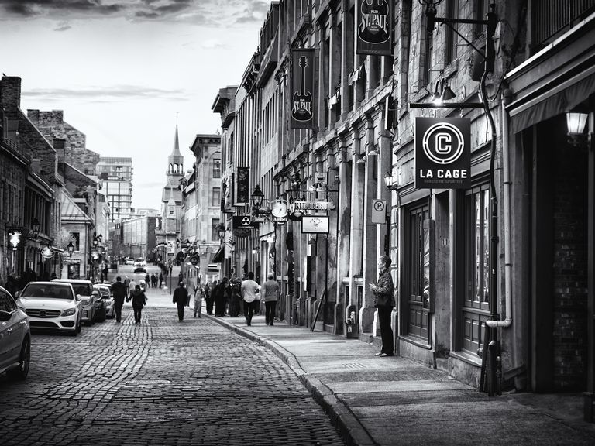
Gray Scale Images
Gray scale is a method of representing black and white images on a computer. Grayscale images are represented using only 256 shades of gray rather than the full pallet of colors.
A 640 x 480 grayscale image requires over 300
KB of storage

Slide 5
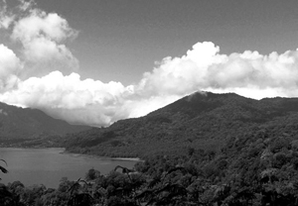
Gray Scale Images
Each pixel is usually stored as a byte – or 8 bits - (value between 0 to 255); usually,
A 640 x 480 gray scale image requires over 300 KB of storage.
No need for half toning since there are 256 levels of gray.
Half toning = Using patterns or dots (for printing and display) to create an illusion of continuous shades of gray or color. The darker the color, the more dots. It is more or less a dithering technique. Half toning is the process of rendering an image with multiple levels of grey or color on a device with fewer tones

Slide 6
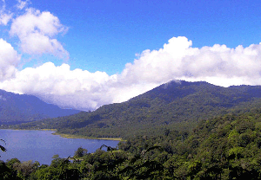
8-bit Color Images
One byte for each pixel
Supports 256 out of the millions of colours possible and has acceptable colour quality
Requires Colour Look-Up Tables (CLUTs)

Slide 7
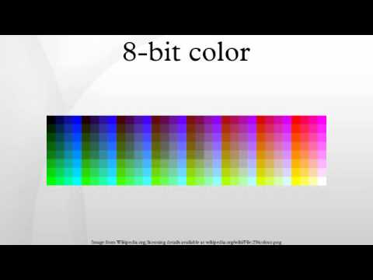
8-bit Color Images
8-bit color graphics is a method of storing image information in a computer's memory or in an image file, such that each pixel is represented by one 8-bit byte. The maximum number of colors that can be displayed at any one time is 256.

Slide 8
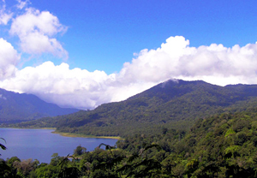
24-bit Colour Images
Each pixel is represented by three bytes (e.g., RGB)
Supports 256 (R) x 256 (G) x 256 (B) possible combined colours (16,777,216)
A 640 x 480 24-bit colour image would require about 921.6 KB
Many 24-bit colour images are stored as 32-bit images, the extra byte of data for each pixel is used to store an alpha value representing special effects information

Slide 9
24-bit Colour Images
Image formats that store a full 24 bits to describe the color of each and every pixel are therefore known as 24-bit color images.
Using 24 bits to encode color information allows
different colors to be represented, and this is sufficient to cover the full range of human color perception fairly well.
Drawback:
It requires three times as much memory, disk space and processing time to store and manipulate 24-bit color images as compared to 8-bit color images

Slide 10
Element II – Images
Standard System Independent Formats

Slide 11
Standard System Independent Formats
The following brief format descriptions are the most commonly used formats.
GIF (gif87a, gif89a)
JPEG
TIFF
PNG

Slide 12
GIF (Graphics Interchange Format)
GIF images are truly the internet standard for any type of small, simple file.
The most common use for a GIF is for menu buttons or icons for a webpage.
The reason being that GIFs are extremely tiny in file size and have no complex colors
Any other file which is made up of only use a few basic, flat colors will want to use GIF compression.

Slide 13
GIF (benefits & downfalls)
Benefits
Supported by all web browsers
Very small file size
Quick to load
Useful for Transparencies and Animations
Downfalls
Only basic colors can be used
Makes complex pictures look horrible
No detail allowed in images

Slide 14
GIF 89a
GIF89a supports simple animation (Graphics Control Extension has control over delay time, transparent index, etc.
Software such as Coral Draw and Photoshop will allow access and editing of GIF images.
GIF images are compressed using the Lempel–Ziv–Welch (LZW) lossless data compression technique to reduce the file size without degrading the visual quality.

Slide 15
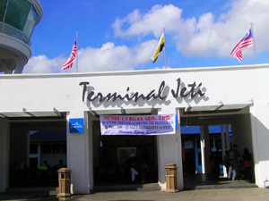
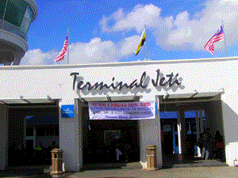
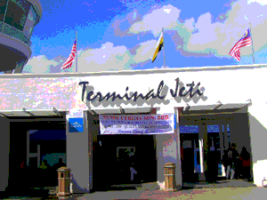
Original Image – Jetty.jpg
300 x 225 pixels, 60.3 KB
24-bit color
The 2 images (Jetty1.gif and Jetty2. gif) show the 256 color limitation of GIF.
Only the use of flat colors, like in a cartoon or in charts/diagrams, can benefit from GIF.
Jetty1.gif → 35KB, 100% Dither
216 Web-palette, 7 second @ 56.6kbps
Jetty2.gif → 19KB, 0% Dither
216 Web-palette, 4 second @ 56.6kbps

Slide 16
JPEG (Joint Photographic Experts Group)
A standard for photographic image compression created by the Joint Photographic Experts Group (JPEG)
The human vision system has some specific limitations and JPEG takes advantage of these to achieve high rates of compression.
Use Lossy compression that allows user to set the desired level of quality/compression
Image compression way has been approved by the photo graphics expert group.

Slide 17
JPEG 2000
A new image coding system that uses state of the art compression techniques based on wavelet technology.
Application:
Its architecture allows a wide range of uses from portable digital cameras to advanced pre-press, medical imaging and other applications which require high quality images
It has the file extension *.jp2, *.j2k
JPEG2000 compression technology retains image quality better than the old JPEG. It is also faster and uses small amounts of data.
Notes:
A wavelet is a mathematical function useful in digital signal processing and image compression . ... In signal processing, wavelets make it possible to recover weak signals from noise . This has proven useful especially in the processing of X-ray and magnetic-resonance images in medical applications.

Slide 18
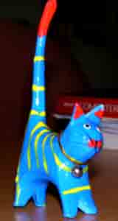
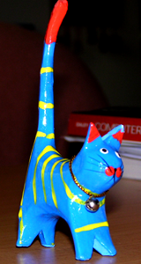
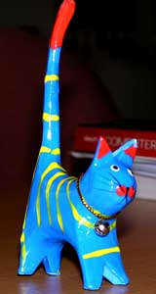
JPEG 2000
JPEG Compressed
6KB
Original Image
700KB
JPEG 2000 Compressed
6KB
Compression Ratio ≈ 116:1

Slide 19
JPEG (benefits & downfalls)
Benefits
Small image size
Viewable from the internet
Uses millions of colors
Perfect for most images
Downfalls
High compression loses quality
Every time a JPEG is saved, it loses more and more of the picture

Slide 20
Common JPEG’s Compression
Common JPEG's compression (known as DCT - Discrete Cosine Transform) cuts the pixels into blocks of 64 (8x8) and processes each block independently, shifting and simplifying the colors so there is less information to encode.
Pixels are changed only in relation to the other pixels within their block
two identical pixels that are next to each other, but in different blocks, could be transformed in different ways.
Consequently, when high compression is used, the block boundaries become obvious, causing the 'blockness' or 'blocking artefact' frequently observed in the common JPEG.

Slide 21
JPEG 2000 Compression
JPEG 2000's wavelet compression processes much larger areas of the image at once - sometimes the whole image.
This avoids any blocking.
The wavelet compression is also able to make a distinction between significant detail in the image, like edges, and less significant areas, for example, where there are slight variations in the color.
At very high compression JPEG 2000 will still introduce artefacts (visible distortion in the image), but by concentrating its compression on the less significant parts it gives much better overall quality than a JPEG of the same file size.

Slide 22
A Bit On Wavelet Compression
The advantage of wavelet compression is that, unlike the (old) JPEG, the wavelet algorithm does not divide image into blocks, but analyzes the whole image. It allows us to get best compression ratio, while maintaining the quality.
Wavelet (left) compression provides higher quality at a ratio of 105.6:1 while,
JPEG (right) delivers a ratio of about 103.8 with visible blockings in the image.
Wavelet compression file size: 1861 bytes compression ratio - 105.6
JPEG compression file size: 1895 bytes compression ratio - 103.8

Slide 23
Tagged Image File Format (TIFF)
Tagged Image File Format (TIFF), stores many different types of images (e.g., monochrome, greyscale, 8-bit & 24-bit RGB, etc.)
It is a computer file format for storing raster graphics images, popular among graphic artists, the publishing industry, and photographers.
TIFF is a lossless format (when not utilizing the new JPEG tag which allows for compression).
It does not provide any major advantages over JPEG and is not as user-controllable. It appears to be declining in popularity.

Slide 24
PNG (Portable Network Graphics)
For image editing, it provides a useful format for the storage of intermediate stages of editing.
Since it is lossless and supports up to 48-bit true color or 16-bit grayscale; saving, restoring and re-saving an image will not degrade its quality, unlike JPEG
PNG's compression (approximately 50% in general) is among the best that can be used without losing image information and without paying patent fees

Slide 25
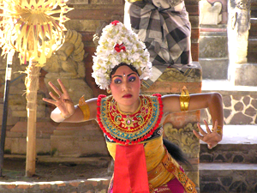
PNG (Portable Network Graphics)
Dancer.bmp
Dancer.png
The bitmap on the left (200 KB) and the PNG on the right (120 KB) are, in theory, identical.
As long as the image editor supports PNG, you can use it like a BMP.
PNG is also an alternative when the image has to be left uncompressed.
At least, it will be only about 50-70% the size of the bitmap.

Slide 26
PNG (benefits & downfalls)
Benefits
PNG supports a large number of colors. PNG-8 (256 colors) and PNG-24 (about 16.7 million Colors)
Small size files.
Minimum compression loss.
Format is suitable for storage of intermediate versions of the image.
– When you re-save image, quality is not lost
Downfalls
Doesn’t support animation
Can not store multiple images in one file

Slide 27
Data Compression
Lossy and Lossless Data Compression Methods

Slide 28
General Overview
Data compression implies sending or storing a smaller number of bits. Although many methods
are used for this purpose, in general
these broad
methods can be divided into two
categories: Lossless and Lossy methods.

Slide 29
Lossless data compression is a class of data compression algorithms that allows the original data to be perfectly reconstructed from the compressed data.
Lossless Data Compression

Slide 30
What is Lossless Compression?
In Lossless data compression, the integrity of the data is preserved. The original data and the data after compression and decompression are exactly the same because, in these methods, the compression and decompression algorithms are exact inverses of each other.
Redundant data is removed in compression and added during decompression. Lossless compression methods are normally used when we cannot afford to lose any data.
Data redundancy is a condition created within a database or data storage technology in which the same piece of data is held in two separate places.

Slide 31
Method of Lossless Encoding
Run-length Encoding
Run-length encoding is probably the simplest method of compression. It can be used to compress data made of any combination of symbols. It does not need to know the frequency of occurrence of symbols and can be very efficient if data is represented as 0s and 1s.
The general idea behind this method is to replace consecutive repeating occurrences of a symbol by one occurrence of the symbol followed by the number of occurrences.
The method can be even more efficient if the data uses only two symbols (for example 0 and 1) in its bit pattern and one symbol is more frequent than the other.

Slide 32
Run-length Encoding example
Run-length Encoding for two symbols

Slide 33
Method of Lossless Encoding
Huffman Coding
Huffman coding assigns shorter codes to symbols that occur more frequently and longer codes to those that occur less frequently. For example, imagine we have a text file that uses only five characters (A, B, C, D, E).
Before we can assign bit patterns to each character, we assign each character a weight based on its frequency of use. In this example, assume that the frequency of the characters is as shown.

Slide 34
Final tree and code
Huffman coding
A character’s code is found by starting at the root and following the branches that lead to that character. The code itself is the bit value of each branch on the path, taken in sequence.

Slide 35
Method of Lossless Encoding
Lempel Ziv Coding
Lempel Ziv (LZ) encoding is an example of a category of algorithms called dictionary-based encoding.
The idea is to create a dictionary (a table) of strings used during the communication session.
If both the sender and the receiver have a copy of the dictionary, then previously- encountered strings can be substituted by their index in the dictionary to reduce the amount of information transmitted.

Slide 36
Compression
In this phase there are two concurrent events: building an indexed dictionary and compressing a string of symbols.
The algorithm extracts the smallest substring that cannot be found in the dictionary from the remaining uncompressed string.
It then stores a copy of this substring in the dictionary as a new entry and assigns it an index value. Compression occurs when the substring, except for the last character, is replaced with the index found in the dictionary.
The process then inserts the index and the last character of the substring into the compressed string.

Slide 37
An example of Lempel Ziv encoding

Slide 38
Decompression
Decompression is the inverse of the compression process. The process extracts the substrings from the compressed string and tries to replace the indexes with the corresponding entry in the dictionary, which is empty at first and built up gradually. The idea is that when an index is received, there is already an entry in the dictionary corresponding to that index.

Slide 39
An example of Lempel Ziv decoding

Slide 40
In information technology, Lossy compression is the class of data encoding methods that uses inexact approximations (or partial data discarding) for representing the content that has been encoded.
Lossy Data Compression

Slide 41
What is Lossy Data Compression?
Our eyes and ears cannot distinguish subtle changes. In such cases, we can use a Lossy data compression method. These methods are cheaper—they take less time and space when it comes to sending millions of bits per second for images and video. Several methods have been developed using Lossy compression techniques:
JPEG (Joint Photographic Experts Group) encoding is used to compress pictures and graphics,
MPEG (Moving Picture Experts Group) encoding is used to compress video
MP3 (MPEG audio layer 3) for audio compression

Slide 42
Image compression – JPEG encoding
An image can be represented by a two- dimensional array (table) of picture elements (pixels). A grayscale picture of 307,200 pixels is represented by 2,457,600 bits, and a color picture is represented by 7,372,800 bits. In JPEG, a grayscale picture is divided into blocks of 8 × 8 pixel blocks.
JPEG grayscale example, 640 × 480 pixels

Slide 43
Image compression – JPEG encoding
The whole idea of JPEG is to change the picture into a linear (vector) set of numbers that reveals the redundancies. The redundancies (lack of changes) can then be removed using one of the lossless compression methods. A simplified version of the process is shown.
The JPEG compression process
DCT: Direct Cosine Transformation

Slide 44
Video compression – MPEG encoding
The Moving Picture Experts Group (MPEG) method is used to compress video.
In principle, a motion picture is a rapid sequence of a set of frames in which each frame is a picture.
In other words, a frame is a spatial combination of pixels, and a video is a temporal combination of frames that are sent one after another.
Compressing video, then, means spatially compressing each frame and temporally compressing a set of frames.
MPEG frames

Slide 45
Spatial compression
The spatial compression of each frame is done with JPEG, or a modification of it. Each frame is a picture that can be independently compressed.
Two types of Video Compression
Temporal compression
In temporal compression, redundant frames are removed. When we watch television, for example, we receive 30 frames per second. However, most of the consecutive frames are almost the same.
For example, in a static scene in which someone is talking, most frames are the same except for the segment around the speaker’s lips, which changes from one frame to the next.

Slide 47
Audio compression-MP3
Audio data compression, as distinguished from dynamic range compression, has the potential to reduce the transmission bandwidth and storage requirements of audio data.
Audio compression algorithms are implemented in software as audio codecs. Lossy audio compression algorithms provide higher compression at the cost of fidelity and are used in numerous audio applications.
These algorithms almost all rely on psychoacoustics to eliminate less audible or meaningful sounds, thereby reducing the space required to store or transmit them.
The term psychoacoustics describes the characteristics of the human auditory system on which modern audio coding technology is based.

