Slide 1
LOW FREQUENCY CURRENTS

Slide 2
CURRENTS USED IN PHYSICAL THERPY
LOW FREQUENCY CURRENTS
FARADIC CURRENTS
SINOSOIDAL CURRENTS
DIRECT CURRENTS etc
MEDIUM FREQUENCU CURRENTS
INTERFRENTIAL THERAPY
HIGH FREQUENCY CURRENTS
SHORT WAVE DIATHERMY
MICROWAVE DIATHERMY

Slide 3
LOW FREQUENCY CURRENTS

Slide 4
Types
Faradic currents (unevenly alternation currents)
Direct Currents
Constant Direct currents (constant galvanism)
Pulsed (interrupted direct currents)
( these are also called muscle stimulating currents)
3. Evenly alternating currents
Sinusoidal currents
Di dynamic currents

Slide 5
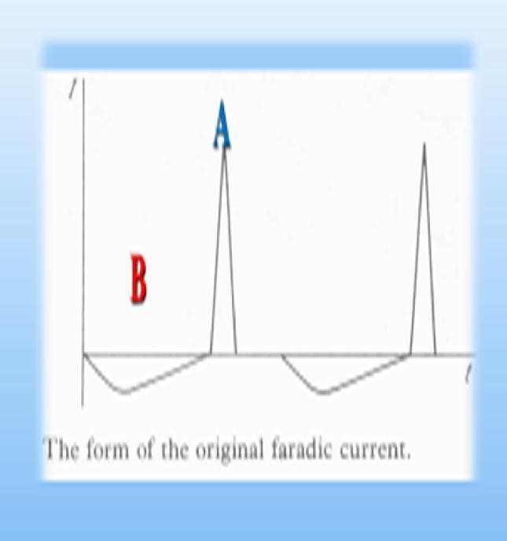
THE FARADIC CURRENTS

Slide 7
The term faradism was originally used to signify the type of current produced by faradic coil which is a type of induction coil.
The current provided by the first faradic coil was an un –evenly alternating current, each cycle consisting of two phases,
the first of low intensity long duration and
second of high intensity and short duration.

Slide 8
Faradic type of current is composed of relatively wide high energy electrical pulses, traditionally having duration (pulse width) 0.1 to 1 millisecond (duration of second phase which was effective one about 1milisecond) and
occurring (repeat) at a frequency 50 to 100 Hz (Hertz). i.e. 50 to 100 pulses per second.
A number of different types of faradic coils were developed, the most recent being used is smart Bristow faradic coil.

Slide 9
Faradic coils have now largely been suppressed by electrical stimulators.
These supply the currents which produce the same physiological effects as the original faradic current although often differing considerably from faradic current in wave form.
Faradic-type of current is used therapeutically for stimulation of weak or paralyzed muscles, the treatment of injuries and as a diagnostic means.
This current is produced from an interrupted DC, derived either from batteries or rectified main current.

Slide 10
Faradic current from an electrical stimulator
Electronic stimulator works on same principle as that for interrupted D.C but resistance controlling the duration of impulses and that of interval b/w them have a very low value .
The low resistance of circuit governing the duration of impulses makes the period of current flow short i.e. 0.1-1 mili/sec
For better results in treatment faradic current is always surged to produce near-normal titanic like contraction and relaxation of muscle.
the apparatus should have sufficient control to surge the current so that the intensity of successive impulses increases gradually with surges varying in wave form to provide satisfactory muscle contraction and relaxation.
In original faradic coil current was surged by hand but in modern stimulators an electronic device is used.

Slide 11
DIRECT CURRENTS (GALVANIC CURRENTS)

Slide 12
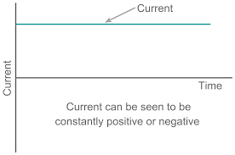
CONSTANT DIRECT CURRENTS
Also referred as Galvanic current or constant galvanism has a unidirectional flow of current towards positive pole.
In modern devices the polarity and thus the directional of flow of current can also reversed.
The therapeutic use of this unidirectional flow of current is to introduce medication into the body tissue is called iontophoresis.

Slide 13
Constant dc is rarely used for the treatment of a patient.
Obtained either from cell or from main supply, in case of later, metal rectifier or valves are used to rectify it
The current must be earth free, cell_ earth free, main supply_ static transformer
About 90 volts are required for the treatment with dc.
60 dry cells wired in series, main supply is reduced by step down transformer

Slide 14
MUSCLE STIMULATING CURRENTS
The currents which varies sufficiently in intensity can stimulate a motor nerve and so produce contraction of muscle which it supplies
In the absence of motor nerve the muscle fibers can be stimulated directly by a suitable currents
Intermittent currents are used in both cases but a considerable range is available
The current flow stops and start at regular intervals and there are four basic points to consider

Slide 15
1. Duration of the current flow
Ranges from 0.01 _ 3000 milliseconds
Impulses commonly available are of duration 0.01, 0.03, 0.1, 0.3, 1, 3, 10, 30, 100, 300, 1000, 3000 milliseconds
Those with a duration of more than 10 milliseconds are classed as impulses of short duration
Those with a duration of less than 10 milliseconds are classed as impulses of long duration

Slide 16
2. frequency of the impulses
This is the number of impulses per unit time
It depends mainly on the intervals between them
The longer the interval, the lower is the frequency
Impulses of long duration are infrequently repeated e.g, for impulses each lasting 100 milliseconds a frequency of 30 per minute is available
Impulses of short duration, repeated at similar frequency
But for treatment purpose the repetition rate is greater, usually being 50 to 100 per second
The infrequently repeated impulses of long duration are used for stimulating denervated muscle and are termed as interrupted or modified direct current
The short duration impulses frequently repeated are used for stimulating innervated muscles, and may be classified as a current of faradic type

Slide 17
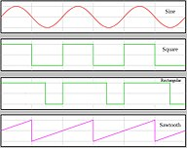
WAVE FORMS

Slide 18
3 wave form
The intensity of current may rise or fall suddenly so that the impulses are rectangular
Or change may be gradual trapezoidal
Triangular
Saw_tooth
The important is the time to reach the max intensity as this affects the response obtained when the current is used for the stimulation of nerve or muscle
Those with gradual rise in intensity of current are often termed “selective impulses” gives physiological effects

Slide 19
4. depolarisation
A current of low intensity may flow in the reverse direction during the interval between the impulses
The current is no longer direct but its therapeutic effects are same as those of interrupted d.c.
And the chemical formation which accompanies the passage of a d.c. through an electrolyte is reduced

Slide 20
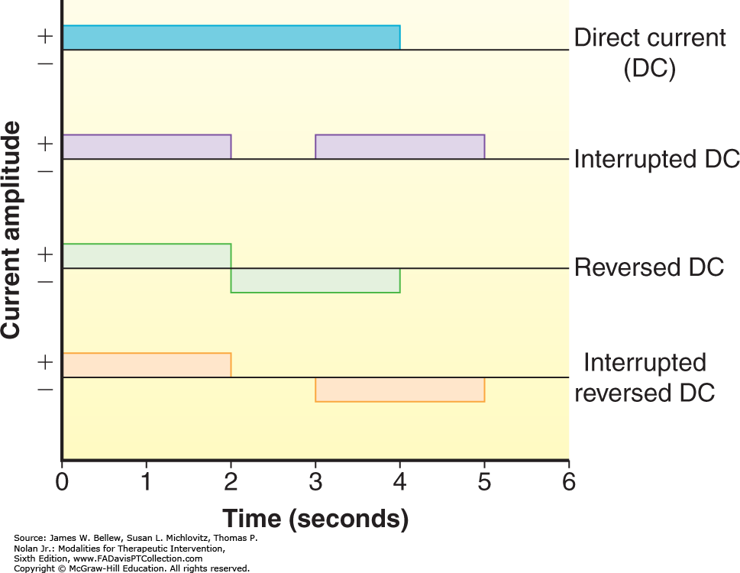
THE INTERRUPTED DIRECT CURRENT
Interrupted d.c. is used for two purposes in the physiotherapy departments

Slide 21
1. the plotting of strength duration curve
This is one method of testing electric reactions
So duration of impulses must be absolutely accurate
Considerable range is available
100, 30, 10, 0.1, 0.3, 0.03, 0.01 millisec
Frequently repeated, rectangular

Slide 22
2. the stimulation of denervated muscle
Long duration impulses are required 100, 300, 600 milliseconds,
The impulses of infrequently repeated, in addition to rectangular impulses at least one form of selective impulses should be available, triangular most satisfactory
Depolarization is desirable

Slide 23
Uses OF Interrupted direct current
Used in the treatment of denevarted muscles and for electrodiagnostic tests such as strength duration curves, faradic interrupted direct current test, pulse ratio, etc.
Physiological effects of interrupted direct current are stimulation of sensory nerves, denervated muscle contraction, increased metabolism and chemical effect.
Can be used for healing purpose and this term named as low intensity direct current therapy (LIDC)

Slide 24
THE SINOSOIDAL CURRENTS

Slide 25
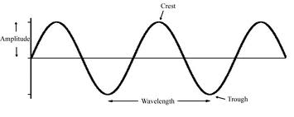
It is evenly alternating, biphasic low frequency current whose waveform resembles to sine curve. Sinusoidal current is obtained from the AC street current by suitable modification through a step-down transformer.

Slide 26
Its frequency is 50 to 100 HZ and pulse duration is 10ms.
Sinusoidal current is classified on the basis of frequency as slow sinusoidal and rapid sinusoidal current.
60 volts are required for treatment purpose, so a step down transformer is used.
Frequency of slow sinusoidal current is 100 Hz. Practically sinusoidal current resembles to faradic current both in effects as well as method of application. Nowadays, it is rarely used for the treatment purpose.

Slide 27
Thanks

