Slide 2
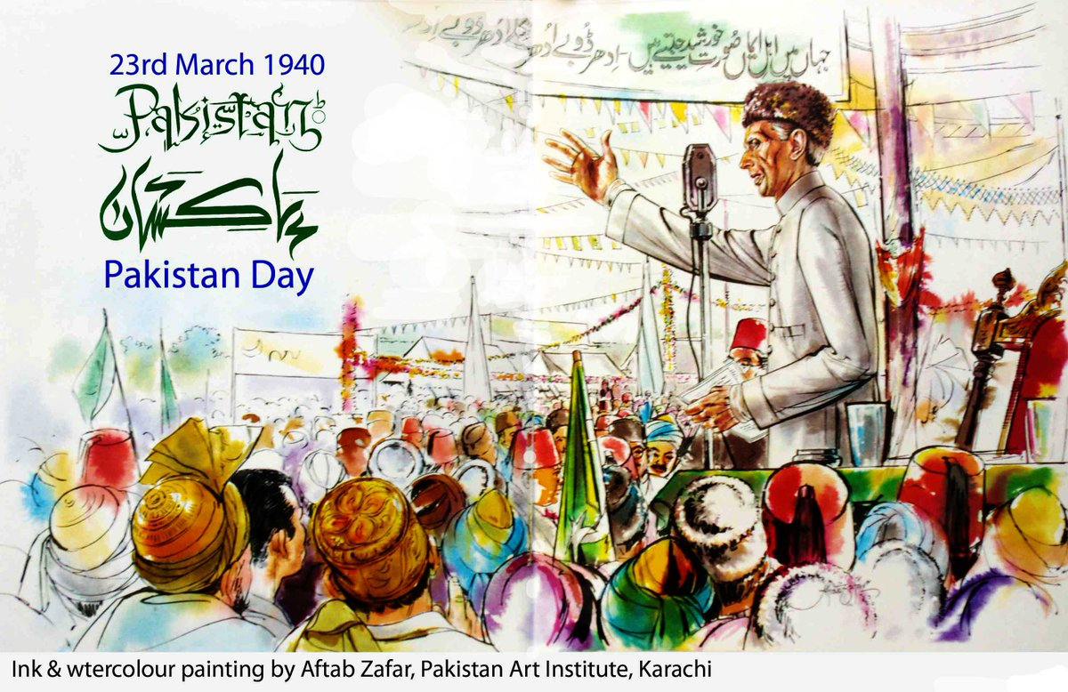
LAHORE RESOLUTION

Slide 3
Background
Blunt 1883
Abdul Haleem Sharar 1890
Kheri Brothers 1917
Abdul Qadir Bilgrami 1920.
Sardar Gul Muhammad Khan 1923
Lajpat Rai 1924
Allama Iqba l1930
Ch. Rehmat Ali 1933
Ali Ghar Scheme 1935
Syed Abdul Latif 1938
Sind Mulsim Leaguge 1938

Slide 4
Causes for Demand of Pakistan
Two Nation Theory
Narrow mindset of Hindus.
Iqbal’s Dream.
British Democratic System
Congress Rule
Hindu Mahasaba
Popularity of Muslim League

Slide 5
Main points of the Resolution
Rejection of Current System
Establishment of Autonomous States
Protection of Minorities
New Constitutional Scheme

Slide 6
Reaction of the Resolution
Muslim Unity
Identification of Destinations
Desire for the Muslim State
Popularity of Muslim League
Satisfaction on the leadership of Quaid e Azam

Slide 7
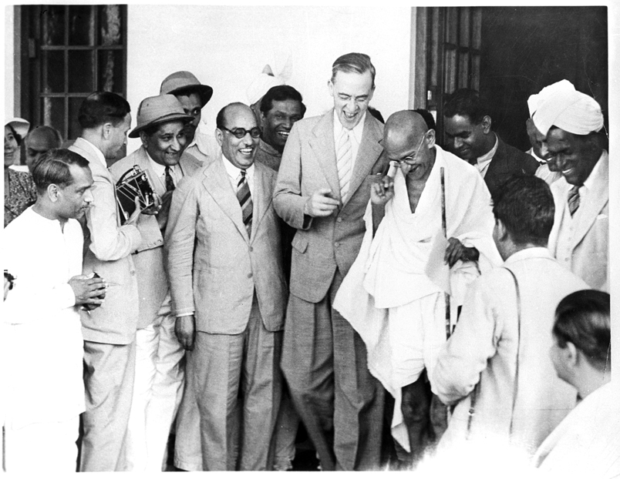
Cripss Mission 1942

Slide 8
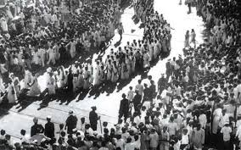
Quit Indian Movement

Slide 9
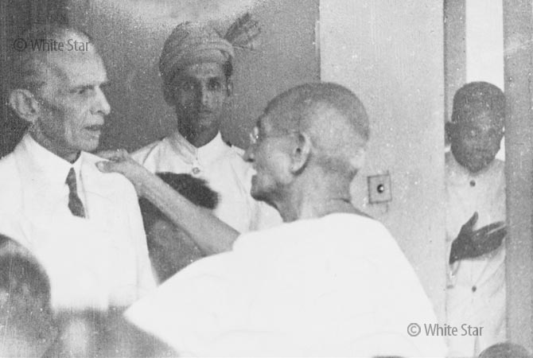
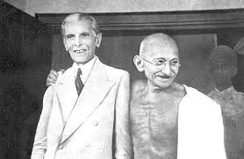
Gandhi Jinnah Talk

Slide 10
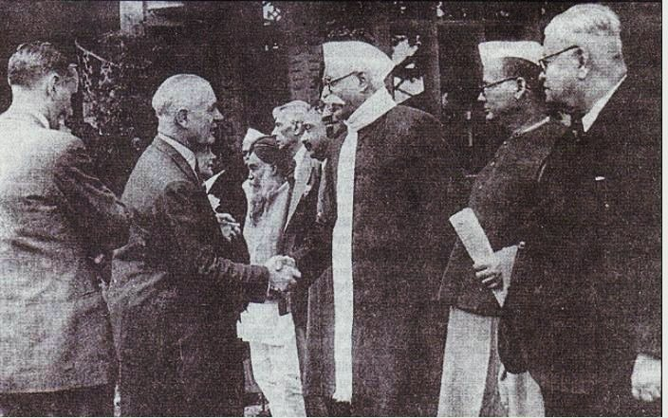
Wavel Plan 1944

Slide 11
Simla Conference 1945

Slide 12
Election 1945-1946

Slide 13
T
A
H
K
N
y
o

