Slide 1
Lecture 8
Reciprocal recurrent selection

Slide 2
Recurrent selection:
Recurrent selection is defined as reselection generation after generation, with intermating of selected plant to produce the population for the next cycle of selection. The idea of this method was to ensure the isolation of superior inbreds from the population subjected to recurrent selection.
The isolation of an outstanding inbred line depends on two factors:
The proportion of superior genotypes present in the base population from which lines are isolated.
The effectiveness of selection during the inbreeding of desirable genes.

Slide 3
Types of recurrent selection:
Simple recurrent selection,
Recurrent selection for general combining ability,
Recurrent selection for specific combining ability, and
Reciprocal recurrent selection.

Slide 4
Simple recurrent selection:
Simple Recurrent Selection:
A type of recurrent selection that does not include tester is referred to as simple recurrent selection. It is also known as phenotypic recurrent selection. This method is an extension of mass selection.
Main features of simple recurrent selection are given below:
i. The tester is not used in this scheme.
ii. It does not measure the combining ability.
iii. The selection is based on phenotype or simple test.
iv. This method is useful only for those characters which have high heritability.

Slide 5
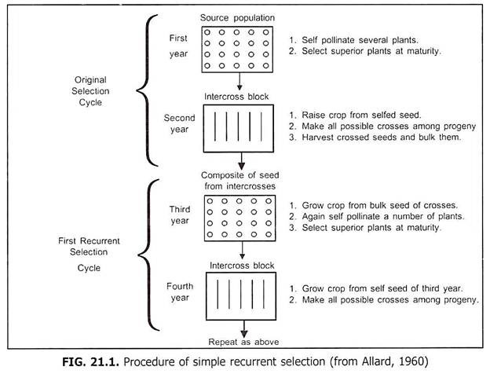

Slide 6
Recurrent selection for GCA
A form of recurrent selection that is used to improve the general combining ability of a population for a character and includes heterozygous tester is referred to as recurrent selection for general combining ability (RSGCA). It is also known as half sib recurrent selection with heterozygous tester. This is an extension of the Jenkin’s (1940) scheme used for development of short term synthetics.
Main features of this scheme are given below:
i. This method is used for genetic improvement of quantitative characters.
ii. The selection is made on the basis of test cross performance.
iii. A heterozygous tester with broad genetic base is used for testing general combining ability. Generally, an open pollinated variety is used as a tester.
iv. This method is used for improving general combining ability of a population for a character.
v. This method is more effective with incomplete dominance and less effective with over dominance.
vi. This method is used for the improvement of those characters which are governed by additive gene action.

Slide 7
Recurrent selection for SCA
A form of recurrent selection that is used to improve the sea of a population for a character by using homozygous tester is referred to as recurrent selection for specific combining ability (RSSCA). It is also known as half sib recurrent selection with homozygous tester. This method was originally proposed by Hull in 1945.
Main features of this scheme are briefly presented below:
i. This method is used for the genetic improvement of polygenic character.
ii. Selection is made on the basis of test cross performance.
iii. A homozygous tester with narrow genetic base is used for testing specific combining ability. In other words, an inbred is used as a tester.
iv. This method is used for improving specific combining ability of the population for a character.
v. This method is more effective with over dominance and less effective with incomplete dominance.
vi. This scheme is used when a character is governed by non-additive (dominance and epistasis) gene action.

Slide 8
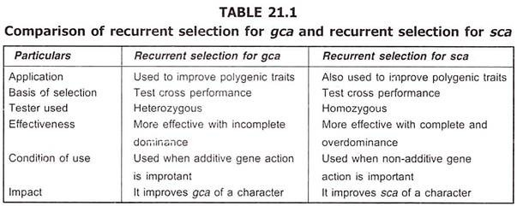

Slide 9
Reciprocal recurrent selection:
A form of recurrent selection that is used to improve both gca and sca of a population for a character using two heterozygous testers is known as reciprocal recurrent selection (RRS). It is also termed as recurrent reciprocal half sib selection. This scheme was proposed by Comstock, et al. in 1949.
Main features of this method are given below:
i. This scheme is also used for the improvement of polygenic characters.
ii. Selection is made on the basis of test cross performance.
iii. Two heterozygous populations each of which is the tester for other are used in this method. The two populations may be designated as A and B.
iv. This method is used for improving a population both for gca and sca for specific character.
v. This method is equally effective with incomplete, complete and over dominance.
vi. This method is used for the improvement of those characters which are governed by both additive and non-additive gene action.

Slide 10
