Slide 1
Micronutrients as pollutants introduction
Micronutrients inclusively both
Vitamins
Minerals
Micronutrients are important for both plants and human.
Deficiencies in specific nutrients render the body more susceptible to injury .

Slide 2
Functions of micronutrients
Serve as cofactor for enzymes involved in metabolism
Required for DNA synthesis
Necessary for cell division
Necessary for oxygen transport
Carry out thousands of essential reactions
Important for the sustainability of life

Slide 3
What do you mean by pollutants and nutrient?
Pollutant:
A substance that makes land, water, air, etc., dirty and not safe or suitable to use
Or
Something that causes pollution
Nutrient :
A substance that plants, animals, and people need to live and grow

Slide 4
List of micronutrients that will be discussed as pollutants
Zinc
Manganese
Copper
Iron
Molybdenum
Boron
Chlorine
Nickel
Selenium

Slide 5
Zinc
Zinc can easily contaminate the soil and water in areas where it is naturally present or mined.
When ingested in excess whether voluntarily through exposure to contaminated soil or water .
Zn can cause various health problems.

Slide 6
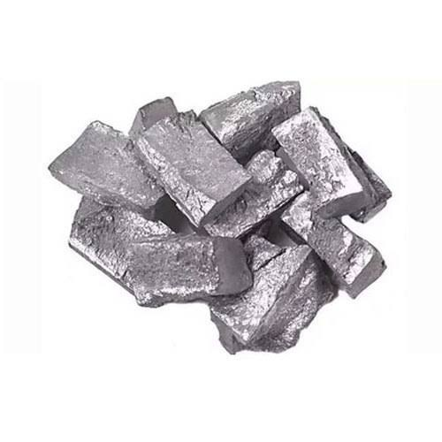

Slide 7
manganese
Mn compounds exist naturally in environment as solids in soil and small particles in water.
Mn substances can cause lung , liver and vascular disturbance.
decline in blood pressure
Failure in development of animal feotuses and brain damage.

Slide 8
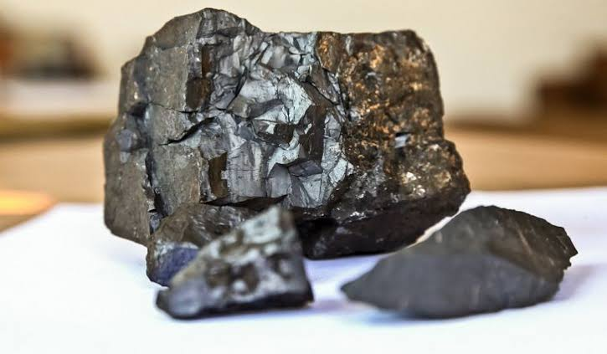

Slide 9
copper
The excavation of copper in mines creates dust rich with the metal and wind can spread it around the mine site.
In buildings copper used in plumbing dissolves gradually and adds the metal into the water supply.ss

Slide 10
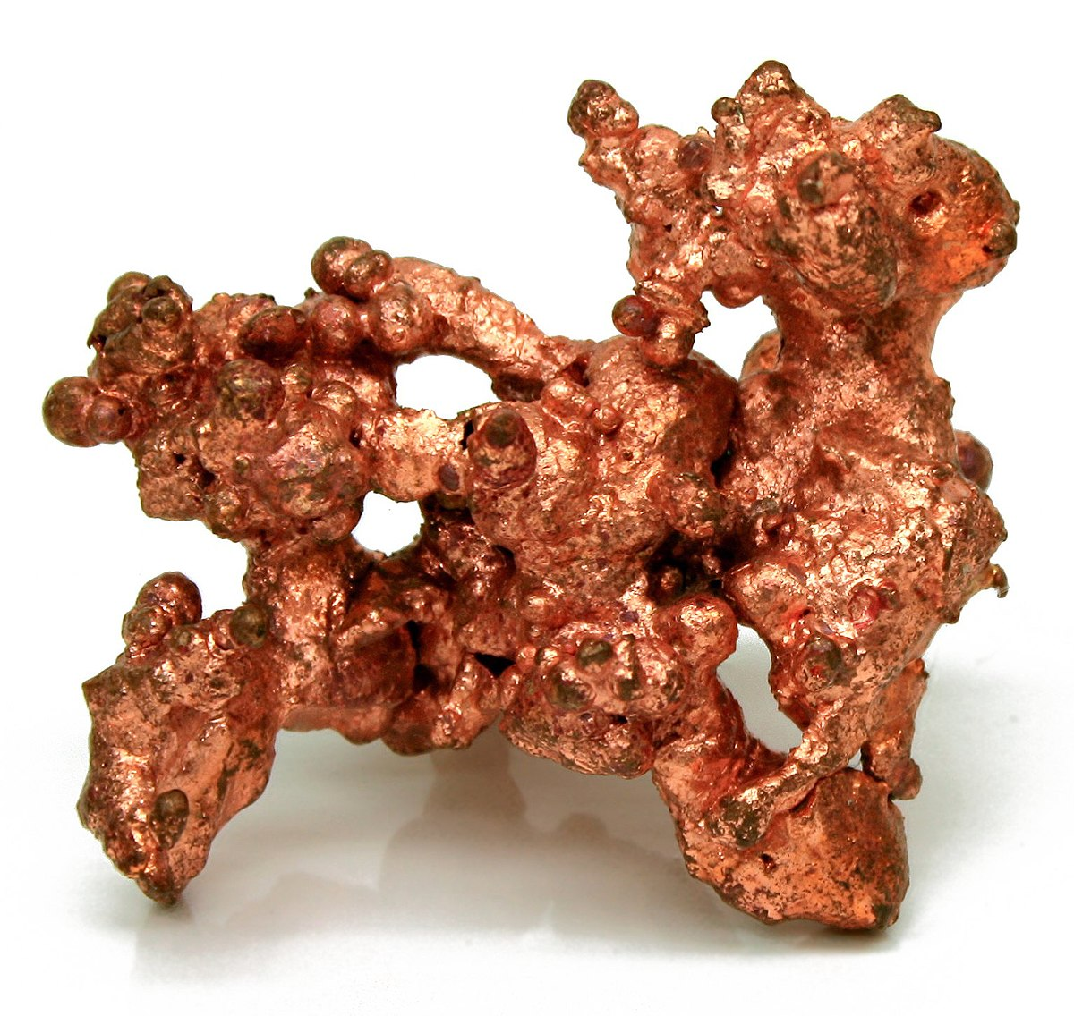

Slide 11
iron
Iron and iron oxide are known to produce a benign siderosis.
Iron oxides have been implicated as vehicle for transporting high concentrations of both carcinogens and sulfur dioxides deep into the lungs .
Iron oxides also cause damage by staining materials.

Slide 13
molybdenum
Mo mines are low-grade and hence the high level of associated heavy metals easily causes pollution in the surrounding areas
The Cu , Cd and Pb concentrations in wormwood exceeded the limits of these metals in general plants.

Slide 14
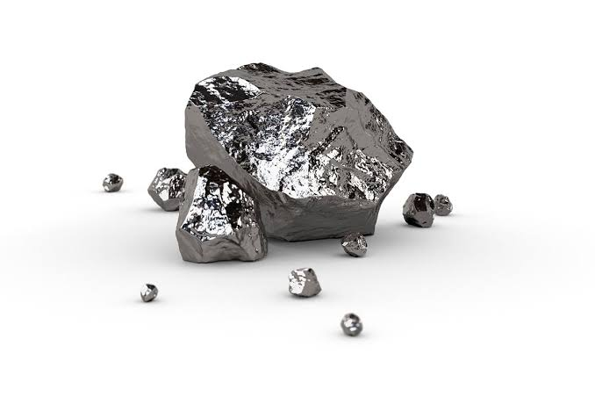

Slide 15
boron
Boron is an element that occurs in the environment mainly through natural processes.
Exposure to large amounts of boron over short periods of time can affect
Stomach
Intestines
Liver
Kidney
Brain

Slide 16
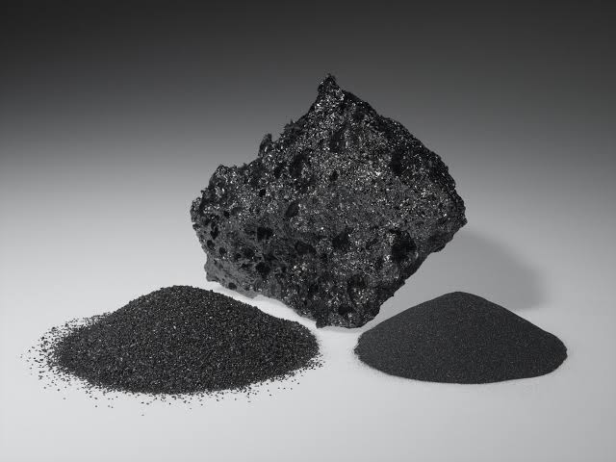

Slide 17
chlorine
Cl used as disinfectant and bleaching agent , is poisonous to fish and other aquatic animals at low levels.
Chlorine causes environmental harm at low levels.
Chlorine is especially harmful to organisms living in water and in soil.

Slide 19
nickel
Nickel cause serious harmful health effects , e.g
Chronic bronchitis
Reduced lung fraction
Cancer of the lungs
Cancer of the nasal sinus

Slide 20
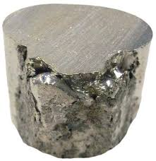

Slide 21
selenium
In high concentrations , sssssi acts as environmental contaminant.
Source of si pollution include waste materials from certain mining , agricultural , petrochemical etc.
Si reduced respiratory capacity due to binding to hemoglobin.

Slide 22
