Slide 2
ROLE OF PHYSICAL THERAPIST

Slide 3
*****************
PT as
Patient/Client Manager
Administrator
Educator
Consultant
Critical Enquirer

Slide 4
The Physical Therapist as Patient/Client Manager
Patient
an individual with impairments
and functional limitations ,diagnosed by a physical therapist , who is receiving physical therapy care to improve function and prevent disability

Slide 5
A client is an individual without diagnosed dysfunction who engages in physical therapy services to promote health and wellness and to prevent dysfunction.

Slide 6
Manager
A person responsible for controlling or administering all or part of a company or similar organization

Slide 7
The physical therapist integrates the five
elements of patient/client management
Examination
Evaluation
Diagnosis
Prognosis
Intervention
in a manner designed to optimize outcomes.
The Interactive Guide to Physical Therapist Practice with Catalog of Tests and Measures (2002)

Slide 8
Change in Physical Therapy

Slide 9
PT has changed over the years
Knowledge and skill used in the processes of evaluation and diagnosis ,prognosis , and discharge planning

Slide 10
Referral relationships with physicians
Technological advances in the tools available for examination and intervention
Interpersonal relationships with patients and clients
Outcomes of care

Slide 11
Evaluation and Diagnosis
Evaluation is the process of making clinical judgments, based on examination data, to create a problem list for each patient.
May need referral…
whether the problems require the skilled
services of a PT.
The end product of evaluation is a diagnosis, which is the term for problems that have been categorized into defined clusters, syndromes, or categories
Notes:
Decision making process: clinical problem solving,diagnosis,clinical reasoning

Slide 12
Physical Therapy diagnosis
using the term is important to distinguish the PT’s findings from other health care practitioners
Some have concerns 1st place diagnosis by PT
Sahrmann defined the term diagnosis as simply the
primary dysfunction toward which the PT directs treatment
Dispelled fear , not interfering others, not performing services outside scope

Slide 13
Sharing one’s results with other PTs
A diagnosis brings some psychological comfort to the PT and the patient;
labeling the problem gives it a sense of reality and makes communication easier.

Slide 14
'Loss of joint mobility associated with hypertrophic scar’

Slide 15
PT diagnosis role IN profession
It eliminates the search for a common treatment for all patients, because diagnosis decreases the generalization of clinical problems.
provides an experiential basis, rather than hypothetical mechanisms
It ensures the homogeneity of patients in comparison groups for research

Slide 16
LONG TERM GOALS
Mr A will become more independent in his movement skills in a standing position so that he can move within his environment and interact with his family by 15/04/17

Slide 17
Short Term Goals must work toward long term Goals
Mr A will be able to sit by himself and start pulling up to a variety of surfaces 3 of 4 trials by 30/3/16
will cruise along a variety of surfaces and along gaps with minimal falls by 30/4/16
will move forward in a standing position with moderate assistance by 30/6/16
will get on and off of a raised surface by himself by 30/9/16
will move forward in a standing position with minimal assistance by 30/11/16

Slide 18
Documentation of patient/client management, the plan of care
reflects the result of the
PT’s evaluative process and
the specific interventions
to be used in an episode of care to accomplish specific goals and outcomes.

Slide 19
Prognosis
Prognosis is the determination of the predicted optimal level of improvement in
function,
the time needed to reach that level
the levels of improvement that may be reached at various intervals during the course of physical therapy

Slide 20
Prognosis is included/documented in Physical Therapy PLAN OF CARE….
Specific short & Long term goals for identified problems.
Time & frequency of specific intervention , selected to meet goals
Expected outcome
Optimal level of IMpRoVeMeNt
Notes:
The HOAC II model7 specifies the types of goals as long term or short term.
Long- and short-term goals represent the same kind of phenomenon (meaningful
change for the patient); the only difference is the time required to achieve them.
Defining goals in this way is an attempt to reduce confusion created by PTs who use
short-term goals to reflect the impairments to be addressed so that long-term functional
goals can be met. Because impairment changes, which are monitored
through testing criteria, are not really goals, considering a change in impairment as
the accomplishment of a goal is inappropriate. This viewpoint is supported by the
fact that impairment changes may or may not result in improved function.

Slide 21
Patient function must therefore be addressed throughout a plan of care in short and long-term goals that represent meaningful accomplishments.
PTs can check whether a goal is meaningful by determining whether anyone, including the payer , would consider physical therapy worthwhile if only that goal were achieved.

Slide 22
As the PT’s role in the prevention of illness gains strength and clarity, the practitioner faces another challenge in writing plans of care: goals related to the reduction or elimination of risk factors.
PTs must be able to justify preventive interventions, often without supporting data. Without such data, unnecessary interventions may occur, or interventions may continue after they are no longer necessary.

Slide 23
Treatment Decisions
PT will decide which intervention will achieve short/long term goals…
Decision making process is influenced by
Pt current health status
Educational level
Payment source
Self interest
Pt case load

Slide 24
Discharge planning and Discontinuance of care
Discharge is the process of ending
physical therapy services provided during a single episode of care because the
anticipated goals a n d
expected outcomes o f treatment
have been achieved.

Slide 25
Discharge does not occur with a transfer;
that is, when the patient is moved from one
site to another site in the same setting or across settings during a single episode of care.
After Discharging Pt, PT provide appropriate f/u
Or Referral.
Notes:
For patients/clients who require multiple episodes of care, periodic follow-up over the life span
is needed to ensure the person’s safe and effective adaptation to changes in physical status, caregivers,
environment, or task demands

Slide 26
Discontinuation is the process of ending physical therapy services provided during a single episode of care
because of the following circumstances:
The patient/client, caregiver, or legal guardian declines to continue intervention.

Slide 27
The patient/client is unable to continue to progress toward anticipated goals and expected outcomes because of medical or psychosocial complications or because financial or insurance resources have been expended.
The physical therapist determines that the patient/client will no longer benefit from
physical therapy.

Slide 28
When physical therapy services must be terminated before anticipated goals and expected outcomes have been achieved, the status of the patient/client and the rationale for discontinuation are documented.
Plan ….f/u / referral

Slide 29
In an episode of physical therapy care, a patient who has undergone surgery for repair of a fractured femur may move from acute care to sub-acute or skilled nursing care to home care to outpatient physical therapy.

Slide 31
Discharge Planning
Certain regulations
The intent of these regulations is to
contain costs,
improve outcomes, and
reduce the need for readmission to the hospital

Slide 32
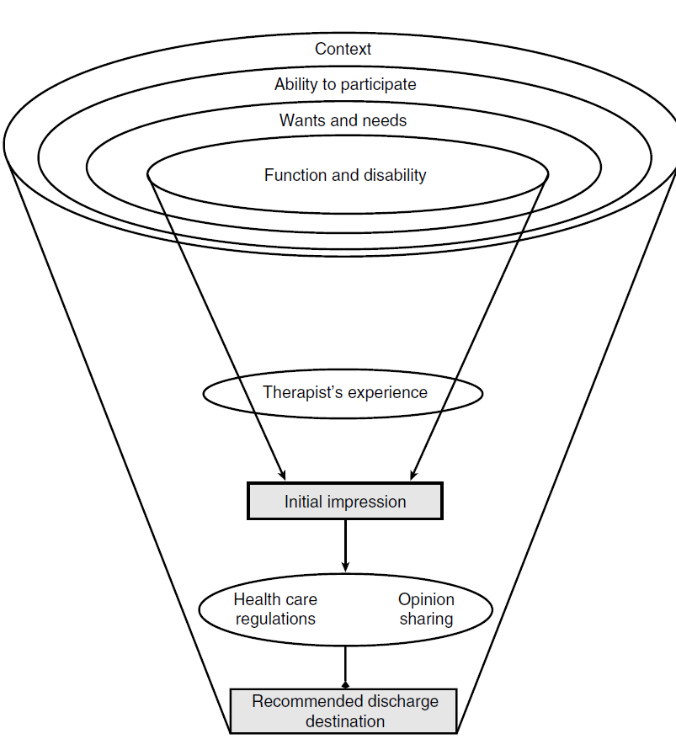

Slide 33
Medicare on discharge planning
Hospital must have a discharge planning process applicable to all patients.
Discharge planning evaluation includes
Likelihood services ,Post discharge
Availability of Services
Hospital must discuss Discharge planning
evaluation with patient or person acting on
his/her behalf
Patient and family members must be counseled
to prepare them for post-hospital care.

Slide 34
Medicare ….
Transfer / Referral
The hospital must transfer or refer patients, along with necessary medical information, to appropriate facilities, agencies, or outpatient services as needed for follow-up or ancillary care.
Primary Health care agency
Bearing Cost , Providing facilities
Hospital role in making clear to Pt regarding medicare Home health coverage policies

Slide 35
In hospitals, nursing homes, and rehabilitation centers, discharge planning is usually a multidisciplinary process led by a social worker or case manager.
Negotiations among health care professionals in ensuring individual Pt goals.

Slide 36
For example, a patient may be medically stable but unable to function safely and independently enough to return home and negotiate flights of steps.
The PT may feel that another 2 or 3 sessions would enable the patient to meet
stair-climbing goals, but the rest of the team
may recommend transfer to a skilled nursing home for more rehabilitation.

Slide 37
Cont……..
Discharge may be done without involvement of all care providers
A Pt’s therapy is going on and may be discharged unexpectedly without informing PT(PT duty,off)
In acute care facility..reimbursement by DRG
(diagnostic related group)
Hospital receive a prospective amount..
Pt may be discharge early /late ….Problem
Money earning…….loss in Revenue for hospital

Slide 38
Prospective Payment System……
The number of visits over a specific period of
time may be predetermined or authorized for
a particular diagnosis.
Negotiations e third party payer….
Normal schedule …inpatient ,..rehab…
Any deviation PT/case manager provide explanation of change in discharge

Slide 39
OUTCOMES
Likely outcome per diagnosis : PT make at start of process.
Outcome…diagnosis…re-examination to determine actual outcomes ,predicted ones.
May modify predicted outcomes accordingly
Effect of Intervention on Pt condition,functional limitations,health,satisfaction
Accountability

Slide 40
Referral Relationship
Military PT usually practice without referrals
At least 1960s Public are seeing PT ,only with prescriptions written by Physicians.
Precise Orders….each Pt..plan of Care.
watts for ultrasound treatment,
the duration of treatment,
the number of repetitions and
specific modes of exercise for particular muscle groups, and the
water temperature for whirlpool treatments.
Dictated……aspect… PT have to contact back to Physician for change

Slide 41
More than 30 states have passed
legislation allowing the public
direct access to PTs
48 states PTs can perform
initial examinations without a
physician’s referral.
PTs routinely must provide evidence
of physician’s referrals in their claims
for reimbursement.
Notes:
“ability of a physical therapist to provide evaluation and treatment to patients without the need for a physician referral.”

Slide 42
Form of referral is now changed..
Most physicians now refer a patient for physical therapy without prescribing a detailed program; the referral simply reads, “Evaluate and treat”
This effected Pt/client management.

Slide 43
Pt/Client management by PT
PT Practice moved from the more technical role of implementing plans of care as instructed by prescription to
total responsibility for the patient/client management process,
from examination to outcomes.
Change in practice’s aspect

Slide 44
The most likely changes will be an increased responsibility
to refer a patient to a physician when the PT identifies problems beyond the scope of physical therapy practice and an increased responsibility for
diagnosis and
outcomes.

Slide 45
Marketing aspect..
Referral….
Lot Of PT & PT Clinics…
Who will be preferred…
More knowledgeable?
Repute
Skill assessment in all aspects of model..
Individuals who are self referring closely monitor work rather than Pt perception/views

Slide 46
Professional trust
Important than referral and making contracts
Accurate physical therapy diagnosis and outcomes that reflect the efficacy and efficiency of the care provided.

Slide 47
Reimbursement without a physician’s referral has the potential to reduce health care costs >
fewer visits to the physician and less paperwork.
Opponents of direct access suggest that it may increase costs
unless PTs are very good at determining the physical therapy diagnosis and, the differential diagnoses,
so that medical problems are not overlooked or incorrectly treated as movement problems, resulting in delayed medical diagnosis that may prove costly or even life threatening.

Slide 48
The ability to perform a thorough systems screening as part of the
history and examination is a critical skill,
even when the physician has referred the patient primarily for confirmation of or the PT’s contribution to the medical diagnosis. Without physician referral, the importance of
the systems screening increases significantly.

Slide 49
Business relationship b/w PT & physician

Slide 51
Interpersonal relationship
Devotion to Human welfare
Care , alturism , compassion
Understanding , conversant
Good human & relation with
others
“Commitment to human services”
Basic Art is same But….Advancements

Slide 52
Address a broader range
of cultural issues
Ever-increasing number of
laws, regulations, and ethical
principles that guide physical
therapy practice
Third-party interpretation of regulations
Increased access to information for both the PT and the patient

Slide 53
Increased accountability and responsibility for care provided
Employer productivity and caseload expectations
Professional development of the PT
Quality of evidence supporting PTs’ decisions

Slide 54
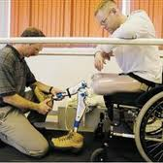
Pt value…Pt preferences

Slide 55
Preparation Of Pt(guiding Pt regarding Rx)
Verbally, language, nature & potential outcomes of Rx

Slide 56
These possible interactions provide the opportunity for PTs to increase patient participation in plans of care by preparing the patient better with information the PT has gathered, clarifying the actual concerns that the patient may have, and providing opportunities for patients to ask questions.

Slide 58
(1) PTs stated that including patients in goal setting was important and would improve outcomes and
(2) Patients believed that their inclusion was important.

Slide 59
Analysis …PTs’ interactions with patients , the researchers found ‘’ PTs did not take full advantage of opportunities for patient participation (on average, 10 of the 21 opportunities were used).
Reasons for this lost potential for patient inclusion :
impaired cognitive status of the patient,
lack of time, and
inadequate understanding or appreciation of the concept.

Slide 60
FACTORS IMPORTANT TO SUCCESSFUL PHYSICAL THERAPY TREATMENT

Slide 61
The physical therapist’s
treatment method is the
most decisive factor in the
patient’s recovery

Slide 62
A physical therapist should not become too involved with the patient’s personal or social
problems; these are the responsibility of other health care professionals

Slide 63
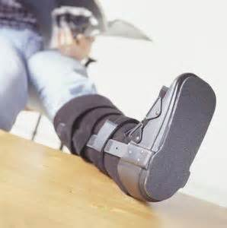
Patient motivation is a vital component of successful therapy.

Slide 64
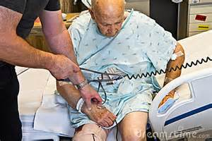
The interaction between the patient and therapist is crucial in physical therapy.

Slide 65
The interaction between the physical therapist and patient that makes physical therapy
successful begins during the first therapy session

Slide 66
The physical therapist’s knowledge
and technique are what make
physical therapy work.

Slide 67
The physical therapist should not simply treat a part of the body part, but rather should be interested in the whole person.
Notes:
The holistic approach to patient care incorporates the mental, emotional, physical and spiritual health of the individual Read more: Holistic Approach to Treatment of Patients | eHow http://www.ehow.com/way_5665709_holistic-approach-treatment-patients.html#ixzz2TIJAex9g

Slide 69
The patient’s own capacity for recovery is a major factor in the success of physical therapy.

Slide 70
Patient’s diagnosis should be the central focus of attention in physical therapy.

Slide 72
Notes:
Disclosure:disclosing full information

Slide 73
INFORMED CONSENT

Slide 74
“the voluntary and revocable agreement of a competent individual to participate in a therapeutic or research procedure, based on an adequate understanding of its nature, purpose and implications”
Notes:
Mistake of not following suit when able to do so…..

Slide 75
Informed consent is comprised of both ethical and legal components
Patient consent to treatment is a standard of physical therapy practice.
Specific requirements…Vary from country to country…..local laws, norms, culture etc

Slide 76
The process of informed consent includes the following components:
the types of consent,
the requirements of
disclosure of information
by the therapist,
how it is obtained,
the requirements of record keeping of the informed consent process.
Notes:
Express,Implied,Tacit,Embodied

Slide 77
It is recommended that physical therapists provide patients with information about the proposed assessment and treatment procedures. The information provided can be communicated verbally or by written material, such as an information brochure.

Slide 78
Provision of a brochure is optional, but allows patients time to consider the recommendations, ask questions, and make an informed choice overall.
It must be specific to the proposed treatment.
It must cover alternative treatment options.
It must cover benefits and risks of the proposed treatment and alternatives.

Slide 79
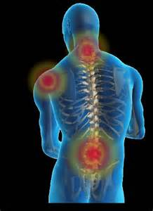
Treatment A,B
Informed consent is dynamic.
Once given, consent can be withdrawn at any time. If a new or altered intervention is provided then the health professional needs to seek the client’s consent again.
Refusing treatment

Slide 80
