Slide 1
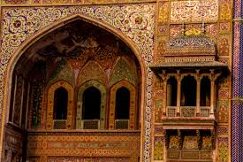
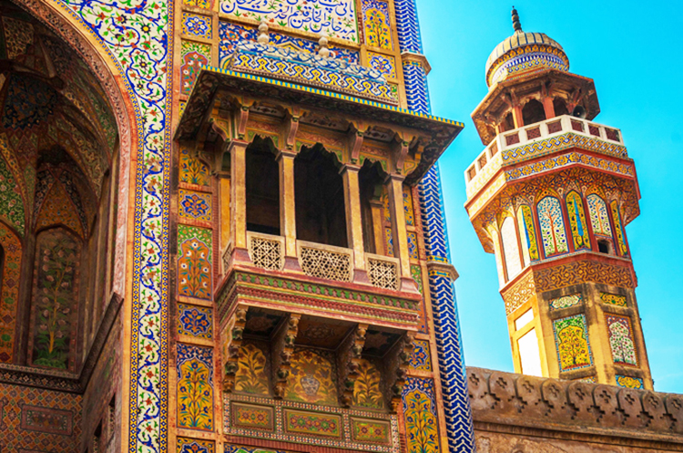
Calligraphy on Historic Monuments
The Wazir Khan Mosque
The Wazir Khan Mosque ) in Lahore, Pakistan, is famous for its extensive faience tile and Calligraphy work. It has been described as ' a mole on the cheek of Lahore'.
It was built in seven years, starting around 1634-1635 AD, during the reign of the Mughal Emperor Shah Jahan. It was built by Shaikh-u-din Ansari.

Slide 2
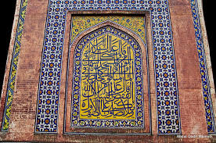
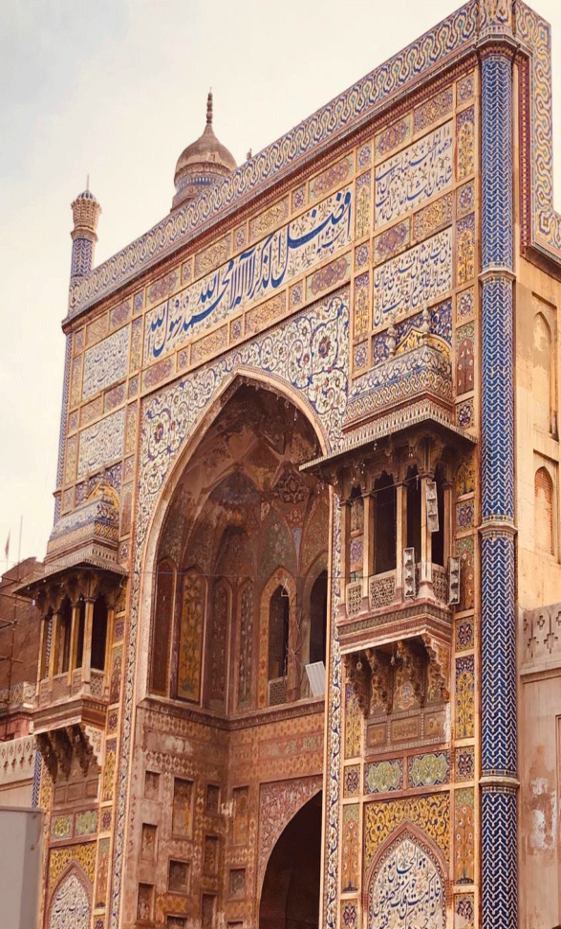
Mughal Art work and calligraphy at Wazir Khan Mosque, Lahore

Slide 3
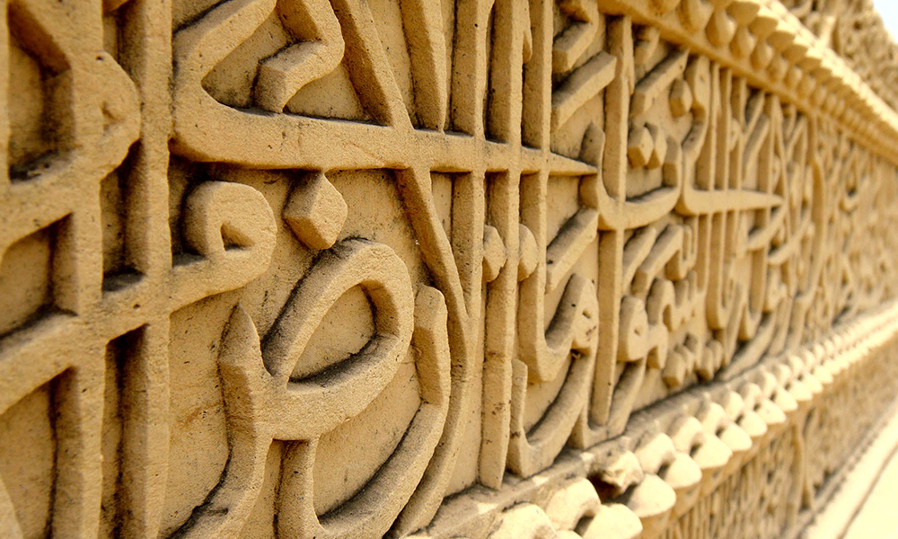
THATTA GRAVEYARD
The World Heritage listed the remains of the city of Thatta in 1981. Thatta’s old necropolis confers you with a view of the Sind civilization.
The carving and Quranic scripts on grave inside a tomb at the famous Makli Graveyard. It is situated over the Makli hill, near city of Thatta and is said to be one of the largest necropolis of the world. The necropolis is spread over some 15 kilometers, and has the graves and tombs of many rulers and elites of times.
.

Slide 4
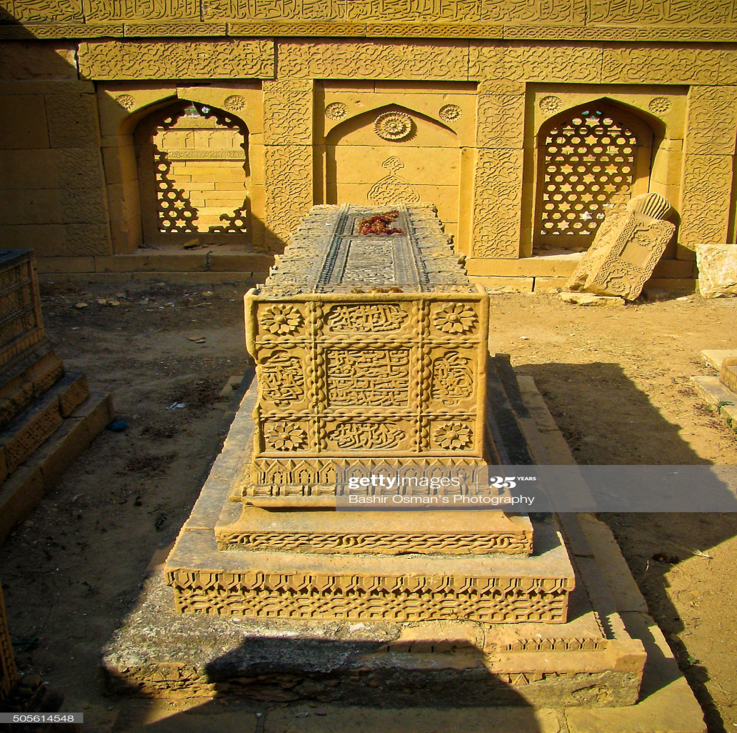

Slide 5
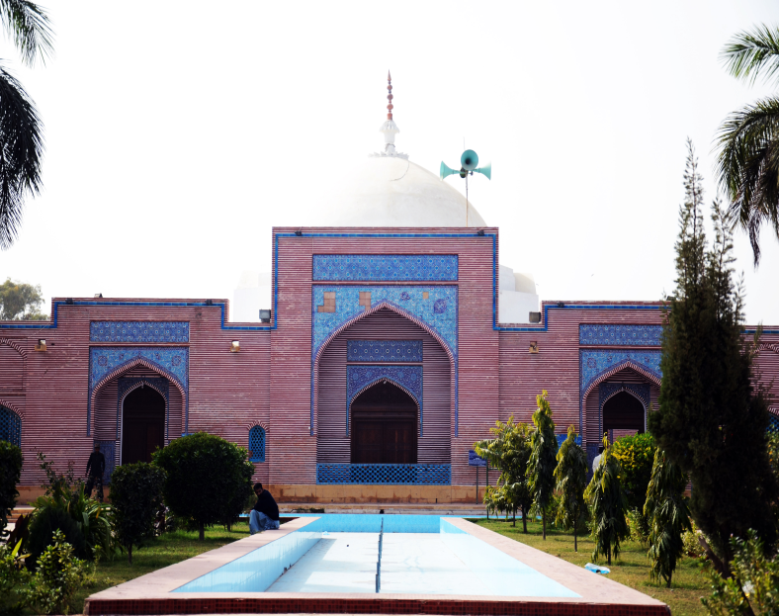
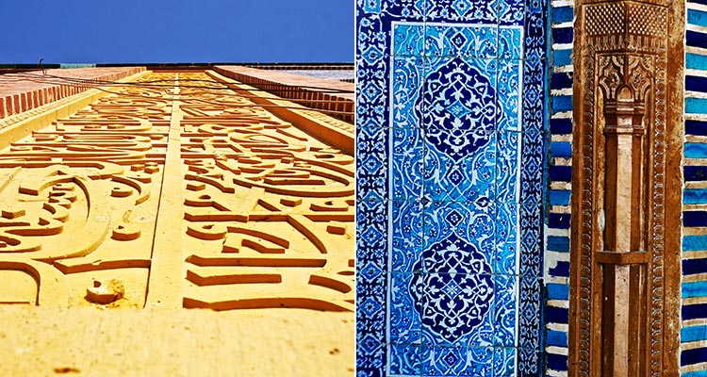
THATTA SHAH JAHAN MOSQUE
Shah Jahan Mosque was built by Shah Jahan in 1647-49 and lined with glazed tiles and beautiful calligraphy. This structure has 101 domes and is designed in such a way that imam's voice can reach every corner of this building without the help of any loudspeaker or other device.

Slide 6
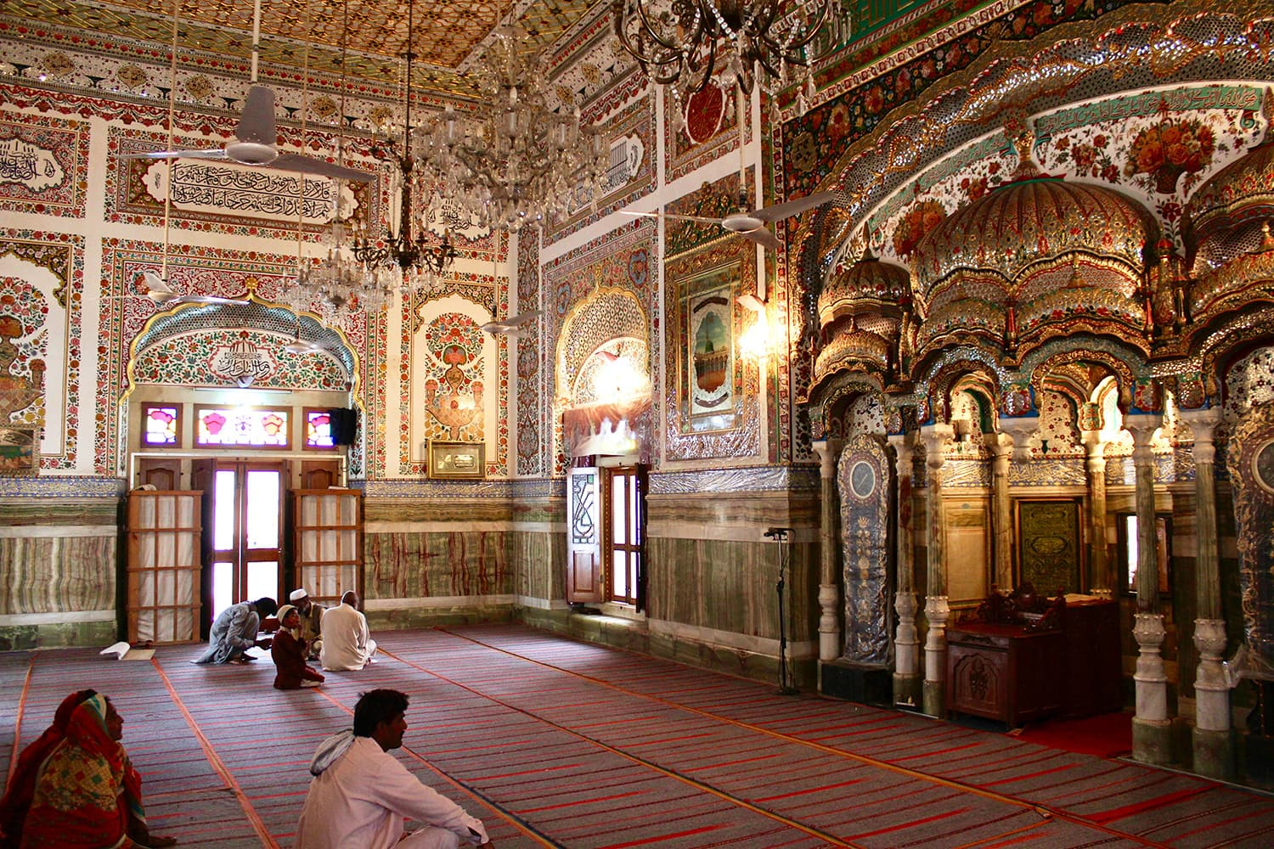
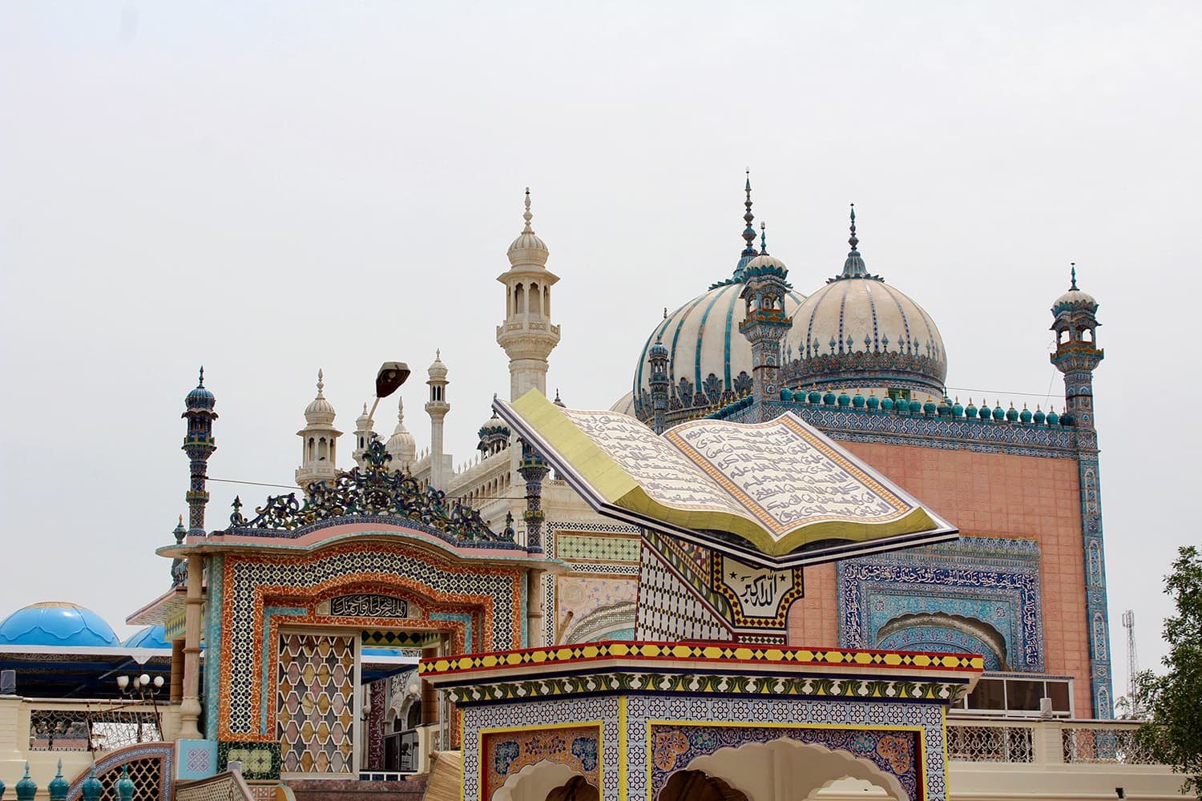
Bhong Mosque
•Bhong Mosque is located in the village of Bhong, Sadiqabad Tehsil, Rahim Yar Khan District, Southern Punjab Pakistan.
•It was designed and constructed over a period of nearly 50 years (1932–1982) and won the Aga Khan Award for Architecture in 1986.

Slide 7
