Slide 1
Multimedia Animation
Multimedia System & Design
CH.5

Slide 2
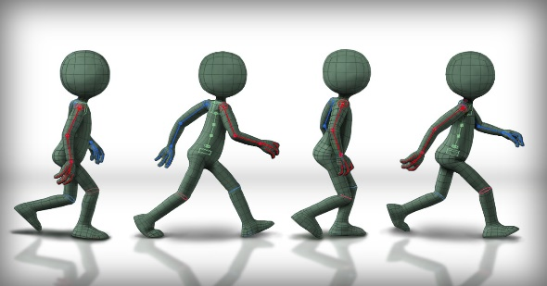
Introduction to Animation
Animation is defined as the act of making something come alive
It is concerned with the visual or aesthetic aspect of the project
Animation is an object moving across or into or out of the screen

Slide 3
Introduction to Animation
Animation is possible because of a biological phenomenon known as persistence of vision and a psychological phenomenon called phi.
The phi phenomenon is the optical illusion of perceiving a series of still images, when viewed in rapid succession, as continuous motion.
In animation, a series of images are rapidly changed to create an illusion of movement.

Slide 4
persistence of vision

Slide 5
Slide Title
Artistic purposes
Storytelling
Displaying data (scientific visualization)
Instructional purposes
USAGE OF ANIMATION

Slide 6
TYPES OF ANIMATION
Animation can be rendered in:
2-D space - 2-D animations are very simple and static.
2-1/2D space - An illusion of depth is created through shadowing, highlighting, and forced perspective, though in reality the image rests in two dimensions.
3-D space - Complicated and realistic animations are done in 3-D space.

Slide 7
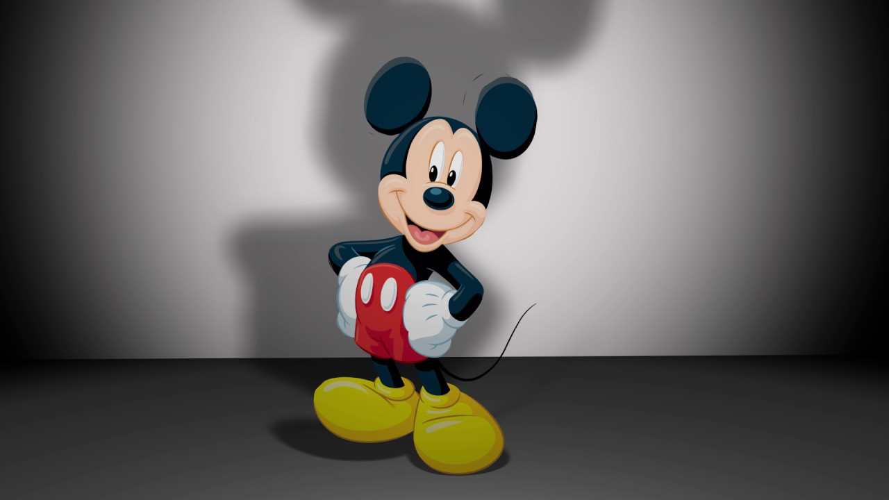
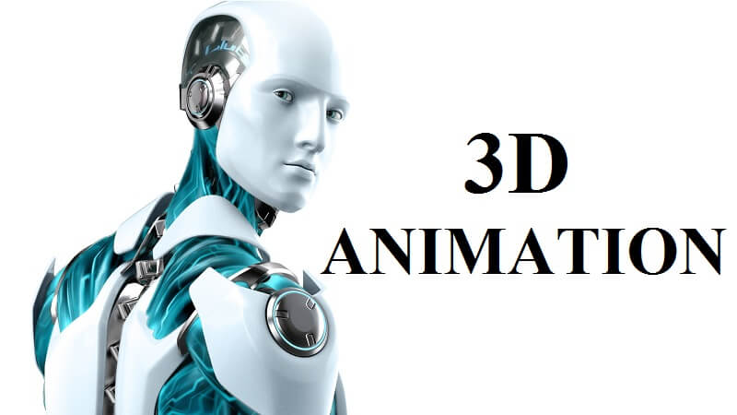
2D animation
2-1/1D animation

Slide 8
Slide Title
Methods of creating animation (type of animation):
Cel animation
Path animation
Computer animation
Animation process
Animation Techniques

Slide 9
Cel Animation
Cel animation is a technique in which a series of progressively different graphics are used on each frame of movie film.
The term "cel" is derived from the clear celluloid sheets that were used for drawing each frame.
Cel animation begins with keyframes.

Slide 10
Cel Animation
Keyframes refer to the first and the last frame of an action.
The frames in between the keyframes are drawn in the Tweening process.
Tweening depicts the action that takes place between key frames.

Slide 11
Tweening in computer animation
Tweening is a key process in all types of animation, including computer animation. It is the process of generating intermediate frames between two images, called key frames, to give the appearance that the first image evolves smoothly into the second image.

Slide 12
PATH ANIMATION
The movement of an object happened along a predetermined path on the screen.
The path could be a straight line or any number of curves.
The object does not change, although it might be resized or reshape.

Slide 13
Computer Animation
Electronically generated movement of anything on your computer screen.
Computer animation is very similar to cel animation.
The primary difference is in how much must be drawn by the animator and how much is automatically generated by the software.
Kinematics is the study of the movement and motion of structures that have joints.
Inverse kinematics is the process of linking objects, and defining their relationship and limits.

Slide 14
Computer Animation
Still or moving images transformed into another
Morphing is a special effect in motion pictures that changes (or morphs) one image or shape into another through a seamless transition.
Morphing means stretching or as part of a fantasy or surreal sequence.
Traditionally such a depiction would be achieved through cross-fading techniques on film.

Slide 15
Slide Title
The animation production pipeline is the path by which a movie goes from a creator’s brain to the screen for the world to see.
STEP: 1
Kick off - Time, location and speed, for this we just need a concept, brief and any other relevant information
Script—What is the story or underlying message of the animation?
ANIMATION PRODUCTION STEPS

Slide 16
STEP: 2
Design - It is always hugely helpful for us to get references from the start.
Depending on the project, clients are provided with one or more style frames
ANIMATION PRODUCTION STEPS

Slide 17
STEP 3:
Storyboard - The storyboard shows the building blocks of the animation, and gives an idea of how the voiceover will match up with the visuals.
ANIMATION PRODUCTION STEPS

Slide 18
STEP 4:
Animatic - pull together everything we’ve got so far, create a fully timed-out rough film. Its purpose is to demonstrate timing, flow and pace alongside key movements and transitions.
STEP 5:
Production - bringing the story to life frame by frame
ANIMATION PRODUCTION STEPS

Slide 19
STEP 6:
Feedback and sign-off- stage applies throughout the whole project process, culminating in the final sign-off before we deliver the finished piece.
Prompt feedback is important to ensure we keep the process moving, and it’s always useful to get the requests listed in order priority
ANIMATION PRODUCTION STEPS

Slide 20
STEP 7:
Render & Final Delivery - With agreed amendments in place project is ready to be delivered in low resolution MP4 file for final sign-off.
Once we get the thumbs-up, we’ll render and deliver a full quality file to the client
ANIMATION PRODUCTION STEPS

Slide 21
Animation tools
Some animation tools are:
Macromedia's Flash
Adobe Premiere
Hyperstudio
Alias|Wavefront's Maya
NewTek's Lightwave
Cartoon Animator
Adobe Photoshop

