Slide 1
ENTO-306
Agricultural pests and their management
Identification of important agricultural pests
Their mode of damages
Control measures
By: Dr. Muhammad Zeeshan Majeed

Slide 2
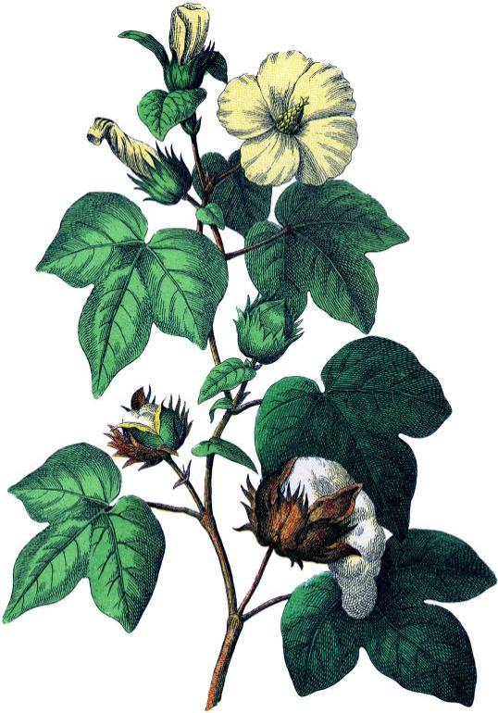
Major Insect Pests of Cotton (Gossypium hirsutum)
Crop in Pakistan
Sucking pest complex
Bollworms complex
Notes:
Single crop country facing threat again by 3 million shortfall (30% less than targeted) of cotton lint (phutti) mainly due to cotton mealy bug and CLCV (12 March 2015).
Target 2018-19= target sowing Punjab 2.31 (overall 2.95) M hec, sown = 2.29 (2.68) M hec. (in 2015 was 3.23 M hec)
Estimated proudction = 8.8 M bales
In major cotton areas, Vehari, Multan, DG Khan, RY Khan, Rajanpur, cotton crop fails due to cotton mealybug.
Cotton growers from Mailsi, Sahiweal, Pakpattan, and Gojra complained bearing Rs 1500 additional expenses on each acre on purchasing pesticides on double rates due to severe Mealy Bug attack.
1300 insect species on globe / 93 species attack in Pakistan.

Slide 3
Minor/Occasional Insect Pests
of Cotton Crop in Pakistan

Slide 4
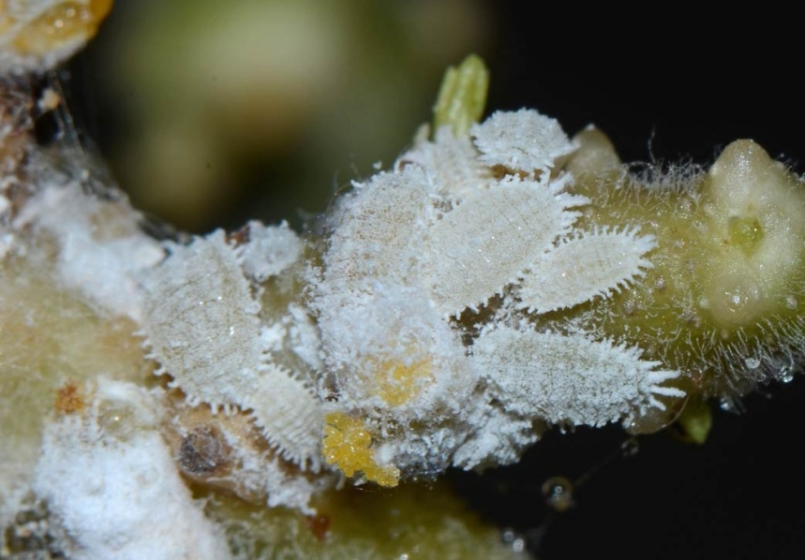
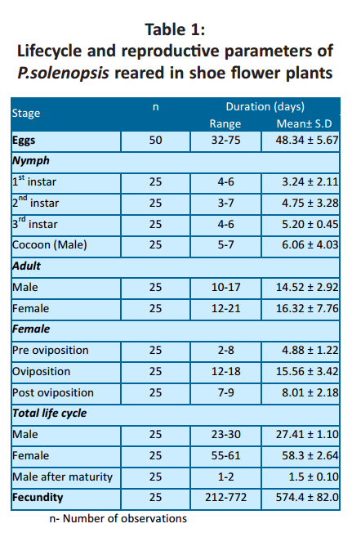
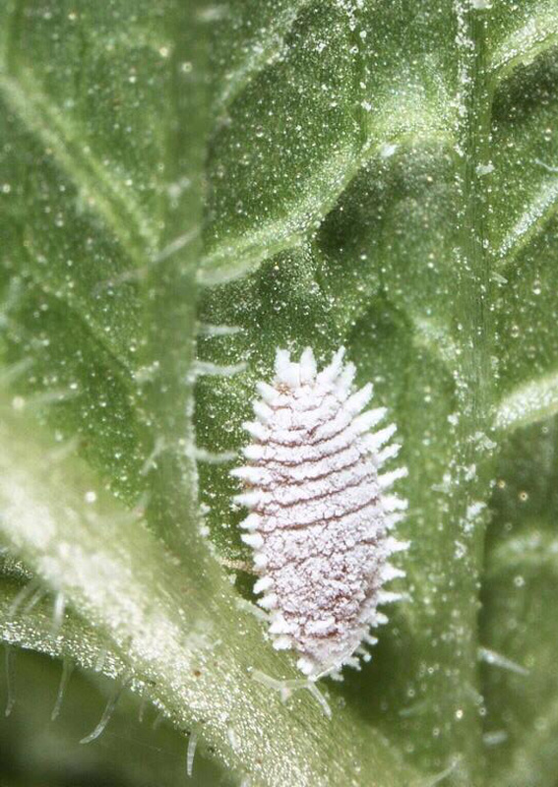
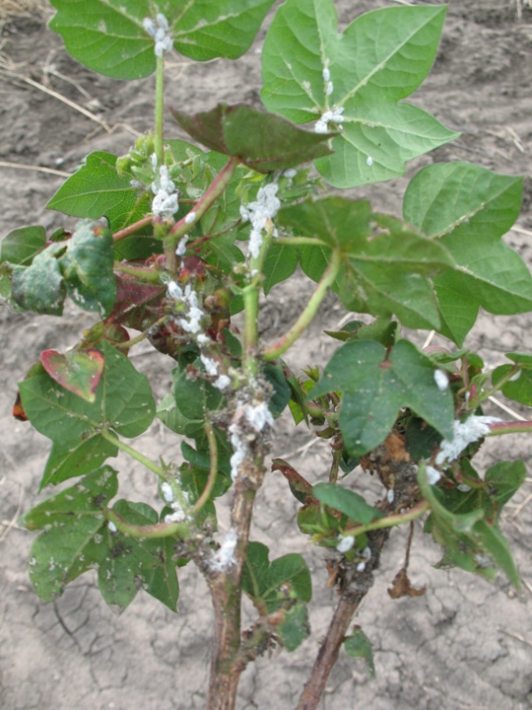
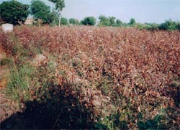
ENTO-306 Agricultural pests and their management 4(3-1)
Insect pests of Cotton Cotton mealybug (Phenacoccus solenopsis; Pseudococcidae, Homoptera)
Notes:
Originated in central America
Polyphagous
Serious invasion pest species of cotton in India and Pakistan.
Fecundity is the actual reproductive rate of an organism or population, measured by the number of gametes (eggs), seed set, or asexual propagules. Fecundity is similar to fertility.

Slide 5
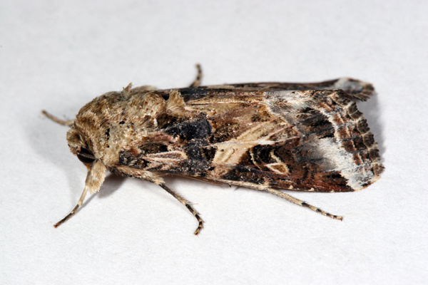
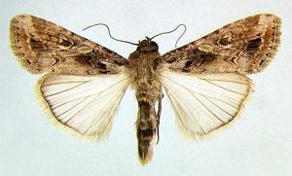
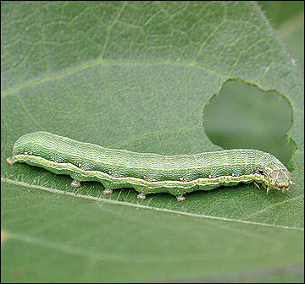
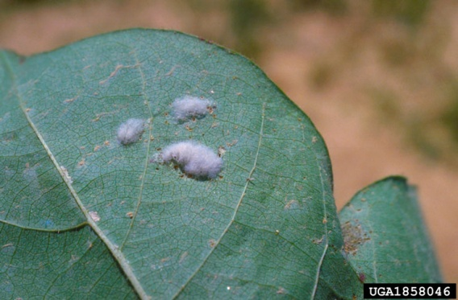
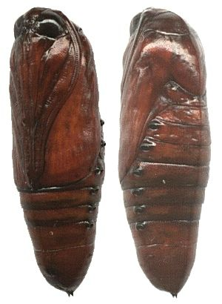
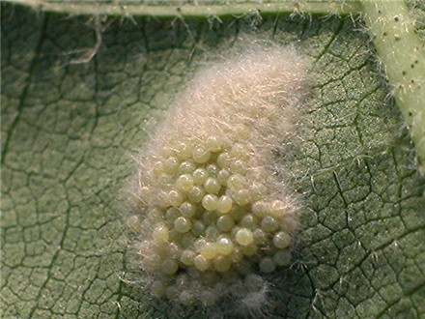
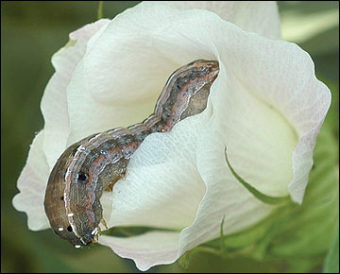
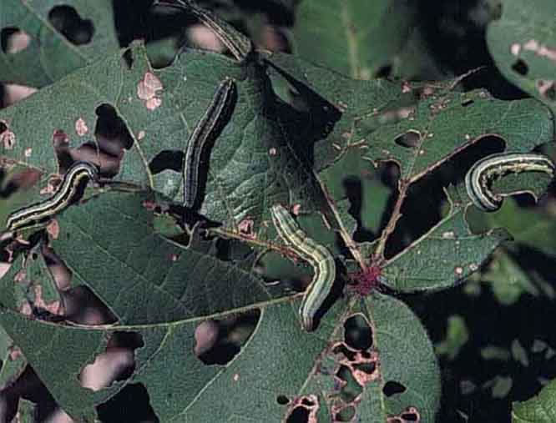
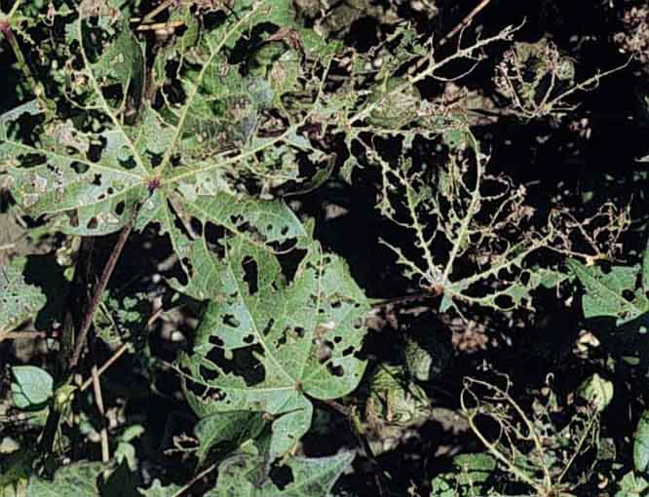
Question why diff. larval
Colors in armyworms?
ENTO-306 Agricultural pests and their management 4(3-1)
Insect pests of Cotton Armyworms
Notes:
Spodoptera litura 40 mm wingspread with golden and greyish sculptured forewings
Larvae (35-40 mm long) 6 larval instars. Color varies according to plant on which they feed.
8 generations per year
Egg masses on upper leaf areas
Larva feeds gregariously on fleshy green matter and leaving behind leaf veinlets or skeleton

Slide 6
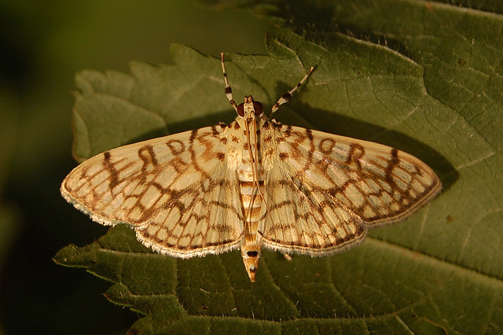
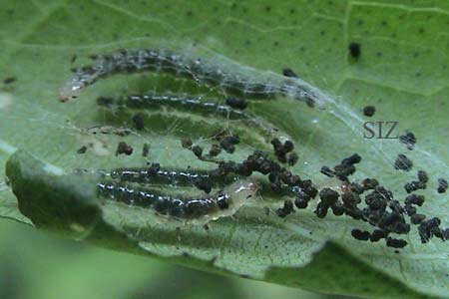
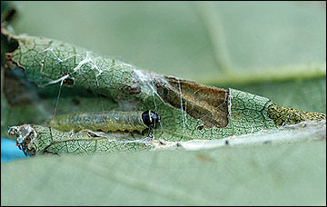
ENTO-306 Agricultural pests and their management 4(3-1)
Insect pests of Cotton Leaf-roller
Notes:
Sylepta derogata
Brown wavy markings on adult wings
Larvae feed on lower side of leaves, roling then upwardly towards mid rib and tighten with silken secretions
Severe attack_defoliation of crop

Slide 7
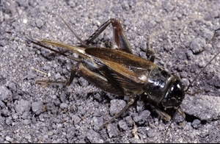
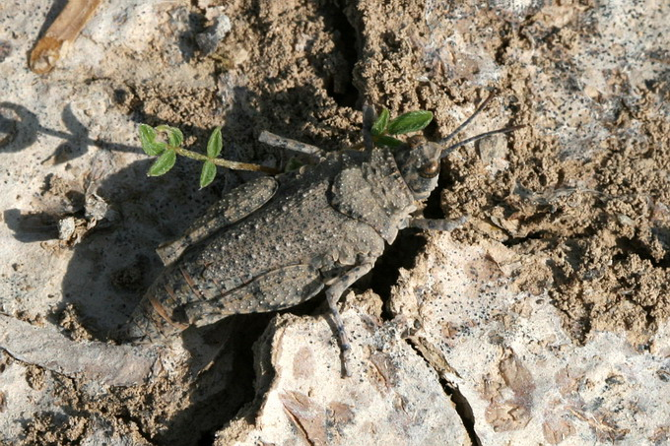
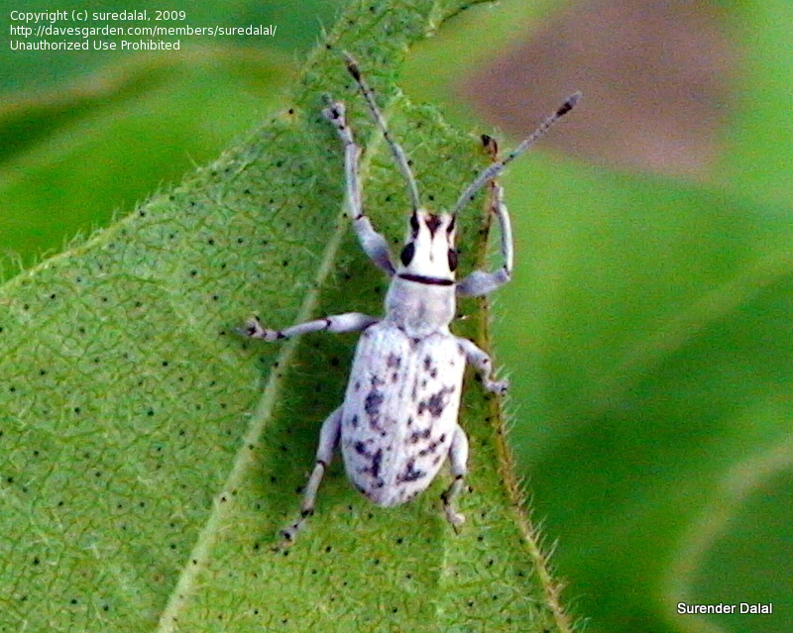
ENTO-306 Agricultural pests and their management 4(3-1)
Insect pests of Cotton Surface grasshopper
Black-headed field cricket
Grey weevil
Notes:
Chrotogonus trachypterous (Pyrgomorphidae)
Gryllus bimaculatus (Gryllidae)
Anthonomus grandis (Curculionidae) (cotton grey weevil / boll weevil)
Weevil larvae feed on seedling roots and adults cut leaves
Damaged plants can be easily pulled out the ground.

Slide 8
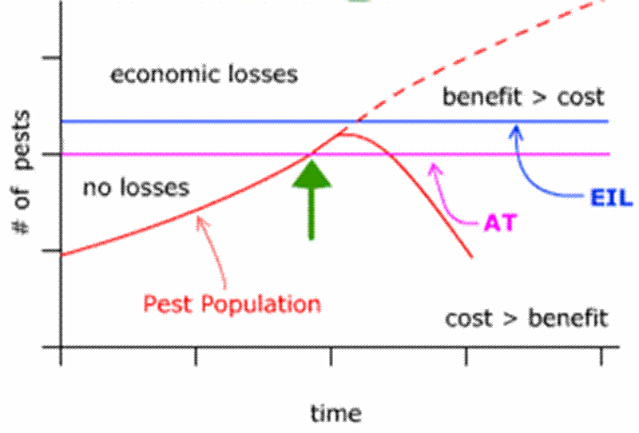
Notes:
This concept was first introduced by Stern et al. (1959), who defined it as “The lowest population density of a pest that will cause economic damage; or the amount of pest injury which will justify the cost of control.
Figure 4. In Integrated Pest Management, the Economic Injury Level (EIL) is defined as that pest population level at which the dollar cost of crop yield loss to the pest begins to exceed the dollar cost of the recommended control measures for the pest. The Economic Threshold (ET) is that level of pest population at which the pest, if left untreated, is likely to reach or exceed the EIL. Therefore, the ET is almost always lower than the EIL, and is considered the point at which the farmer should take action against the pest. Therefore, the ET is sometimes called an Action Threshold (AT). Figure credit: Ed Zaborski, University of Illinois.
Economic threshold (Action threshold): The pest density or level of damage at which a control measure is needed to prevent economic loss.
Economic thresholds are not static; they change with fluctuating market values or control costs. If the value of corn or soybean increases, the economic threshold declines, If the cost of control increases, the economic threshold increases.
Economic loss: Occurs when the cost of insect damage in terms of yield or quality exceeds the cost of control.

Slide 9
Economic Threshold Levels (ETLs) for some major insect pests of cotton
El-Wakeil and Abdallah 2012

