Slide 1
ECG
DR SHEHZAD ASLAM
MCPS (MEDICINE)
FCPS (CARDIOLOGY)
ASSISTANT PROFESSOR
HEAD OF CARDIOLOGY
DHQ TEACHING HOSPITAL
SARGODHA MEDICAL COLLEGE UNIVERSITY OF SARGODHA.

Slide 2
ECG LEADS
FRONTAL PLANE LEADS
Bipolar Limb Leads I,II,III
Unipolar Limb Leads aVR, aVL, aVF
HORIZONTAL PLANE LEADS
Left Sided Chest Leads V1-V6
Right Sided Chest Leads V1R-V6R
Posterial Chest Leads V7-V9

Slide 3
PLACEMENT OF CHEST LEADS
V1 Right parasternal border 4th ICS
V2 left parasternal border 4th ICS
V3 In between V2 and V4
V4 5th ICS mid clavicular line
V5 anterior axiliary line in the line of v4
V6 mid axillary line in the line of v4
V7 posterior axillary line in the line of v4
V8 scapular line in the line of v4
V9 paravertebral line in the line of v4

Slide 4
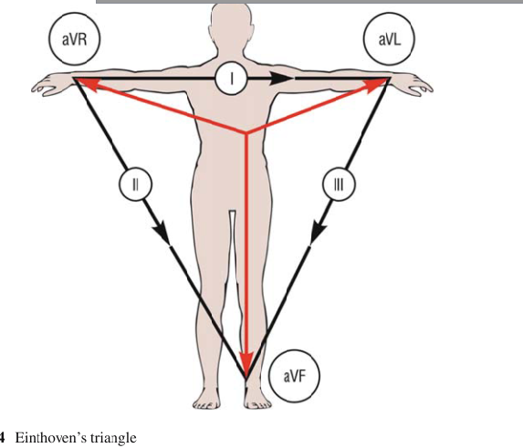

Slide 5
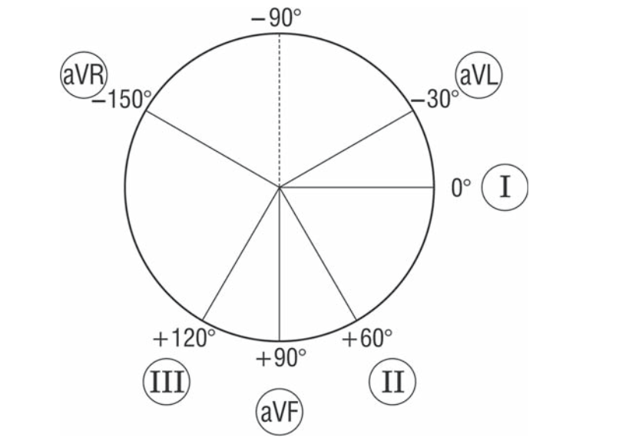
Cabrera’s circle

Slide 6
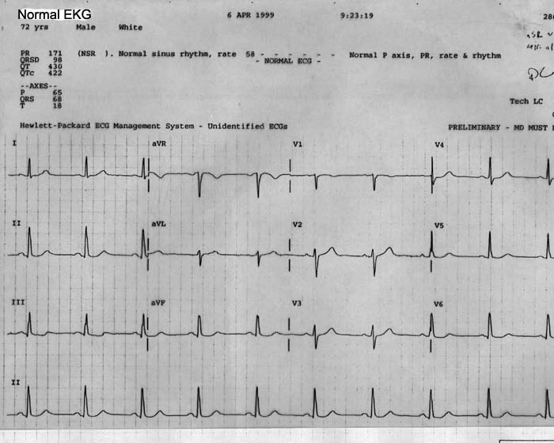
ANATOMICAL LEADS

Slide 7
Differences between nonpacemaker and pacemaker cell action potentials
PCs - Slow, continuous depolarization during rest
Continuously moves potential towards threshold for a new action potential (called a phase 4 depolarization)

Slide 8
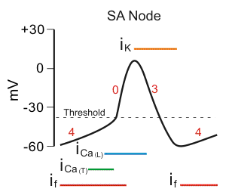
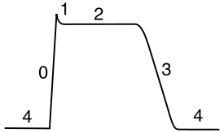
Action potential of the heart:
In the atria, purkinje, and ventricles the AP curve consists of 5 phases
In the SA node and AV node, AP curve consists of 3 phases

Slide 9
Non-pacemaker action potential
Phase 1: partial repolarization
Due to rapid efflux of K⁺
Phase 2: plateu
Due to Ca⁺⁺ influx
Phase 0: fast upstroke
Due to Na⁺ influx
Phase 3: repolarization
Due to K⁺ efflux
Phase 4: resting membrane potential
N.B. The slope of phase 0 = conduction velocity
Also the peak of phase 0 = V_{max}

Slide 10
Pacemaker AP
Phase 0: upstroke:
Due to Ca⁺⁺ influx
Phase 3: repolarization:
Due to K⁺ efflux
Phase 4: pacemaker potential
Na influx and K efflux and Ca influx until the cell reaches threshold and then turns into phase 0
Pacemaker cells (automatic cells) have unstable membrane potential so they can generate AP spontaneously

Slide 11
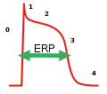
Effective refractory period (ERP)
It is also called absolute refractory period (ARP) :
In this period the cell can’t be excited
Takes place between phase 0 and 3

Slide 12
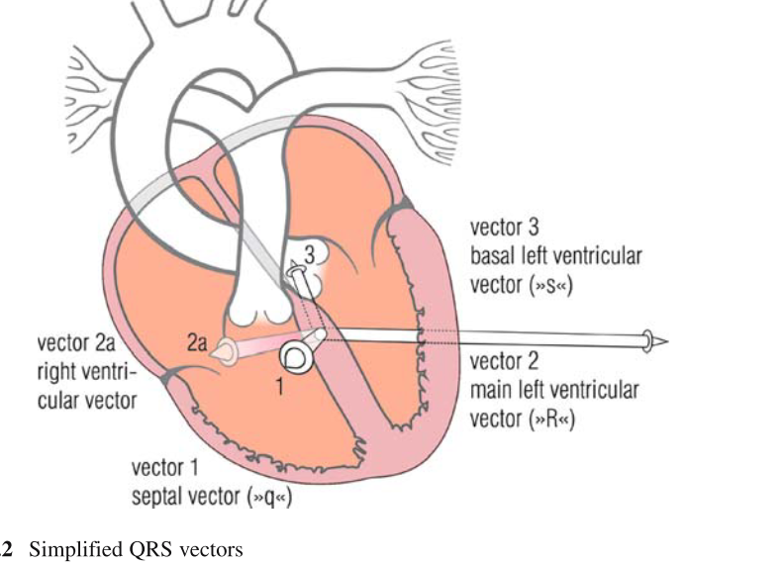

Slide 13
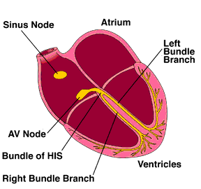

Slide 14
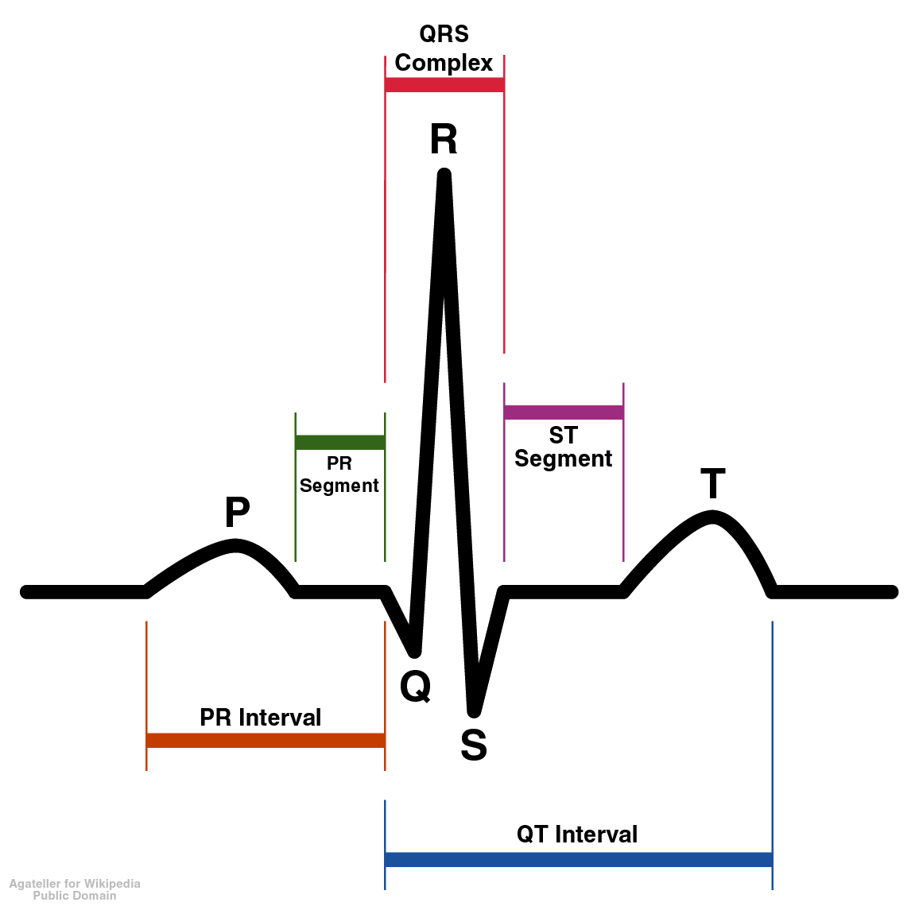
ECG (EKG) showing wave segments
Contraction of ventricles
Repolarization of ventricles
Contraction of atria

Slide 15
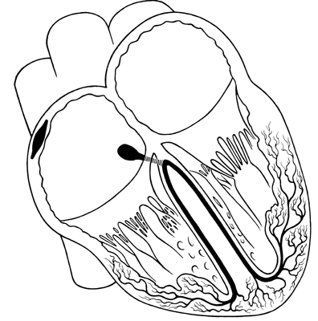
Physiology of the normal heart
Normal conduction pathway:
1- SA node generates action potential and delivers it to the atria and the AV node
Other types of conduction that occurs between myocardial cells:
When a cell is depolarized → adjacent cell depolarizes along
2- The AV node delivers the impulse to purkinje fibers
3- purkinje fibers conduct the impulse to the ventricles

Slide 16
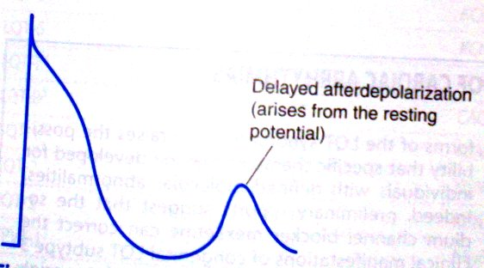
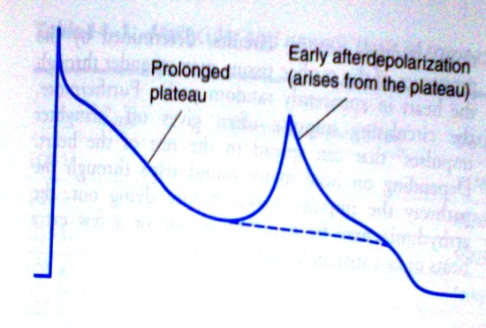
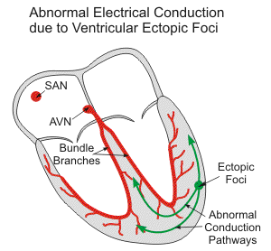
Mechnisms of Arrhythmogenesis
1- Abnormal impulse generation
Automatic rhythms
Triggered rhythms
Ectopic focus
Enhanced normal automaticity
Delayed afterdepolarization
Early afterdepolarization
AP arises from sites other than SA node
↑AP from SA node

Slide 17
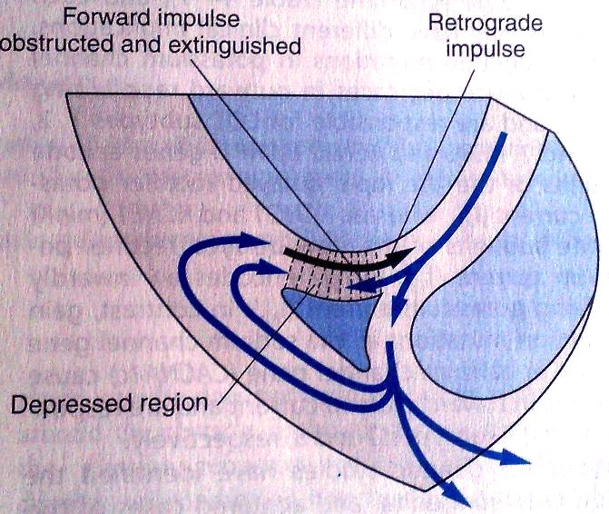
2-Abnormal conduction
Conduction block
1st degree
2nd degree
Reentry
Circus movement
3rd degree
Reflection
This is when the impulse is not conducted from the atria to the ventricles
1-This pathway is blocked
3-So the cells here will be reexcited (first by the original pathway and the other from the retrograde)
2-The impulse from this pathway travels in a retrograde fashion (backward)

Slide 18
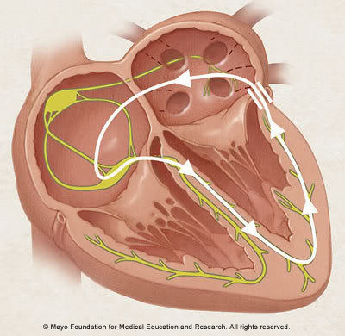
Abnormal anatomic conduction
Here is an accessory pathway in the heart called Bundle of Kent
Present only in small populations
Lead to reexcitation → Wolf-Parkinson-White Syndrome (WPW)

Slide 19
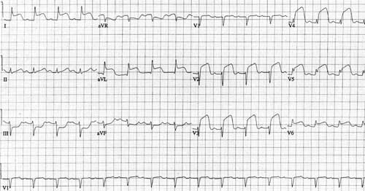
ANTERIOR ST ELEVATION MI

Slide 20
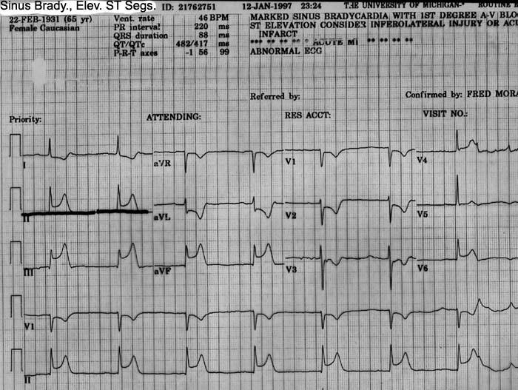

Slide 21
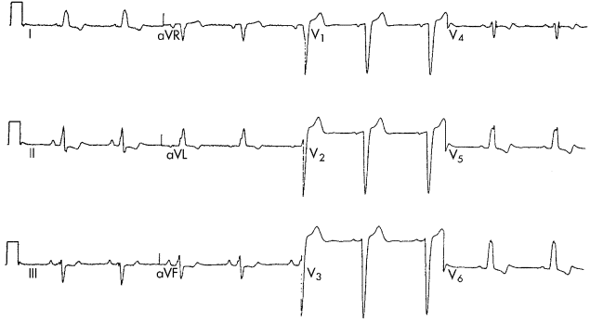
LEFT BUNDLE BRANCH BLOCK

Slide 22
DIFFERENTIAL DIAGNOSIS OF ST-SEGMENT ELEVATION
LVH
LBBB
Hyper K
M.I
Brugada
Pericarditis
RBBB+M.I

Slide 23
DIFFERENTIAL DIAGNOSIS OF ST-SEGMENT ELEVATION
Early Repolarization

Slide 24
Types of Arrhythmia
Supraventricular Arrhythmias
Sinus Tachycardia: high sinus rate of 100-180 beats/min, occurs during exercise or other conditions that lead to increased SA nodal firing rate
Atrial Tachycardia: a series of 3 or more consecutive atrial premature beats occurring at a frequency >100/min
Paroxysmal Atrial Tachycardia (PAT): tachycardia which begins and ends in acute manner
Atrial Flutter: sinus rate of 250-350 beats/min.
Atrial Fibrillation: uncoordinated atrial depolarizations.
AV blocks
A conduction block within the AV node , occasionally in the bundle of His, that impairs impulse conduction from the atria to the ventricles.

Slide 25
ventricular Arrhythmias
Ventricular Premature Beats (VPBs): caused by ectopic ventricular foci; characterized by widened QRS.
Ventricular Tachycardia (VT): high ventricular rate caused by abnormal ventricular automaticity or by intraventricular reentry; can be sustained or non-sustained (paroxysmal); characterized by widened QRS; rates of 100 to 200 beats/min; life-threatening.
Ventricular Flutter - ventricular depolarizations >200/min.
Ventricular Fibrillation - uncoordinated ventricular depolarizations

Slide 26
APPROACH TO TACHYCARDIA

Slide 27
Goals
To make tachycardia “less scary”
To give you an approach to tachycardia
Pearls of interpretating

Slide 28
Tachycardia
Definition
HR > 100bpm
Or Cycle Length < 600msec
Narrow complex tachycardia
QRS < 120msec
Wide complex tachycardia
QRS > 120 msec

Slide 29
Narrow Complex Tachycardia
What are the questions to ask?
Is the rhythm regular or irregular?
Is there P with everything QRS or is P > QRS?
How did the tachycardia start, with PAC or PVCs?
How did the tachycardia terminate, with P or QRS?

Slide 30
Sinus tachycardia
There is one P with one QRS
Regular rhythm

Slide 31
Atrial Flutter
More P then QRS, 3:1, 4:1 ratio
Regular Rhythm
Saw tooth appearance

Slide 32
Atrial Tachycardia
P before QRS. (may have different p morphology)
May be indistinguishable from sinus tachycardia
Usually abrupt onset and offset (as opposed to gradual with sinus tachycardia

Slide 33
Multifocal atrial tachycardia
One P wave with one QRS
Irregular rhythm
Varying p wave morphology and PR segments
Usually Seen in patients with lung disease

Slide 34
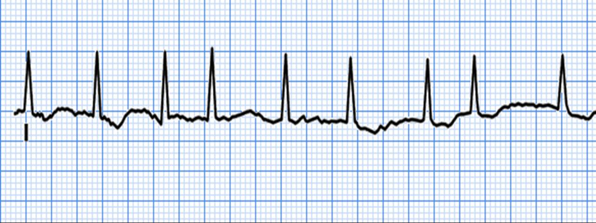
Atrial fibrillation
No clear visible P waves
Irregular rhythm

Slide 35
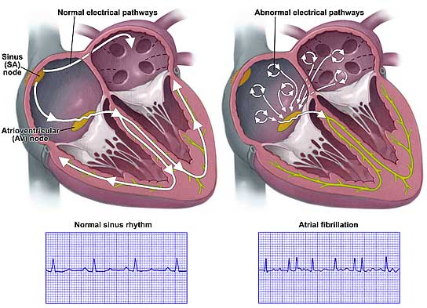
Atrial Fibrillation

Slide 36
Supraventricular tachycardia
Narrow complex, regular
Starts and stops suddenly, usually with PAC
May see inverted p waves in the ST segment or T wave
P waves may be invisible

Slide 45
Narrow Complex Tachycardia
Regular
Irregular
P before QRS:
Sinus tachy
Atach
Aflutter with 1:1 AV
No p wave:
SVT
Atach
?very fast AFIB
Irregularly Irregular:
Afib
Multifocal Atach
Regularly Irregular:
Aflutter with variable response
Atach with var response
P>QRS:
Aflutter

Slide 46
WIDE COMPLEX TACHYCARDIAS

Slide 47
Definition
Wide QRS complex tachycardia is a rhythm with a rate of more than ≥100 b/m and QRS duration of more than ≥120 ms
SVT (20%)
VT (80%)

Slide 48
Why QRS is wide?
A widened QRS (≥120 msec) occurs when ventricular activation is abnormally slow
Arrhythmia originates outside of the normal conduction system (ventricular tachycardia)
Abnormalities within the His-Purkinje system (supraventricular tachycardia with aberrancy).
Pre-excited tachycardias: supraventricular tachycardias with antegrade conduction over an accessory pathway into the ventricular myocardium.

Slide 49
Probability of Origin
80% of all wide complex tachycardia (WCT) are of Ventricular origin (VT)
In patients with structural heart disease, 95% of all WCT is VT

Slide 50
Causes of wide QRS complex tachycardia
Ventricular tachycardia
Supraventricular tachycardia
- with prexsisting BBB
- with BBB due to heart rate (aberrant conduction)
- antidromic tachycardia in WPW syndrome

Slide 51
Other causes…….
Hyperkalemia
Acidosis
Antiarrhythmics -IA,IC
Ventricular pacing

Slide 52
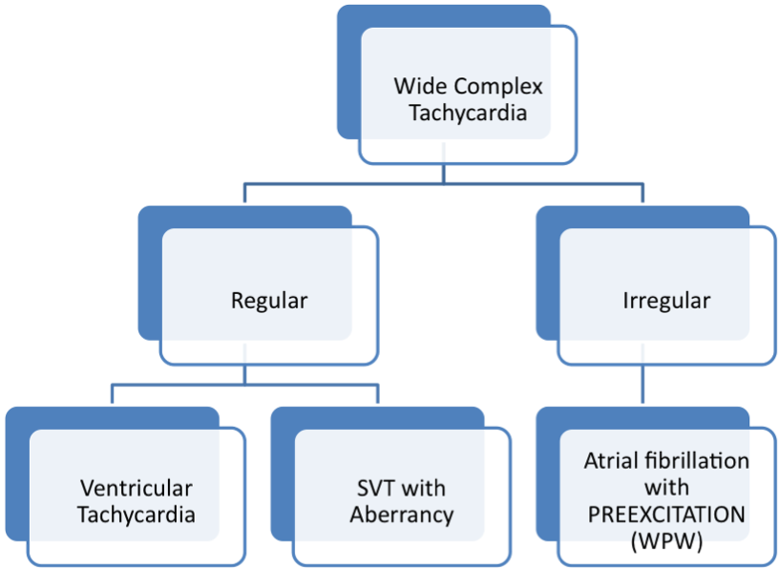
Wide Complex tachycardia

Slide 53
Ventricular tachycardia

Slide 54
Ventricular tachycardia
Wide complex tachycardia
May be monomorphic or polymorphic
Usually preceded by PVC
Look for more QRS then P

Slide 55
Clinical history
Age : ≥ 35 ys → VT (positive predictive value of 85%)
Underlying heart disease: Previous MI → 90% VT
Pacemakers or ICD: Increased risk of ventricular tachyarrhythmia
Medication: Drug-induced tachycardia → Torsade de pointes, Diuretics
Digoxin-induced arrhythmia → [digoxin] ≥2ng/l or normal if hypokalemia

Slide 56
Symptoms
Palpitations
Syncope
Low output symptoms
CHF

Slide 57
SVT vs VT
AV dissociation
-cannon A waves
-variable intensity of S1
Termination of WCT in response to maneuvers like Valsalva, carotid sinus pressure, or adenosine favor SVT

Slide 58
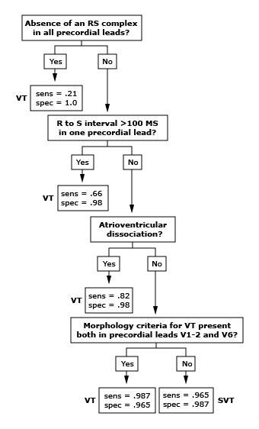
SVT vs VT ECG criteria: Brugada algorithm

Slide 59
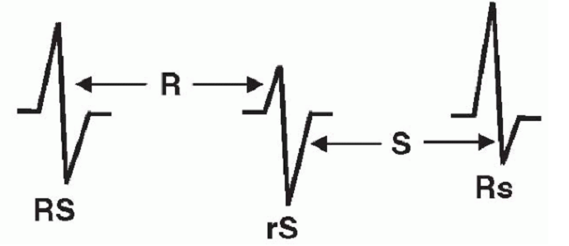
Step 1

Slide 60
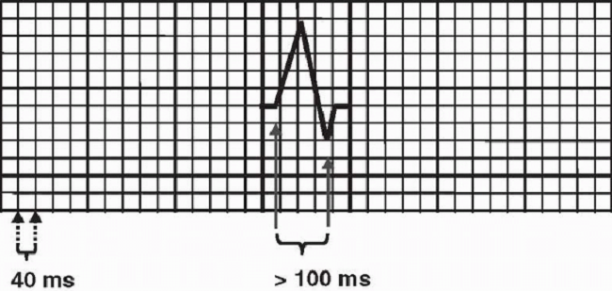
Step 2

Slide 61
Step 3

Slide 62
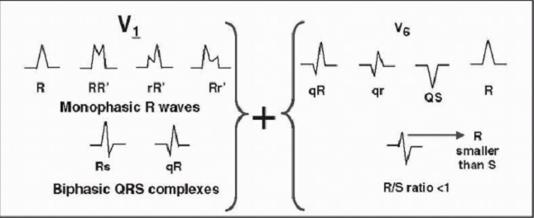
Step 4: RBBB morphology

Slide 63
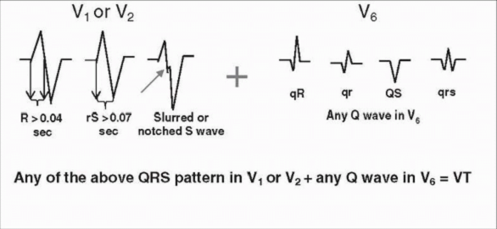
Step 4: LBBB morphology

Slide 65
Sensitivity Specificity PPV NPV
Brugada 89% 73% 92% 67%
Vereckei 97% 75% 93% 87%

Slide 66
Wellens Criteria
QRS width > 140 msec
Left axis deviation
AV dissociation
Precordial concondrance
Capture or Fusion Beats
Configurational characteristics of the QRS morphology

Slide 67
aVR algorithm
Criteria looks ONLY at lead aVR
(if answer is yes, then VT):
1. Is there an initial R wave?
2. Is there a r or q wave > 40 msec
3. Is there a notch on the descending limb of a negative QRS complex?
4. Measure the voltage change in the first (v_{i}) and last 40 msec (v_{t}). Is v_{i} / v_{t} < 1?
Vereckei et al, Heart Rhythm 2008

Slide 68
Other ECG criteria
North - west QRS axis deviation
Negative or positive concordance
Fusion beats, capture beats
Ventriculoatrial conduction with block
RBBB morphology with LAD > - 30⁰
LBBB morphology with RAD > + 90⁰
Previous ECG show MI

Slide 69
Axis
A right superior axis (axis from -90 to ±180º)- “northwest" axis, strongly suggests VT .
(sensitivity 20%,specificity 96%)
Exception - Antidromic AVRT in Wolff-Parkinson-White (WPW) syndrome .

Slide 70
Concordance and Northwest Axis

Slide 71
Concordance
Concordance is present when the QRS complexes in all six precordial leads (V1 through V6) are monophasic with the same polarity.
Either entirely positive with tall, monophasic R waves, or entirely negative with deep monophasic QS complexes.
If any of the six leads has a biphasic QRS (qR or RS complexes), concordance is not present.

Slide 72
Presence of concordance strongly suggests VT (90 percent specificity)
Absence is not helpful diagnostically (approximately 20 percent sensitivity)
Higher specificity for Positive concordance compared to negative concordance(specificity 95% vs 90 %)

Slide 73
Negative concordance

Slide 74
Positive concordance

Slide 75
Fusion beats
Fusion beat-produced by fusion of two ventricular activation wavefronts characterised by QRST morphology intermediate between normal and fully abnormal beat.
Fusion beats during a WCT are diagnostic of AV dissociation and therefore of VT.
Low sensitivity(5-20%)

Slide 76
Capture beats
Capture beats, or Dressler beats, are QRS complexes during a WCT that are identical to the sinus QRS complex .
Implies that the normal conduction system has momentarily "captured" control of ventricular activation from the VT focus.
Fusion beats and capture beats are more commonly seen when the tachycardia rate is slower.

Slide 77
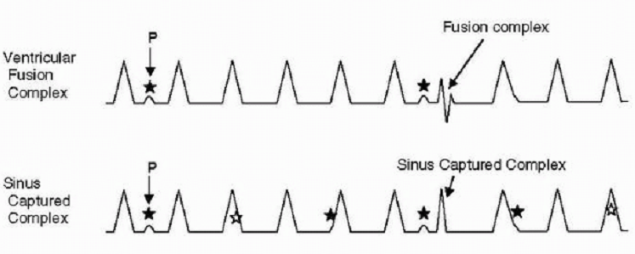
Fusion beat and capture beat

Slide 78
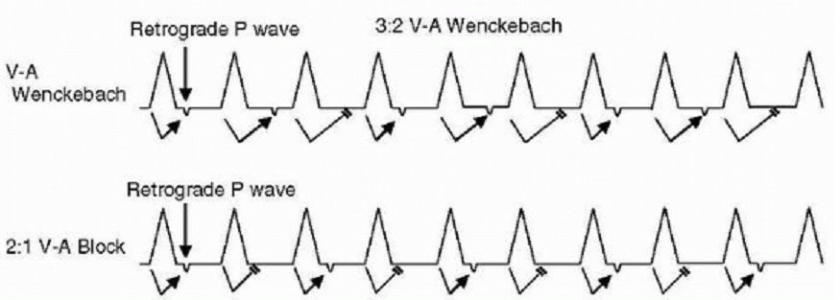
Ventriculoatrial conduction with block

Slide 79
RBBB morphology with LAD

Slide 80
LBBB morphology with RAD

Slide 81
Previous MI

Slide 82
Previous LBBB

Slide 83
SVT with Aberrancy
SVT with native bundle branch block or rate-related aberrancy
May be difficult to distinguish VT from SVT with aberrancy even with most skilled Electrophysiologists

Slide 84
Findings favoring SVT
Triphasic pattern in V1 and V6
Rabbit’s ear
Previous ECG: Preexistent BBB or pre-excitation

Slide 85
Triphasic pattern

Slide 86
Rabbit’s ear

Slide 87
Wide complex SVT from preexisting RBBB

Slide 88
Wide complex SVT from preexisting LBBB

Slide 89
Polymorphic VT/Torsade de Pointes
Classic pattern of “twisting” of QRS in an axis
Can be seen with electrolyte abnormalities- Hypo K, Hypo Mg or Long QT syndrome
Typical onset- bradycardia, long R-R interval followed by premature ventricular complex (PVC)

Slide 90
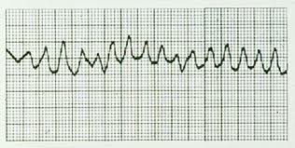
Ventricular Fibrillation
No clear visible P
Very fast > 300 bpm

Slide 91
** This may not be ASYSTOLE
ALWAYS check that leads are properly put on
ALWAYS check gain is not too low!

Slide 98
Management – Hemodynamic compromise
Unstable patient, but still responsible with a discernible BP and/or pulse:
- Emergent synchronized cardioversion
- If the QRS complex and T wave cannot be distinguished accurately → immediate defibrillation
Unstable patient, unresponsive or pulseless → standard ACLS resusciation algorithms

Slide 99
Management – Stable hemodynamic
VT or WCT of uncertain etiology:
Any associated conditions (cardiac ischemia, heart failure, electrolyte abnormalities or drug toxicities)
Class I and III antiarrhythmic drugs
- Amiodarone: 150mg IV/10mins followed by an infusion of 1mg/min for 6 hours, then 0.5mg/min
- Procainamide: 15-18mg/kg infusion over 25-30mins, followed by 1-4mg/min by continuous infusion
- Lidocaine: 1-1.5mg/kg IV/2-3mins followed by an infusion of 1-4mg/min
Urgent or elective cardioversion

Slide 100
Management – Stable hemodynamic
SVT:
Vagal maneuvers: carotid sinus pressure (if no carotid bruits) or Valsava maneuver
Adenosine: 6mg over 1-2 seconds. If the initial dose is ineffective, a 12mg dose may be given and repeated once if necessary
Calcium channel blocker (Verapamil 2.5 to 5mg IV) or beta blokers (Metoprolol 5 to 10 mg IV)
Cardioversion

Slide 101
Recommendation acute management hemodynamically stable and regular tachycardia

